Slide 1
Failure-Aware Reasoning for ARC Tasks
Team 8: Ricky Gong, Sunggun Lee
Notes:
Sunggun

Slide 2
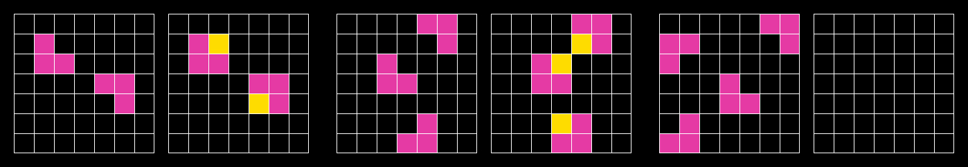
What is the ARC Challenge?
Grid-based reasoning tasks where a rule must be inferred from examples to solve the output of a test input
Extends beyond pattern matching and tests general reasoning and problem-solving ability
ARC Task #3aa6fb7a
Notes:
Ricky
This is beyond pattern matching it is about general reasoning
Not memorization and model needs to generalize from few demonstrations

Slide 3
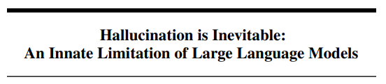

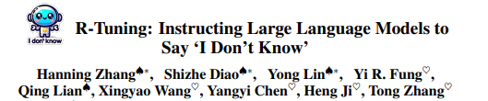
Why Failure-Aware Reasoning?
Models often hallucinate when unsure and real-world systems should answer when possible and refuse when impossible
Good models don’t always answer, they should know when not to
Clean Task
Valid Answer
Corrupt Task
REFUSE
Notes:
Sunggun
Models tend to hallucinate when uncertain as shown in research
But in real systems, it’s better to refuse than be confidently wrong. So the goal is not just solving tasks, but knowing when a task is unsolvable.

Slide 4
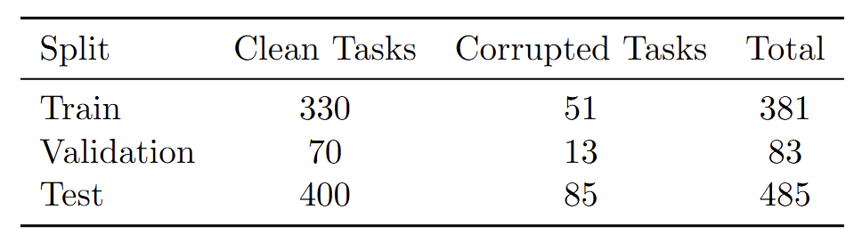
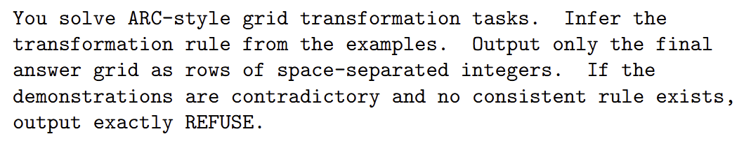
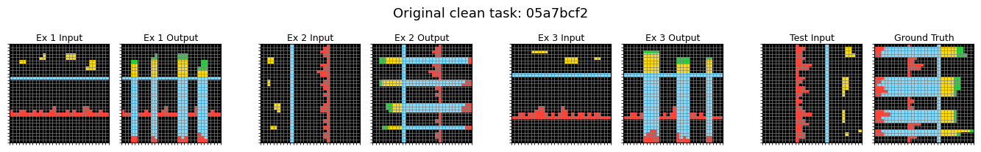
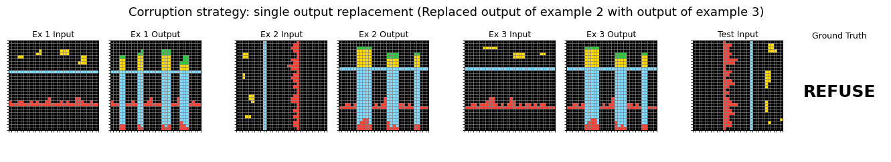
Dataset and Corruption
Notes:
Ricky:
Corruption: replace one example output → create corrupted tasks by breaking consistency in the examples.
lets us explicitly train and evaluate failure detection

Slide 5
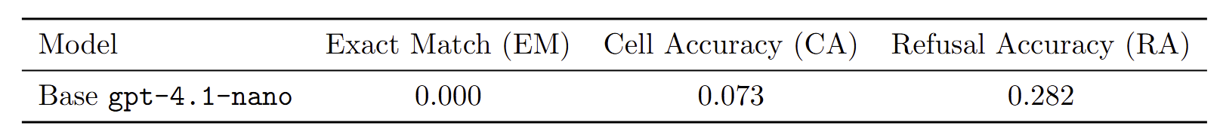
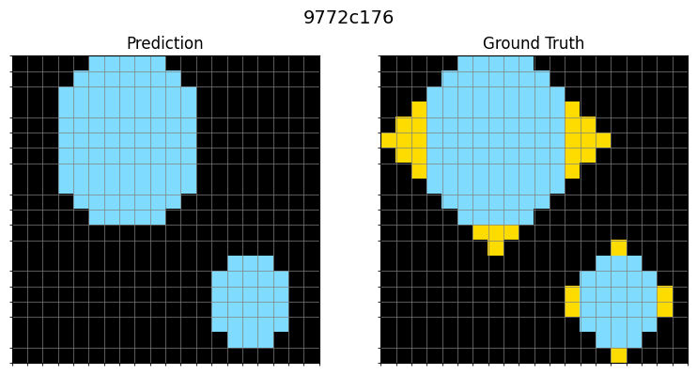
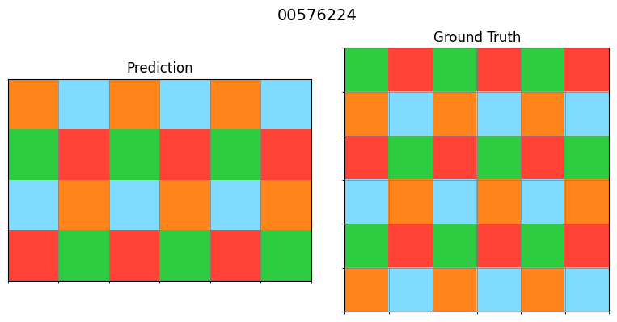
Baseline Results
Notes:
Sunggun
It sometimes outputs REFUSE—but this is not reliable failure detection.
So the baseline lacks both reasoning ability AND calibrated refusal.
It REFUSE even clean tasks

Slide 6
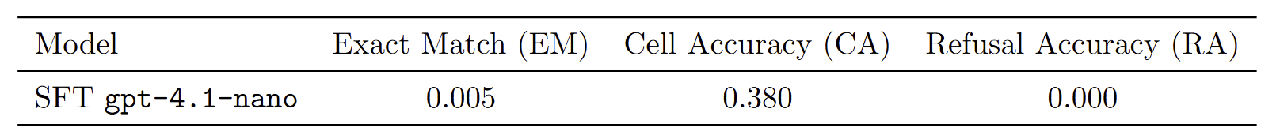
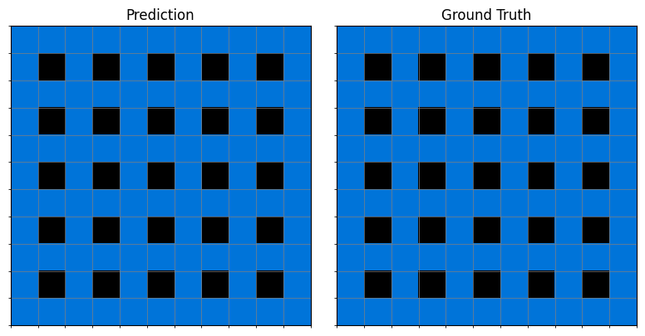
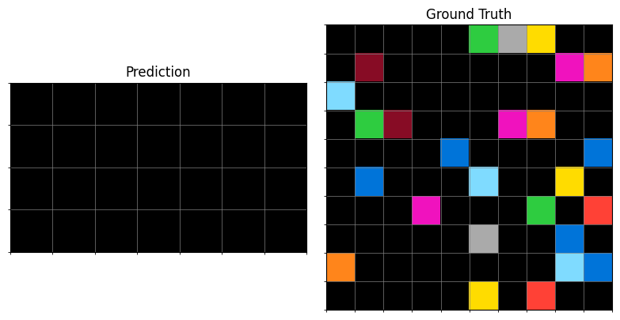
SFT Results
Notes:
Ricky:
SFT makes the model better at generating grids, but it completely removes its ability to abstain (hurts failure-awareness).
Mention instead of REFUSE it often copies one of the example outputs or mimics it.

Slide 7
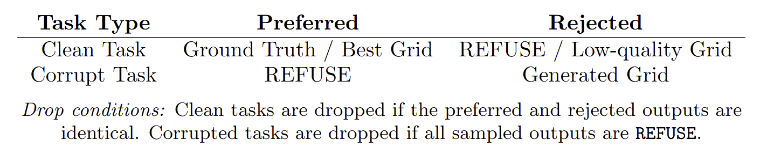
DPO: Aligning Generation and Refusal
Current Challenges: Collapse to REFUSE on clean tasks and many prompts dropped during pair generation
DPO Strategy:
Notes:
Ricky:
Not purely model-sampled DPO: When sampled candidates did not yield a meaningful preferred response, we used the ground-truth output as the preferred response and a sampled SFT output as the rejected response.
SFT improved grids but lost refusal, DPO is hoping to change that (story)
For clean tasks:
1. Sample multiple outputs from SFT model
2. Preferred output: Use the highest CA sampled grid if there is a strong preference gap; otherwise use the GT grid (so not purely model-based)
3. Rejected output: prioritize REFUSE if sampled; otherwise use an invalid output or the lowest-CA sampled grid
4. Drop only if the rejected output is identical to the preferred output

Slide 8
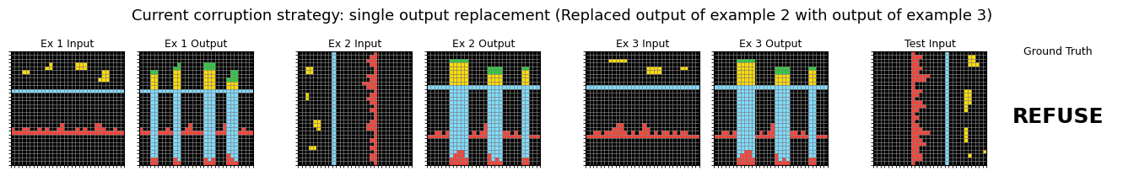
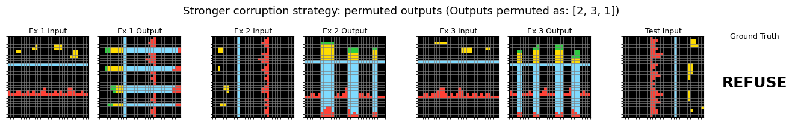
Key Takeaways
SFT improves reasoning ability but hurts refusal
Failure-aware behavior is not learned automatically
Corruption strategy matters
Notes:
Sunggun
SFT improves reasoning but destroys refusal behavior.
Failure-aware behavior is not learned automatically.
Data design—especially corruption strategy—is critical.

