Slide 1


Application of Generative AI in Healthcare: Through Ollama
Dr. Satendra Kumar,
Assistant Professor
Dept. of Computer Science & Engg.
Indian Institute of Technology Patna

Slide 2
Content:
Generative AI can understand, summarize, generate, and organize healthcare information.
Generative AI can work with:
  Clinical notes
  Medical reports
  Research literature
  Patient questions
  Hospital documentation
Ollama allows us to run many AI models locally on our own computer.
Today we will move from concept → healthcare problem → local AI → working demo.

Slide 3
Where generative AI fits in healthcare
Clinical support : summarize, explain, draft, differential reasoning support
Administration: letters, discharge summaries, coding support, SOP drafting
Research: literature triage, protocol drafting, molecule hypothesis generation
Patient-facing: education, language simplification, symptom navigation

Slide 4
Why Generative AI Matters Now
Traditional healthcare AI mainly performs:
Input → Prediction
Example:
  ECG → AI Model → Normal / Abnormal
Generative AI can perform:
  Input + Context → New Content / Explanation / Summary / Response
Example:
  Medical Record + Question → LLM → Structured Clinical Summary

Slide 5
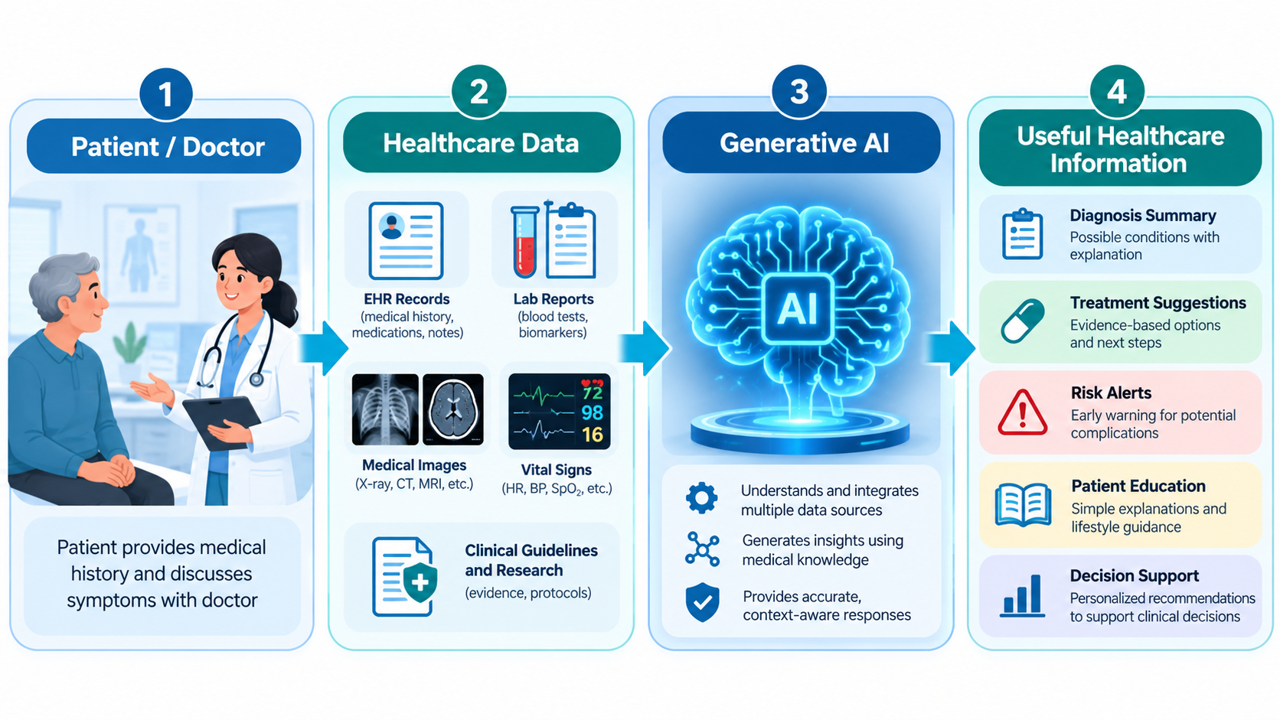

Slide 6
Why Generative AI Matters Now
Generative AI can therefore support:
  Information extraction
  Question answering
  Medical documentation
  Report summarization
  Patient communication
  Research assistance

Slide 7
The challenge
For doctors and researchers :
  Large Amount of Medical Data
  Useful Information
  Clinical Knowledge
  Decision
Role of Generative AI
  Generative AI can act as an information-processing layer between healthcare data and humans.
Important:
  AI should assist healthcare professionals, not independently replace clinical judgment.

Slide 8
Why demonstrate with Ollama instead of only cloud chatbots?
Data control: summarize, explain, draft, differential reasoning support
Reproducibility: Same model tag + same prompt + saved output = better auditability.
Cost predictability: No per-token cost during classroom exploration
Offline/edge research: Useful for hospitals, labs, rural health pilots, and low-connectivity settings.

Slide 9

Why Ollama for Healthcare Demo?
Key idea: Run Generative AI locally.
Healthcare data is sensitive.
Cloud AI may create privacy concerns.
Ollama helps demonstrate AI on a local
machine.
Useful for classroom, lab, and prototype
projects.
Users can test models without
building full cloud infrastructure.

Slide 10
Local AI for Sensitive Healthcare Data
Patient records should not be casually sent to external systems.
Local models keep data on the user’s computer.
Useful for demoing:- Clinical summaries
  Patient education
  Medical document Q&A
  Report drafting
Better control over data flow.

Slide 11
AI Without Continuous Internet
After model download, many Ollama models can run locally.
Useful in:-
  Rural clinics
  Hospital labs
  Low-connectivity environments
Reduces dependency on paid cloud APIs.

Slide 12
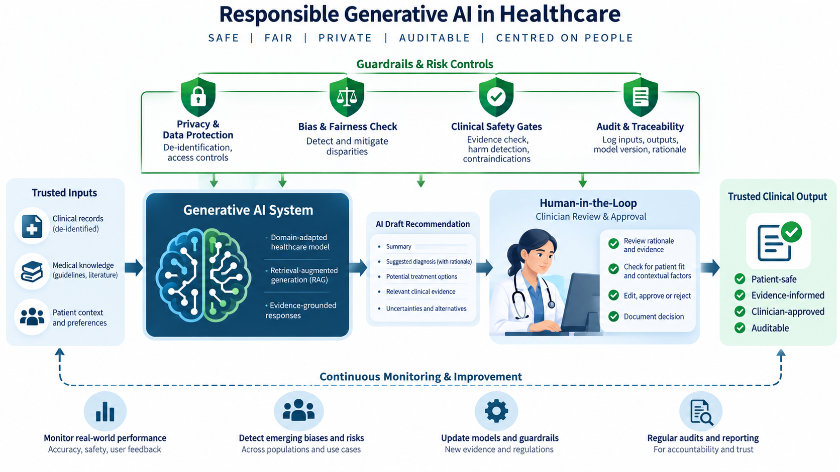

Slide 13
Choosing the Right Model
Ollama supports many open models such as Llama, Mistral, Gemma, Qwen, Phi, and others.
Model selection depends on:
  Hardware capacity
  Speed requirement
  Accuracy requirement
  Language support
  Context length
  Task type

Slide 14
Continued ..
Task | Better model choice
Short patient explanation | Small fast model
Long clinical summary | Larger model
Medical document Q&A | Model with RAG
Code demo | Coding-capable model

Slide 15
Hands-on Demo Setup
Goal: Run a local healthcare chatbot using Ollama.
Today’s setup flow:
  Install Ollama → Pull Model → Run Chatbot → Test Healthcare Prompts

Slide 16
Install Ollama
Windows PowerShell:
  irm https://ollama.com/install.ps1 | iex
macOS / Linux:
  curl -fsSL https://ollama.com/install.sh | sh
Then check:
  ollama --version

Slide 17
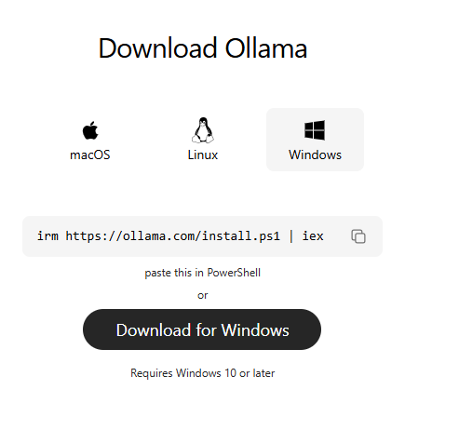
Steps
Install: https://docs.ollama.com/quickstart

Slide 18
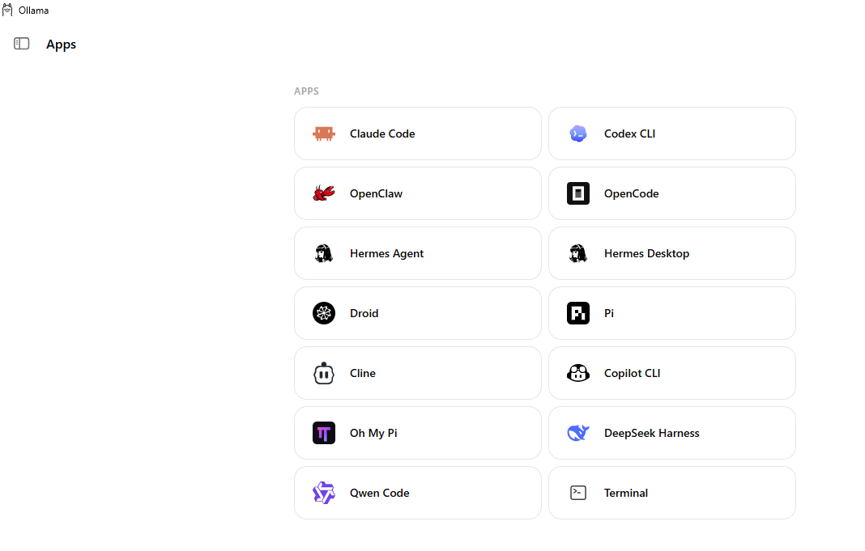

Slide 19
Pull a Model
Download a model:
  ollama run tinyllama
Check available local models:
  ollama list
select a model based on:
  Laptop RAM
  Speed
  Accuracy
  Language support
  Healthcare explanation quality

Slide 20
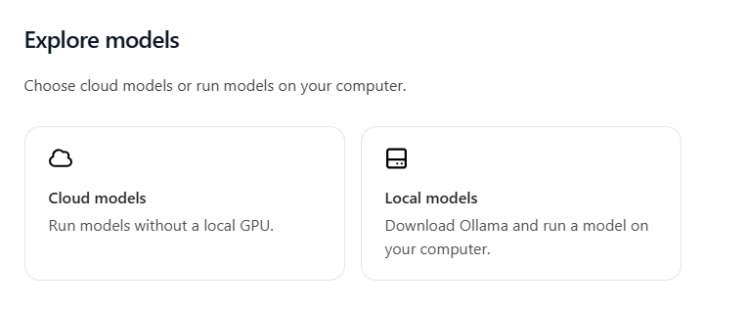

Slide 21
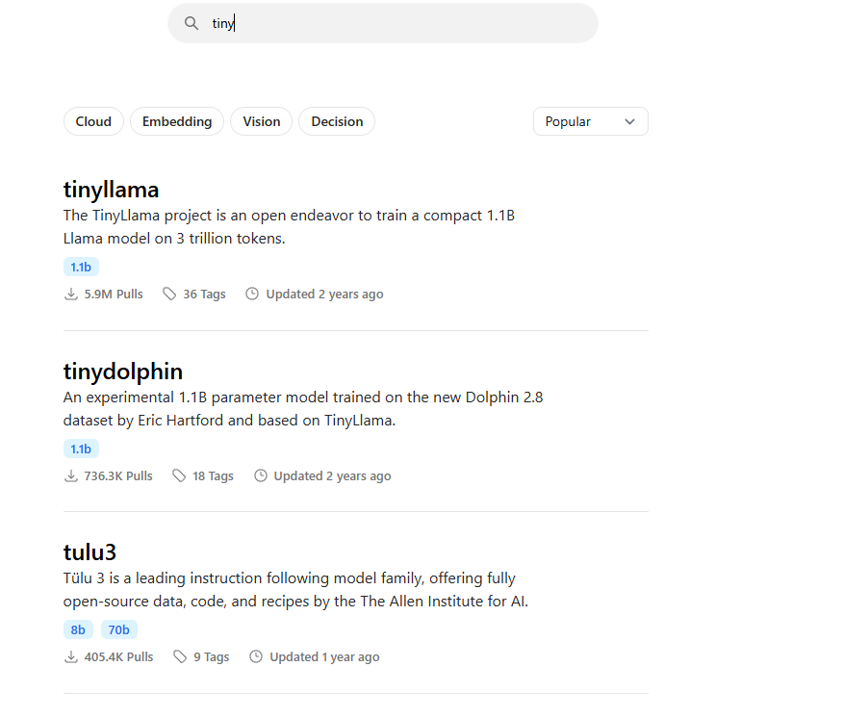

Slide 22
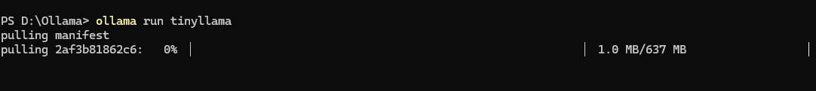
Open terminal: ollama run tinyllama

Slide 23
Run Local Chatbot
Test prompt:
  Explain high blood pressure to a patient in simple language.
Healthcare safety rule:
  Do not diagnose. Give educational information and advise consulting a qualified healthcare professional.

Slide 24
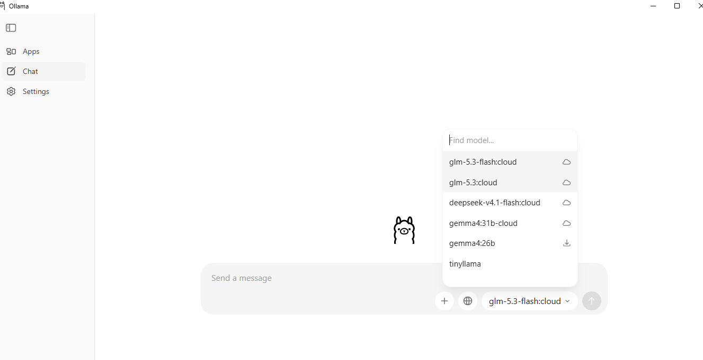

Slide 25
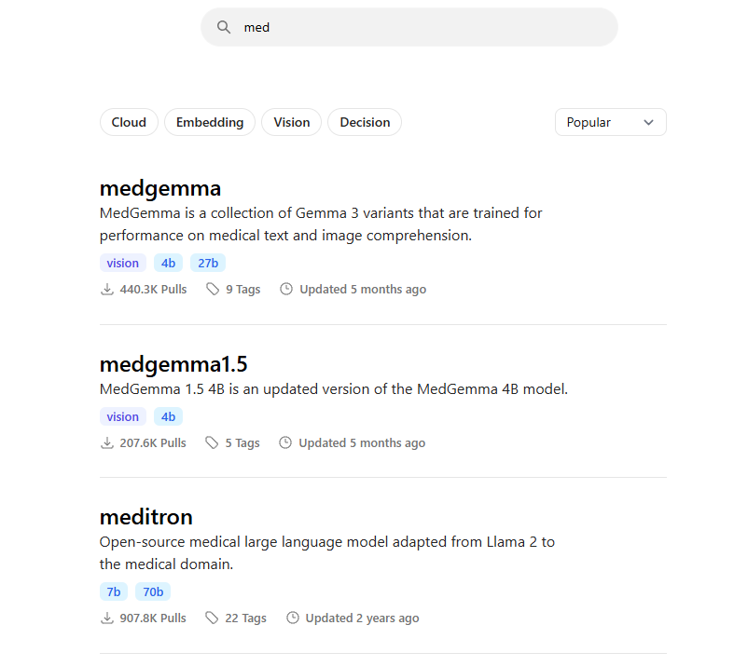

Slide 26
Demo 1: Medical Text Summarization
Objective: Convert long clinical text into a structured summary.
Input example:
Long patient case note with symptoms, history, investigation, treatment, and advice.
Expected output:
  Patient profile
  Main complaints
  Relevant history
  Key findings
  Diagnosis impression
  Treatment plan
  Follow-up advice
Key idea: Generative AI helps reduce information overload.

Slide 27
Prompt for Structured Summary
You are a healthcare documentation assistant.
Summarize the following case note into a structured format:
1. Patient details
2. Chief complaint
3. History
4. Examination findings
5. Investigations
6. Assessment
7. Treatment plan
8. Follow-up advice

Slide 28
Check the AI summary for:
  Did it include all important clinical points?
  Did it remove unnecessary details?
  Did it invent any information?
  Is the output structured and readable?
  Can a doctor quickly review it?
Important warning:
AI summarization is useful, but the final summary must be
verified by a healthcare professional.

Slide 29
Patient-Friendly Explanation
Objective: Convert medical language into simple patient language.
Example input:
The patient has hypertension and has been prescribed amlodipine.
Explain the condition and medicine in simple language.
Expected output:
  What the condition means
  Why treatment is important
  How the medicine helps
  Common precautions
  When to consult a doctor
Key idea: AI can improve patient understanding

Slide 30
Patient Explanation
You are a patient education assistant.
Explain the following medical condition in simple language.
Rules:
  Use non-technical words.
  Do not frighten the patient.
  Do not give a final diagnosis.
  Mention that a doctor’s advice is most important.
  Use short sentences.
Topic: Hypertension and amlodipine.

Slide 31
Demo — synthetic patient summarization
Synthetic patient case
Age: 62; Sex: Male
Complaint: fever, cough, breathlessness for 3 days
Vitals: T 38.2°C, HR 108, RR 26, SpO2 91% room air
History: diabetes, hypertension
Ask: Create a handover note for clinician review. Include uncertainties.

Slide 32
RAG with Medical Documents
RAG = Retrieval-Augmented Generation
Instead of asking the model from memory:
Question → LLM → Answer
Use local medical documents:
Question → Search PDF/Guideline → Relevant Text → LLM → Answer
Why important?
  Reduces hallucination
  Uses trusted documents
  Supports local hospital guidelines
  Improves explainability

Slide 33
The 3 Core Components of RAG
1. The Retrieval Component (The Searcher): When you ask a question, the system searches an external database (often a vector database) to find text snippets, documents, or data relevant to your query.
2. The Augmentation Component (The Context Builder): The system takes the relevant information it found and cleanly stitches it directly into your original prompt.
3. The Generation Component (The Writer): The LLM reads your original question plus the freshly injected context data, then writes an accurate, grounded response.

Slide 34
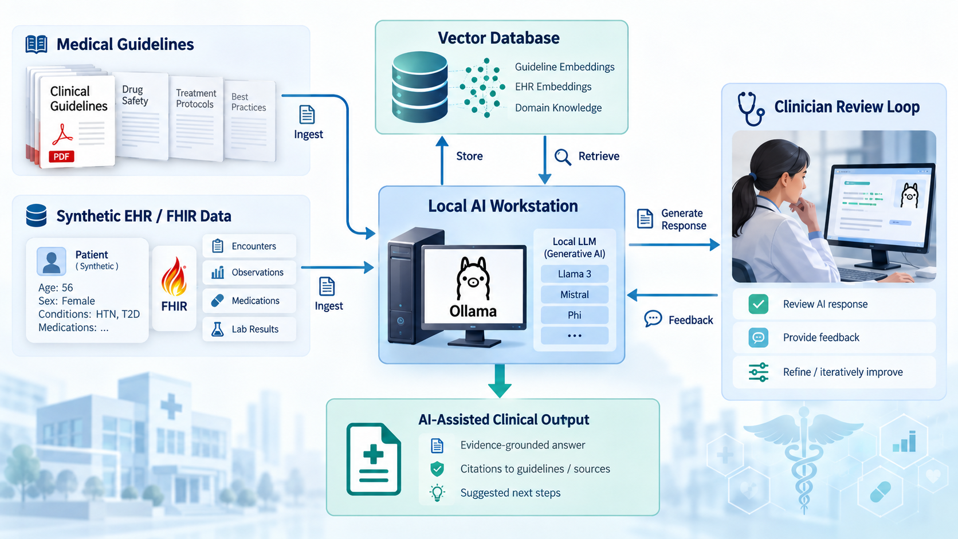

Slide 35


