Slide 1
RELAYS
Ricky L. Washington

Slide 2

Possibilities
-Telegraph in case you want to practice morse code
-From Cars to Rockets
-Plenty of other places with High Voltage

Slide 3
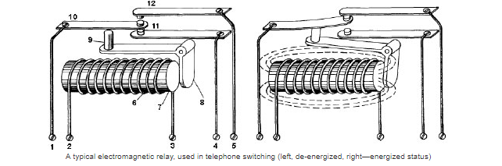
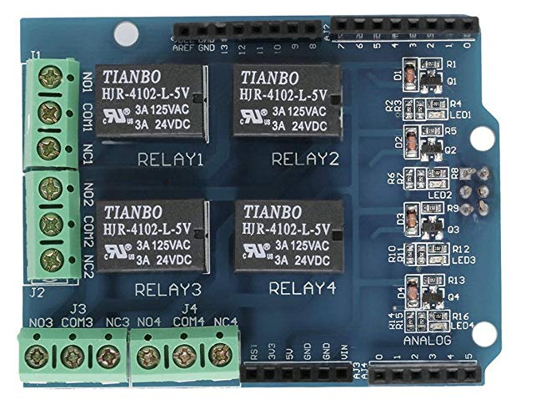
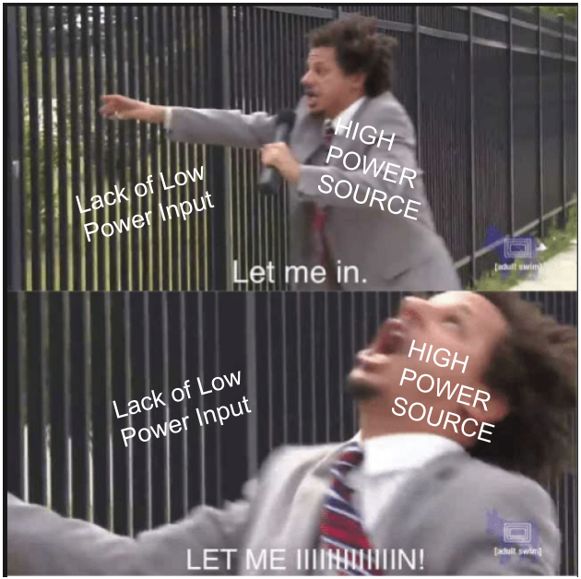
What and How
-Control HIGH POWER with
low power
-Yes, kind of like a transistor

Slide 4

The Venn Diagram Slide
Relays
-higher current/voltage
-can use with AC
-lower resistance
-galvanic isolation
Transistors
-faster switching
-analog, allowing for signal amplification
-smaller, cheaper
-can’t use with AC
-Can use with DC loads
-switches current on/off

Slide 5
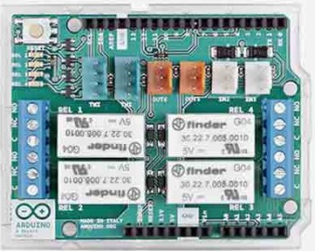
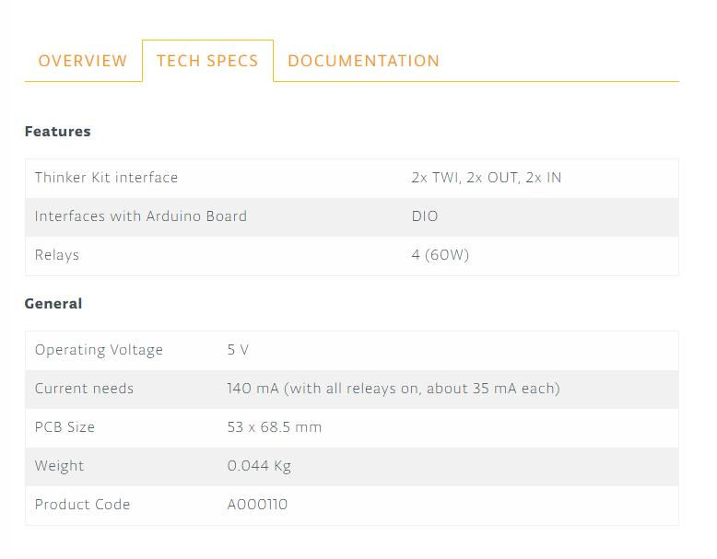
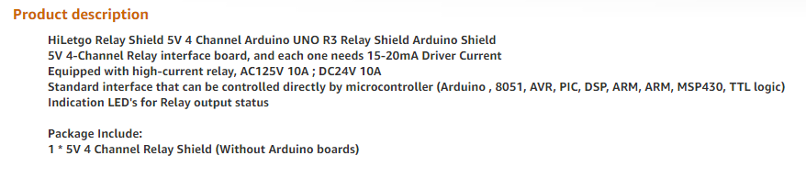
DataSheet
Arduino
HiLetgo

Slide 6
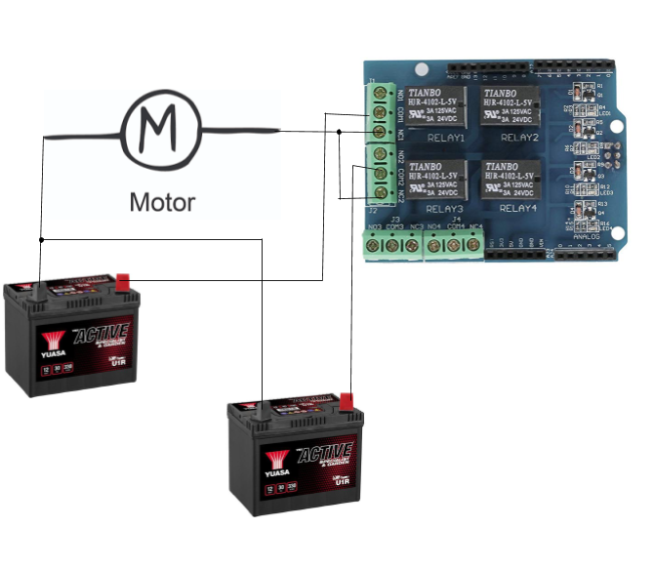
The Schematic

Slide 7
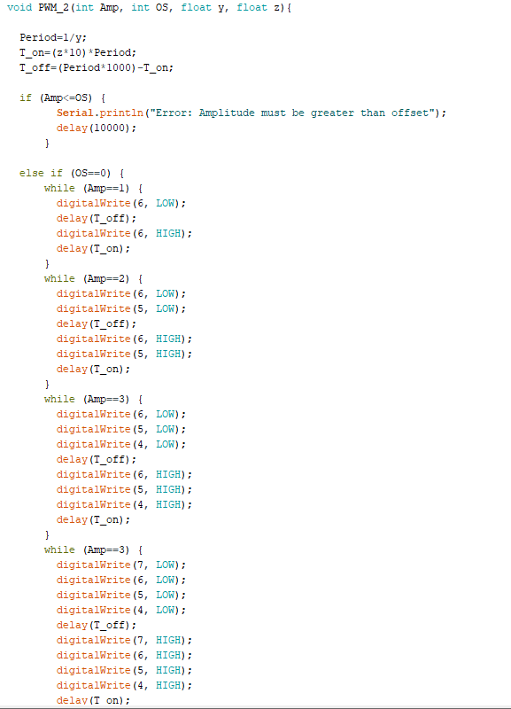
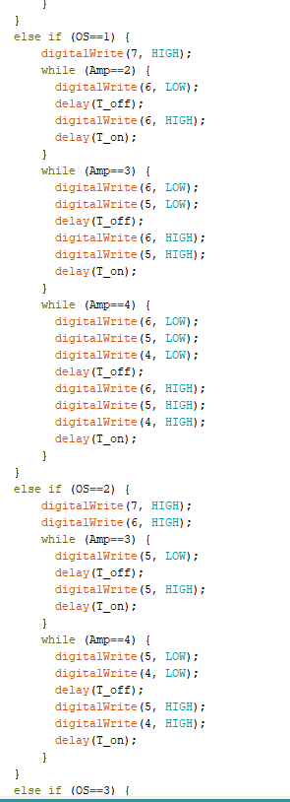
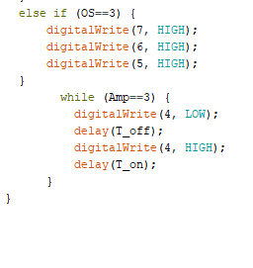
Code

Slide 8
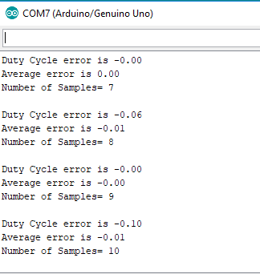
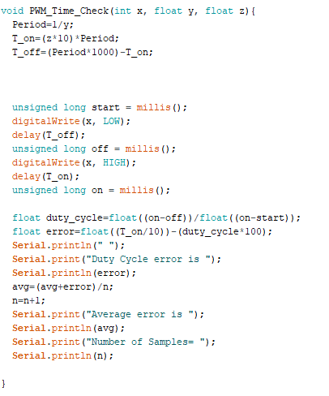
More Code

Slide 9

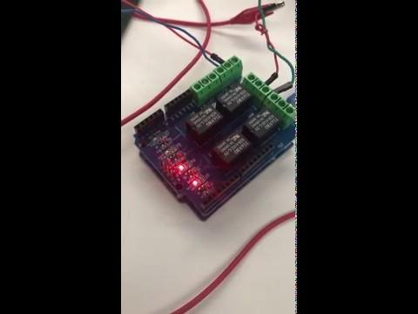
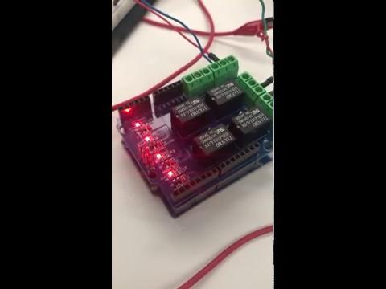
What I Did
Amplitude 4x Source
Offset 2x Source
1 Hz @ 75% Duty Cycle
Amplitude 4x Source
Offset 2x Source
7Hz @ 75% Duty Cycle

Slide 10
Sources
https://www.seeedstudio.com/Relay-Shield-v3-0-p-2440.html
https://store.arduino.cc/usa/4-relays-shield
https://www.arrow.com/en/research-and-events/articles/relays-vs-transistors-choosing-the-best-tool-for-the-job
https://history-computer.com/ModernComputer/Basis/relay.html

