Slide 1
EverythingComputer v1.0b1
Version Blog
Operating System
v1.0b1
Software
Hardware
About
Thank you
Exit
Click to go to Operating System page

Slide 2


Operating System
MS-DOS
Windows
MacOS
Linux
Others
Enter

Slide 3
Windows
Windows 1.0 DRs
Windows 1.0x
Windows 2.0 DR

Slide 4
Windows 1.0
DR1 (Development / Developer Release 1)
- Build Date
Windows 1.0 Development / Developer Release 1 was probably compiled some time in 1984-05, possibly on 1984-05-29[?] if the date in DR5's REMOVE.BAT is a leftover from this build. An article in InfoWorld's 1984-05-07 issues claims the first version for developers will be released towards the end of 1984-05.
- Links
https://betawiki.net/wiki/Windows_1.0_Development_Release_1
https://betawiki.net/wiki/Windows_1.0_Developer_Release_1
https://archive.org/stream/Infoworld-1984-05-07#page/n53/mode/2up
Architecture | x86

Slide 5
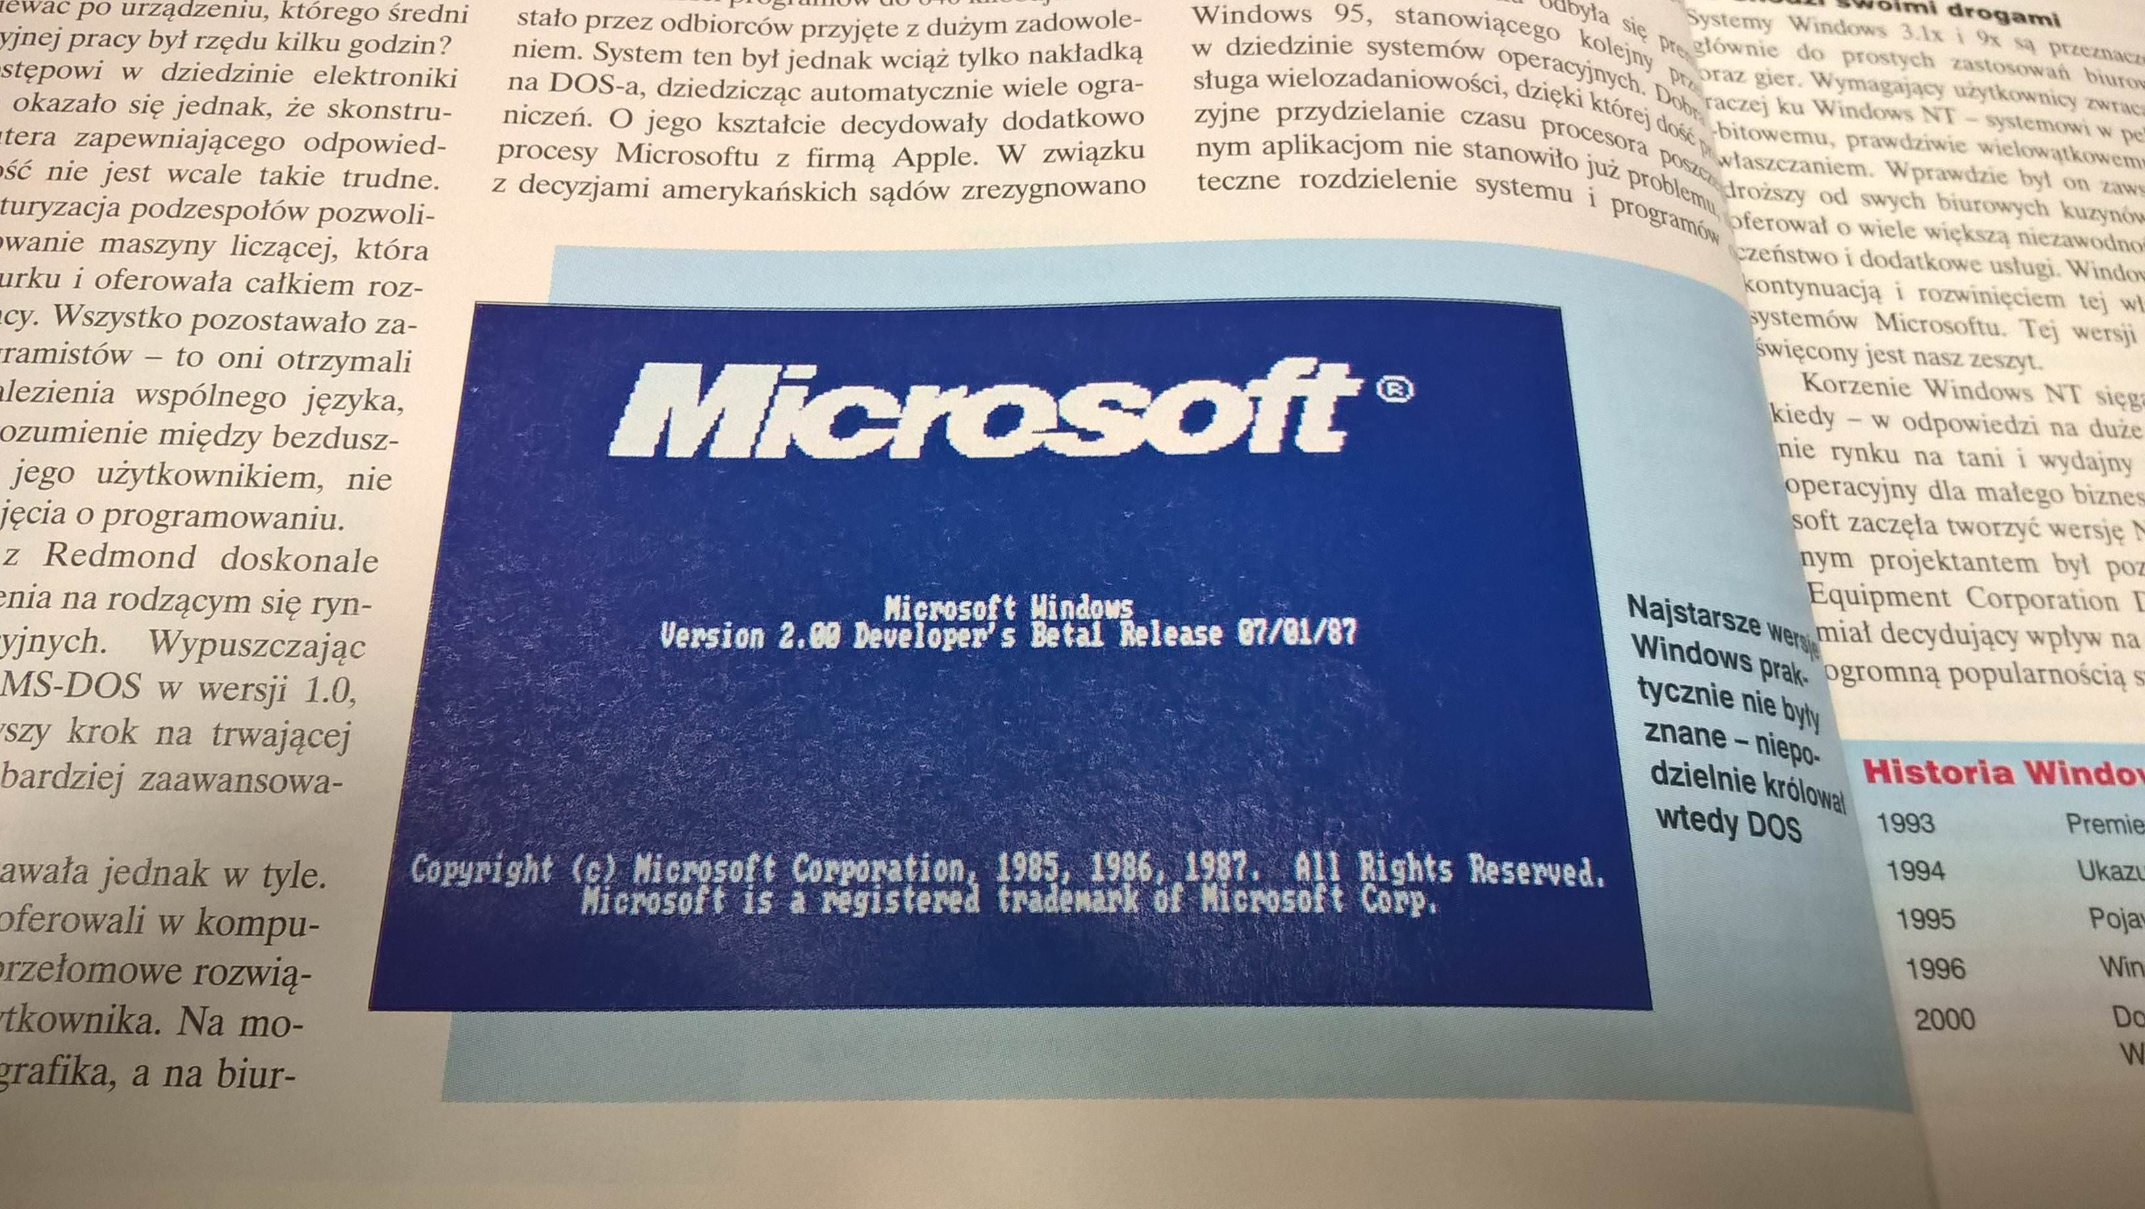
Windows 2.0 Developer’s Betal Release 07/01/87
- Boot Screen
The boot screen of this build was found in a CHIP magazine issue from 2000[1] on 2017-11-19.
- Links
Architecture | x86 16-bit
Compiled | 1987-06-30

Slide 6
Version 1.0b1
Version Finished 1.0b1 at 28/12/2018 19:31:15
Added the Home Screen with 5 buttons and a version blog
You can tap on the background to go to next page
Starting to make operating system pages

Slide 7
Exit
You can click once more to exit.

