Slide 1

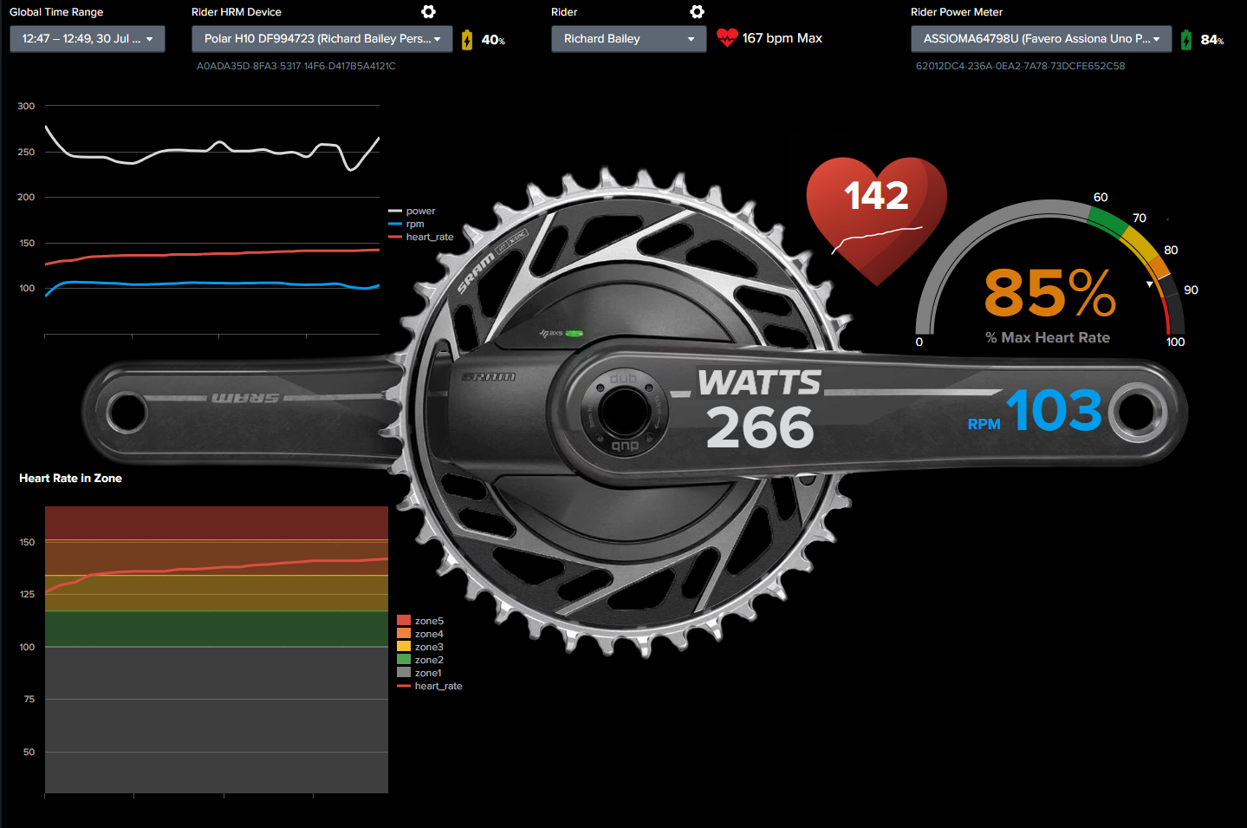




Pedal Power and HRM Data Flow
Splunk Platform
Power Meter Pedals
lookups
Python script
gym_collect.py
HEC
Per-second
data
bleak
otel
O11y Cloud
Multiple Heart Rate Monitors

