Slide 1
Data Architecture
An overview of the Data Architecture in the
Enterprise Architecture Framework

Slide 2
Coillte Architecture – Meta-Model
Draft
Architecture
Framework
Architecture
Meta-model
Architecture
Viewpoints
Enterprise
Architecture
Process
Solution
Architecture
process
Architect
Roles
Roadmap &
Migration Planning
Architecture
Landscapes
Architecture Issues
& Constraints
Role
This realises an Architecture Strategy by defining the what architecture changes are required in each phase of the transitions. These illustrates multiple architecture views, such as: Business, Applications, Data and technology.
Are used to illustrate various architecture states in time. They are aligned to the Architecture Roadmap and are a viewpoint for each phase within the roadmap. Used to show both the current and target (Visionary) Architectures.
Used to capture specific known issues or constraints relating to a specific architecture component or technology.
Principles &
Standards
The usual or expected function of an actor, or the part somebody or
something plays in a particular action or event. An actor may have a
number of roles.
A defined statement of intent aligned to the IT Architecture Strategy. Used to help steer IT decision making. Includes a supporting rational and measure of importance.
Top level representation of the Coillte Business . Links to Organisation Unit representing the various Collite Divisions (E.g. Coillte Forest, Enterprise etc).
Organisation
Organisation
Unit
A self-contained unit of resources with line management
responsibility, goals, objectives, and measures. Organizations may
include external par ties and business partner organizations.
Actor
A person, organization, or system that has a role that initiates or interacts with activities; for example, a BUA Manager reviews Production plans. Actors may be internal or external to an organization.
Delivers business capabilities closely aligned to an organization, but
not necessarily explicitly governed by the organization. Also referred
to as ‘‘business function’’.
Function
Architecture
Practice
Overview
Architecture
Strategy
Defines key architecture enablers strategically aligned to the business strategy. Can be defined at various levels: Organisation, Unit, Business function, Technology (E.g. CRM, Server, Networks, etc). Uses the Roadmap Architecture Landscapes to illustrate the transitions.
A process represents flow of control between or within functions and/or services (depends on the granularity of definition). Processes represent a sequence of activities that together achieve a specified outcome, can be decomposed into sub-processes, and can show operation of a function or service (at next level of detail). Processes may also be used to link or compose organizations, functions, services, and processes.
Process
EA Practice
Development
Defines the Architecture Governance method and associated compliance KPIs. Links to both Architecture Strategy to review proposed strategies and Project Architecture for review of project based solutions.
Architecture
Governance & KPIs
A Process is made up of one or more steps. A Step represents a finite activity that can be performed by a person, and systems or both. Steps can be either activities or decision points.
Step
Framework
& Process
Enterprise Architecture Meta-Model
Governance
Decision Log
Captures the Architecture Compliance decisions for both proposed Strategies and project architectures. Also includes any actions, recommendations.
Supports business capabilities through an explicitly defined interface and is explicitly governed by an organization.
Business Service
Holds the results of the assessment criteria for a given review. Includes specific information on the proposals compliance.
Compliance
Assessments
Logical Technology
Component
An encapsulation of application functionality that is independent of a particular implementation. For example, the classification of all purchase request processing applications implemented in an
enterprise. This can hierarchical where you have Financial Management and its sub-components are: Reporting, AR, AP, Budgeting & Forecasting and Credit Control etc.
Architecture
Governance
Project
Architecture
A proposed architecture for a specified project or change. This includes all four architecture views: Business, Applications, Data and Technology.
Physical Technology
Component
A boundary zone that encapsulates related data entities to for m a physical location to be held. E.g. example, a purchase order business object, comprising purchase order header and item business object nodes.
A specific technology infrastructure product or technology infrastructure product instance. For example, a particular product
version of a Commercial Off-The-Shelf (COTS) solution, or a specific brand and version of server.
Physical Data
Component
A boundary zone that encapsulates related data entities to for m a logical location to be held; for example, external procurement information.
Logical Data
Component
An encapsulation of data that is recognized by a business domain expert as a thing. Logical data entities can be tied to applications, repositories, and services and may be structured according to implementation considerations.
Data Entity
Describes an information flow between one or more logical applications. The information is classified into a high level data set such as: Sales Plan, Production Schedule etc.
Logical
Integration
Describes a physical interface between one or more physical applications.
Physical
Integration
An encapsulation of application functionality that is independent of a particular implementation. For example, the classification of all purchase request processing applications implemented in an enterprise.
Logical Application
Component
An application, application module, application service, or other deployable component of functionality. E.g. a configured & deployed instance of a Commercial Off-The-Shelf (COTS) Enterprise Resource Planning (ERP) application.
Physical Application
Component
The automated elements of a business service. An information system service may deliver or support part or all of one or more business services.
Information
System Service
Architecture
Artefacts
Prepared by: Brendon O’Brien
Date: 23rd January 2013
Version: 0.3. (Draft)
Description:
This model summaries the phases and core activities of implementing an Enterprise Architecture practice.
Front
3

Slide 3
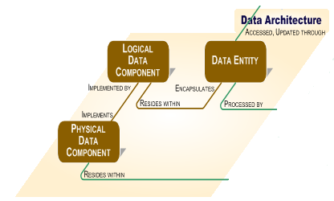
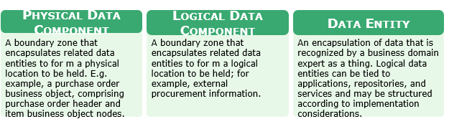
Data Architecture – Stored in iServer

Slide 4
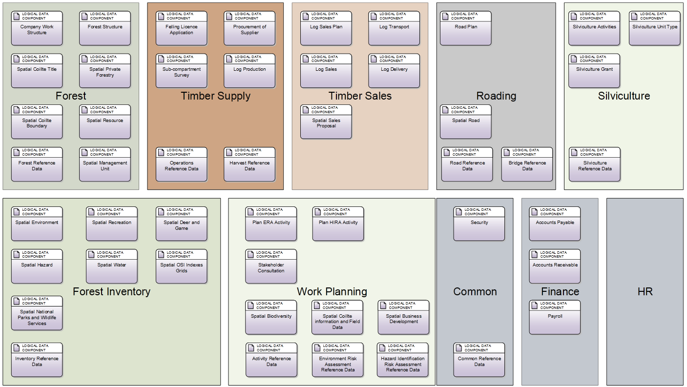
Data – Conceptual Model

Slide 5
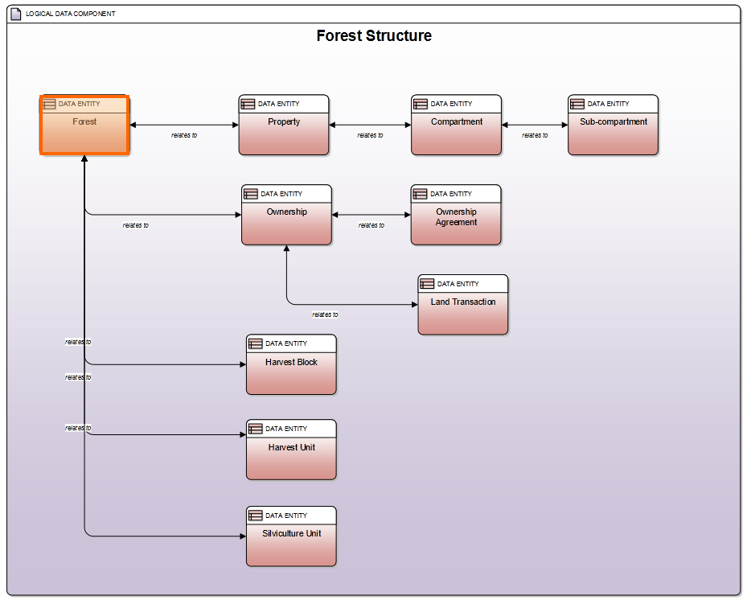
Forest Structure - Logical Data Component

Slide 6
Forest Structure – Data Entities
Forest
A large area dominated by trees, both conifers and broad-leaved, either planted or natural.
Property
A block within a forest usually defined by the local townland name.
Compartment
A land unit which, as far as possible, is based on well defined features such as rivers, roads or other well defined features.
Sub-Compartment
An area within a compartment comprising of a homogenous crop in terms of species, age and composition.

Slide 7
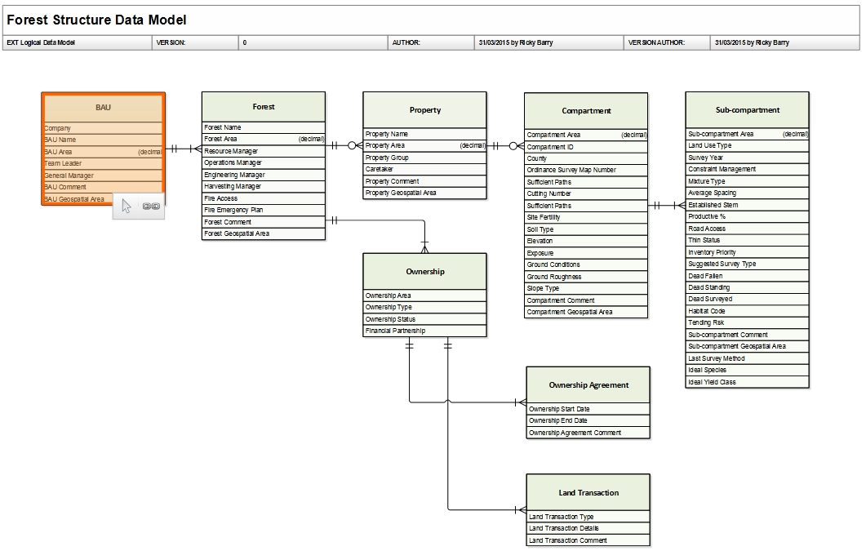

Slide 8
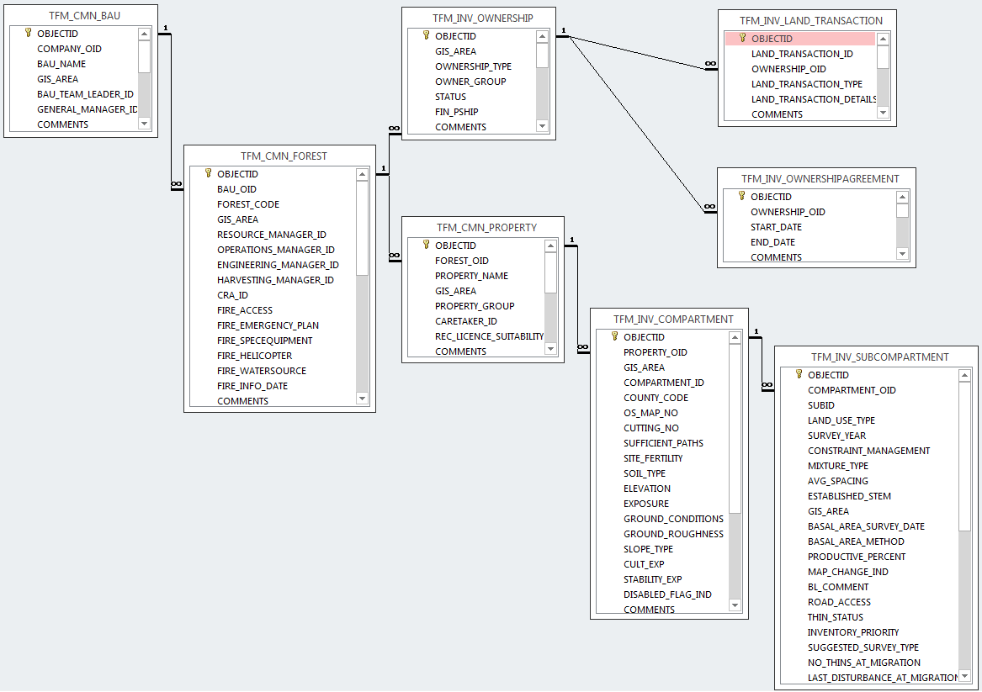
Forest Structure - Physical Tables

Slide 9
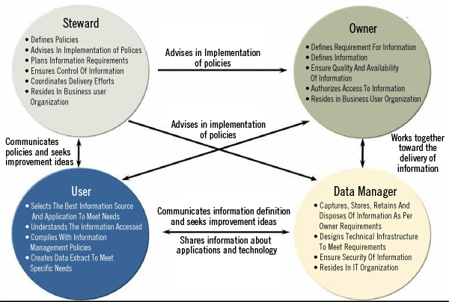
Data Governance Roles

Slide 10
Data Governance Responsibilities
Level 1
Governance role
Understands data at high level
Assign data steward resources
Advise on policy & approves decisions from data stewards
Level 1 escalation point for data issues
Level 2
Stewardship role
Understands data within their domain to entity level
Assign data owner resources
Devises & Implements policy
Level 2 escalation point for data issues
Level 3
Ownership role
Advises on policy
Understands data to attribute level
ICT
Data Manager role
Designs technical infrastructure
Responsible for safe custody, transport, storage of the data & implementation of business rules

Slide 11
Further Data Links
Enterprise Architecture Portal
Coillte Forest - Process Ownership Data Governance Framework v0.1.vsd
Data Governance Framework - Business Journey Map v1.23.xlsx
UC-18_Inventory_Survey_Data_Flow.vsdx

Slide 12

Questions

