Slide 1
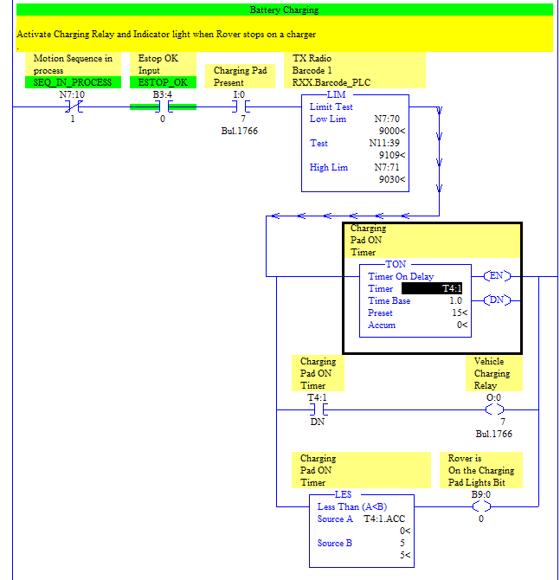
Rover: Request to Charge
System PLC
At charger. Request to Charge
Charging Pad is Up.
Currently, the rover just waits 15 seconds. It then considers itself to be charging. It should get feedback from System PLC.
Rover

Slide 2
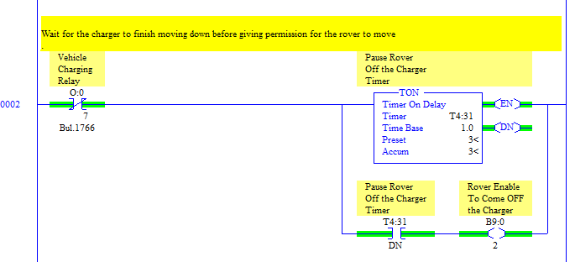
Rover: Request to Leave Charger
System PLC
Request to Leave Charger
Charging Pad is Down.
Currently, the rover just waits 3 seconds after turning off the charging relay. It then considers itself ready to move. It should receive feedback from the System PLC.
Rover

Slide 3
Rover: Request to Leave Charger
System PLC
N11:30-49 -> Nxx:0-19
Rxx_ToDevice ->N11:0-15
Currently, the rover just waits 3 seconds after turnin off the charging relay. It then considers itself ready to move. It should receive feedback from the System PLC.
Rover

