Slide 1

BIDIRECTIONAL SPARSE FACTORISATION (BSP) ALGORITHM Computer Science and Engineering 3nd year
Project Report
CSE-359 PARALLEL COMPUTING
MOHIT MALVIYA - 160001035 PRANAY MUNDA - 160001045
Under the Guidance of
Dr. Surya Prakash

Slide 2
Introduction:
The problem of solving general sparse system of linear equations arises in various problems in structural engineering,chemical engineering and nuclear physics. So for the project,we consider the problem of solving general sparse system of linear equations of the form Ax= b .A has a generaal structure i.e. A can be either symmetric or non symmetric in nature and is of dimension NxN,adn x and b are N dimensional vectors. As with the sparse symmetric coefficient matrix case,the traditional process for obtaining direct solution of a general sparse sytem of linear equation,Ax=B.
With A being symmetric positive definite matrix.
A = L* L^{T}
In this project the above decomposition of a symmetric positive definite matrix into L and
L^{T} is implemented using a parallel algorithm.

Slide 3
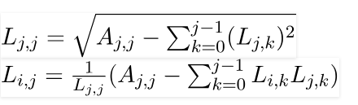
The Bidirectional Sparse factorisation(BSF) Algorithm
The BSF algorithm factorizes a given a Sparse matrix which is diagonal symmetric positive definite matrix with sub-diagonal and super-diagonal, find its corresponding L matrix by cholesky decomposition. for Sequential implimentation:
we are using the following formula t obtain lower triangular matrix L .
The sequentially we can perform in time complexity for this problem can be in O(n³).
Algorithm:
The subroutines modify_seq and divide_seq used. The function modify_seq(i,j) multiplies column j by a(i,j) and subtract it from column I. the routine divide_seq(i) divides column I by the square root of its diagonal element.

Slide 4
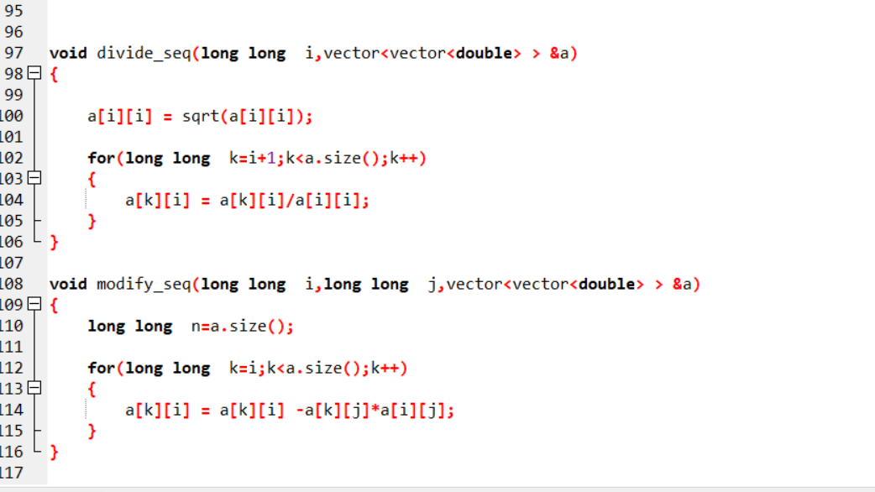
Function :

Slide 5
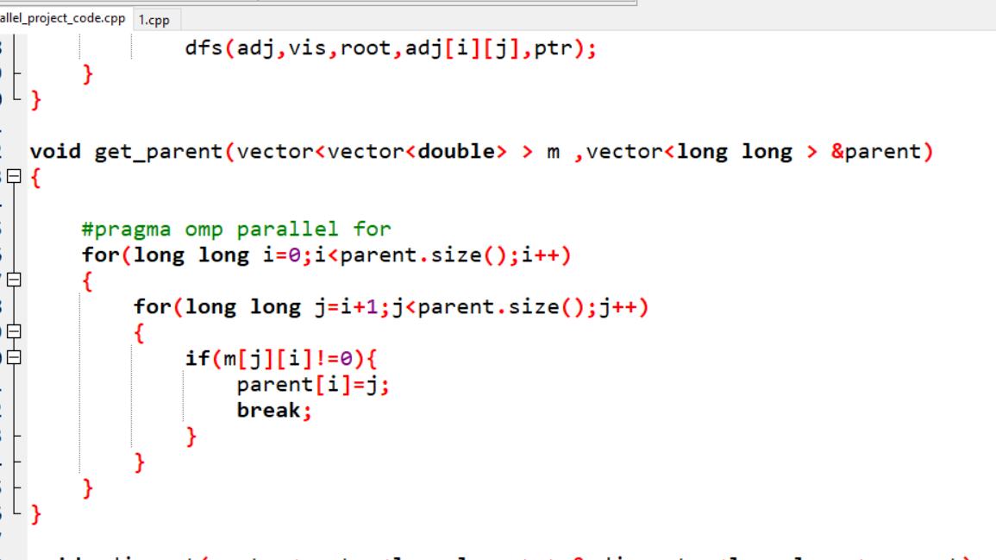
For Parallel implementation:
we follow a structure called elimination tree, whose computation is a part of symbolic factorization and which shows column dependencies in Cholesky factor L.
Create parent array of the given matrix. We do this using n processors in O(1) time .
Using the parent array adjacent list is build in O(n) time.

Slide 6
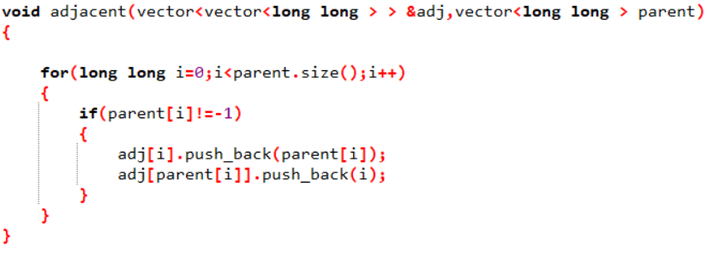
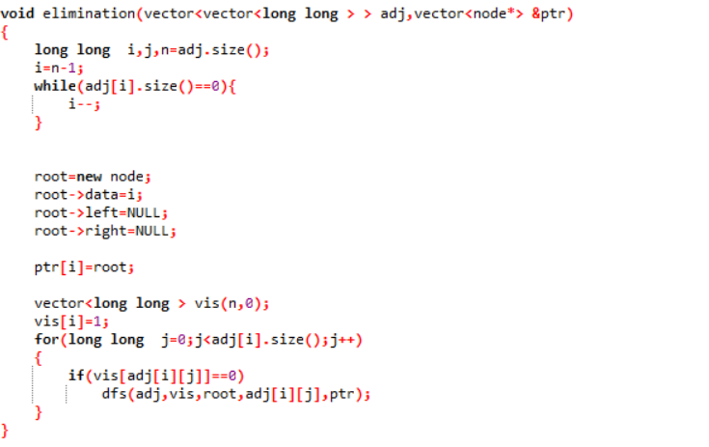
After this we create elimination tree using DFS algorithm which takes O(n) time.

Slide 7
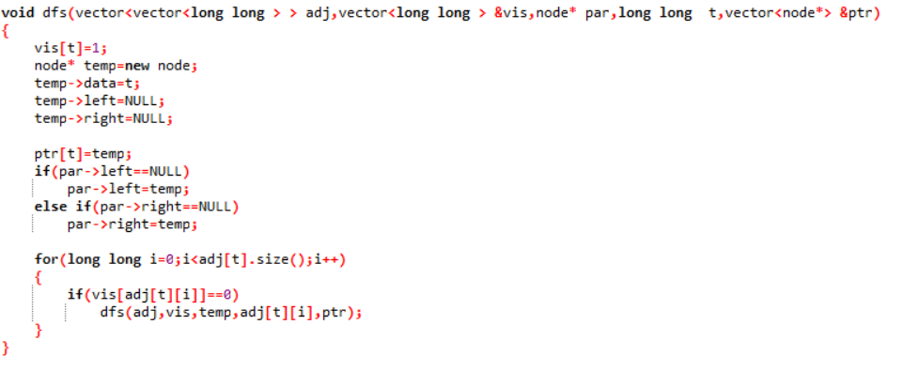
Now all the leave nodes are used in parallel form the elimination tree. This algorithm uses n² processors and time complexity is O(Height of the elimination tree*n). After each completion of level its removes all the leaves of that level and rises to the upper level until it reaches the root node. Which indicated that all the node have been visited.

Slide 8
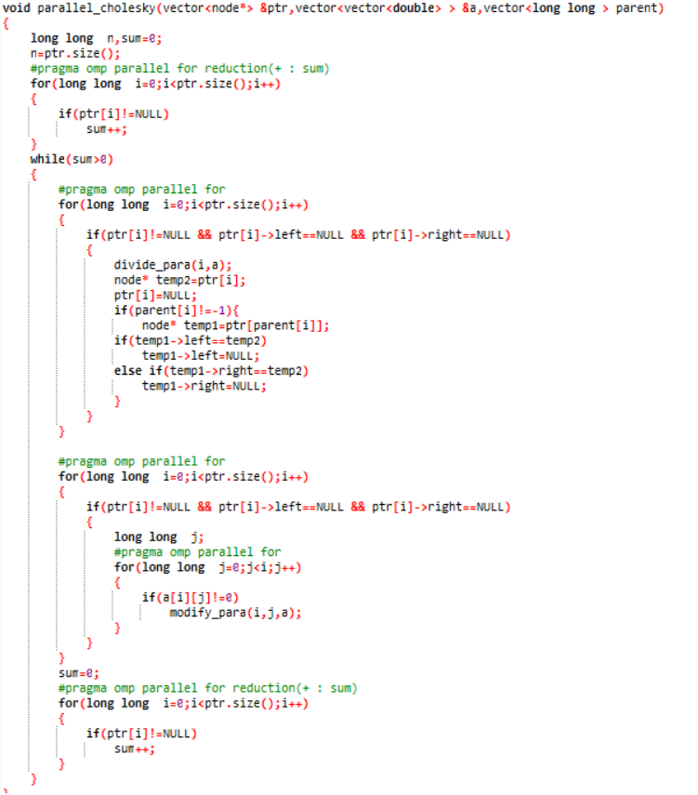

Slide 9
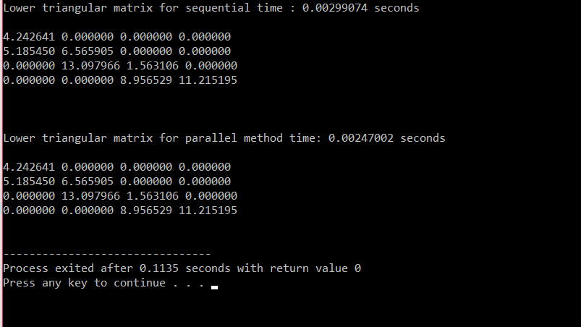
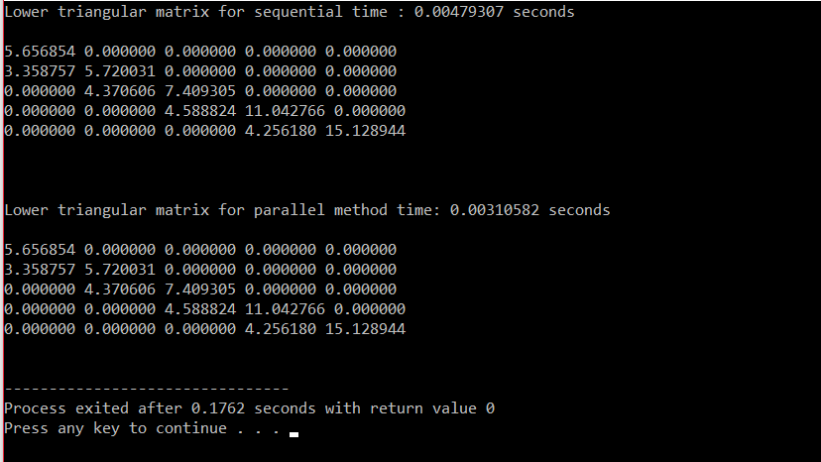
Parallel Algorithm: This is CRCW PRAM algorithm in which we find the L matrix using n^2 processors and O(n*(height of the elimination tree)) time complexity.

Slide 10
Size of Matrix | Sequential Time | Parallel Time
4x4 | 0.00299074 | 0.00247002
5x5 | 0.00479307 | 0.00310582
Performance:
Time Complexity: O(n*(height of the elimination tree))
Work complexity: O(n²*(height of the elimination tree))
Speedup: O(n²/(height of the elimination tree))
References:
https://osnet.cs.binghamton.edu/publications/masters/gopalan97new2.pdf

