Slide 1

Restaurant Clustering In Toronto

Slide 2
Business Study
In order to start a new restaurant, we should do some research on existing competitor and suitable area to start it. A place with dense area is suitable to open up a new high end restaurant but it require more capital and its competing with all the inclusive data shown here. However starting a family restaurant will be done better on rural area with lower cost and slight accessibility to the area like close to a station or its near a neighborhood. This data will be suitable and interesting to new investors or entrepreneur trying a new business.

Slide 3
Data Used
The data used will be the data of all restaurant from foursquare and clustered by the types of restaurant available in Toronto. With the multi diversity condition in Toronto. It might be wise to see which restaurant prevailed the most in the area.

Slide 4
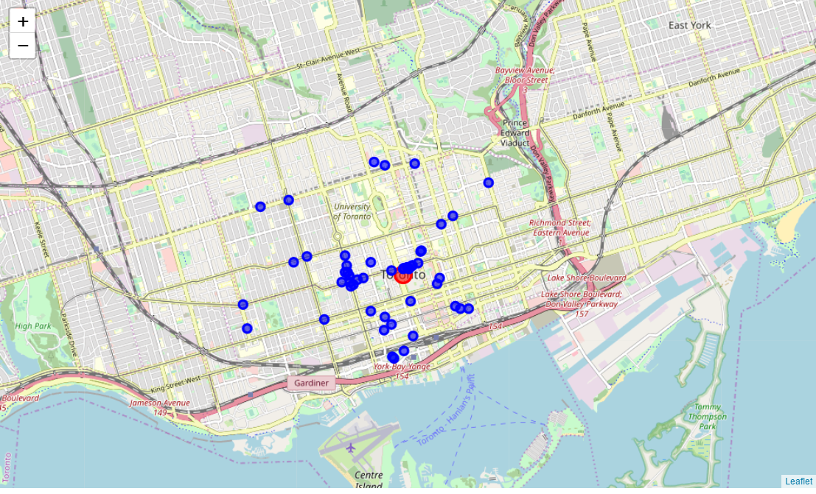
Restaurant Mapping

Slide 5
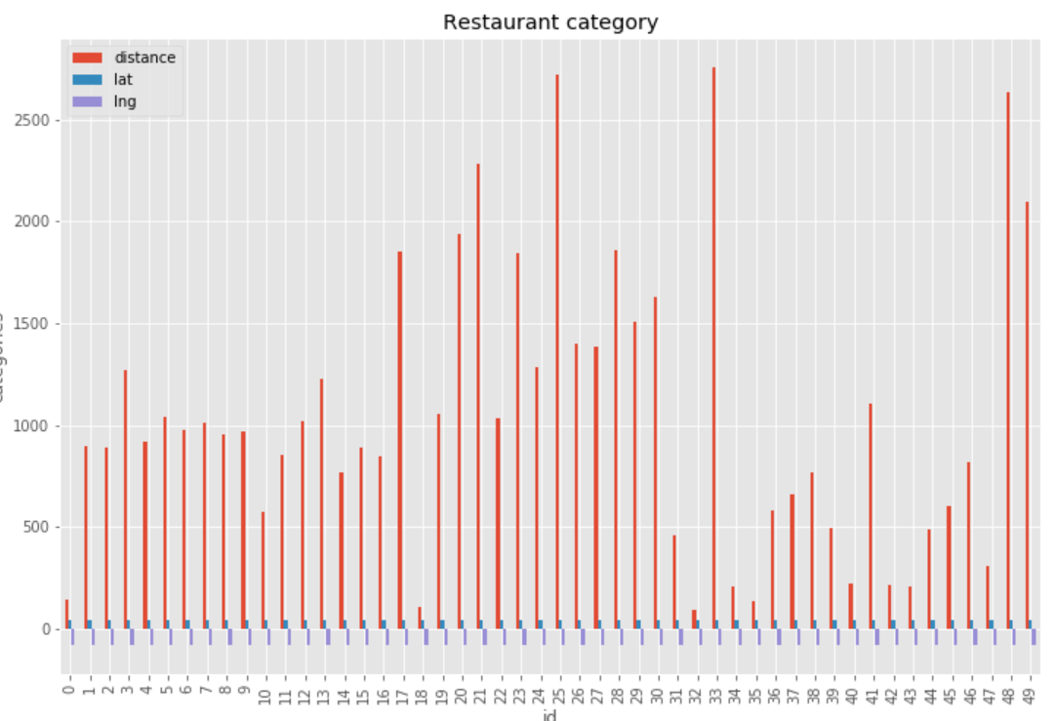
Distance to Center ( Conrad Hotel)

Slide 6
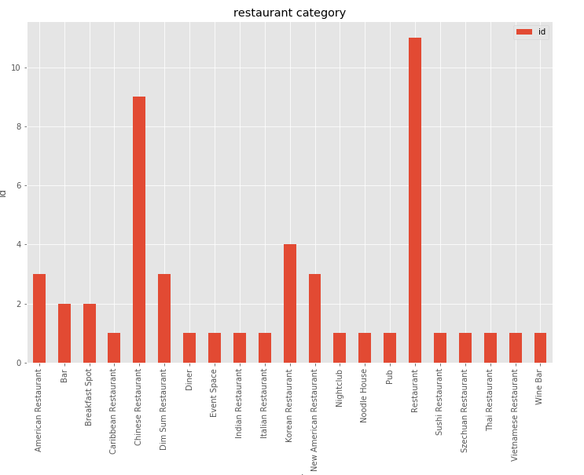
Categories List

