Slide 1
Creative technology Camera Face Detection California Lutheran university Summer 2014
By: Kevin T. Duraj

Slide 2
What is face detection
Face detection is a computer technology that determines the location and size of human faces in digital images or streaming videos.
It detects face ad ignores anything else, such as building, tree, bodies or any other objects .

Slide 3
introduction
In the recent years, face recognition has attracted much attention and its research has rapidly expanded by not only engineers but also neuroscientists, since it has many potential application in computer vision, communication and automatic access control systems.
Feature of face detection uses:
Eyes
Mouth
Ears
Nose

Slide 4
Open source for Face detection
Because of complexity of face detection algorithms engineers and scientists working together using open source freely available and free redistributable source code that people around the world can freely improve and update.
OpenCV – started by Intel in 1999
OpenBR – Biometric Recognition build on OpenCV
Libface – Face Recognition Library
Facedetect – Free face detection software
Mac Development Library – can analyze and find human faces in an image.

Slide 5
Introducing Opencv
OpenCV ( Open Computer Vision ) is a library of programming functions mainly aimed at real-time computer vision developed by Intel Russia research center in Nizhny Novgorod.
Officially launched in 1999, the OpenCV project was initially and Intel Research initiative to advance CPU-intensive applications.
The first alpha version of OpenCV was released in the public at the IEEE Conference on Computer Vision and Pattern Recognition in 2000.
The second major release of the OpenCV was on Obtober 2009.
OpenCV2 includes major changes to the C++ interface, aiming towards easier and safer patterns.
In August 2012, support for OpenCV was taken by non-profit foundation, OpenCV.org

Slide 6
OpenCV application Usage
Egomotion
Facial recognition system
Gesture recognition
Image segmentation
Object Identification
Stereopsis
Structure from motion
Motion tracking
Augmented reality
Notes:
Egomotion is defined as the 3D motion of a camera within and environment. In the field of computer vision, egomotion refers to estimating a camera’s motion relative to a rigid scene. For example of egomotion would be estimating a car’s moving position relative to lines on the road or street signs being observed from the car itself.

Slide 7
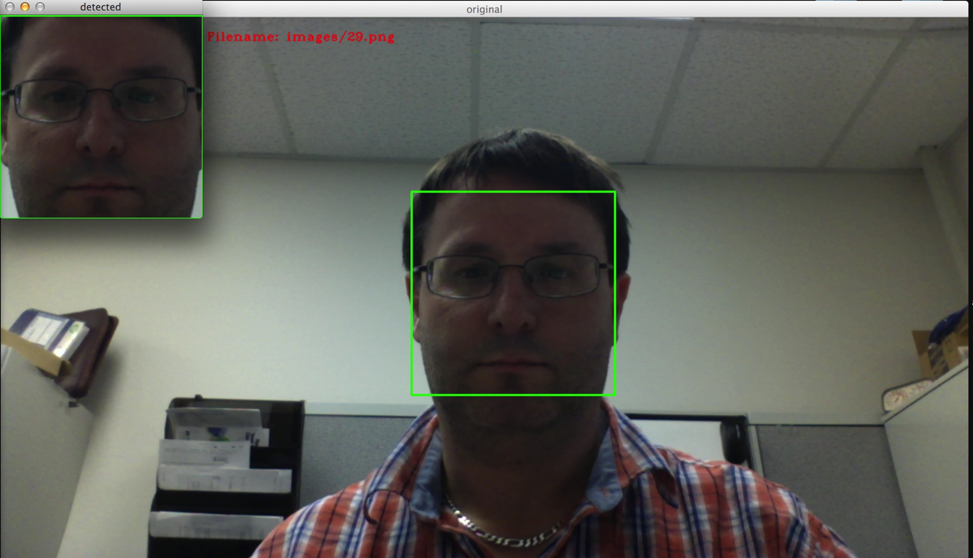
Face detection using opencv

Slide 8
references
OpenCV – www.opencv.org
OpenCV – Wikipedia, en.wikipedia.org/wiki/OpenCV
Open Biometrics – www.openbiometrics.org
Libface – libeface.sourceforge.net

