Slide 1
Key Logger Creative Technology California Lutheran University
By: Kevin Duraj

Slide 2
“Key Logger” - 1
“Key Logger” is gathering user activity information from a personal computers
Keyloggers can also be embedded in spywareallowing your information to be transmitted to an unknown third party. Key Loggers can be written using various compiled and interpreted programming languages and also can be purchases on open market.
Key Loggers are also being lawfuly used by employers to monitor employee activities.

Slide 3
“Key Logger” - 2
A keylogger is a type of surveillance software (considered to be either software or spyware) that has the capability to record every keystroke you make to a log file, usually encrypted. A keylogger recorder can record instant messages, e-mail, and any information you type at any time using your keyboard. The log file created by the keylogger can then be sent to a specified receiver. Some keylogger programs will also record any e-mail addresses you use and Web site URLsyou visit.
Keyloggers, as a surveillance tool, are often used by employers to ensure employees use work computers for business purposes only. Unfortunately, keyloggers can also be embedded in spywareallowing your information to be transmitted to an unknown third party..

Slide 4
“Key Logger” - 3
Keyloggers, as a surveillance tool, are often used by employers to ensure employees use work computers for business purposes only. Unfortunately, keyloggers can also be embedded in spywareallowing your information to be transmitted to an unknown third party.
A “key logger”, also known as keystroke logging or “key logging”, is a method of tracking the strokes on a keyboard without the knowledge of the user.
This information is then collected and used to access private accounts or collect personal information.

Slide 5
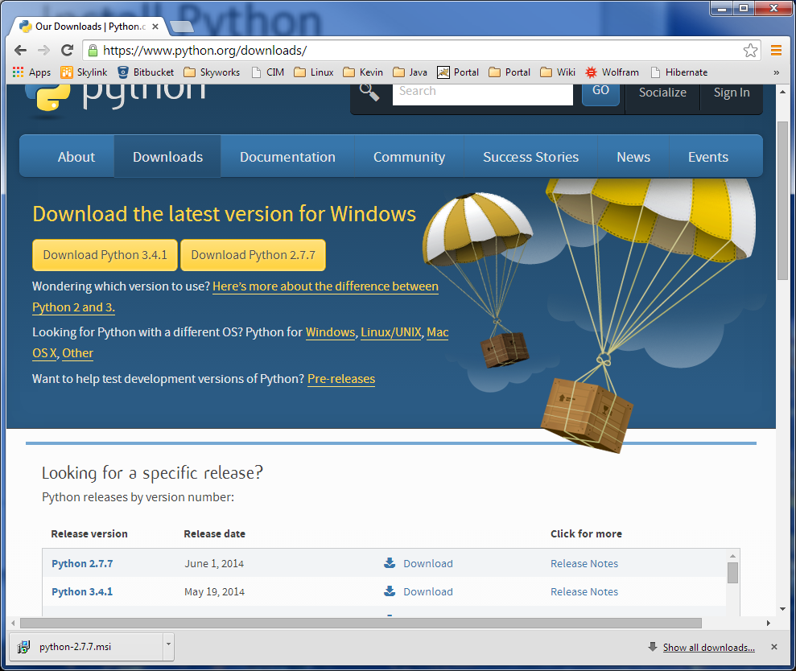
Download Python 2.7.7

Slide 6
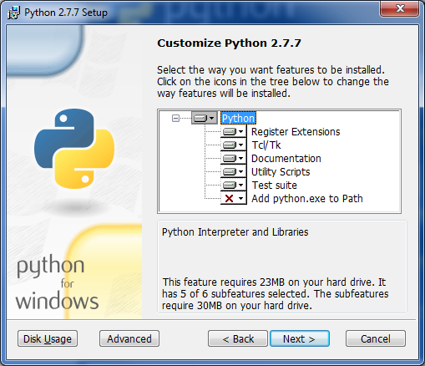
Install Python 2.7.7

Slide 7
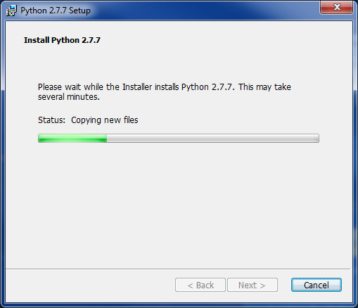
Installing Python procedure on Windows

Slide 8
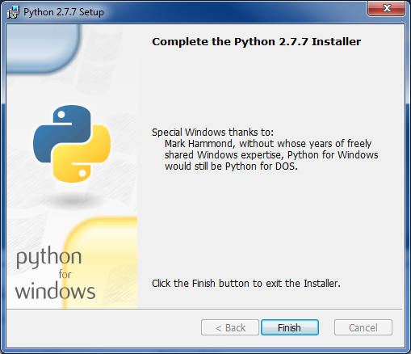
Python 2.7.7 Installation Completed

Slide 9
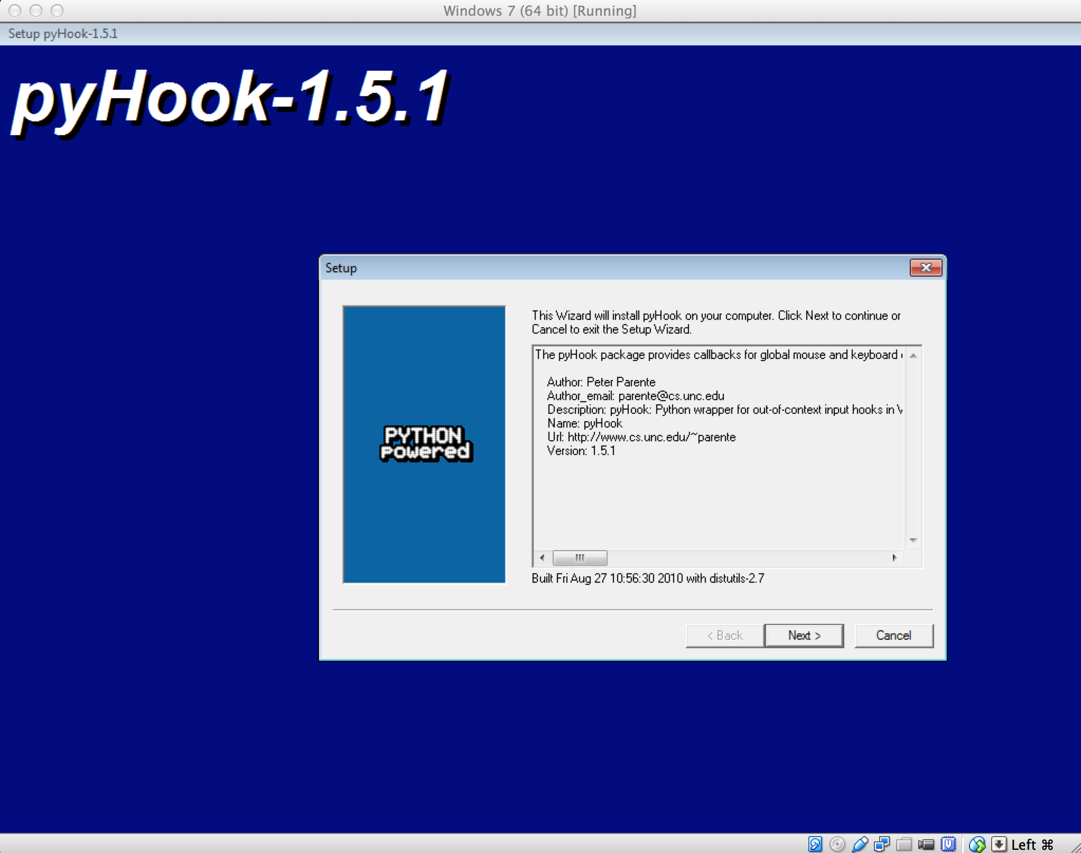
Installing pyHook-1.5.1
pyHook is a python wrapper for global input hooks in Windows. Specifically it wraps the Windows SetWindowsHookEx API function using low-level keyboard (WH_KEYBOARD_LL) and mouse (WH_MOUSE_LL) hooks.
The pyHook package provides callbacks for global mouse and keyboard events in Windows.

Slide 10
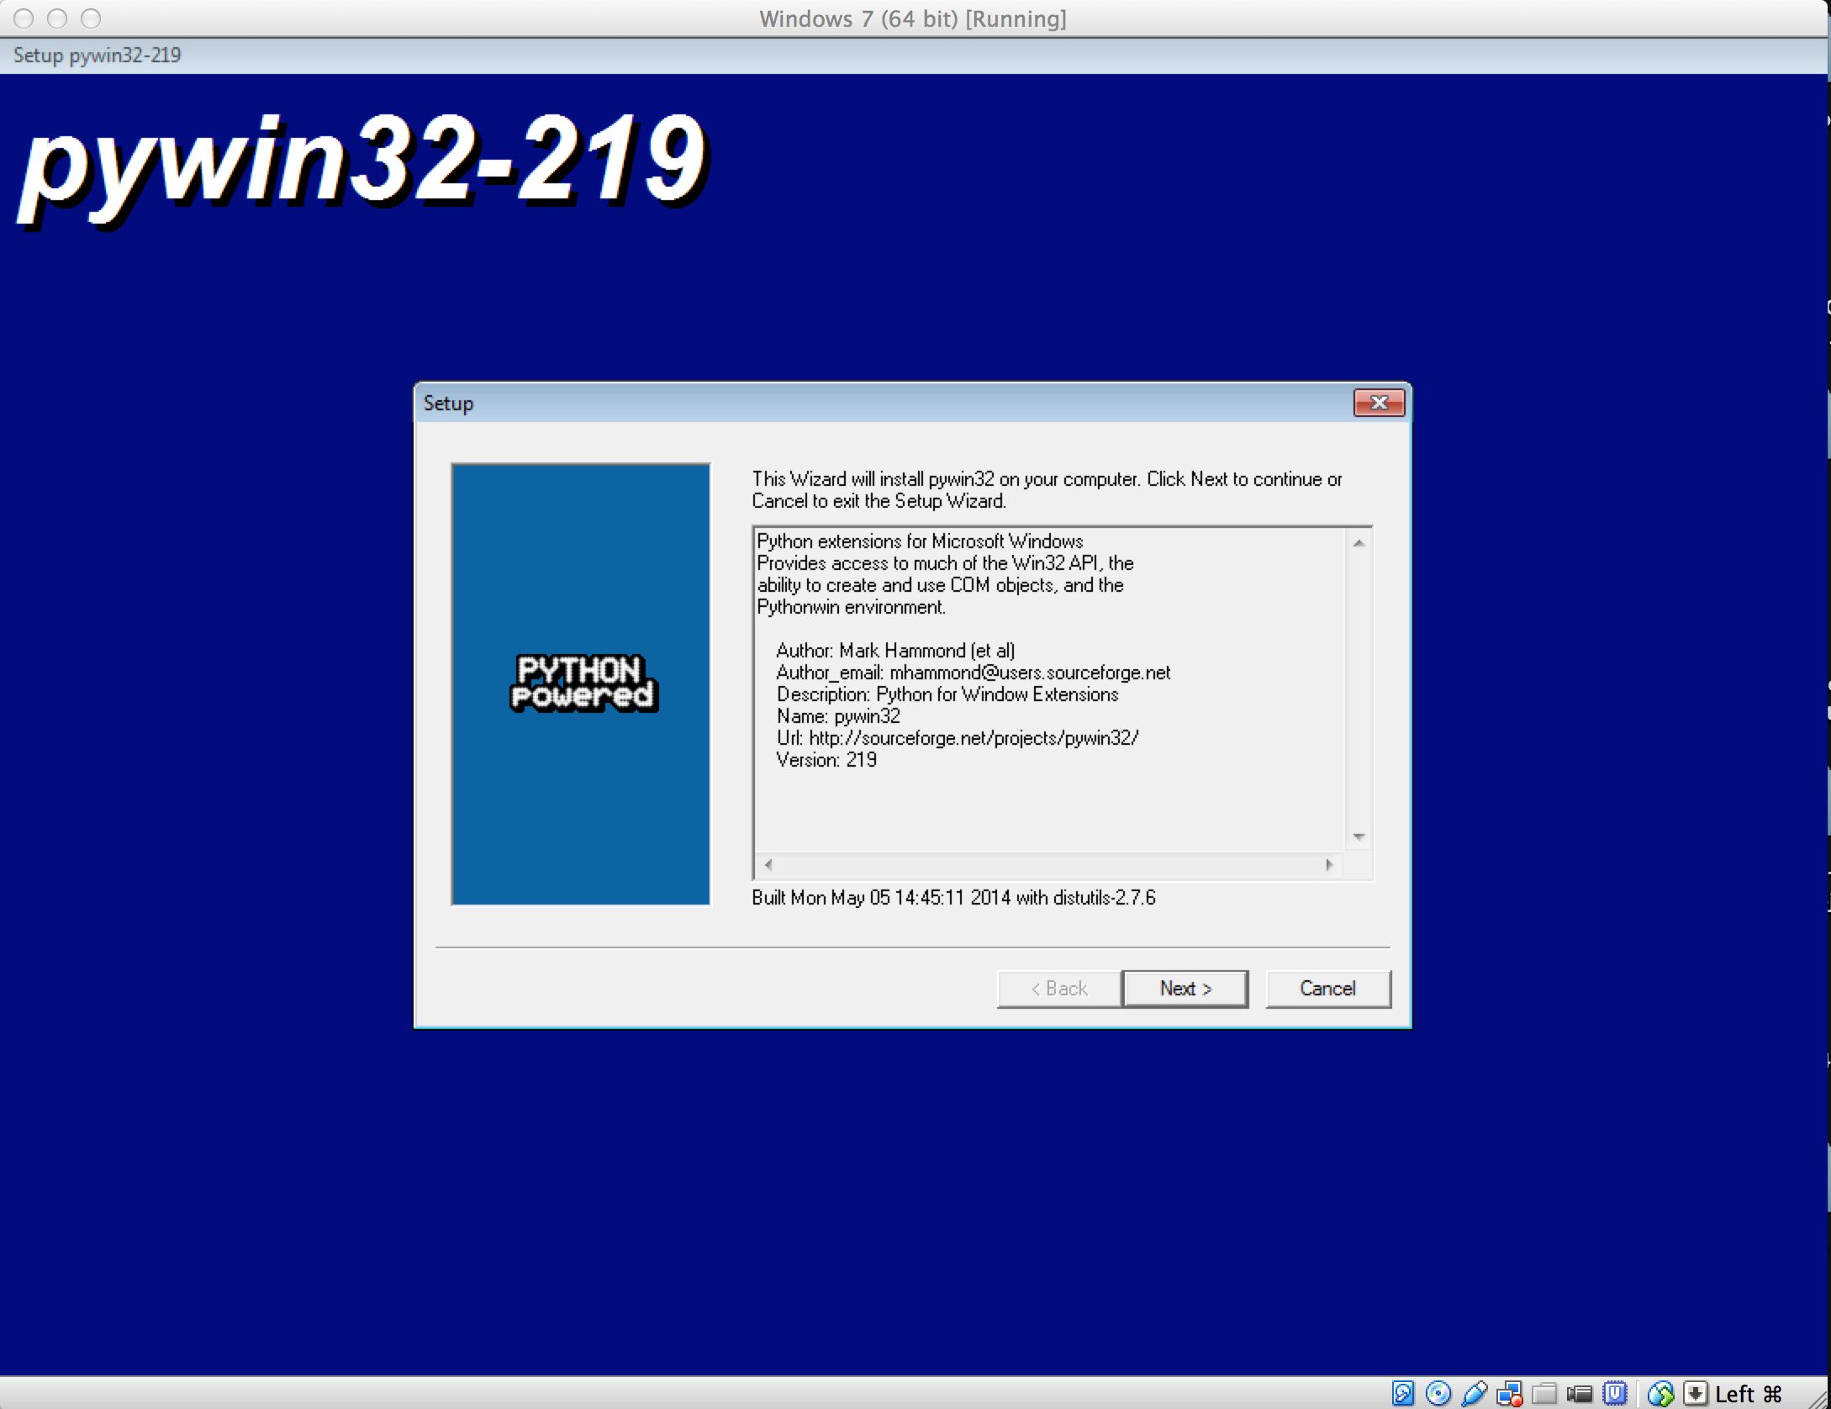
Installing pywin32-219
pyWin32 is a software that enable to python communicate via COM to other Windows software aplications.

Slide 11
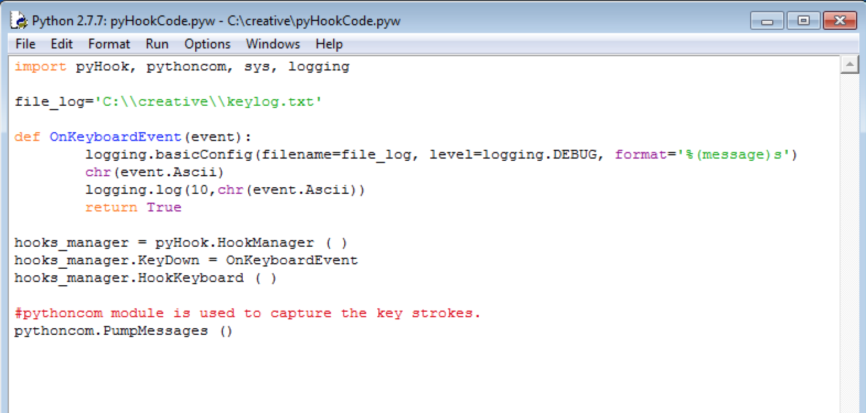
Python Implementation

Slide 12
Anti-KeyLoggers
Experts recommend to use a combination of three products: a personal firewall, an anti-virus and an anti-spyware - and regularly update the latter two. However, even in this case a computer won't be 100% secure against keyloggers.
Most anti-spy and anti-virus products, apply the same scheme - pattern matching. These programs scan the system, looking for code that matches signatures - pieces of spyware code, which are kept in so-called signature bases.
These products can protect from spyware which has already been detected and studied before. This approach makes anti-spyware developers inevitably lag behind spyware writers. Without frequent updating anti-spy products lose their efficiency very quickly. It can become very risky because the PC owner still relies on his anti-spy or anti-virus.

Slide 13
References:
http://www.webopedia.com/TERM/K/keylogger.html
http://en.wikipedia.org/wiki/Keystroke_logging
http://www.anti-keyloggers.com

