Slide 1
Creative Technology Project 1 A/V formats/codecs
Kevin T. Duraj, Weijian Ji,
Shu-Wei Lin, Yuanye Zeng

Slide 2
MP3 Audio Compression
MP3 means of compressing a sound sequence into a very small file, to enable digital storage and transmission. MP3, is an encoding format for digital audio which uses a form of lossy data compression. It is a common audio format for consumer audio streaming or storage, as well as a de facto standard of digital audio compression for the transfer and playback of music on most digital audio players.
One of the earliest audio format Although MP3 file are more popular ACC files are gaining group specially through iTune store.

Slide 3
Advanced Audio Coding (ACC)
AAC file are the native format of iTunes and the iTunes Store. AAC is not invented by an Apple however this file sound better and takes up less or same space as MP3 files of the same song.
Anecdotally, I’ve long believed that this is true, but wanted to put the proposition to a more exacting test in order to better help you decide which file format to use for songs in your iTunes library and on your iPhone and iPod.

Slide 4
MP3 vs. ACC
People who have great ears and really value the highest possible sound quality – generally detest MP3 and other digital audio formats because they use compression that removes information from the digital files in order to save space.
Question:
Question: Why people seeking higher quality of audio file compression when people cannot hear the sounds that are removed by MP3 compressions.
Answer:
Sound that can be heard by person with healthy hearing are also being removed.

Slide 5
AAC vs. MP3 Compression
128 Kbps
ACC sounds better than MP#
192 Kbps
Almost the same, somehow ACC is better and smaller file
256 Kbps AAC - Hard to distinguish between AAC and MP3 and almost same file size

Slide 6
What is AVI?
Audio Video Interleaved (also Audio Video Interleave), known by its initials AVI, is a multimedia container format introduced by Microsoft in November 1992 as part of its Video for Windows technology.
AVI files can contain both audio and video data in a file container and it allows synchronous audio-with-video playback.

Slide 7
Format
AVI is a derivative of the Resource Interchange File Format (RIFF), which divides a file's data into blocks, or "chunks." Each "chunk" is identified by a FourCC tag. An AVI file takes the form of a single chunk in a RIFF formatted file, which is then subdivided into two mandatory "chunks" and one optional "chunk".
The first sub-chunk is identified by the "hdrl" tag. This sub-chunk is the file header and contains metadata about the video, such as its width, height and frame rate.
The second sub-chunk is identified by the "movi" tag. This chunk contains the actual audio/visual data that make up the AVI movie.
The third optional ORANGE sub-chunk is identified by the "idx1" tag which indexes the offsets of the data chunks within the file.

Slide 8
Advantage of AVI
You have Choices of codecs and it means you can achieve a high rate compression if you experiment.
AVI can play in mainstream media players such as Windows Media Player.
AVI Can be used as a starting point to create playable DVDs.

Slide 9
Disadvantage of AVI
AVI does not provide a standardized way to encode aspect ratio information
AVI cannot contain some specific types of variable bitrate (VBR) data reliably (such as MP3 audio at sample rates below 32 kHz).

Slide 10
What is MPEG-4?
MPEG-4 is a method of defining compression of audio and visual (AV) digital data.
It was introduced in late 1998 and designated a standard for a group of audio and video coding formats.

Slide 11
Background
MPEG-4 absorbs many of the features of MPEG-1 and MPEG-2 and other related standards contributing to this, adding new features such as (extended) VRML support for 3D rendering, object-oriented composite files (including audio, video and VRML objects), support for externally specified Digital Rights Management and various types of interactivity.

Slide 12
Advantages
Excellence Performance. A codec’s compression efficiency, or the bitrate required for a given perceived quality level, is one of its most important features. MPEG-4’s latest audio and video codec, AAC and AVC, provide outstanding compression efficiency, equaling or exceeding the performance of any codecs now available.
Open, collaborative development to select the best technologies.Key to this evolution in performance is MPEG-4’s open and collaborative development process, where new techniques are proposed and evaluated not on business considerations, but strictly on their technical merit in a careful, thorough, and objective set of experiments and tests.
Competitive but compatible implementations. With MPEG-4, manufactures and technology developers collaborate to create the standard, but they compete to implement it. In MPEG-4, the bitstream format and decoder operations are carefully specified to allow complete interoperability, but manufactures are not restricted in how they design encoders and decoders internally.

Slide 13
MP4 File
MP4 is a digital multimedia format most commonly used to store video and audio, but can also be used to store other data such as subtitles and still images. Like most modern container formats, it allows streaming over the Internet. The only official filename extension for MPEG-4 Part 14 files is .mp4, but many have other extensions, most commonly .m4a and .m4p. M4A (audio only) is often compressed using AAC encoding (lossy), but can also be in Apple Lossless format. M4P is a protected format which employs DRM technology to restrict copying. MPEG-4 Part 14 (formally ISO/IEC 14496-14:2003) is a standard specified as a part of MPEG-4.

Slide 14
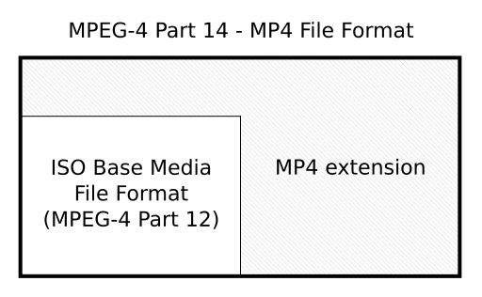
MP4 File

Slide 15
MP4 File
In MP4, all data are store in box, also named “atom” in QuickTime, means that MP4 composed of several box. each box has a type and length, box can be understood as a data object blocks. box can contain another box, this box called a container box. At first, a MP4 file will contain only one type of box called “ftyp” as a symbol MP4 format and contains some information about the file. Then there will be only one box type called “moov”, which is a container box contains the metadata information media. The media data in MP4 is contained in a box type called “mdat” (media data box), this is also a container box. It can be many, and also can be none when all the data reference from other media file.

Slide 16
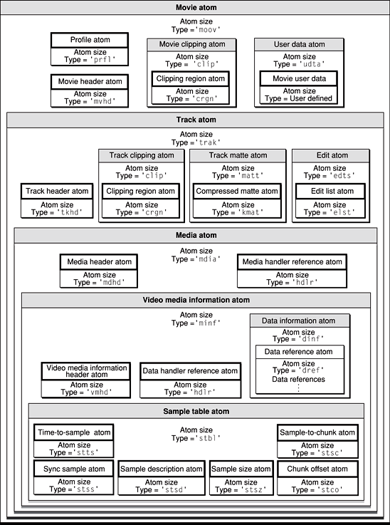

Slide 17
3GP File
3GP is not that popular nowadays maybe because the cost of storage capacity becomes much cheaper. But in 10 years ago, 3GP format video plays a very important role in mobile device. In that time, mobile phone and most MP4 players only have 256MB to 1GB storage capacity, if we used MP4 format to store movie on those devices, we may only store one or two movie, because generally a MP4 format movie will use 400MB or more. But if we used 3GP, it only takes about 150MB to store a movie, greatly improve the storage capacity.
3GP (3GPP file format) is a multimedia container format defined by the Third Generation Partnership Project (3GPP) for 3G UMTS multimedia services. It is used on 3G mobile phones but can also be played on some 2G and 4G phones.

Slide 18
3GP File
The 3GP file format stores video streams as MPEG-4 Part 2 or H.263 or MPEG-4 Part 10 (AVC/H.264), and audio streams as AMR-NB, AMR-WB, AMR-WB+, AAC-LC, HE-AAC v1 or Enhanced aacPlus (HE-AAC v2). 3GPP allowed use of AMR and H.263 codecs in the ISO base media file format (MPEG-4 Part 12), because 3GPP specified the usage of the Sample Entry and template fields in the ISO base media file format as well as defining new boxes to which codecs refer.
The MP4 and the AVC file format specifications described usage of MPEG-4 content in the ISO base media file format. International Organization for Standardization (2008). ISO/IEC 14496-12:2008, Information technology -- Coding of audio-visual objects -- Part 12: ISO base media file format (PDF). International Organization for Standardization. p. 95. Retrieved 2009-05-30.
Registered types - Codecs. Registration authority for code-points in "MP4 Family" files - mp4ra.org. 2008. Archived from the original on 19 April 2009. Retrieved 2009-05-31.

Slide 19
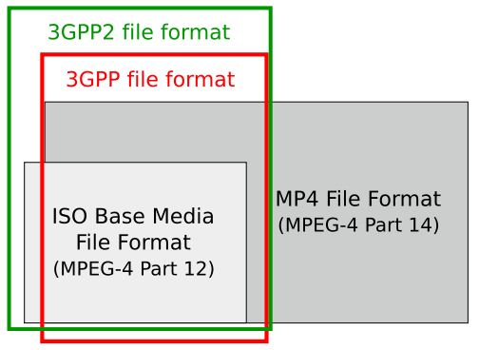
Figure 1: Relations between ISO Base Media File Format, MP4 File Format, 3GPP file format and 3GPP2 file format.

Slide 20
What Is QuickTime?
QuickTime is Apple’s multiplatform, multimedia technology for handling video, sound, animation, graphics, text, interactivity, and music. As a cross-platform technology,
QuickTime can deliver content on Mac OS and Windows computers. Many applications, including Final Cut Pro, use the powerful architecture of QuickTime to view, create, import, and export media.

Slide 21
What Is QuickTime?
QuickTime supports most major video, audio, and graphics file formats. It works with local disk-based media, media accessed over a network, and streams of real-time data.
QuickTime supports a wide variety of video and audio codecs and can be extended with third-party codecs.

Slide 22
A movie file format
Using an application like QuickTime Player Pro or Final Cut Pro, you can import, edit, and export every file format that QuickTime supports. This allows you to create movies for the web, for DVD, or for output to videotape. You can also create movies including video, audio, text, still images, and interactive layers.
There are various resources for learning more about QuickTime technology and architecture.

Slide 23
References 1/2
Microsoft Corporation (1998) WAVE and AVI Codec Registies – RFC 2361
2. "Determining the Shape of Pixels and Frames".
3. MPEG. "MPEG standards – Full list of standards developed or under development". Chiariglione. Retrieved 2010-02-09.
4. ISO/IEC JTC 1/SC 29 (2009-11-09). "Programme of Work – MPEG-4 (Coding of audio-visual objects)". Retrieved 2009-11-10.
5. http://ipod.about.com/od/introductiontoitunes/a/sound_qual_test.htm
6. http://en.wikipedia.org/wiki/MPEG-4_Part_14

Slide 24
References 2/2
https://developer.apple.com/library/mac/documentation/QuickTime/qtff/QTFFChap2/qtff2.html
International Organization for Standardization (2008). ISO/IEC 14496-12:2008, Information technology -- Coding of audio-visual objects -- Part 12: ISO base media file format (PDF). International Organization for Standardization. p. 95. Retrieved 2009-05-30.
Registered types - Codecs. Registration authority for code-points in "MP4 Family" files - mp4ra.org. 2008. Archived from the original on 19 April 2009. Retrieved 2009-05-31.
http://en.wikipedia.org/wiki/3GP_and_3G2

