Slide 1
Wardriving
Kevin T. Duraj
Weijian Ji
Shu-wei Lin
Yuanye Zeng

Slide 2
Introduction
The process to used the wardriving technique are uses a wireless device such as a laptop with complete with hardware, tools and software, a user drives around an area, often after mapping a route out first, to determine all of the wireless access points in that area.
Once these access points are discovered, a user uses a software program e.g. Airsnort, Kismet, and Netstumbler, to map the results of their efforts. Based on these results, a statistical analysis is performed. This statistical analysis can be of one drive, one area, or a general overview of all wireless networks.
Some people will get map out different wireless networks which the find.

Slide 3
Windows Wardriving Tools
Netstumbler is the most popular program for Windows and Lucent/Orinoco and other Hermes-based chipset wireless cards. (http://www.netstumbler.org)
Airsnort is Linux program that breaks WEP encryption with Prism2 based
chipset. (http://airsnort.shmoo.com/)
Kismet is an 802.11b wireless network sniffer, which is different from a standard network sniffer (such as Etheral or tcpdump), since it separates and identifies different wireless network in the area.
http://kismetwireless.net/code/

Slide 4
Mac/Linux Wardriving Tools
KisMAC is an open-source and free sniffer/scanner application for Mac OS X. It has an advantage over MacStumbler / iStumbler / NetStumbler in that it uses monitor mode and passive scanning. KisMAC supports many third party USB devices: Intersil Prism2, Ralink rt2570, rt73, and Realtek rtl8187 chipsets. All of the internal AirPort hardware is supported for scanning.
http://www.kismac-ng.org/
Aircrack-ng is an 802.11 WEP and WPA-PSK keys cracking program that can recover keys once enough data packets have been captured. It implements the standard FMS attack along with some optimizations like KoreK attacks, as well as the all-new PTW attack, thus making the attack much faster compared to other WEP cracking tools. In fact, Aircrack-ng is a set of tools for auditing wireless networks.
http://www.aircrack-ng.org

Slide 5
Airsnort
Airsnort is a wireless LAN tool that recovers encryption keys on 802.11b WEP network.
Airsnort operates by passively monitoring transmissions, computing the encryption key when enough packets (about 5 to 10 million) have been gathered.
For users looking to break into wireless network, they can choose this software.
Airsnort run under Linux and requires that the wireless card be capable of rf monitor code.

Slide 6
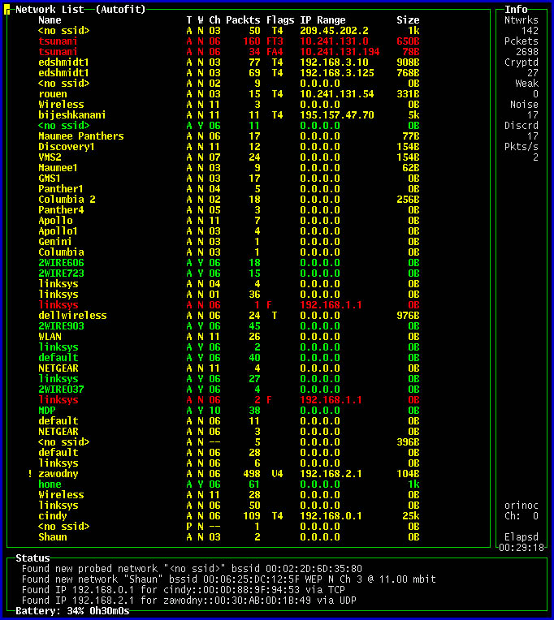

Slide 7
Netstumbler
Netstumbler is one the wireless security tools which used for 802.1 lb network scanning and also is a Window Utility for AP mapping.
It does not sniff the TCPIIP protocol; rather it provides an easy method for numerating wireless networks.
Netstumbler transmit connection request to all the listening access point with SSID. The AP responds by sending their own SSID and it can tell the user whether the WLAN has the built-in WEP security protocol turned off or on.
From that, Netstumbler is not a passive snifer, which is means that the traffic handled by it is visible on the victim‘s network. The most difficult part using Netstumbler is locating wireless networks.
The main difference between Kismet and Netstumbler is that Netstumbler runs on Windows and is extremely easy to use.

Slide 8
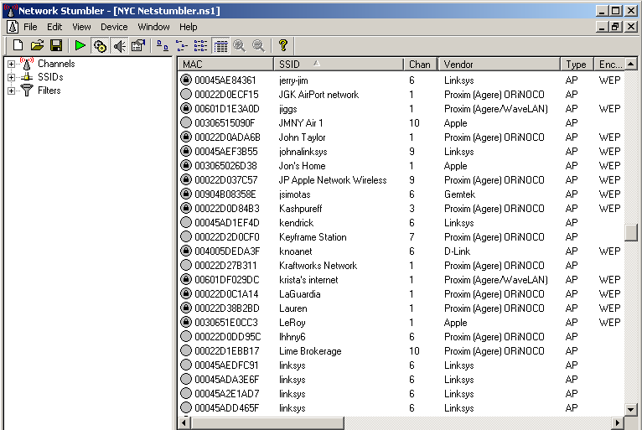

Slide 9
Kismet
Kismet is a wireless network sniffer, detector and intrusion detection system. Kismet is different from other wireless network detectors.
Kismet works by quering the firmware of the card to see what networks are in the area that will let the card join them.
Kismet collects the entire packet in the air at any given time and dissects them to identify each network.
Kismet also detects networks with hidden SSID and works with every wireless card that supports raw packet monitoring mode (rfmon) in Linux and a “decent selection” of cards on other operating systems, such as OpenBSD and Mac OSX.
If a GPS is available, Kismet can log the coordinates of every packet seen. It comes with a utility called "gpsmap" to plot the data graphically on downloaded maps

Slide 10
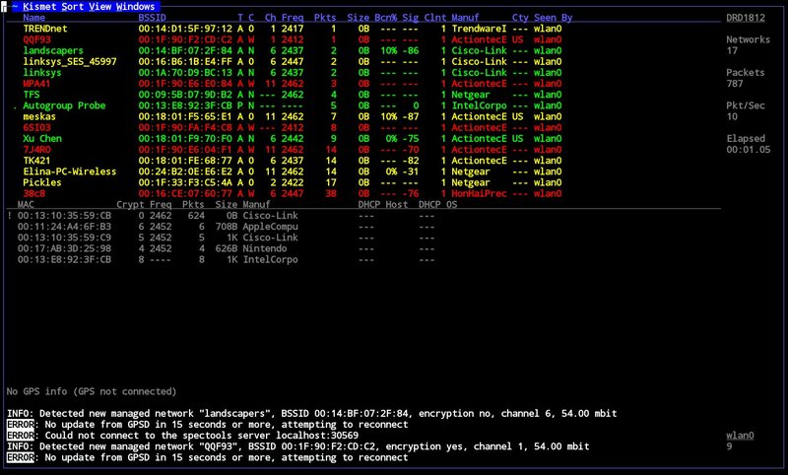

Slide 11
Comparison of Wardriving Tools
Airsnort uses sniff and analyze packets, and it can run under Linux and Windows.
Netstumbler queries the log files in Windows, which is the easiest one for using, but it can run only under Windows.
Kismet also sniffs the network, which detects firmware in the network area and do some intruction detection. This software can run under Mac OS and Linux.
------Choose one you prefer.

Slide 12
KisMac Overview
KisMAC is user friendly wireless network discovery tool for Mac OS X computers. It has a wide range of features, similar to those of Kismet (its Linux/BSD namesake).
The program is geared toward network security professionals, and is not as novice-friendly as similar applications.

Slide 13
Kismet
Kismet is a wireless network sniffer, detector and intrusion detection system. Kismet is different from other wireless network detectors.
Kismet works by quering the firmware of the card to see what networks are in the area that will let the card join them.
Kismet collects the entire packet in the air at any given time and dissects them to identify each network.
Kismet also detects networks with hidden SSID and works with every wireless card that supports raw packet monitoring mode (rfmon) in Linux and a “decent selection” of cards on other operating systems, such as OpenBSD and Mac OSX.
If a GPS is available, Kismet can log the coordinates of every packet seen. It comes with a utility called "gpsmap" to plot the data graphically on downloaded maps

Slide 14
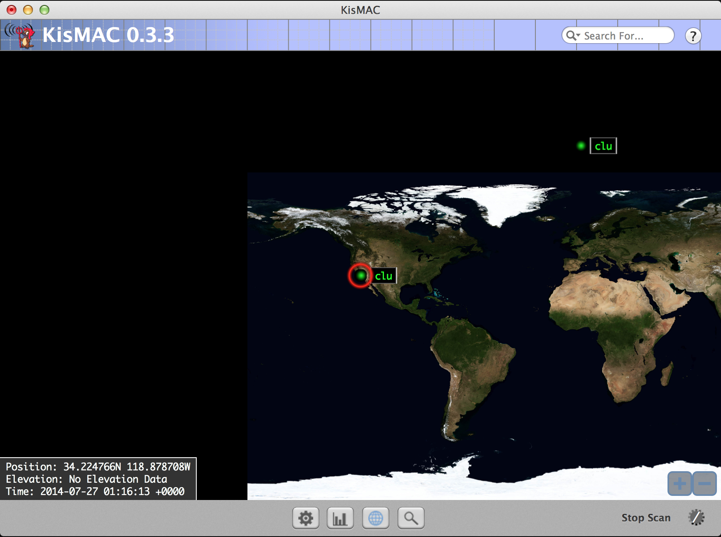

Slide 15
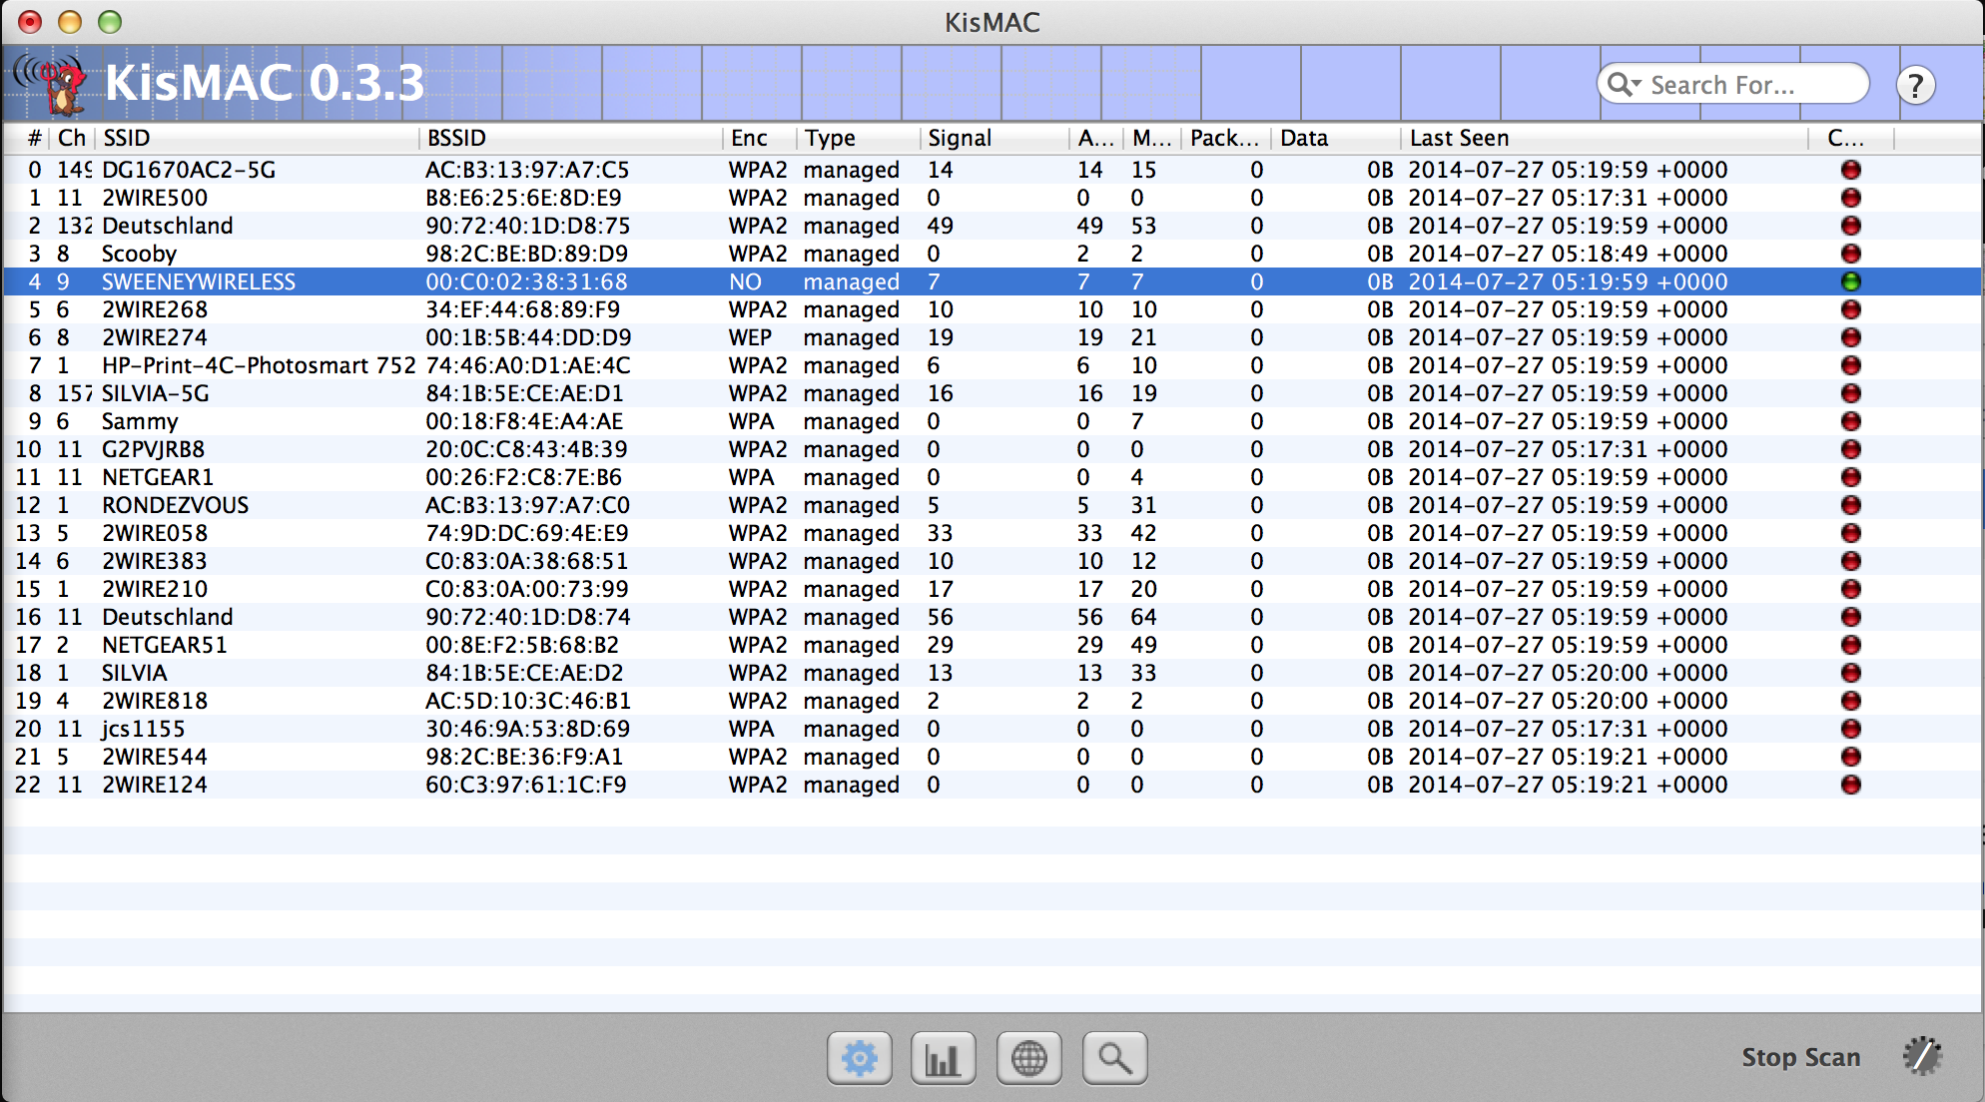
KisMac in Action

Slide 16
5D Wifi
5D Wifi is an application that scan for wifi around to let you do wardrive or crack.

Slide 17
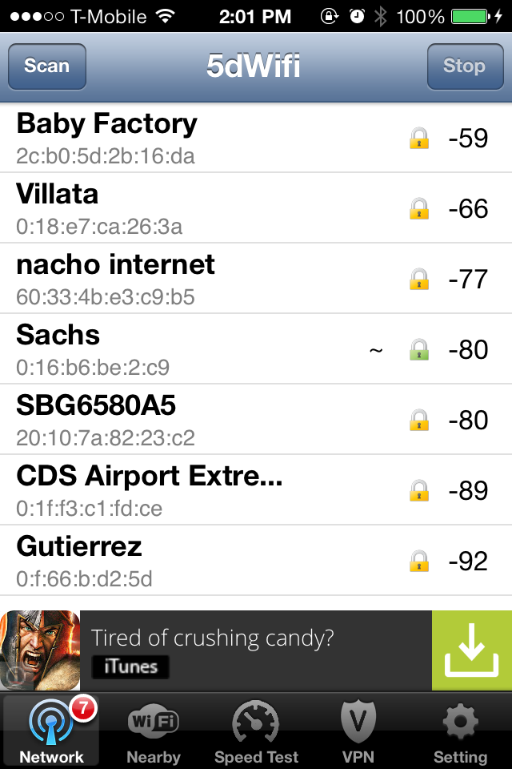
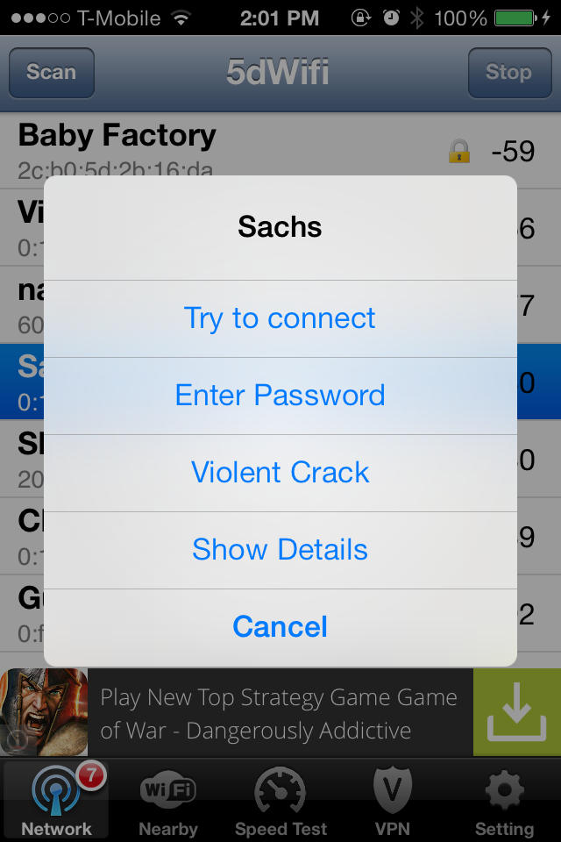

Slide 18
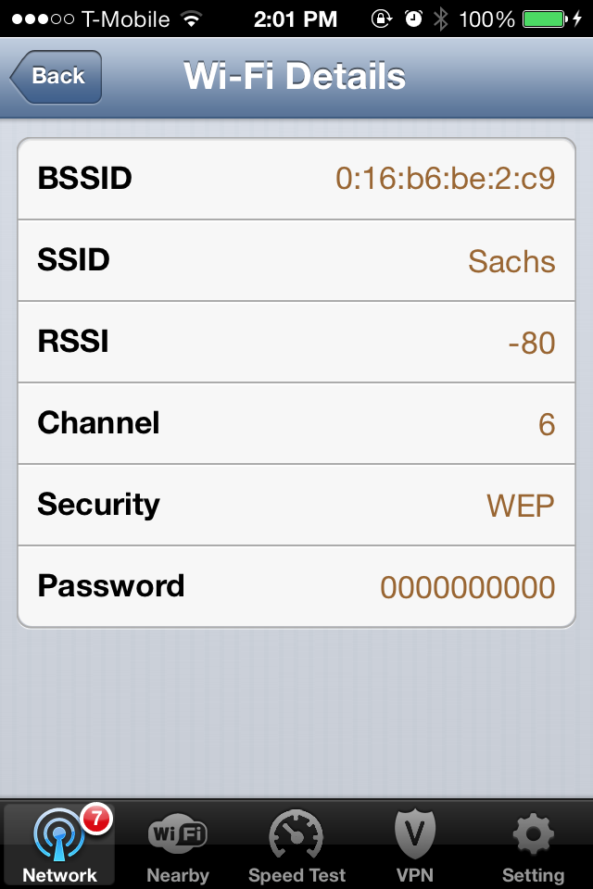
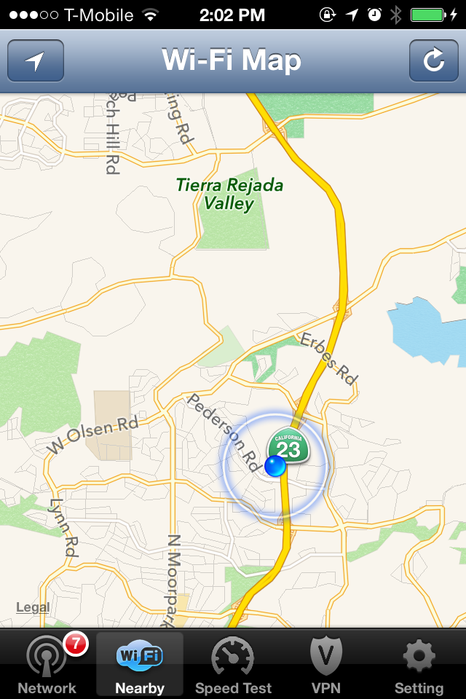

Slide 19
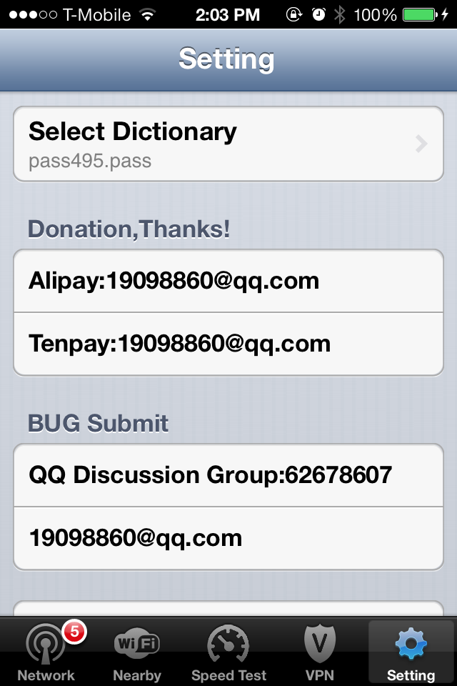
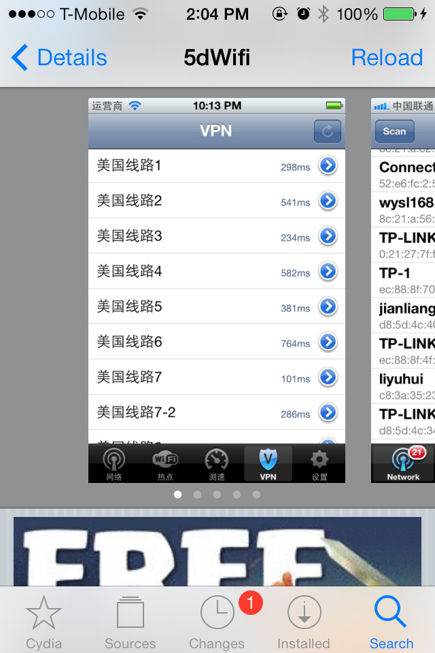

Slide 20
Reference
Tsui, Arvin Wen Tsui, et al. "Accuracy performance analysis between war driving and war walking in metropolitan Wi-Fi localization." Mobile Computing, IEEE Transactions on 9.11 (2010): 1551-1562.
Issac, Biju, and Lawan A. Mohammed. "War driving and WLAN security issues—attacks, security design and remedies." Information Systems Management24.4 (2007): 289-298.
Said, Huwida, et al. “Forensics and war-driving on unsecured wireless network.”Internet Technology and Secured Transactions (ICITST), 2011 International Conference for. IEEE, 2011.
http://en.wikipedia.org/wiki/KisMAC

