Slide 1
Creative technology Camera Face Detection California Lutheran university Summer 2014
By: Kevin T. Duraj

Slide 2
What is face detection
Face detection is a computer technology that determines the location and size of human faces in digital images or streaming videos.
It detects face ad ignores anything else, such as building, tree, bodies or any other objects .

Slide 3
introduction
In the recent years, face recognition has attracted much attention and its research has rapidly expanded by not only engineers but also neuroscientists, since it has many potential application in computer vision, communication and automatic access control systems.
Feature of face detection uses:
Eyes
Mouth
Ears
Nose

Slide 4
Open source for Face detection
Because of complexity of face detection algorithms engineers and scientists working together using open source freely available and free redistributable source code that people around the world can freely improve and update.
OpenCV – started by Intel in 1999
OpenBR – Biometric Recognition build on OpenCV
Libface – Face Recognition Library
Facedetect – Free face detection software
Mac Development Library – can analyze and find human faces in an image.

Slide 5
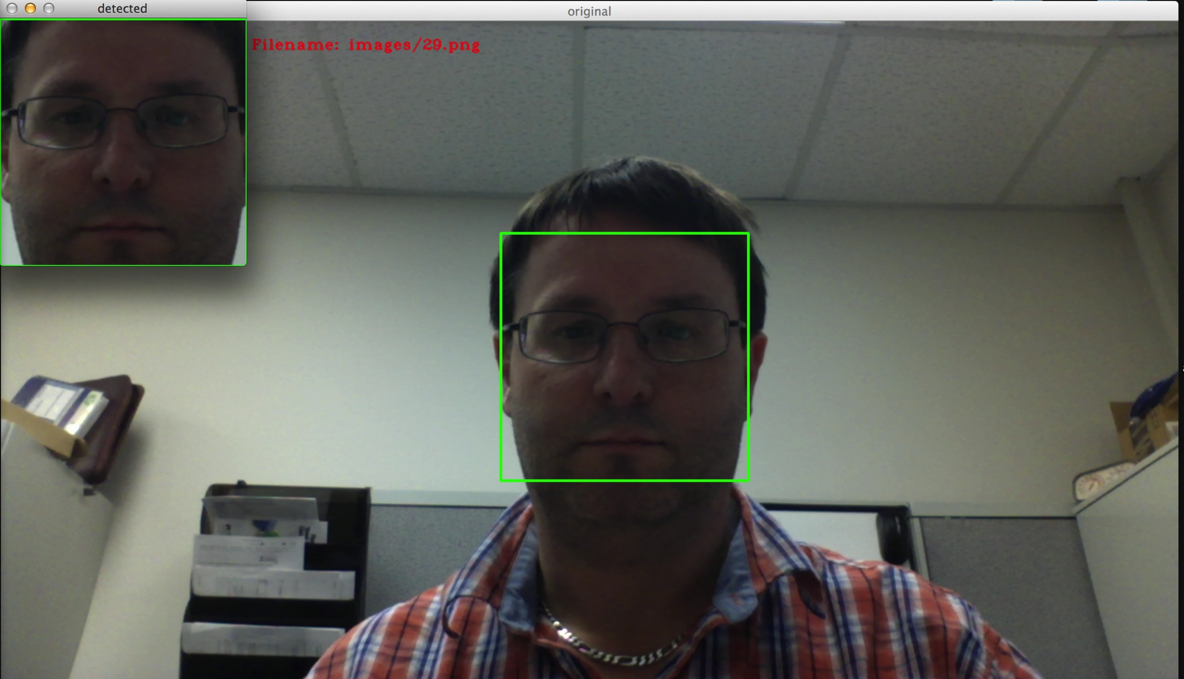
Face detection using IVS

