Slide 1
Creative technology Camera Face Detection California Lutheran university Summer 2014
By: Kevin T. Duraj

Slide 2
What is face detection
Face detection is a computer technology that determines the location and size of human faces in digital images or streaming videos.
It detects face ad ignores anything else, such as building, tree, bodies or any other objects .

Slide 3
introduction
In the recent years, face recognition has attracted much attention and its research has rapidly expanded by not only engineers but also neuroscientists, since it has many potential application in computer vision, communication and automatic access control systems.
Feature of face detection uses:
Eyes
Mouth
Ears
Nose

Slide 4
Open source for Face detection
Because of complexity of face detection algorithms engineers and scientists working together using open source freely available and free redistributable source code that people around the world can freely improve and update.
OpenCV – started by Intel in 1999
OpenBR – Biometric Recognition build on OpenCV
Libface – Face Recognition Library
Facedetect – Free face detection software
Mac Development Library – can analyze and find human faces in an image.

Slide 5
Introducing Opencv
OpenCV ( Open Computer Vision ) is a library of programming functions mainly aimed at real-time computer vision developed by Intel Russia research center in Nizhny Novgorod.
Officially launched in 1999, the OpenCV project was initially and Intel Research initiative to advance CPU-intensive applications.
The first alpha version of OpenCV was released in the public at the IEEE Conference on Computer Vision and Pattern Recognition in 2000.
The second major release of the OpenCV was on Obtober 2009.
OpenCV2 includes major changes to the C++ interface, aiming towards easier and safer patterns.
In August 2012, support for OpenCV was taken by non-profit foundation, OpenCV.org

Slide 6
OpenCV application Usage
Facial recognition system
Egomotion - defined as 3D motion of a camera
Gesture recognition - interpreting human gestures
Mobile Robots – automatic machine capable of locomotion
Object Identification – recognize different type of objects
Motion / Video tracking - process of locating a moving object
Statistical machine learning - artificial intelligence
Notes:
A facial recognition system: is a computer application for automatically identifying or verifying a person from a digital image or a video frame from a video source. One of the ways to do this is by comparing selected facial features from the image and a facial database. It is typically used in security systems and can be compared to other biometrics such as fingerprint or eye iris recognition systems.
Egomotion: is defined as the 3D motion of a camera within and environment. In the field of computer vision, egomotion refers to estimating a camera’s motion relative to a rigid scene. For example of egomotion would be estimating a car’s moving position relative to lines on the road or street signs being observed from the car itself.
Gesture recognition: is a topic in computer science and language technology with the goal of interpreting human gestures via mathematical algorithms. Gestures can originate from any bodily motion or state but commonly originate from the face or hand. Current focuses in the field include emotion recognition from the face and hand gesture recognition.
A mobile robot is an automatic machine that is capable of locomotion. A spying robot is an example of a mobile robot capable of movement in a given environment. Mobile robots have the capability to move around in their environment and are not fixed to one physical location. By contrast, industrial robots are usually more-or-less stationary, consisting of a jointed arm (multi-linked manipulator) and gripper assembly (or end effector), attached to a fixed surface.
Object recognition enables programs to recognize different type of object within an image or streaming video.
Motion / Video tracking is the process of locating a moving object (or multiple objects) over time using a camera. It has a variety of uses, some of which are: human-computer interaction, security and surveillance, video communication and compression, augmented reality, traffic control, medical imaging[1] and video editing.[2][3] Video tracking can be a time consuming process due to the amount of data that is contained in video. Adding further to the complexity is the possible need to use object recognition techniques for tracking, a challenging problem in its own right.
Statistical machine learning is a subfield of computer science (CS) and artificial intelligence (AI) that deals with the construction and study of systems that can learn from data, rather than follow only explicitly programmed instructions. Besides CS and AI, it has strong ties to statistics and optimization, which deliver both methods and theory to the field. Machine learning is employed in a range of computing tasks where designing and programming explicit rule-based algorithms is infeasible for a variety of reasons. Example applications include spam filtering, optical character recognition (OCR), search engines and computer vision. Machine learning is sometimes conflated with, and sometimes distinguished from data mining and pattern recognition.

Slide 7
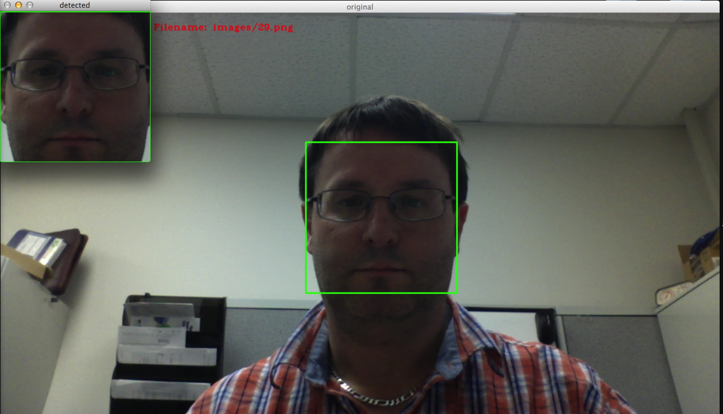
Facial recognition system

Slide 8
references
OpenCV – www.opencv.org
OpenCV – Wikipedia, en.wikipedia.org/wiki/OpenCV
Open Biometrics – www.openbiometrics.org
Libface – libeface.sourceforge.net

