Slide 1
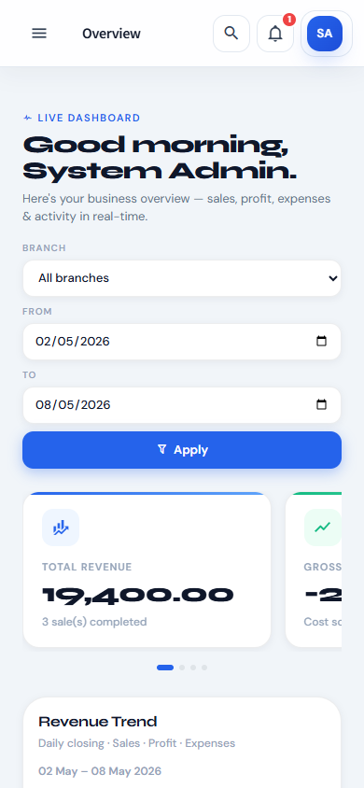
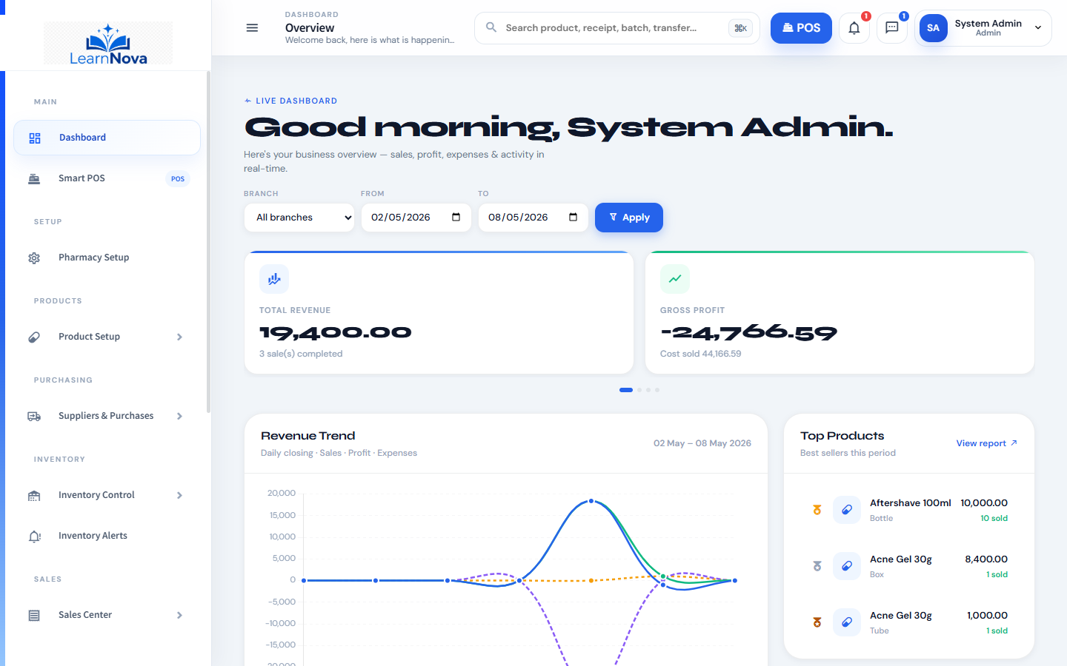
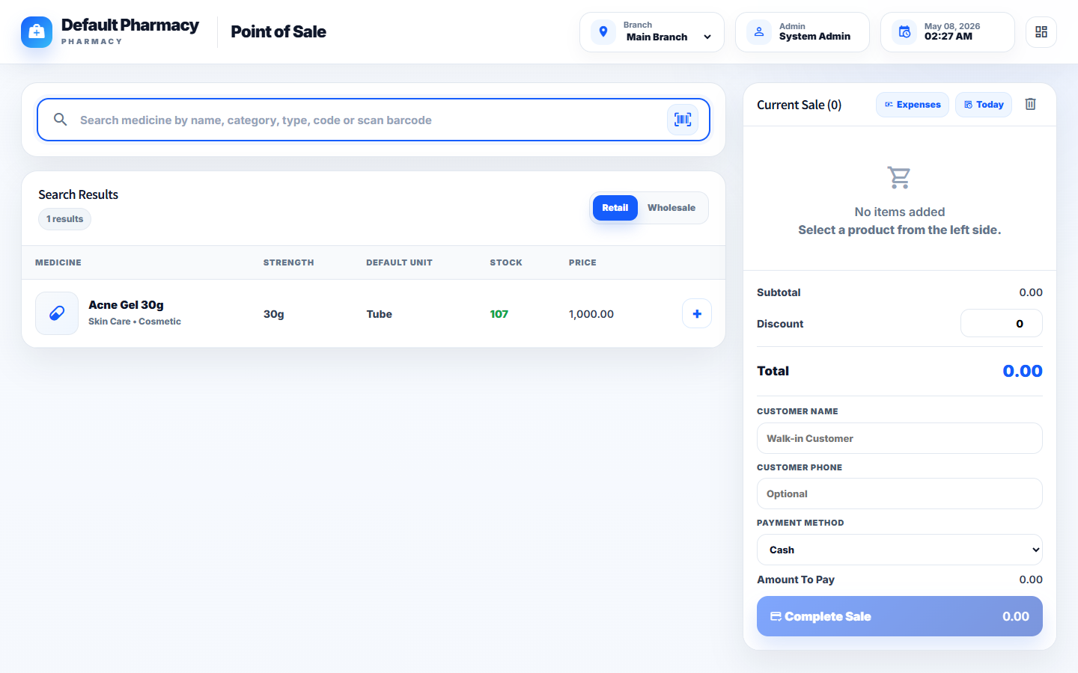
EXECUTIVE PRESENTATION
Smart Pharmacy
Faster sales, safer stock, and stronger owner visibility.
CORE
CONTROL
POS + Stock
Approvals
Proposal deck | May 2026

Slide 2
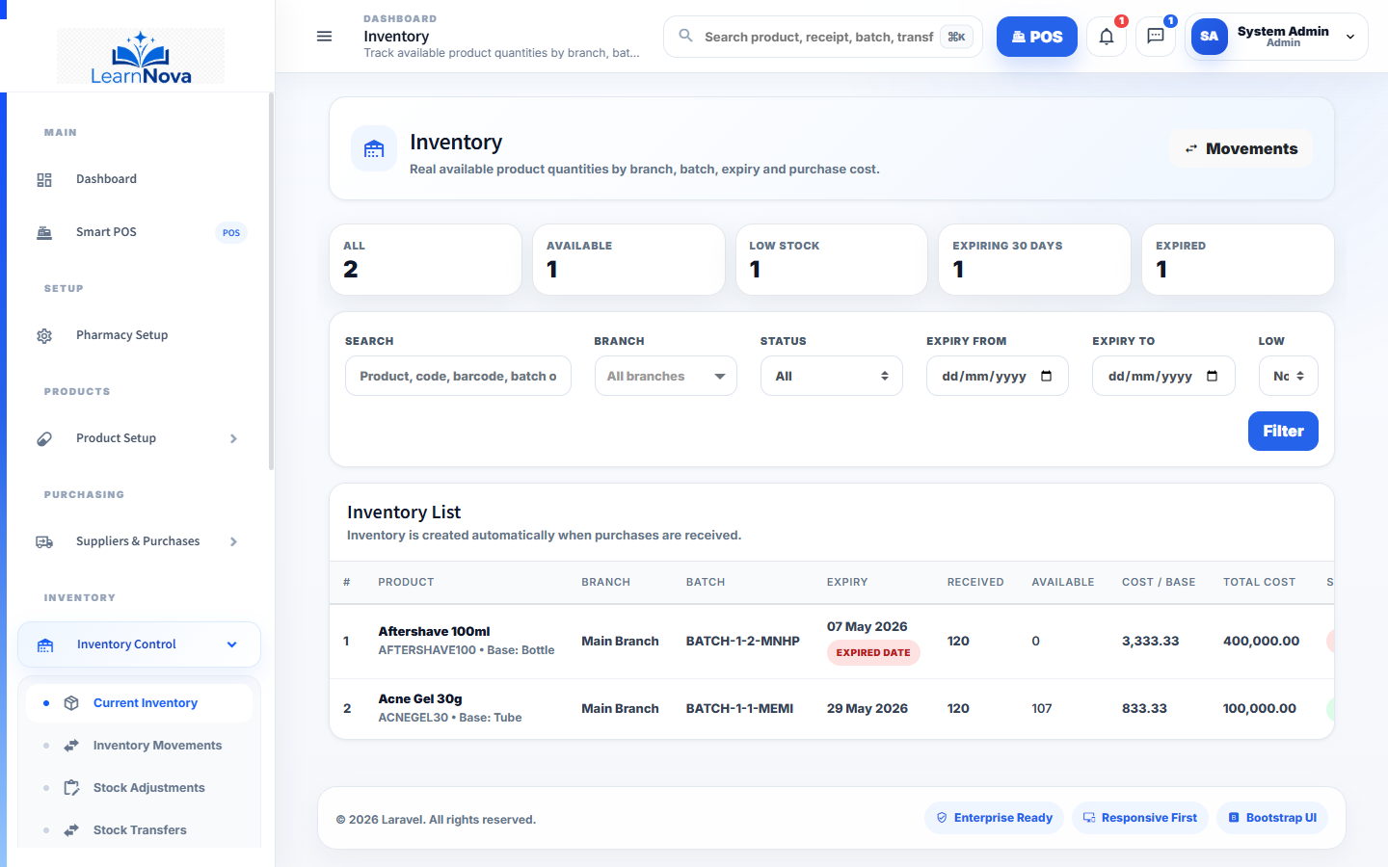
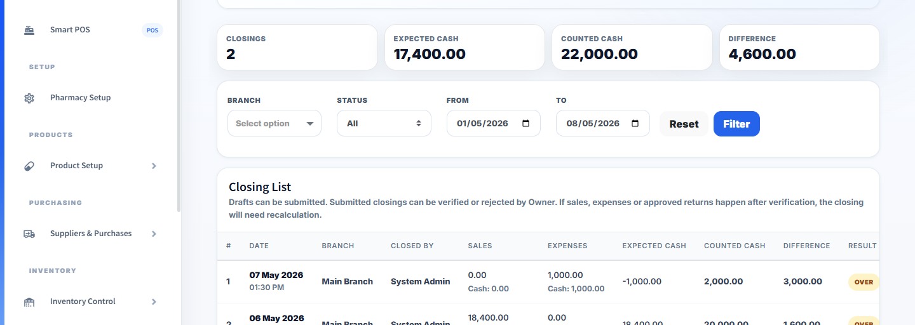
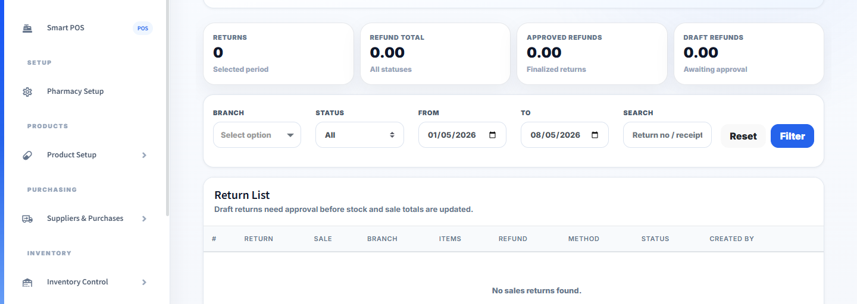
PROBLEM DESCRIPTION
Pharmacies move fast, but control often moves slowly.
When POS, stock, expiry, returns, cash, and branch decisions are separated, the owner loses the full operating picture.
Stock can look available even when it is expired, damaged, or sold.
Cash closing becomes difficult when expenses and refunds sit elsewhere.
Approvals are delayed when sensitive actions depend on informal messages.
Managers see the problem late, after losses or shortages have already happened.
Smart Pharmacy | POS + Inventory + Finance + Alerts + Reports

Slide 3
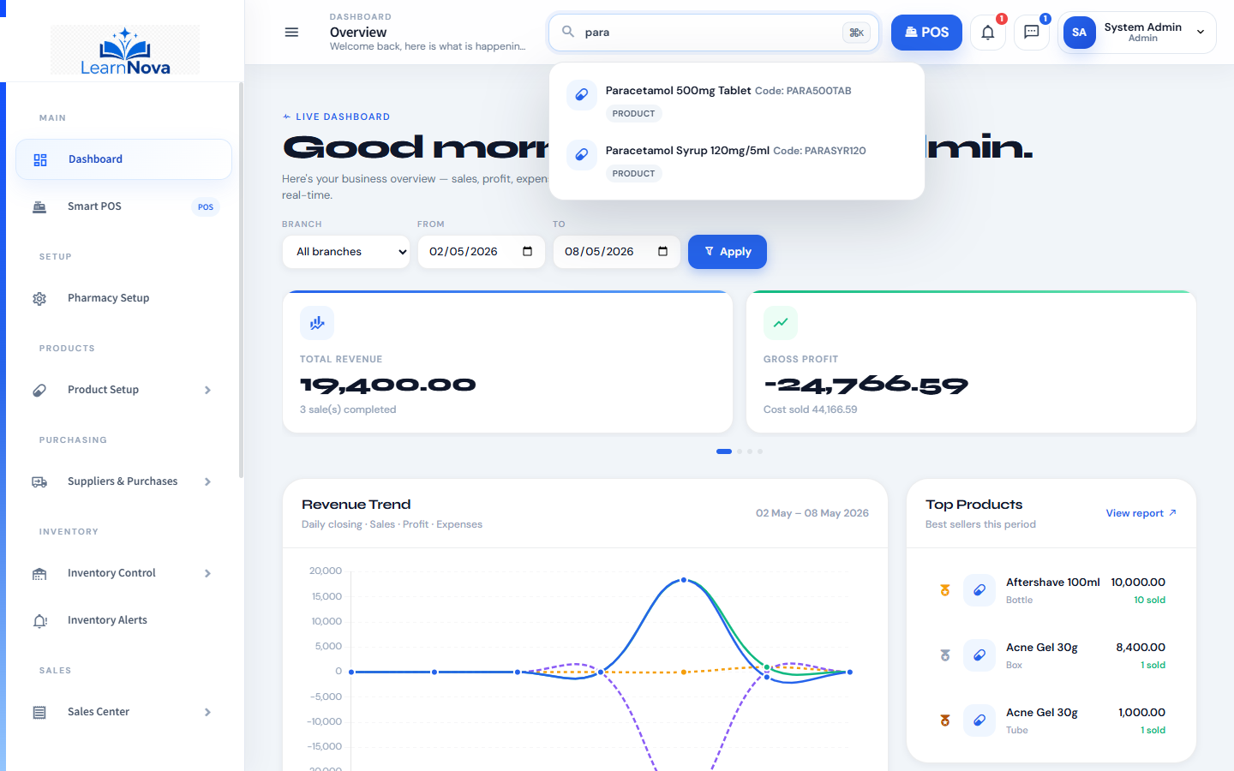
DISCOVERY
The system is needed where every movement touches another record.
A sale touches stock. A return touches revenue and batch quantity. An expense touches closing. A transfer touches two branches.
MOVEMENT
PERMISSION
Discovery outcome: the pharmacy does not need another isolated screen. It needs one connected operating layer.
Recorded once
Controlled action
REPORT
AUDIT
Visible outcome
Traceable user

Slide 4
SOLUTION
Smart Pharmacy brings the operating layer into one responsive system.
The same platform connects products, suppliers, purchases, batches, sales, returns, expenses, closing, reports, alerts, and audit logs.
One role-based shell for all daily modules.
Inventory updates from real business movements.
Topbar alerts and system messages keep action visible.
Reports and dashboards turn records into owner decisions.
Smart Pharmacy | POS + Inventory + Finance + Alerts + Reports

Slide 5
FAST SALES
The POS is designed for speed without losing control.
Search, select, discount, payment, customer details, receipt, and today sales stay in one work surface.
Search medicine by name, category, type, code, or barcode.
Retail and wholesale modes support different selling contexts.
Inventory decreases immediately after sale completion.
Cashier can record POS expenses without leaving the sales flow.
Smart Pharmacy | POS + Inventory + Finance + Alerts + Reports

Slide 6
STOCK INTELLIGENCE
Inventory is tracked by branch, product, batch, expiry, quantity, cost, and status.
That structure protects the business from silent stock loss and protects customers from expired products.
Batch and expiry records make risk visible.
Low stock and expiring items become action points.
Movements show before and after balances.
Automatic expiry write-off can remove unsafe stock from sale.
Smart Pharmacy | POS + Inventory + Finance + Alerts + Reports

Slide 7
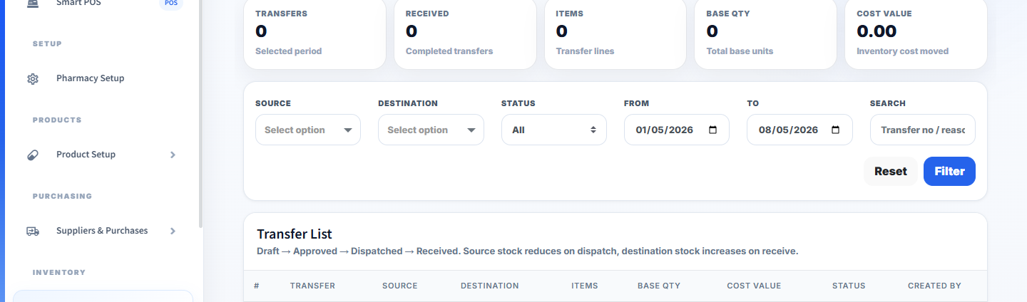
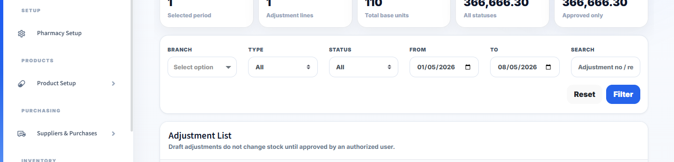
CONTROLLED APPROVALS
Sensitive stock and finance actions are separated from normal entry.
Users can create requests, while trusted roles approve, reject, verify, dispatch, receive, or recalculate.
Sales returns require review before stock and finance are affected.
Stock adjustments protect against unapproved shrinkage or found stock changes.
Transfers separate request, approval, dispatch, and receiving.
Daily closing verification keeps cash accountability clean.
Smart Pharmacy | POS + Inventory + Finance + Alerts + Reports

Slide 8
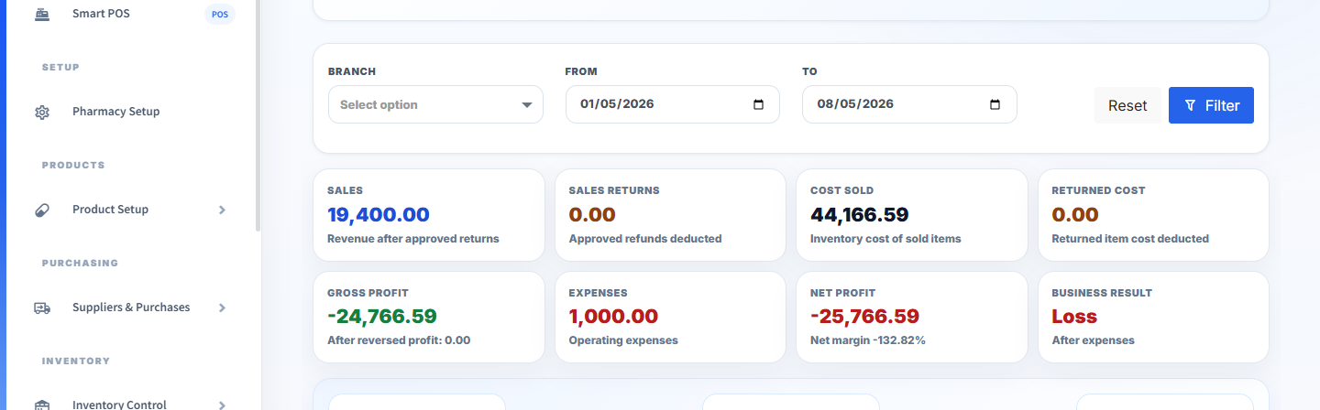
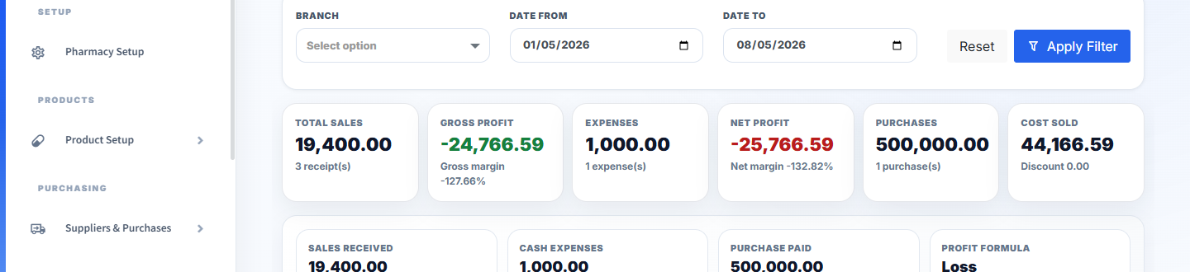
OWNER VISIBILITY
The owner can see performance, risk, and exceptions without waiting for manual summaries.
Dashboards and reports convert daily transactions into sales, stock, profit, expense, and accountability evidence.
Revenue, gross profit, net profit, and cost sold are visible together.
Top products and trends support restocking and pricing decisions.
Report center centralizes sales, stock, purchase, profit, expense, and prescription reporting.
Activity logs preserve who did what and when.
Smart Pharmacy | POS + Inventory + Finance + Alerts + Reports

Slide 9
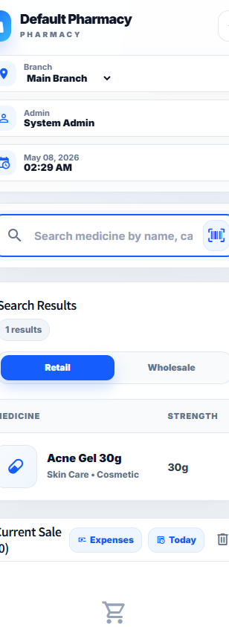
RESPONSIVE ONLINE ACCESS
One system, from counter screen to phone screen.
Smart Pharmacy is web-based and responsive, so managers and authorized users can monitor operations across desktop, tablet, and mobile views.
No separate desktop-only reporting habit.
Mobile dashboards keep owner visibility alive away from the branch.
Counter POS and smaller operational views share the same data source.
Responsive first: one login, one data source, multiple screen sizes.

Slide 10
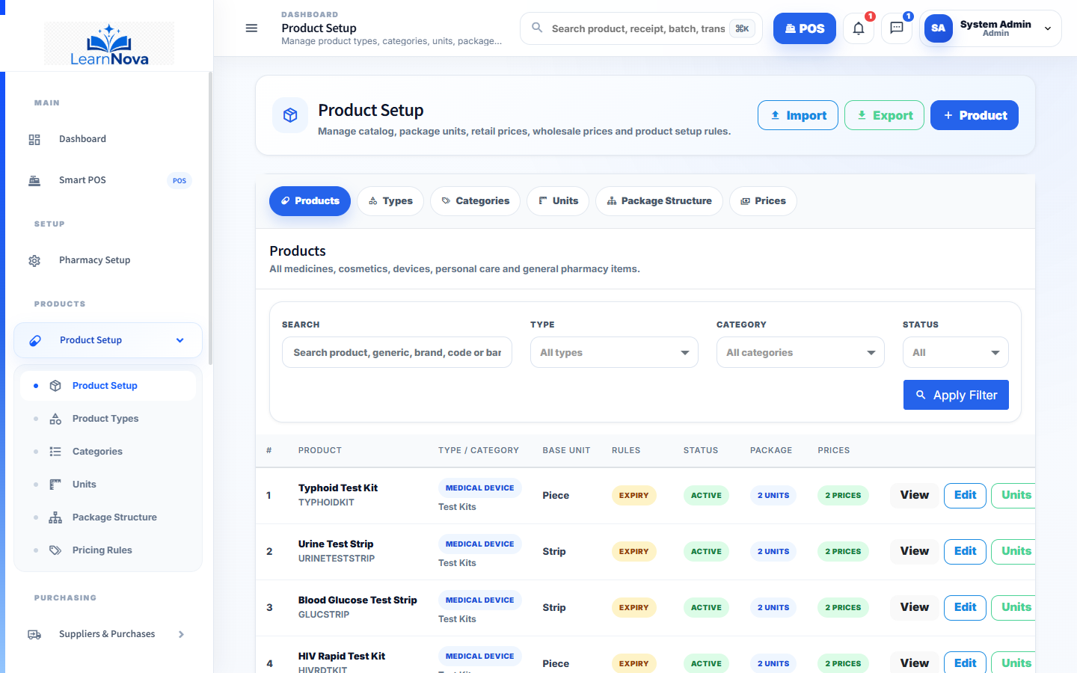
WHY THIS SYSTEM
It is advised because it controls the full pharmacy workflow, not only the receipt.
Ordinary POS
Smart Pharmacy
Sales screen only
Sales + inventory + finance + reports
Manual expiry checking
Expiry alerts and write-off readiness
Informal approvals
Permission-based approval workflow
Computer-bound view
Responsive online access
Hard to extend
AI and communication-ready roadmap
Decision read: choose the system that connects daily speed with management control.

Slide 11
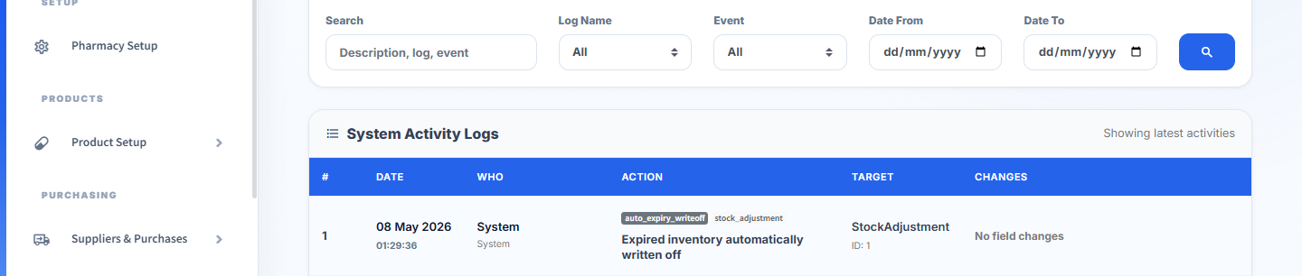
FUTURE IMPROVEMENT
AI and communication make the system proactive.
The next layer can turn system events into the right message, sent to the right person, through the right channel.
AI assistant for stock risk, report summaries, product lookup, and management questions.
Internal communication for approvals, tasks, branch notes, and issue follow-up.
SMS, email, and WhatsApp for alerts, receipts, customer reminders, and owner summaries.
Permission-aware AI so assistance never bypasses system access rules.
Smart Pharmacy | POS + Inventory + Finance + Alerts + Reports

Slide 12
RECOMMENDATION
Move forward with Smart Pharmacy as the operating foundation.
Start with the MVP core, then expand into AI, internal communication, SMS, email, WhatsApp, integrations, and owner mobile workflows.
PHASE 1
Setup + Product + Users
PHASE 2
POS + Purchases + Inventory
PHASE 3
Approvals + Alerts + Reports
PHASE 4
AI + Communication + Integrations
Best MVP value: accurate stock, fast sales, controlled approvals, expiry safety, owner visibility, and branch accountability.

