Slide 1
Portfolio Building
SQLlite vs MySQL

Slide 2
Table of Contents
What is Database Management System
SQLite & MySQL
When SQLite
When MySQL

Slide 3
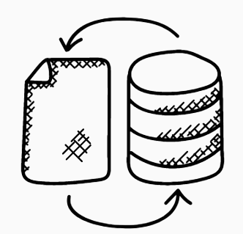
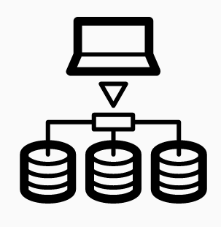


What is Database Managament System (DBMS)
Notes:
A DBMS is a software that interacts with a database. It is easy way to make several operations over the databases it manages. A few of these operations are:
Managing the access of a database
Running SQL queries
Writing data into the database
Updating database
Deleting data from the database
In most cases, database and DBMS are used interchangeably. However, a database is a collection of stored data while a DBMS is the software used to access the database.

Slide 4
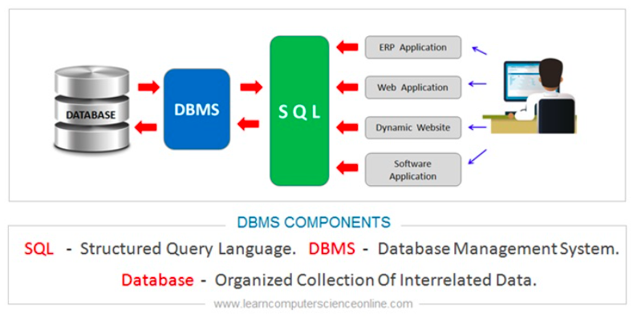
Database Managament Systems
Notes:
This shows us the workflow of database management systems. When the user run a query with SQL, DBMS manages the process, connect to the database and execute the querries immediately then return it to the user.
Or there is a UI on your web-site, when you click one of buttons, it runs a querry an same process is repeated,then your information is brought to you.

Slide 5
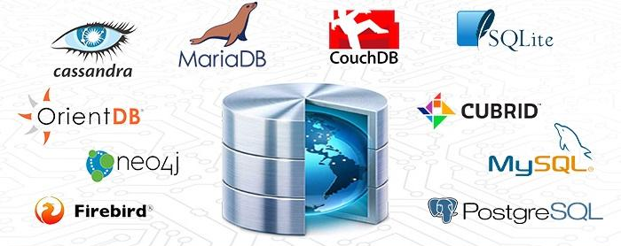

What is Database Managament System
Notes:
Every DBMS has an underlying model which decides the structure of the database and how the data can be retrieved. A relational DBMS uses the relational data model. Here data is organized in the form of tables. Each table has a set of attributes or columns, and each row also referred to as tuples have a relation. Hence, the structuring is referred to as RDBMS. There are a lot of database management systems in the field.

Slide 6


SQLite and MySQL
Architectural Difference
Storage and Portability
Multiple Access and Scalability
Security and Ease of Setup
&
Notes:
We are focus on two of them SQLite and MySQL. In addition, we’ll talk about their differencies. After talking on them, We’ll write a basic app with SQLite and run our local.
SQLite and MySQL are open source RDBMS. However, there are big differencies between each other
As Architectural Difference
SQLite is a server-less and self-contained database. This is also referred to as an embedded database which means the DB engine runs as a part of the app. On the other hand, MySQL requires a server to run. MySQL will require a client and server architecture to interact over a network.
Storage and Portability – SQLite vs MySQL
The SQLite directly stores info in a single file, making it easy to copy. No configurations are required, and the process can be done using minimal support.
Nevertheless, before copying or exporting MySQL you need to condense it into a single file. For larger databases, this will be a time-consuming activity.
Multiple Access and Scalability – SQLite vs MySQL
SQLite does not have any specific user management functionality and hence is not suitable for multiple user access. MySQL has a well-constructed user management system which can handle multiple users and grant various levels of permission.
SQLite is suitable for smaller databases. As the database grows the memory requirement also gets larger while using SQLite. Performance optimization is harder when using SQLite. This has a few write constraints.
On the contrary, MySQL is easily scalable and can handle a bigger database with less effort.
Security and Ease of Setup – SQLite vs MySQL
SQLite does not have an inbuilt authentication mechanism. The database files can be accessed by anyone. However, MySQL comes with a lot of inbuilt security features. This includes authentication with a username, password, and SSH.
SQLite does not require too many configurations and is easy to set up. MySQL requires more configurations as compared to SQLite. MySQL also has more setup guides available.

Slide 7
When SQLite
Small apps
Smaller projects
Read and write directly from the disk
Basic development and testing
Notes:
There are certain times when SQLite can be more effective than the alternative. Some of these scenarios are:
1. Developing small standalone apps
2. Smaller projects which do not require much scalability
3. When you have a requirement to read and write directly from the disk
4. Basic development and testing

Slide 8
When MySQL
Multiple user
Strong security and authentication features
With distributed systems
With apps requiring a larger database
With projects which require more scalability
Web-based applications
When developing customized solutions
Notes:
How about MySQL? We could use MySQL:
1. Multiple user access to apps
2. When users require strong security and authentication features
3. With distributed systems
4. With apps requiring a larger database
5. With projects which require more scalability
6. Web-based applications
7. When developing customized solutions

Slide 9
SQLite & MySQL
Let's get our hands dirty!
- Create an App with SQLite
- Create an App with MySQL and run this on EC2 and RDS

Slide 10
THANKS!
Any questions?
You can find me at:
@armando - instructor
armando@clarusway.com

