Slide 1

Infrastructure Onboarding
v0.2.0

Slide 2



24G Architecture
24G
The other guy
Notes:
Unlike other tech companies where their technology teams build and maintain few, large, critical applications, 24G builds tons of small, simple applications. 24G’s “scale” challenge is how do we build a platform that can support so many different application while providing our engineers a consistent building experience.

Slide 3
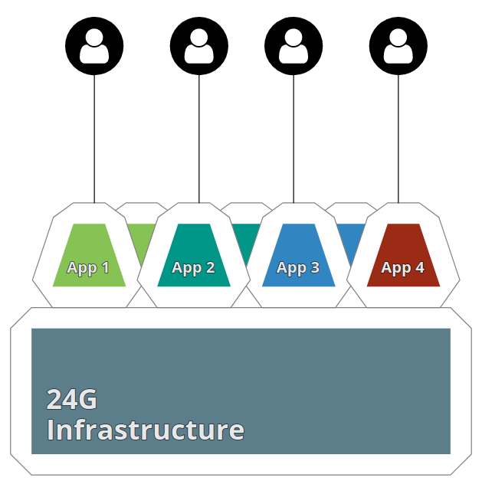


24G Cloud Platform
Users
Developers
DevOps
Cloud Platform
Notes:
At the highest level, this is 24G’s Cloud Platform. Developers write code and push it to their project’s repo(s). The code is deployed onto the platform via CI/CD pipelines.
Users can view the applications on the platform by navigating to it over the internet.
DevOps folks maintain the platform and ensure it’s useability to developers and availability to users.

Slide 4

24G Cloud Platform
AWS Account 1
AWS Account 2
AWS Account n
Project 1
Project 2
Project 3
Project 4
Project 5
Project 6
DevOps Engineers
Terraform Modules
Notes:
If you were to zoom in more on the Platform itself, it would start to look something like this.
The Platform consists of many different AWS account. Each account contains many different projects. Each project will have multiple environments usually dev, qa, and prod.
DevOps engineers on the Cloud team are in charge of the Platform. They will scale it (adding to new AWS accounts) and provision infrastructure on it using Terraform.

Slide 5

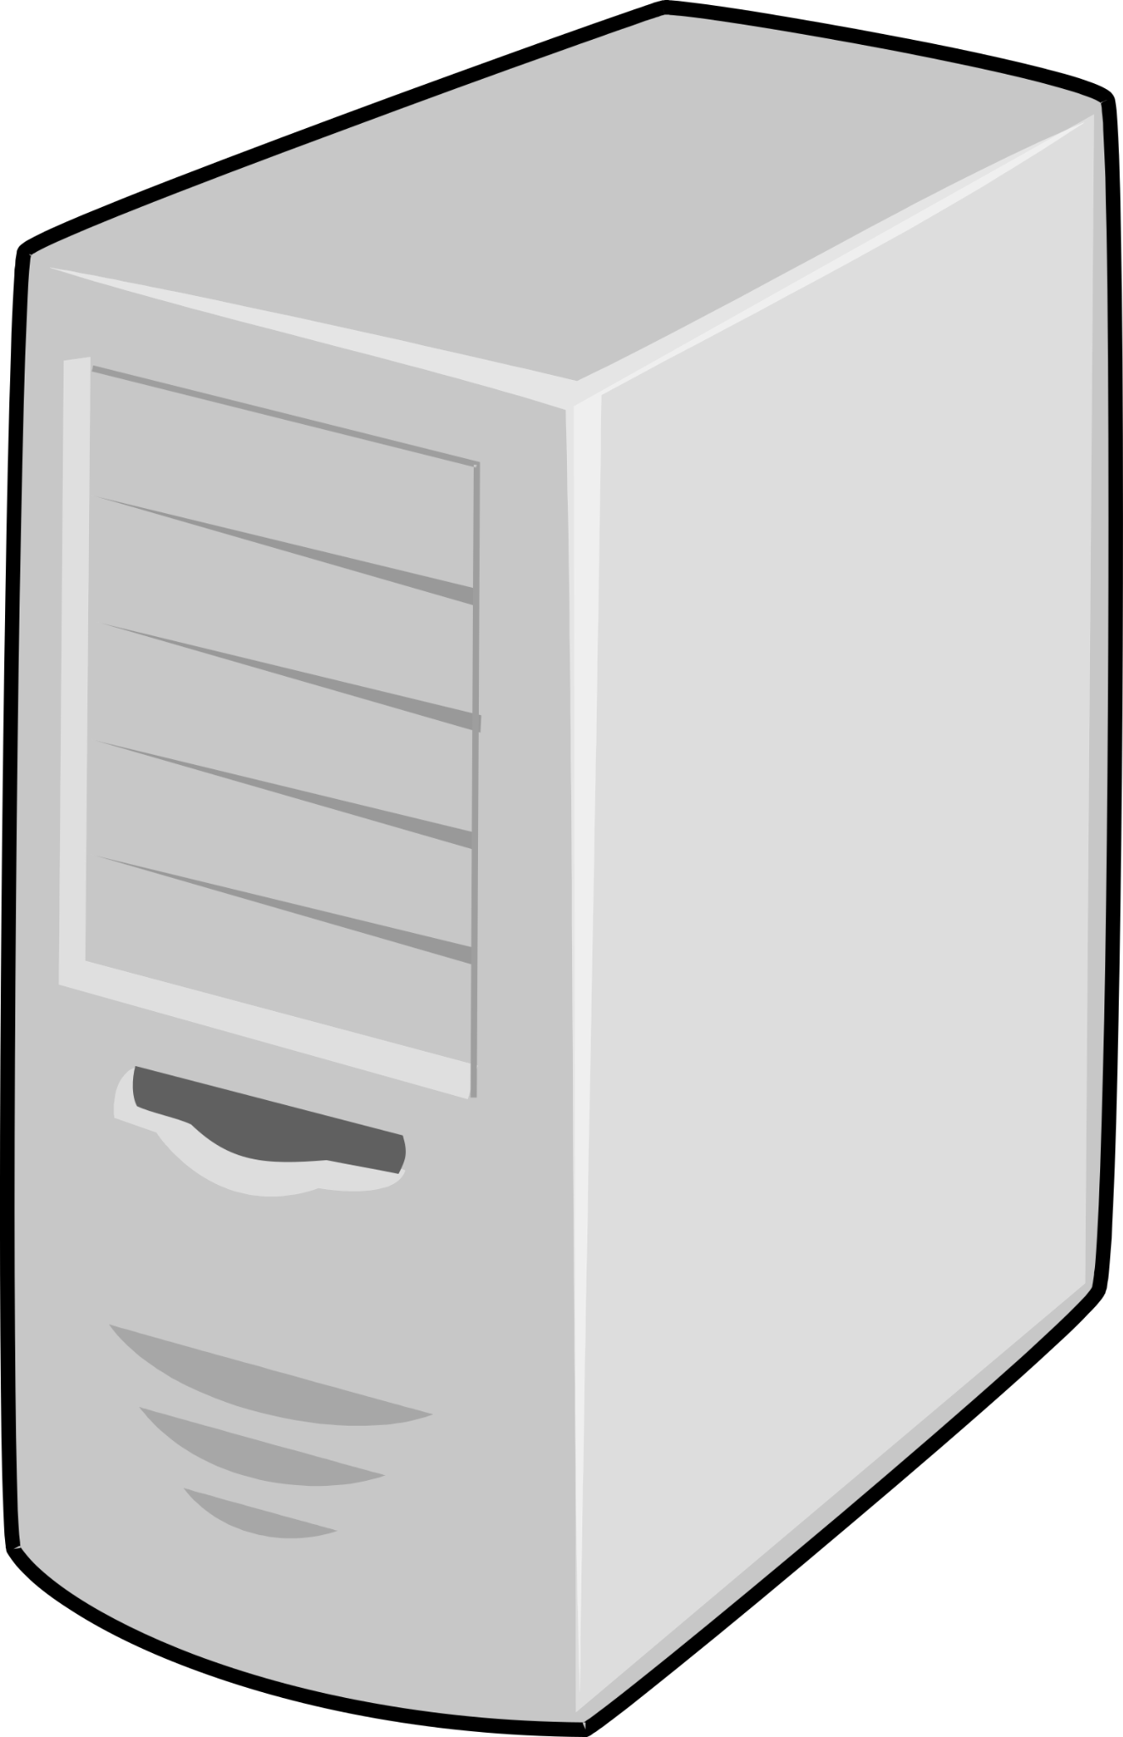

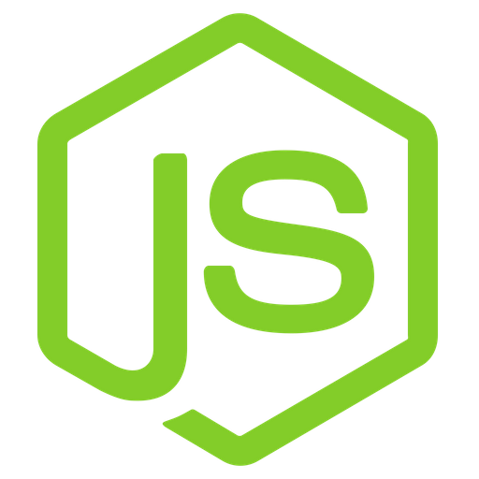
Project Anatomy
Job Number = 1234-1
Job Name = acme-inc
1234-1-acme-inc
global
1234-1-acme-inc-frontend
1234-1-acme-inc-api
dev
prod
/kv/1234-1/dev/
/kv/1234-1/prod/
Environmental
dev-1234-1-1-acme-inc-frontend
prod -1234-1-1-acme-inc-frontend
dev-1234-1-2-acme-inc-api
prod-1234-1-2-acme-inc-api
Notes:
Every 24G project has a Job Number and Job Name these two values are crucial for identifying resources associated with the project. All git repos, cloud infrastructure, etc. for the project will include these values
You can think of a project having two levels. A Global level and a environment level.
Global resources: Are resources that scope to a project but aren’t tied to a specific environment. An example being git repos. Global resources won’t have any environment (dev, qa, prod) in their name, as a reinforcer that it doesn’t belong to any individual resource.
Environmental resources: Are resources that are scoped to the project’s environments. An example being cloud infrastructure for an API. There will be separate infrastructure for hosting the API in each environment.
Services in an environment will have a service name. This name is made up of the environment, job number, job name, architecture number, and a descriptive suffix
Architecture Number: Is a number incrementing up from 1 to protect against name collisions across service in a given environment. By simply appending a number for each service to the service name, we can guarantee that no services will accidentally have the same name
Descriptive suffixes: Are human friendly descriptors appending to a service name to help you understand what the service is used for at a glance.

Slide 6

Deployment/Provisioning
Project A
Dev
QA
Prod
Infrastructure code
TF modules, Helm charts, Bash scripts, templates
Developer
DevOps Engineer
Notes:
A 24G project will usually consist of a few environments each containing services. Some examples of services might be a SPA static site(frontend), an API, CRON job, batch processor, message queue worker, etc.
The infrastructure for these services is provisioned by a DevOps engineer using 24G’s Infrastructure as Code library. This library primarily consists of Terraform modules but also includes custom Bash scripts and YAML. A project’s infrastructure code is stored in a mono architecture repo.
Frontend and backend developers write code for the project’s services. They push the code for these services to the appropriate GIT repository which then triggers a pipeline to deploy it.

Slide 7

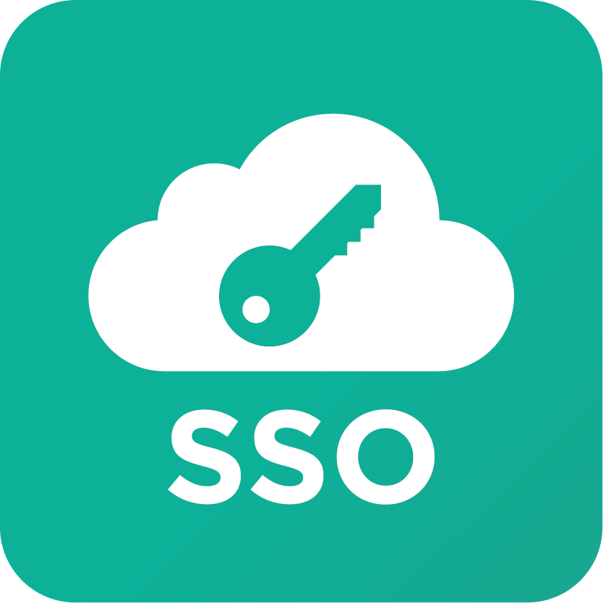

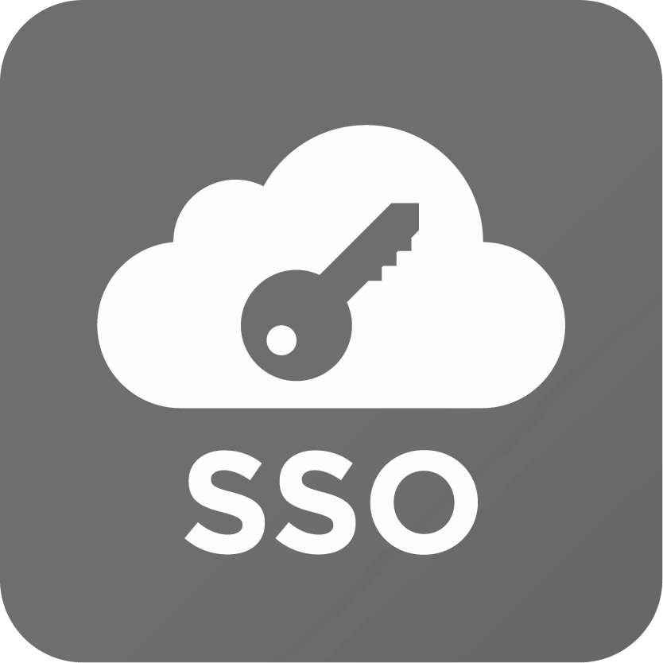
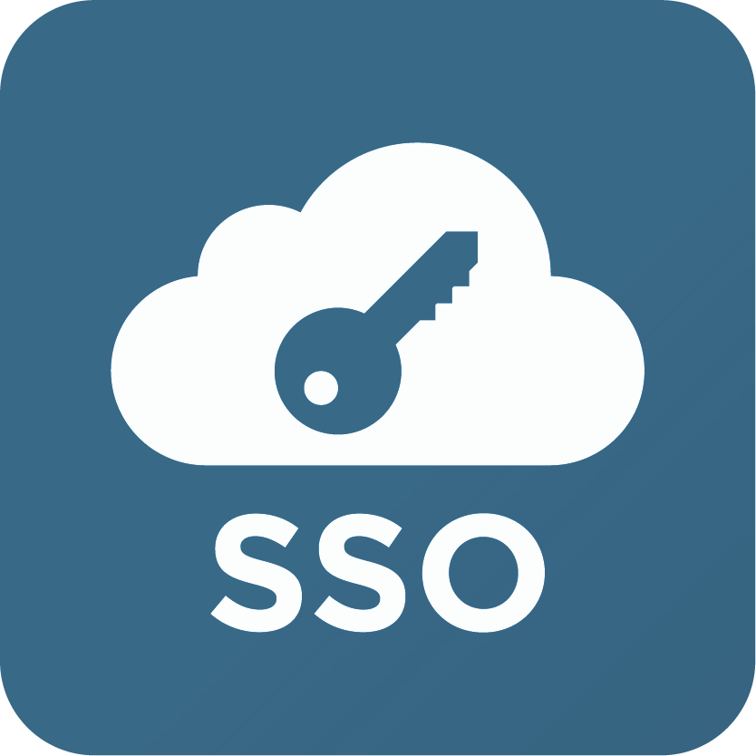
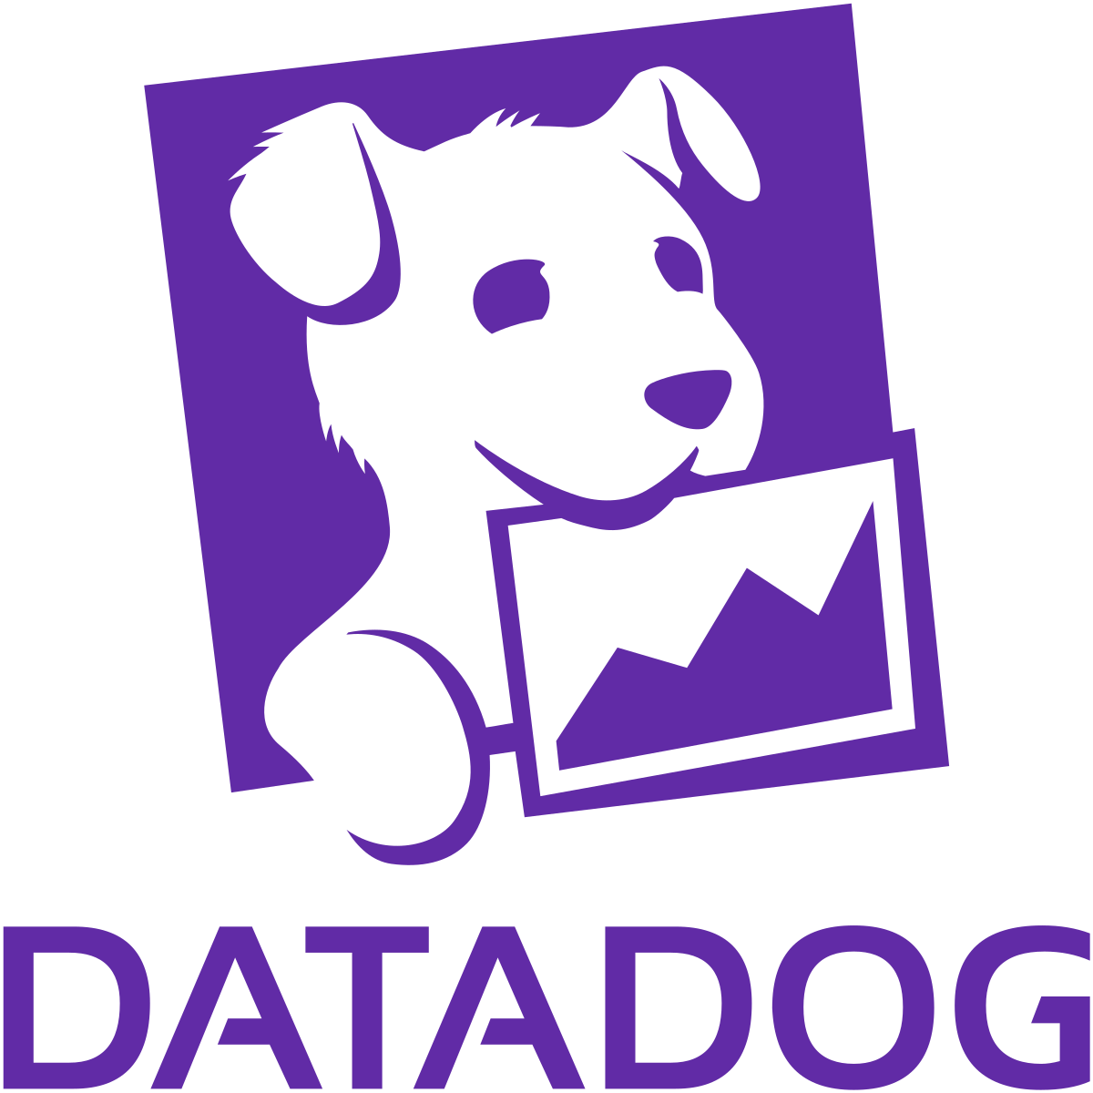
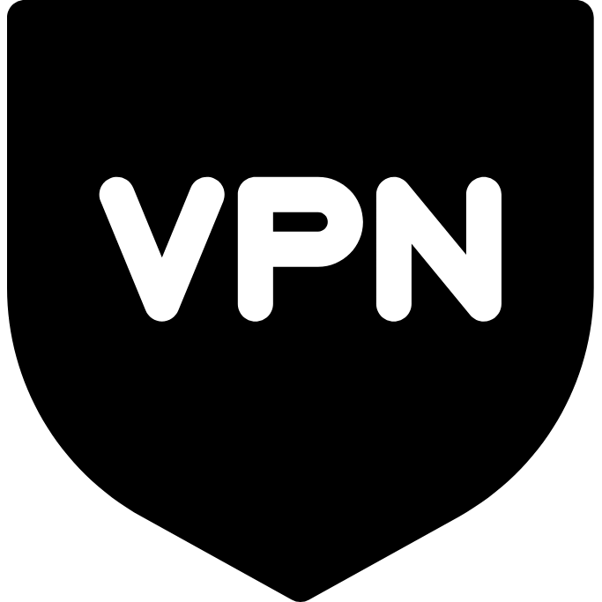
Interacting with the Cloud Platform
AWS Account 1
AWS Account n
Project 1
Project 2
Project X
Project Y
Notes:
Use the VPN to get network access to the platform
Logs of the applications running on the platform are sent to Datadog
Developers can get console access to the Platform’s individual AWS account via a SSO role created for each of their projects
Credentials and other service configurations are stored in Vault and then injected as environment variables for the services.
Developers can manipulate the secrets in Vault
Developers can generate a .env file from Vault for local development
Infrastructure changes(write) should be in Terraform.

Slide 8
AWS SSO
AWS Account A
AWS Account B
Project 1
Project 2
Every job will have a separate SSO role
Permissions for that job are assigned to role
SSO and Leapp docs

Slide 9
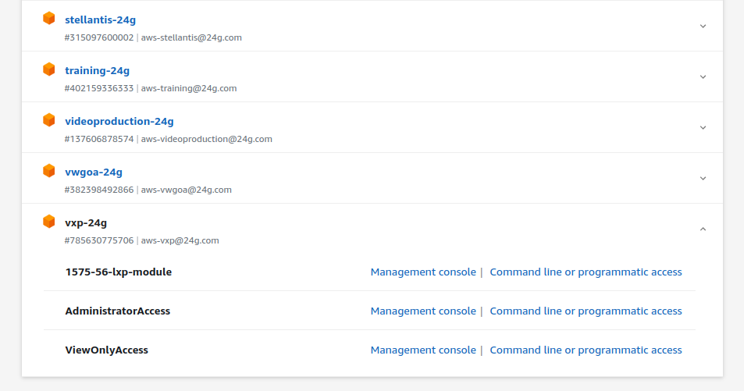
AWS SSO - Console Access
aws.24g.dev

Slide 10
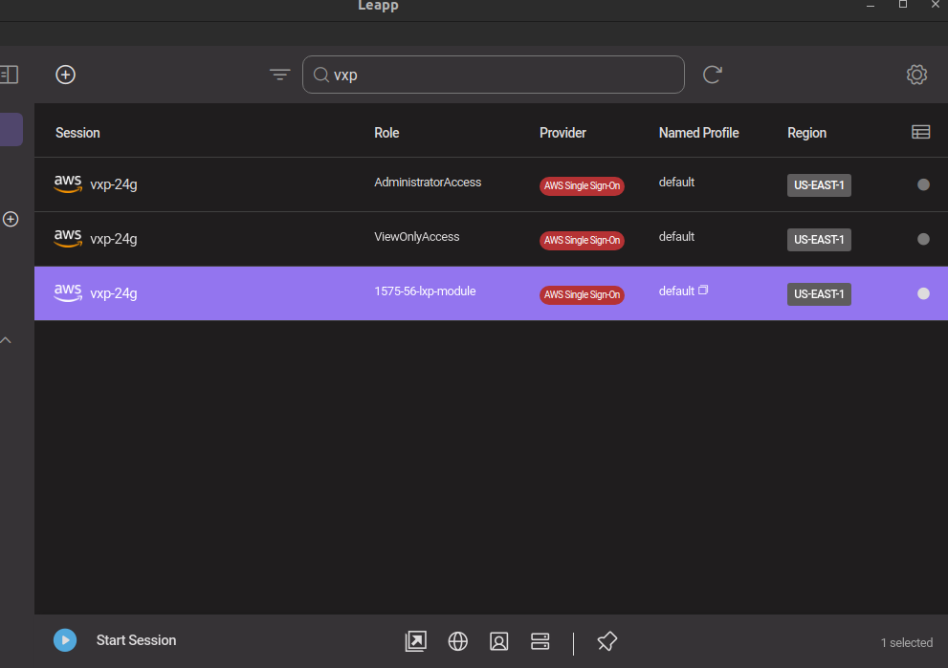
AWS SSO - Programmatic Access
Find your SSO role in Leap
Start the session to update your local credential file

Slide 11
AWS VPN
Account 2
Account 1
Account N
auth-24g
Connect to the VPN to reach AWS resource
VPN Docs

Slide 12
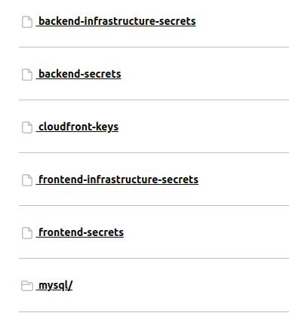


Vault
Cloud Platform
Notes:
Vault is a security tools 24G uses to store application credentials and configuration.
24G’s Vault service is located at vault.24g.dev
Vault is a simple file system consisting of folders and and secrets
Secrets are stored as JSON
Secrets that have the word “infrastructure” in then are managed by Terraform and shouldn’t be edited by a human. As the details about the “stack” change, Terraform will automatically update these secrets.
The folder structure follows syntax /kv/<job number>/<environment>
Values are injected as environment variables or can be access directly via the @24g/vault NPM package.
Developers can generate a .env file with the values from Vault for local development with the help of the @24g/vault-dotenv NPM package

Slide 13

Vault
NPM package to talk to Vault
@twentyfourg/cloud-sdk
Code
Developer updates secrets
Notes:
Vault secrets are provisioned, like the rest of the project’s infrastructure, by Terraform.
Developers can edit/update these secrets as they see fit.
Secrets that have the word “infrastructure” in then are managed by Terraform and shouldn’t be edited by a human. As the details about the “stack” change, Terraform will automatically update these secrets.
Our current practice is inject Vault values as environment variables into the application.
For local development, developers can use the @24g/vault-dotenv package to generate a .env file from Vault
If a developer wish to make an application that is “Vault aware” they can use the @24g/vault npm package to interact with Vault.

Slide 14
Vault
Secret Name | Description | Who edits
backend-infrastructure-secrets | Stores backend infrastructure secrets such as API keys, URLs, database credentials, etc. | Terraform
backend-secrets | Stores any miscellaneous backend configuration | Developer
cloudfront-keys | Stores credentials for interacting with assets stored in AWS CloudFront. Developers don’t have access to the production CloudFront credentials | Terraform
frontend-infrastructure-secrets | Stores frontend URLs and configuration | Terraform
frontend-secrets | Stores any miscellaneous frontend configuration | Developer
mysql/<developer email> | Stores DB credentials for each that individual developer | Terraform
Notes:
Vault secrets are provisioned, like the rest of the project’s infrastructure, by Terraform.
Developers can edit/update these secrets as they see fit.
Secrets that have the word “infrastructure” in then are managed by Terraform and shouldn’t be edited by a human. As the details about the “stack” change, Terraform will automatically update these secrets.
Our current practice is inject Vault values as environment variables into the application.
For local development, developers can use the @24g/vault-dotenv package to generate a .env file from Vault
If a developer wish to make an application that is “Vault aware” they can use the @24g/vault npm package to interact with Vault.

Slide 15
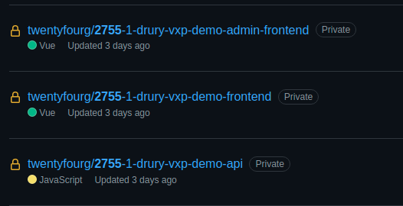

git Repos
<job number>-<job name>-<descriptive suffix>
help.24g.com
#bitbucket-github-requests
Notes:
Git repositories are provisioned like other project resources by Terraform. There will different repositories for different services.
Repositories follow a similar naming convention as the rest of the project’s resources by utilizing the job number, job name, and a descriptive suffix.
If a developer needs access to a repository, they can request access via the #bitbucket-github-requests Slack channel.

Slide 16



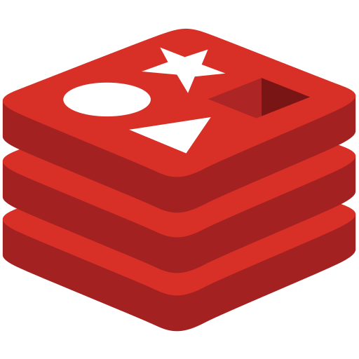
Cloud SDK
Project A
Tool to help developers make application at 24G.
https://github.com/twentyfourg/cloud-sdk
https://www.npmjs.com/package/@twentyfourg/cloud-sdk
Notes:
Supports multiple secrets

Slide 17
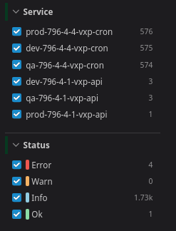
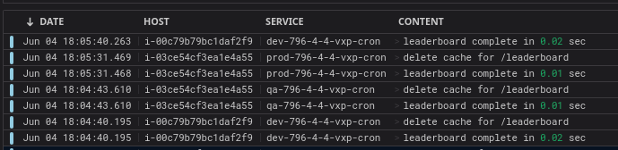
DataDog
AWS Account 1
AWS Account n
Project 1
Project X
job_number: 24G Job Number
repo_slug: The name of git repo
Query Logs
Notes:
Log of applications on the Cloud Platform are piped to Datadog
You can query logs for your application using many tags but two easiest tags to use are the job_number and repo_slug tags.
job_number: will show you all logs from all the services in that projects. You can use use the “Service” filter on the left navigation bar to filter logs from specific services
repo_slug: Will show all logs from applications who are deployed from that git repo.

Slide 18
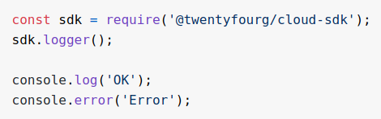


Equipping your application for DataDog
dev-1234-1-2-acme-inc-api
Apache
Application
Notes:
In order for a service’s logs to show up in Datadog, you must use the Winston NPM package
Logs are categorized into two types, apache and application logs
Apache: Logs that follow the Apache log syntax and generally are used for access logs. Datadog will only index 5% of 200-399 status code logs but will index all error logs
Application: Logs that the application emits from the logger.<level>() function. These are usually logs that the developer configures in the code. Datadog will index all of these logs

Slide 19

Interacting with the Cloud Team
Cloud Team
#cloud-team-support
Triage/General Support
cloud.monday.24g.com
Large Requests

Slide 20
Code Pipelines
Dev
QA
Prod
Notes:
Git repos for a project’s services are configured with CI/CD pipelines. These pipelines are triggered upon pushing code to git branches.

Slide 21
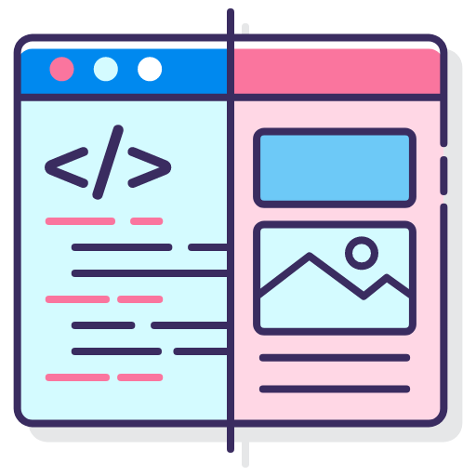
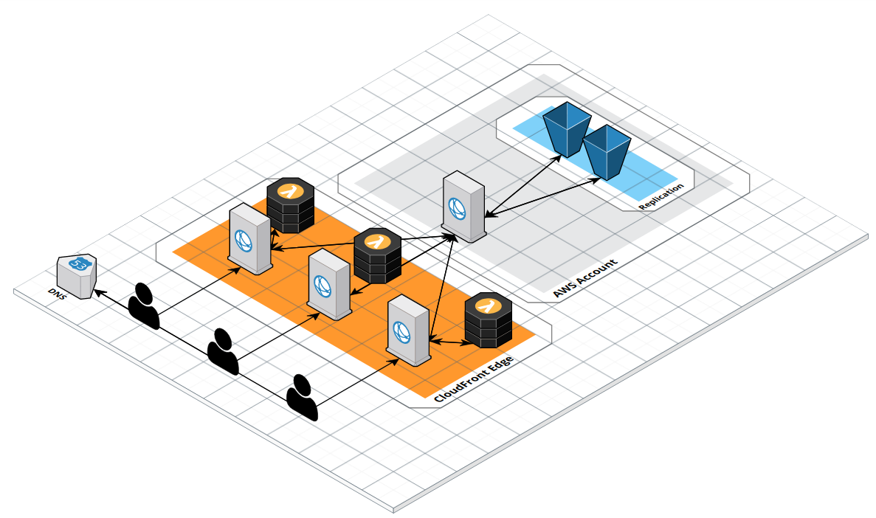
Frontend
static-site:
Vue History Mode, Vue Prerendering
Single depth Path Based Routing
CDN Caching
WAFv2
Access logging (Datadog)
Basic auth
Custom security headers
Custom Lambda@Edge
Replication/failover
Aliases

Slide 22

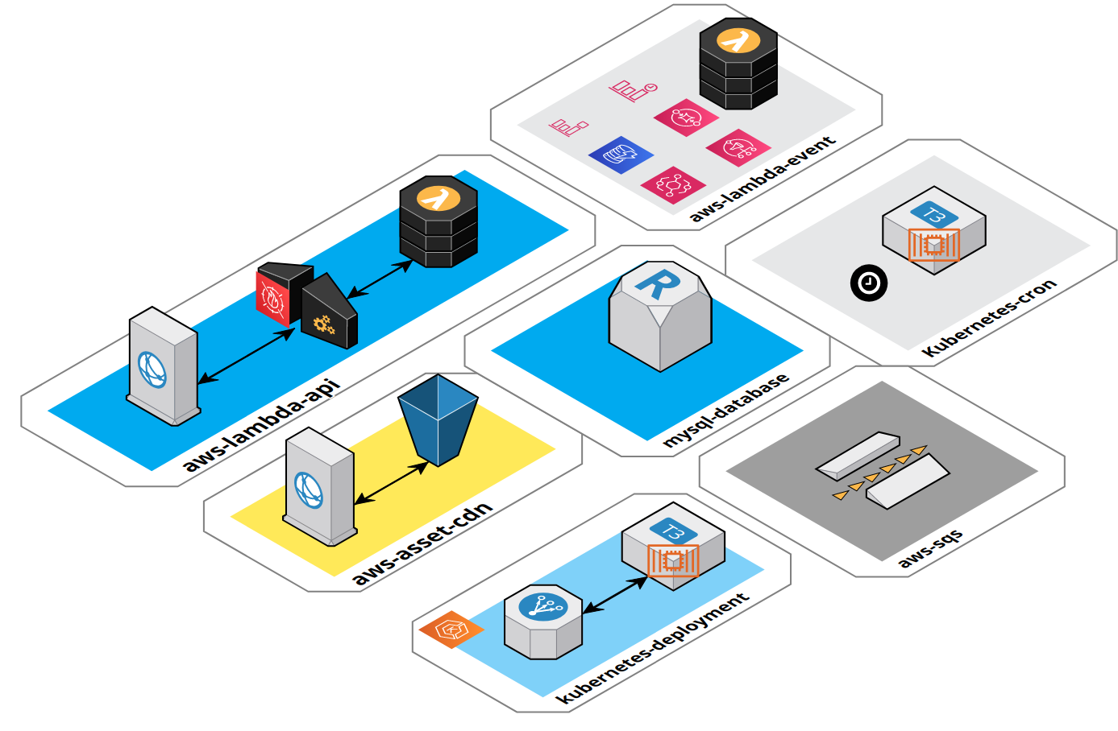
aws-lambda-api:
Proxy Lambda function
Custom Domain Name
WAF
Vault
Datadog
aws-asset-cdn:
CloudFront signed URLs
Replication/failover
WAF
Custom headers/Lambda@Edge
kubernetes-deployment:
Autoscaling
Network/Application load balancer
Vault
Datadog
aws-sqs:
Dead Letter queues
mysql-database:
schema/user creation
Permission grants
aws-lambda-event:
CRON, S3, SNS, SQS, Cloudwatch Logs, DynamoDB, EventBridge trigger
Vault
Datadog
Kubernetes-cronjob:
CRON trigger Kubernetes job
Vault
Datadog
Backend

Slide 23
Account Setup
GitHub
Vault (GUI/CLI)
  Log into vault.24g.dev
  Download Vault CLI
AWS
VPN

Slide 24
Training Catalog
Infrastructure Onboarding
Frontend Petting Zoo
Backend Petting Zoo
Terraform Workshop

Slide 25

Questions?

Slide 27





Infrastructure Project Timeline
Start
Planning
Provision
Development
Maintain
Tear Down
End
Create infrastructure and repos using 24G’s IaC library
Create vendor accounts
Give developers access to resources
Monitor infrastructure uptime and performance
Patch infrastructure
Respond to any outages/fires
Decide on stack
Discuss any constraints
Determine domains and number of environments
Create infrastructure provision ticket(s)
Add additional components
Assist developers with infrastructure related bugs
Ensure code pipelines are operational
Backup any data
Destroy infrastructure and any PII data
Archive/destroy repos
Remove developer access

