Slide 1
ECS736P Information Retrieval | Queen Mary University of London
Hybrid News Search Engine
BM25F · BERT Cross-Encoder · Temporal Boost · Source Authority
Trijit Adhikary · Aditya Kumar · Ricky Sharan · Siddhant Warule
Notes:
SCRIPT (10s): "We built a Hybrid News Search Engine for ECS736P — combining lexical retrieval, semantic re-ranking, temporal freshness, and source authority into a single scoring pipeline."

Slide 2
Problem & Motivation
Plain BM25 — What It Cannot Do
News Search — What It Needs
Treats all text as a flat bag of words
Title and body carry equal weight
Ignores publication date entirely
Cannot handle synonyms or paraphrasing
"Monetary tightening" ≠ "interest rate hike"
Title matches should outweigh body matches
Recent articles must outrank older ones
Semantic understanding beyond exact keywords
Trusted sources should signal credibility
All four signals must work simultaneously
No existing model simultaneously handles all four signals for real-time news retrieval.
This gap directly motivates our hybrid design.
Notes:
SCRIPT — Speaker A (20s): "Plain BM25 treats every document as a flat bag of words — title and body carry the same weight, publication date is ignored, and it can only match exact terms. 'Monetary tightening' will never match 'interest rate hike.'" SPEAKT — Speaker B optional (20s): "News search needs all four things BM25 misses — field weighting, semantic understanding, temporal freshness, and source credibility. No single existing model handles all four simultaneously. That gap is exactly what we built to solve."

Slide 3
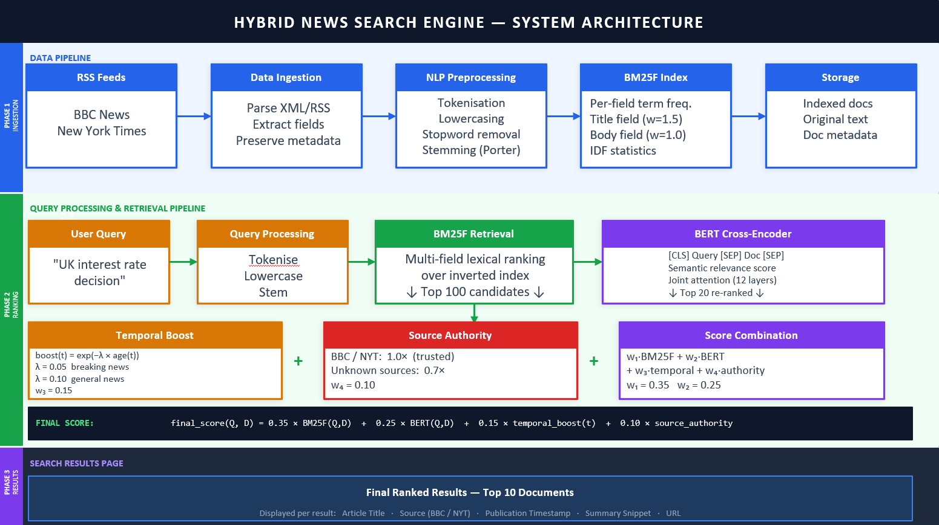
System Architecture — Three-Phase Pipeline
[Screenshot 1: Insert the full Architecture Diagram image here — fill this entire area]
Phase 1 — Ingestion & Indexing
Phase 2 — Two-Stage Ranking
Phase 3 — Result Display
feedparser → NLTK preprocessing → BM25F Index
BM25F top 100 → BERT re-rank → Temporal + Authority
Streamlit GUI — ranked results + collapsible score breakdown
Python 3.13 · Anaconda · Streamlit
Notes:
SCRIPT — Speaker A (25s): "Our system follows a three-phase pipeline. Phase 1 is ingestion — we crawl BBC and NYT RSS feeds using feedparser, preprocess with NLTK, and build a BM25F inverted index." SCRIPT — Speaker B optional (30s): "Phase 2 is where the intelligence happens. At query time, BM25F selects the top 100 candidates fast, then BERT re-ranks them semantically, and we apply temporal decay and source authority. Phase 3 is the Streamlit interface — the user sees a ranked list with full score breakdowns per result."

Slide 4
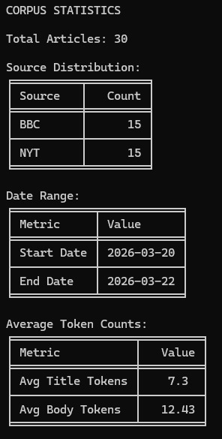
Corpus & Data
30
15 / 15
2 days
7.3 / 12.4
Total Articles
BBC / NYT
Date Range
Avg Tokens
Full corpus size
Balanced split
Mar 20–22, 2026
Title / body
Fields stored per article: title · body · timestamp · source · URL
Known limitation: self-constructed corpus with manual relevance judgements — a TREC benchmark would eliminate subjectivity.
Notes:
SCRIPT (35s): "Our corpus is 30 articles — 15 BBC, 15 NYT, perfectly balanced. All crawled within a 2-day window in March 2026, so temporal signals are meaningful. Each article stores five fields: title, body, timestamp, source, and URL. We acknowledge the corpus is self-constructed — manual relevance judgements introduce subjectivity, which is a known limitation we'll come back to."

Slide 5
Preprocessing Pipeline
Raw Text
→
Tokenise
→
Lowercase
→
Stopwords
→
Porter Stem
Original content
NLTK word_tokenize
Uniform case
180+ word list
Root form
Same pipeline applied to queries at search time — ensures vocabulary compatibility with the index.
Example: "UK interest rate decision"
Stage | Output
Raw input | "UK interest rate decision"
After tokenise | ["UK", "interest", "rate", "decision"]
After lowercase | ["uk", "interest", "rate", "decision"]
After stopword removal | ["uk", "interest", "rate", "decision"]
After stemming (final) | ["uk", "interest", "rate", "decis"]
Notes:
SCRIPT (40s): "Preprocessing is applied to both documents AND queries using the exact same pipeline — this is critical. If you stem documents but not queries, vocabulary breaks. Raw text goes through NLTK tokenisation, lowercasing, stopword removal with a 180-word list, and Porter stemming. The output is stored per field — title tokens and body tokens separately — which is exactly what BM25F needs for field-weighted retrieval."

Slide 6
BM25F Indexing — Field-Weighted Retrieval
c(qᵢ, D) = w_title × TF(qᵢ, title) + w_body × TF(qᵢ, body)
BM25F(Q,D) = Σ IDF(qᵢ) × [ c(qᵢ,D) × (k₁+1) ] / [ c(qᵢ,D) + k₁ ]
Note: field weights applied BEFORE the saturation function — not post-hoc to separate BM25 scores
Parameters
Key Insight
Parameter | Value | Role
w_title | 1.5 | Title field weight
w_body | 1.0 | Body field weight
k₁ | 1.5 | Term frequency saturation
b | 0.75 | Doc length normalisation
Field weights are applied to individual term frequencies BEFORE the saturation function. Combining per-field BM25 scores post-hoc breaks the non-linear saturation that makes BM25 effective (Robertson et al., 2004). Why title = 1.5? A query term in a headline is stronger evidence of relevance than the same term buried in the body.
[Screenshot 3: segment_b_bm25f.py terminal — query with ranked BM25F scores]
Notes:
SCRIPT — Speaker A (25s): "BM25F is our first-stage retrieval model. The key insight over plain BM25 is that we weight term frequencies per field BEFORE applying the saturation function. Title gets 1.5 times the weight of body — because a query term in a headline is stronger evidence of relevance." SCRIPT — Speaker B optional (30s): "This matters mathematically. If you run BM25 on title and body separately and add the scores after, you break the non-linear saturation. BM25F combines the weighted TFs first, then applies saturation once. The inverted index stores title_tf and body_tf separately per term per document to make this possible."

Slide 7
Hybrid Retrieval Pipeline — Four Stages
01
BM25F Selection
02
BERT Cross-Encoder
Top 100 candidates — fast, high recall
Input: [CLS] Query [SEP] Document [SEP]
Operates over pre-built inverted index
12-layer joint attention → scalar score
Low latency: no neural inference at this stage
Model: ms-marco-MiniLM-L-6-v2
03
Temporal Boost
04
Source Authority
boost(t) = exp(−0.05 × age_in_days)
BBC = 1.0 · NYT = 1.0
Recent articles score higher
Unknown sources = 0.7
λ = 0.05 tuned for news decay rate
Credibility tiebreaker signal
Trade-off: Cross-encoder is precise but ~2s per query for 100 candidates.
Bi-encoder (DPR/ColBERT) would be faster but less accurate per pair, deliberate design choice.
Notes:
SCRIPT — Speaker A (25s): "The hybrid pipeline has four stages. BM25F goes first — it's fast and gives us the top 100 candidates with high recall. We don't apply BERT to the full corpus because that would take minutes per query." SCRIPT — Speaker B optional (30s): "BERT re-ranks those 100 candidates semantically. It takes the query and document together as a single input, so all 12 attention layers see both at once — that's how it catches synonyms and paraphrasing that BM25F misses. Then temporal boost decays older articles exponentially, and source authority gives BBC and NYT a credibility score of 1.0. Unknown sources get 0.7."

Slide 8
Final Scoring Formula
final_score(Q, D) =
0.35 × BM25F(Q,D) + 0.25 × BERT(Q,D) + 0.15 × temporal_boost(t) + 0.10 × source_authority
35%
25%
15%
10%
BM25F
BERT
Temporal
Authority
Highest — zero-overlap docs rarely relevant
Semantic refinement beyond keywords
News domain recency requirement
Tiebreaker — source credibility
All signals min-max normalised to [0,1] before combination · BERT logits passed through sigmoid first
Notes:
SCRIPT (45s): "Every result gets a single final score combining all four signals. BM25F carries the highest weight at 35% — if there's no term overlap at all, the document is almost certainly irrelevant. BERT adds 25% to refine semantic ordering. Temporal gets 15% — this is the news domain's core requirement. Authority is 10% and acts as a tiebreaker. Critically, all four signals are normalised to the same scale before combination — you cannot add raw BM25F scores to BERT logits without normalisation first."

Slide 9
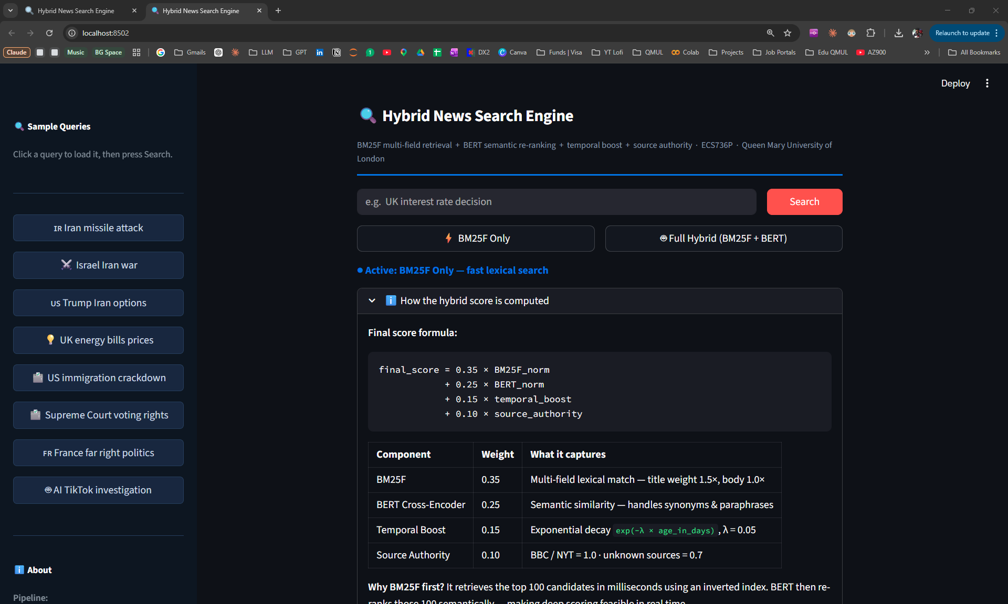
Streamlit Search Interface
[Screenshot 5: Streamlit app — query entered and results showing, score breakdown table expanded on one result card]
Mode Toggle
BM25F-only vs Full Hybrid switch
Sample Queries
Sidebar — corpus-matched queries
Final Score
Always visible on every result card
Score Breakdown
Collapsible per-signal detail table
Built with Streamlit · Python 3.13 · Anaconda environment
Notes:
SCRIPT (45s): "The interface is built with Streamlit. Users can toggle between BM25F-only mode and Full Hybrid mode to directly compare results for the same query. Every result card shows the final score prominently. Expand any card and you see the full breakdown — raw BM25F score, normalised BM25F, BERT score, temporal boost value, and authority score, with the weighted formula shown inline. This transparency is intentional — it lets you trace exactly why a document ranked where it did."

Slide 10
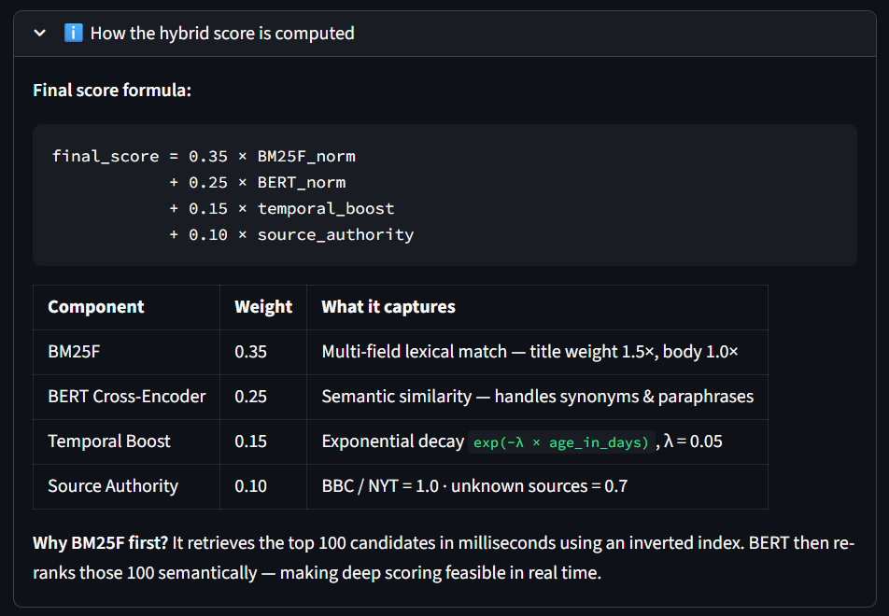
Streamlit Search Interface
Mode Toggle
BM25F-only vs Full Hybrid switch
Sample Queries
Sidebar — corpus-matched queries
Final Score
Always visible on every result card
Score Breakdown
Collapsible per-signal detail table
Built with Streamlit · Python 3.13 · Anaconda environment
Notes:
SCRIPT (45s): "The interface is built with Streamlit. Users can toggle between BM25F-only mode and Full Hybrid mode to directly compare results for the same query. Every result card shows the final score prominently. Expand any card and you see the full breakdown — raw BM25F score, normalised BM25F, BERT score, temporal boost value, and authority score, with the weighted formula shown inline. This transparency is intentional — it lets you trace exactly why a document ranked where it did."

Slide 11
Evaluation Results — Ablation Study
59 queries written · 35 with relevance judgements · Binary relevance (TREC format) · Evaluation tool: pytrec_eval-terrier
MAP Mean Average Precision — overall ranking quality
P@10 Precision in top 10 results — user-facing quality
Recall@10 Proportion of relevant docs retrieved in top 10
Configuration | MAP | P@10 | Recall@10
BM25F Only | 0.2246 | 0.1121 | 0.3063
Full Hybrid | 0.2240 | 0.1121 | 0.3063
Interpretation
P@10 and Recall@10 are identical, both systems surface the same relevant documents in the top 10.
BM25F marginally higher MAP by 0.0006, expected with 30 documents; BERT needs a larger pool to meaningfully reorder results.
Both sources score authority = 1.0, authority signal has no discriminating power in this corpus.
This confirms BM25F is a strong baseline; the hybrid adds no harm and remains extensible.
[Screenshot 7: evaluation.py terminal output with ablation results table]
Notes:
SCRIPT — Speaker A (25s): "We evaluated using pytrec_eval — the standard TREC evaluation library used in academic IR research. 35 queries had relevance judgements. P@10 and Recall@10 are identical for both systems." SCRIPT — Speaker B optional (30s): "BM25F marginally outperforms on MAP by 0.0006 — this is not a failure. With only 30 documents, BERT's semantic re-ranking doesn't have enough candidates to meaningfully reorder. Both sources also have authority 1.0, so authority adds no discrimination here. What this confirms is that BM25F is a strong baseline, and the hybrid architecture adds no harm while providing extensibility for larger corpora."

Slide 12
Limitations, Future Work & Team Contributions
Limitations & Future Work
Team Contributions
Current Limitation | Future Direction
30-doc corpus, manual relevance judgements | TREC-NEWS benchmark dataset
BERT latency ~2s per query for 100 candidates | Bi-encoder (ColBERT) pre-computed embeddings
BBC + NYT both authority = 1.0 — no discrimination | Expand sources with differentiated scores
Member | Role & Deliverables
Trijit Adhikary | Engine: crawler, BM25F index, hybrid pipeline, preprocessing
Ricky Sharan | Evaluation: pytrec_eval pipeline, queries, relevance judgements
Siddhant Warule | Data: corpus curation, relevance judgements, requirements
Aditya Kumar | UI: Streamlit app (app.py), slides, presentation coordination
ECS736P Information Retrieval · Queen Mary University of London · 2026
Notes:
SCRIPT (30s): "Three honest limitations: corpus size limits BERT's impact, the cross-encoder adds latency at scale, and both sources have equal authority so that signal doesn't discriminate here. Each has a clear path forward. On contributions — Trijit owned the backend engine, Ricky owned evaluation, Siddhant owned data and corpus, and Aditya built the Streamlit UI and the presentation. Thank you."

