Slide 1

Impact of Pre-existing Health Conditions and Demographic on COVID-19 Outcome
PRESENTED BY: ERIC MWANGI GITHINJI

Slide 2
Background
Studies shows that pre-existing medical conditions can influence the severity of COVID-19. The study on “Impact of Pre-exisiting Health Conditions in Adults” found that, among COVID-19 cases, the three most common underlying health conditions are cardiovascular disease (32%), diabetes (30%), and chronic lung disease (18%). Among COVID-19 hospitalizations, the three most common underlying conditions are hypertension (57.7%), obesity (47.8%), and metabolic disease (42.9%).
> Ref: https://sph.uth.edu/research/centers/dell/legislative-initiatives/COVID-19%20Impact%20on%20pre-existing%20conditions_Adults_8_27_2021.pdf
Demographic factors e.g. age and sex can as well influence the severity of COVID-19. For example, Adults are at a high risk of contracting the disease compared to younger people. Although adults aged older than 65 years represent only about 16% of the US population, they account for 31% of reported cases, 45% of hospitalizations, 53% of intensive care unit (ICU) admissions, and 80% of COVID-19–associated deaths.
> Ref: https://www.ncbi.nlm.nih.gov/pmc/articles/PMC9633621/#:~:text=Early%20and%20late%20reports%20showed,also%20differ%20in%20older%20adults.

Slide 3
Analysis Objective
To analyze the relationship between demographic factors (such as age and sex) and Covid-19 outcome.
To investigate the impact of pre-existing medical conditions on Covid-19 outcomes.
To study the timeline from symptom onset to death and its impact on patient outcomes.

Slide 4
Analysis Approach
Data Exploration and Cleaning
Getting to know the dataset, structure, types of data in each column.
Identify and handle missing values, outliers and incorrect data entries.
Descriptive Analysis
Summarizing data and finding patterns or relationships.
Use visualization to better understand the data.
Comparative Analysis
Comparing different groups to identify significance differences.
Time-to-Event Analysis
Survival analysis using cox proportional hazards model to analyze time-to-event.

Slide 5
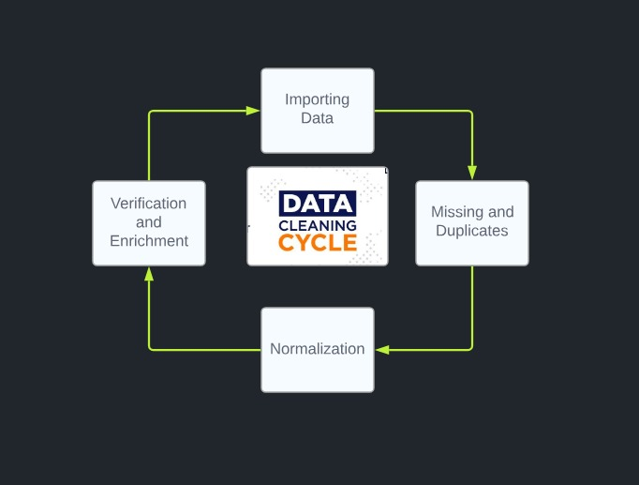
Data Exploration and Cleaning

Slide 6
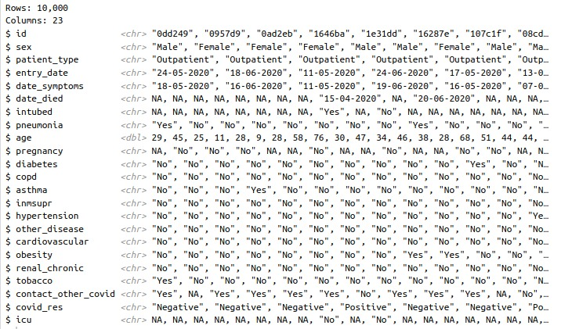
Covid-19 Mexico Data (10000 rows X 23 columns)

Slide 7
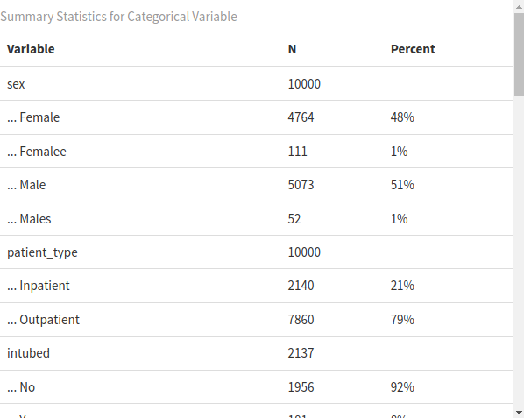
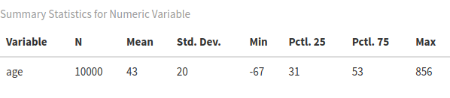
Summary Statistics
Numeric Data
Categorical Data

Slide 8
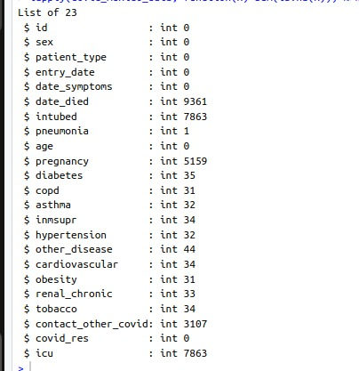
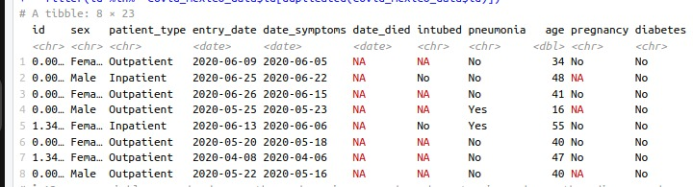
Missing Values
Missing Values
Duplicated Values
Variables Id, sex and entry_date merged to create a unique variable ID, hence eliminating duplicates. Missing value handled differently for different variables.

Slide 9
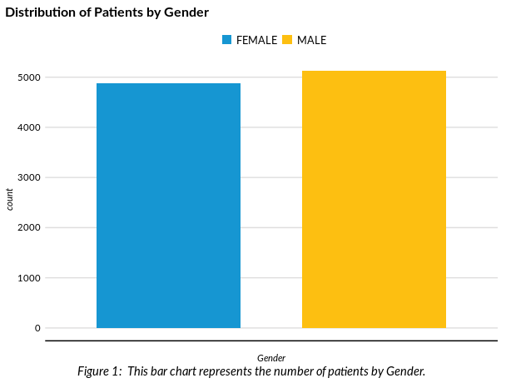
Descriptive statistics GENDER*
Male = 5125 (51.25%)
Female = 4875 (48.78%)
N= 10000

Slide 10
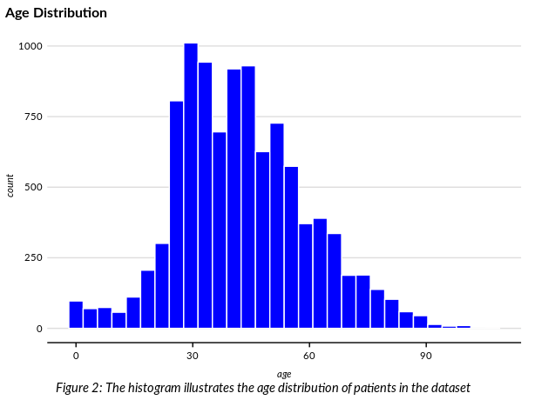
Descriptive statistics AGE*
Mean=42.62
Sd = 16.82
Min= 0 Max= 107
N= 10000

Slide 11
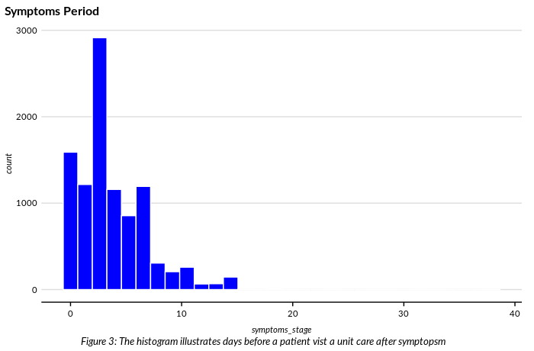
Descriptive statistics Symptoms Period
Mean=3.64
Sd = 3.24
Min= 0 Max= 38
N= 10000
Days between symptoms and entry date.

Slide 12
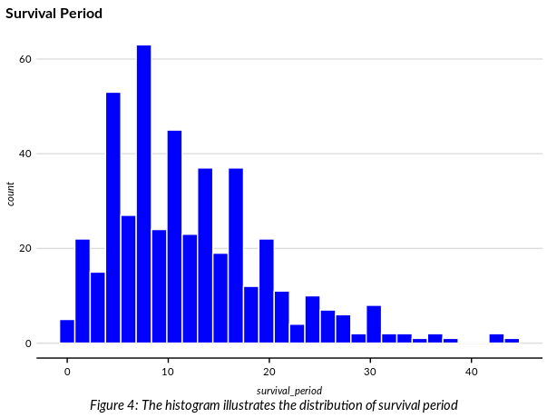
Descriptive statistics Survival Period
Mean=12.06
Sd = 7.89
Min= 0 Max= 44
N= 463
Days between symptoms and death of a patient.

Slide 13
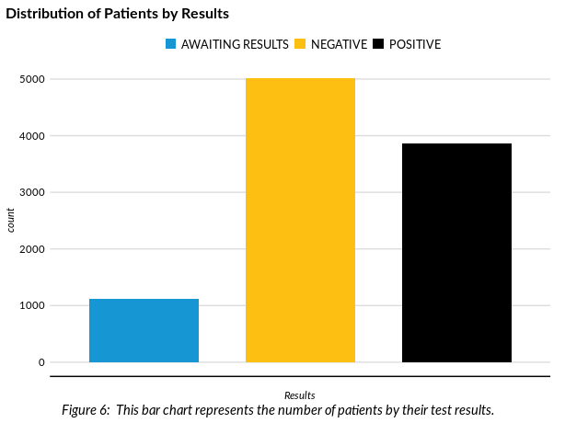
Descriptive statistics COVID-19 Results
Awaiting Results=1122 (11.22%)
Negative = 5013 (50.13%)
Positive= 3865 (38.65%)
N= 10000

Slide 14
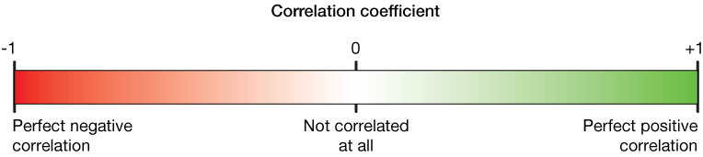
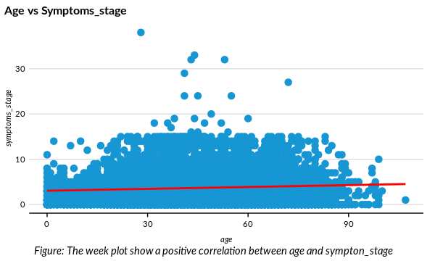
Correlation Analysis
Correlation coefficient(r)= 0.071
Weak positive correlation

Slide 15
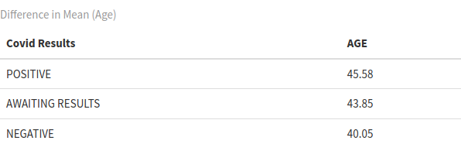
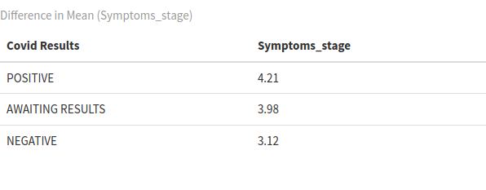
Comparative Analysis Group Means
Is the difference significant?

Slide 16
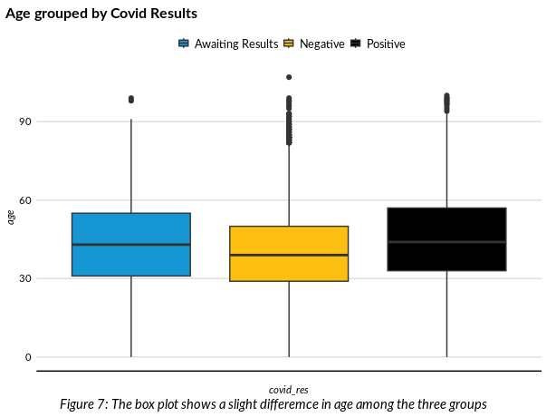
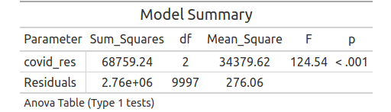
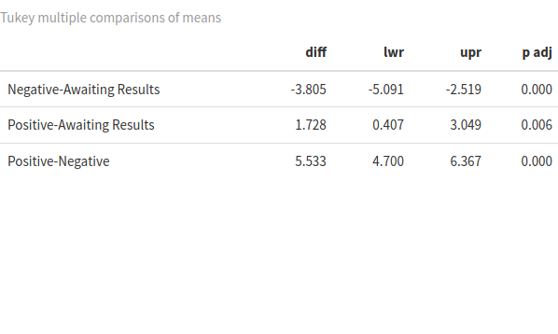
Comparative Analysis One-Way ANOVA
Anova assumptions: Homogeneity of Variance (Equal variance between groups)
Bartlett’s test: H0> All groups have equal variance H1> Not all groups have equal variance
P-value =0.4418 > 0.05. Fail to reject null hypothesis.

Slide 17
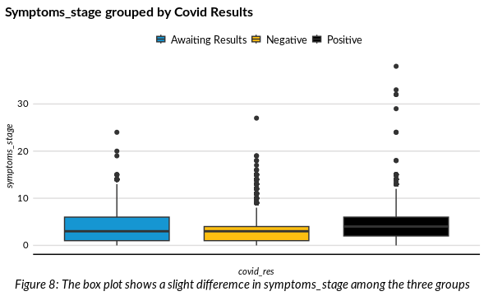
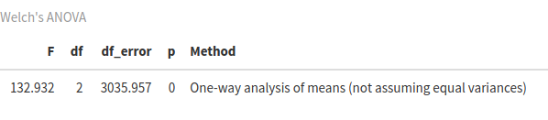
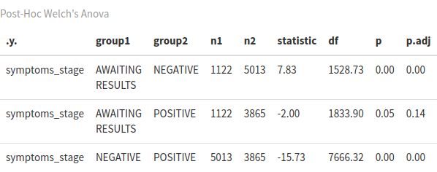
Comparative Analysis Welch’s ANOVA
Anova assumptions: Homogeneity of Variance (Equal variance between groups)
Bartlett’s test: H0> All groups have equal variance H1> Not all groups have equal variance
P-value =0.00 > 0.05. Reject null hypothesis.

Slide 18
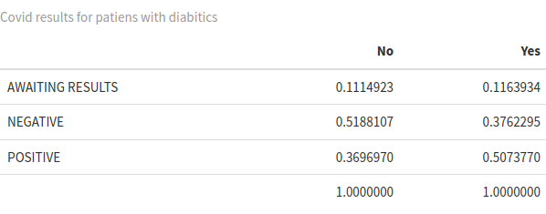
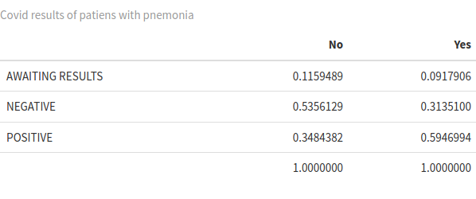
Comparative Analysis Proportion Tables
Diabetic Patients
Pneumonia Patients
Condition
Condition
COVID-19 Results
COVID-19 Results
Total
Total
YES
YES
Approximately 11.64% are still awaiting results.
About 37.62% have tested negative for Covid-19.
Around 50.74% have tested positive for Covid-19
Approximately 9.17% are still awaiting results.
About 31.35% have tested negative for Covid-19.
Around 59.46% have tested positive for Covid-19

Slide 19
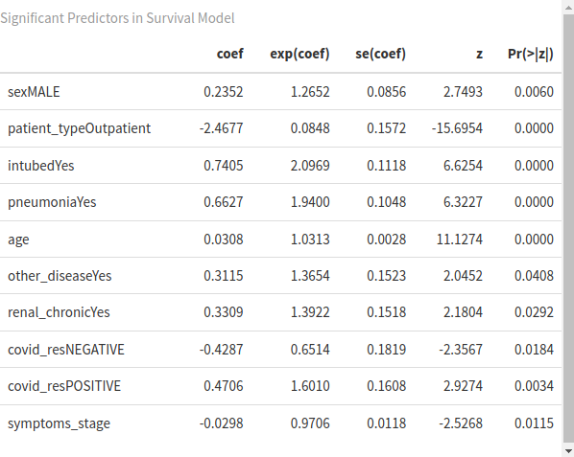
Time-to-Event Analysis (Survival Analysis)
A positive coefficient indicates an increase in the hazard rate, and a negative coefficient indicates a decrease in the hazard rate.
At a given point in time someone who is male is 1.2652 times likely to die as someone who is female adjusting for other variable.
At a given point in time someone who is male is 26.52% more times likely to die as someone who is female adjusting for other variable.
At a given point in time the probability of dying for someone who is 1 year 0ld is 1.0313 times higher than someone who is 1 year young.
Notes:
Hazard is defined as the slope of the survival curve — a measure of how rapidly subjects are dying. The hazard ratio compares two treatments. If the hazard ratio is 2.0, then the rate of deaths in one treatment group is twice the rate in the other group.

Slide 20
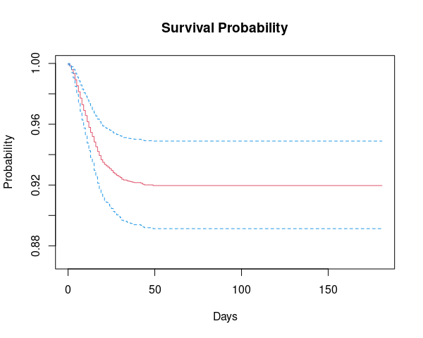
Time-to-Event Analysis (Survival Analysis)
The y-axis represents the probability of survival. A survival probability of 1 means all individuals are alive, while a survival probability of 0 means all individuals have experienced the event
Notes:
Hazard is defined as the slope of the survival curve — a measure of how rapidly subjects are dying. The hazard ratio compares two treatments. If the hazard ratio is 2.0, then the rate of deaths in one treatment group is twice the rate in the other group.

Slide 21
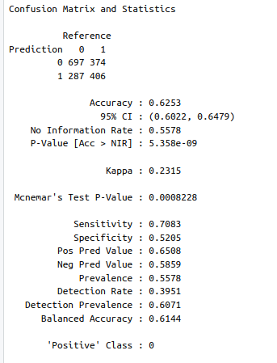
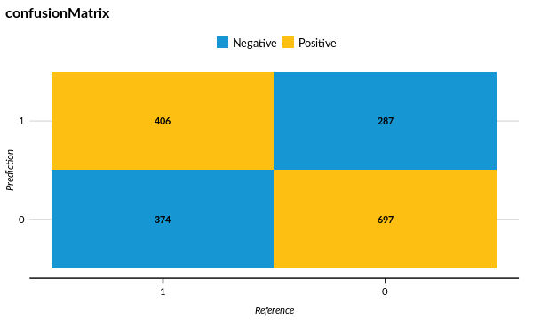
Classification Model
Notes:
Hazard is defined as the slope of the survival curve — a measure of how rapidly subjects are dying. The hazard ratio compares two treatments. If the hazard ratio is 2.0, then the rate of deaths in one treatment group is twice the rate in the other group.

Slide 22
Summary
Demographic Factors
The average age of patients diagnosed with COVID-19 is notably higher, indicating a potential age-related vulnerability to the virus.
Pre-existing Conditions
Our data suggests a correlation between pre-existing conditions such as diabetes and pneumonia, and an increased number of positive COVID-19 cases. This means that these conditions may make people more likely to get sick from the virus..
Survival Probability
The presence of pre-existing conditions appears to negatively impact the survival rate among COVID-19 patients, suggesting these conditions could complicate the disease progression.
A delay in seeking medical attention seems to decrease the survival probability for COVID-19 patients. This underscores the importance of timely medical intervention in improving patient outcomes.
Notes:
Hazard is defined as the slope of the survival curve — a measure of how rapidly subjects are dying. The hazard ratio compares two treatments. If the hazard ratio is 2.0, then the rate of deaths in one treatment group is twice the rate in the other group.

Slide 23
Recommendations
Public health measures should consider age and pre-existing conditions as significant factors of COVID-19 outcome. This could include prioritizing older individuals and those with pre-existing for vaccination and implementing targeted protective measures for such cases.
Healthcare providers should be prepared to provide enhanced care for patients with Pre-existing conditions. This could include closer monitoring, more aggressive treatment strategies, and comprehensive post-recovery care.
Public health campaigns should emphasize the importance of seeking medical attention at the earliest signs of symptoms, and healthcare systems should be prepared to respond swiftly to new cases.
Notes:
Hazard is defined as the slope of the survival curve — a measure of how rapidly subjects are dying. The hazard ratio compares two treatments. If the hazard ratio is 2.0, then the rate of deaths in one treatment group is twice the rate in the other group.

Slide 24

Notes:
Hazard is defined as the slope of the survival curve — a measure of how rapidly subjects are dying. The hazard ratio compares two treatments. If the hazard ratio is 2.0, then the rate of deaths in one treatment group is twice the rate in the other group.

