Slide 1
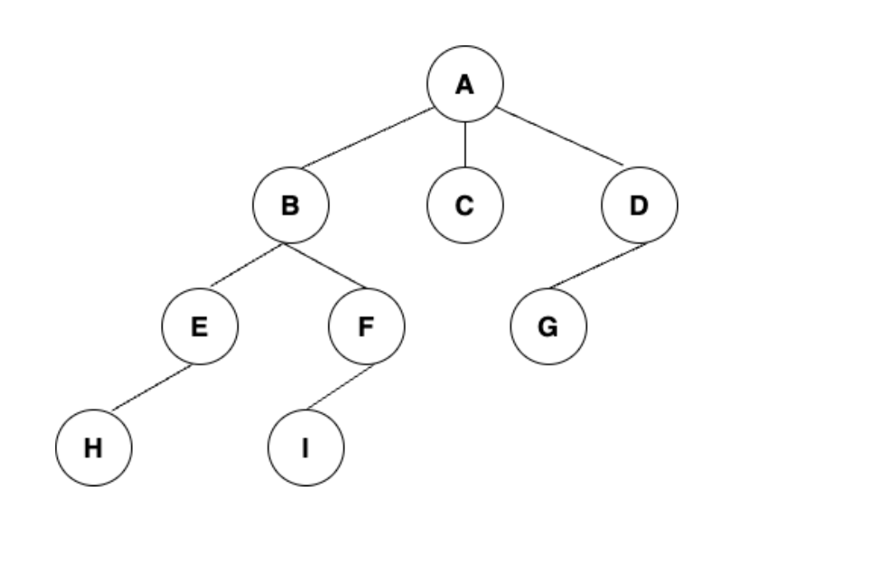
Problem 1 (20 points)
CS526 Homework Assignment 4
Consider the tree
What is the sequence of nodes (characters) generated by preorder tree traversal
What is the sequence of nodes (characters) generated by breadth-first tree traversal
What is the sequence of nodes (characters) generated by post tree traversal

Slide 2
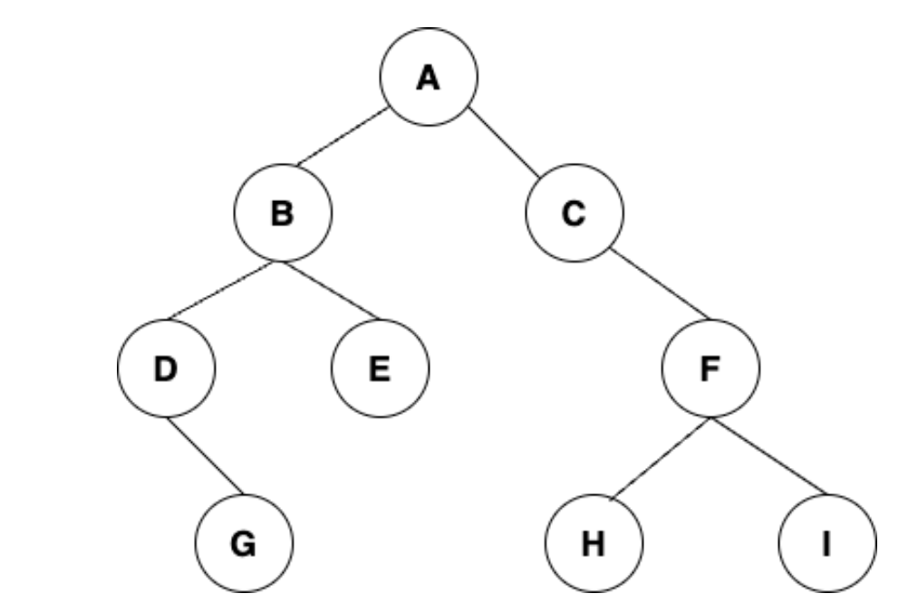
Problem 1 (20 points)
CS526 Homework Assignment 4
Consider the binary tree
What is the sequence of nodes (characters) generated by in-order tree traversal

Slide 3
Problem 2 (30 points)
CS526 Homework Assignment 4
You are given an array with n elements and a number T (target). You can assume that the sum of all of the elements in the array is larger than T. Create an algorithm to compute the smallest number of elements from the array whose sum is greater than the target T.
Example: given the array [8,3,9,2,7,1,5] with a target T of 18 then the answer is 3.
You will be given an input file with the number of elements in the array on line 1, line 2 will contain the target T and line 3 will contain a space separated list of values for the array.
e.g.
8
17
3 1 8 2 4 6 9 5
Your solution should print the given array to the console followed by the target and the answer to the console:
Python3 smallestNumber.py < smallest_input.txt
Input: 8,3,9,2,7,1,5 Target: 18 Answer: 3

Slide 4
Problem 3 (50 points)
CS526 Homework Assignment 4
You are given n different points in a 2-dimensional space. Design an algorithm that determines the unique number of right triangles that can be formed by choosing sets of three points. Your solution must run in under 30 seconds to receive full credit, partial credit will be given for all correct answers.
You will be given an input file where the first line contains the number of points followed by a number of lines each with one point e.g.
5
0 0
0 4
0 7
3 0
9 0
Your solution should the answer to the console:
Python3 rightTriangles.py < right_triangles_input.txt
The number of right triangles is: <your answer>

