Slide 1


Joint Embedding Transformer for Self-Supervised Audio Representation

Slide 2
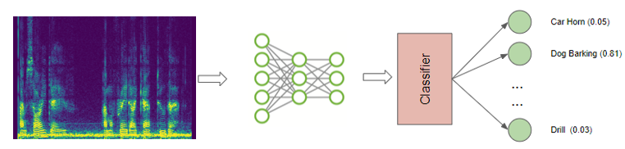
1. Introduction
Audio classification: learn a direct mapping from audio spectrograms to corresponding labels.
Real-time translation: translate text from one language to another in real-time.
Sound event detection: detect specific sound events, such as dog barking or a car honking, in an audio signal.
Audio Tasks

Slide 3
2. State-of-the-Art Methods
AST – Audio Spectrogram Transformer
First convolution-free, purely attention-based model for audio classification.
Transformer architecture based on Self-attention mechanism.
Main Steps:
  Spectrograms
  Linear Projection
  Positional Embedding
  Transformer Encoder

Slide 4
2. State-of-the-Art Methods
AST Advantages
The advantages of AST are threefold:
Superior performance on AudioSet, ESC-50, and Speech Commands.
Naturally supports variable-length inputs without any change in the architecture.
Features a simpler architecture with fewer parameters and converges faster during training.

Slide 5
2. State-of-the-Art Methods
AST Advantages
The advantages of AST are threefold:
Superior performance on AudioSet, ESC-50, and Speech Commands.
Naturally supports variable-length inputs without any change in the architecture.
Features a simpler architecture with fewer parameters and converges faster during training.
Main disadvantage:
It requires extremely expensive pretraining with image datasets that, in addition, make it less flexible for other tasks.

Slide 6
2. State-of-the-Art Methods
Possible Improvements
Supervised Methods
Self-Supervised Methods
No requirements for labeled data
No transfer learning needed (free to choose architecture and parameters)
Can be more efficient
Can learn useful features for downstream tasks
Reach great performances, but:
Need extremely long pretraining (e.g. on Image datasets)
Need huge labelled datasets
Transfer learning needs the same architecture, batch size, and shape.

Slide 7
3. Proposed Methodology – VCR-AST
Variance-Invariance-Covariance Regularization for AST
A new SSL framework that aims at:
learning invariance to different views with an invariance term
avoiding the collapse of the representations with a variance preservation term
maximizing the information content of the representation with a covariance regularization term.

Slide 8
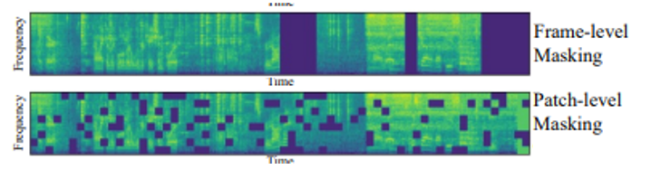
3. Proposed Methodology – VCR-AST
Variance-Invariance-Covariance Regularization for AST
Main steps:
Input batch of spectrograms is randomly transformed twice
Every sample is given as input to Transformers’ layers and to Projector
The output is used for computing the loss

Slide 9
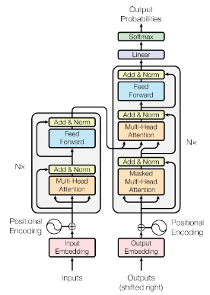
3. Proposed Methodology – VCR-AST
Variance-Invariance-Covariance Regularization for AST
Main steps:
Input batch of spectrograms is randomly transformed twice.
Every sample is given as input to Transformers’ layers and to Projector
The output is used for computing the loss

Slide 10




3. Proposed Methodology – VCR-AST
Variance-Invariance-Covariance Regularization for AST
Main steps:
Input batch of spectrograms is randomly transformed twice.
Every sample is given as input to Transformers’ layers and to Projector
The output is used for computing the loss
Variance Loss:
Covariance Loss:
Representation Loss:
Total Loss:

Slide 11
3. Proposed Methodology – VCR-AST
Advantages and Contribution of VCR
First time a Variance-Invariance-Covariance Regularization method is used for Audio Tasks and on the Transformer backbone.
Main contribution of this work is the Variance preservation term
The main advantages of VCR are:
  Modularity of its objective function and applicability to multi-model setups.
  Resilience to collapse
  Time efficiency.

Slide 12
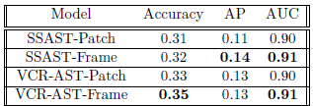
4. Experimental Results
SSAST vs VCR-AST Main Metrics
Comparison between SSAST in Patch and Frame configuration and our VCR-AST in Patch and Frame Configuration.
The 4 configurations have been trained with the same parameters for 100 epochs (~13k iteration) on the ESC-50 dataset.

Slide 13
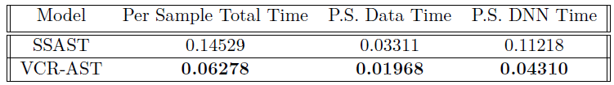
4. Experimental Results
SSAST vs VCR-AST Timing
Comparison about Training time: we have pretrained the model, again, with the same parameters, for 100 epochs.
Results show that VCR-AST is almost 3 times faster than SSAST. This also results in a "Time for epoch" of 4 minutes for SSAST against less than 2 minutes for VCR-AST.

Slide 14
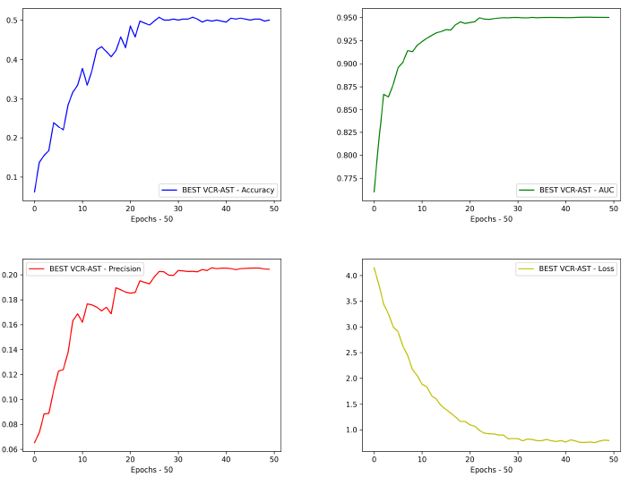
4. Experimental Results
VCR-AST Best Model Fine-tuned
Model pretrained for 200 epochs (26k iterations) and finetuned for 50 epochs (7k iterations) .
Going on training the model, performances keep improving, showing potential for Large-scale.

Slide 15
5. Ablation Study
Impact of Masked Patches
In the beginning, a higher number of masked patches (250) causes a more difficult fine-tuning process.
Anyway, after a few epochs, it outperforms the model pretrained with a lower number of masked patches (100).

Slide 16

5. Ablation Study
Impact of Model Size
The base model (the biggest) obviously reaches better performances.
However, it is worse in terms of training time and extremely heavier.

Slide 17
5. Ablation Study
Impact of Batch-Size
A higher batch size (12) helps the model to reach better performances.
Using a larger batch size allows the model to see more examples in each training iteration, which can help it generalize better to unseen data.

Slide 18
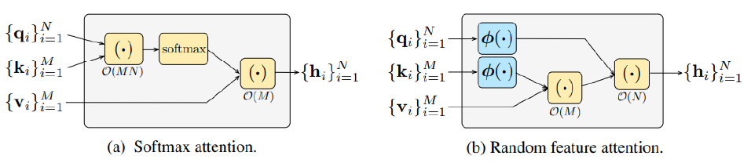
6. Future Works
The following list outlines two areas of potential future work to enhance the system's performance and functionality.
RFA - Random Feature Attention: It scales linearly in sequence length in terms of time and space.
AST on Quaternion domain: Quaternions are a type of mathematical object that extend complex numbers to four dimensions. It has shown promising results in natural language processing tasks.

Slide 19
7. Conclusions
VCR-AST is, to the best of our knowledge, the first Variance-Invariance-Covariance regularization self-supervised method for Audio tasks using a Transformer as the backbone.
Despite the limitations, our results demonstrate the potential of this proposed method, outperforming SSAST.
However, further improvements are possible with more advanced hardware resources.
In conclusion, we think our study provides a promising direction for future research in self-supervised audio spectrogram transformer methods

Slide 20
THANKS FOR YOUR ATTENTION

