Slide 1



Slide 2

Assignment 2
Richard Rumpelt Javier Comes Tello Tobias Brand

Slide 3
Outline
Q1 – Camera
Q2 – Lidar
Q3 – Camera-Lidar Fusion
Q4 – Autonomous navigation and slip estimation

Slide 4

Q1 – Camera
25 points

Slide 5
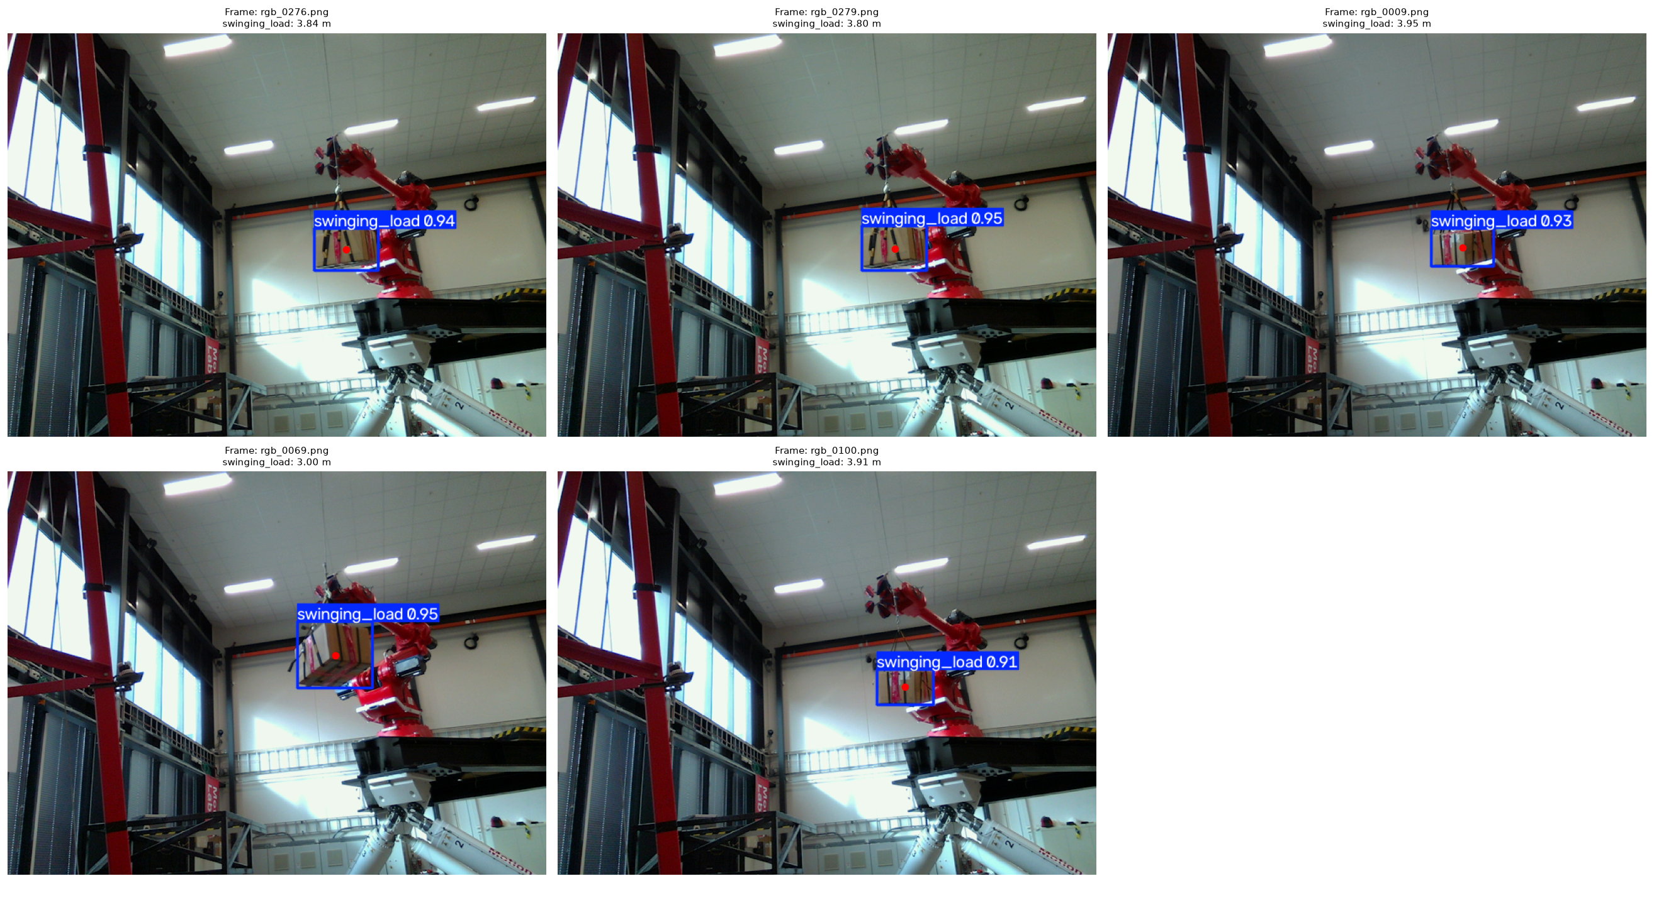
Assignment 1 – Q1 Result

Slide 6
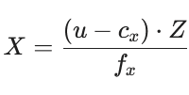
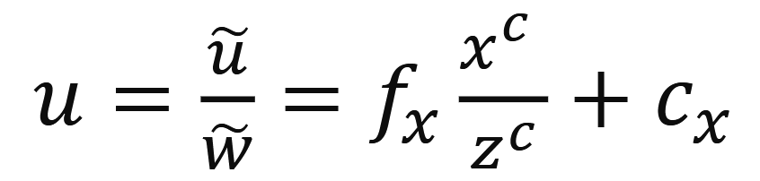
Objective & Method (a,b,c)
Objective: Calculate and visualize, in a three-dimensional space, the temporal trajectory of the center of the swinging load throughout all the frames of the training video.
Method:
  Object Detection: the YOLO model trained in Assignment 1 (best.pt)
  2D centroid calculation: (u,v)
  Depth extraction with filtering
  Deprojection to 3D coordinates:

Slide 7
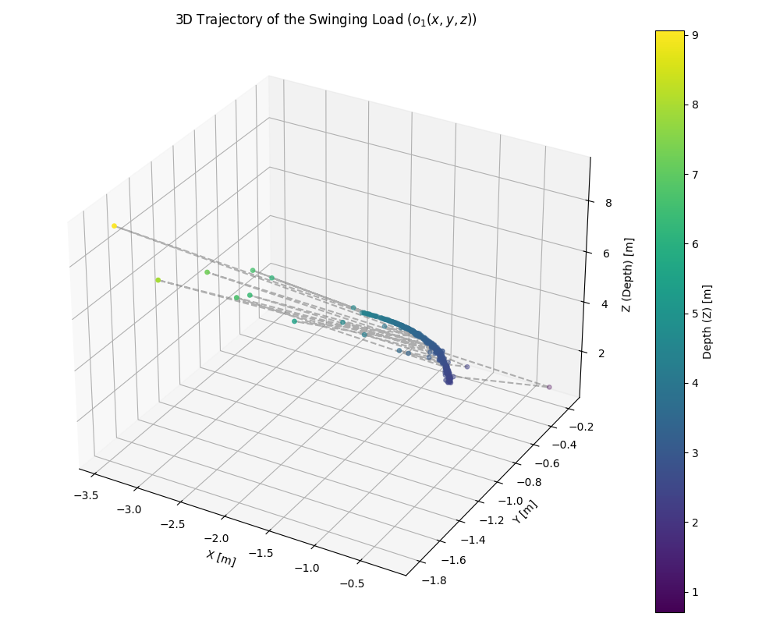
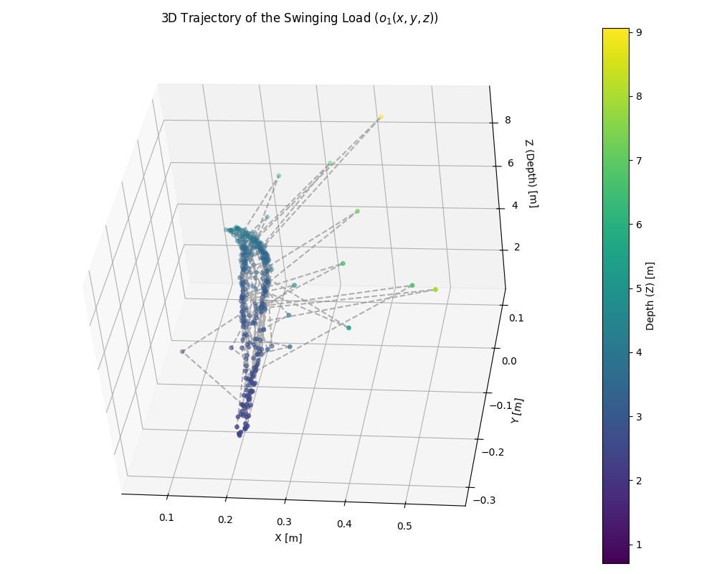

Results
3D Trajectory of the Swinging Load with 𝑀𝑖𝑛𝑡
3D Trajectory of the Swinging Load with 𝑀𝑑

Slide 8
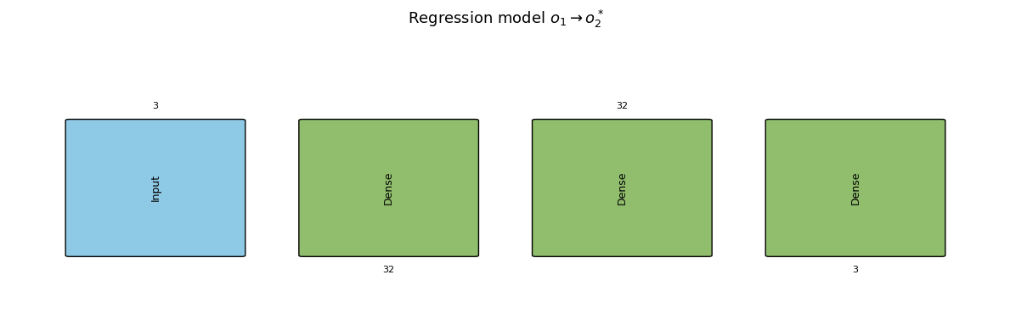
Objective & Method (d,e)
Objective: Learn the mapping fθ(o1) = o2* with an ML model and compare o1, o2 and o2* with the Euclidean error.
Method:
  Data: o1 (M_int) and o2 (M_d) of the 391 frames with valid depth, 80 % training / 20 % test
  Model: dense network 3-32-32-3 (ReLU), Adam, MSE loss, early stopping, normalized data
  KPI: RMSE on the training and on the test data
  Euclidean error per frame: ||a − b|| = √(Δx² + Δy² + Δz²)
Architecture of the regression model: 3 inputs (X, Y, Z of o1), two dense layers with 32 neurons, 3 outputs (o2*)

Slide 9
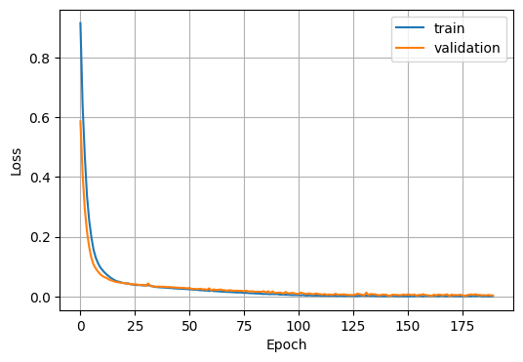
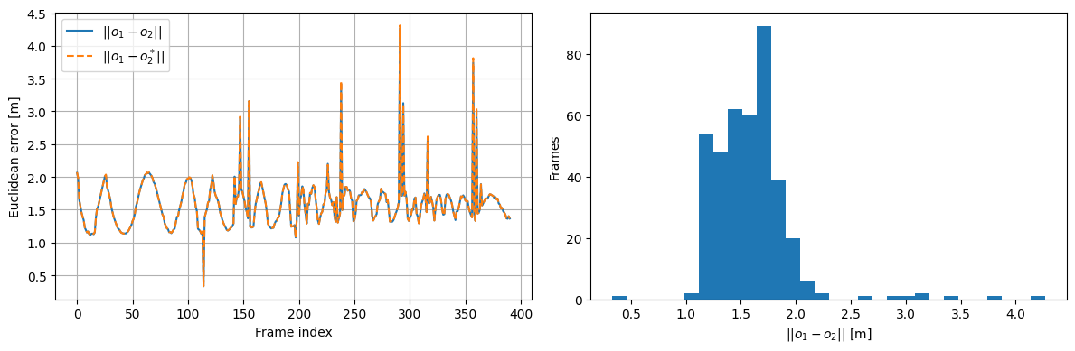
Results (d,e)
Training and validation loss
Euclidean error per frame (left) and distribution (right)
Train RMSE = 0.011 m, test RMSE = 0.013 m: both small and similar, so o2* ≈ o2 and the model does not overfit
||o1 − o2||: mean 1.59 m, max 4.27 m – the choice of M_int or M_d changes the trajectory a lot
||o2 − o2*||: mean 0.010 m – the model learns the difference of the matrices, but not which one is correct

Slide 10
Q2 – Lidar
25 points

Slide 11
Objective & Method
Objective:
            Given: Ouster Lidar + swinging box in Lab => Pointcloud
            Goal: find center and pose of swinging load
            Methods:
            RANSAC
            ICP

Slide 12
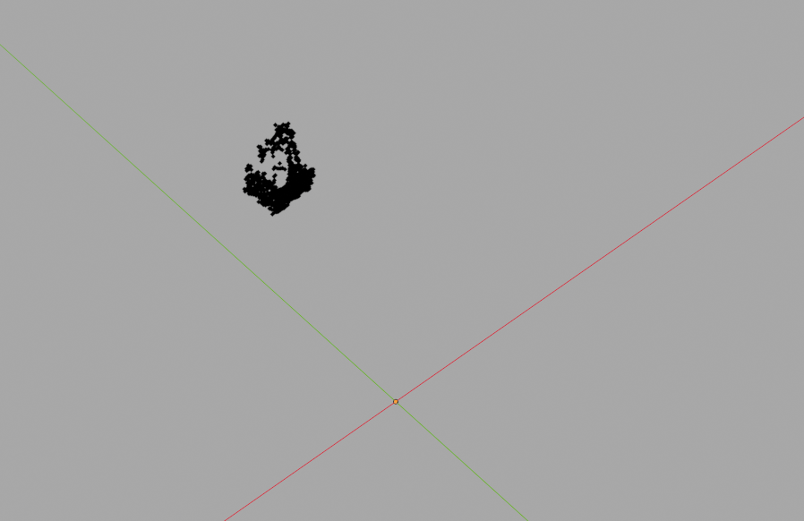
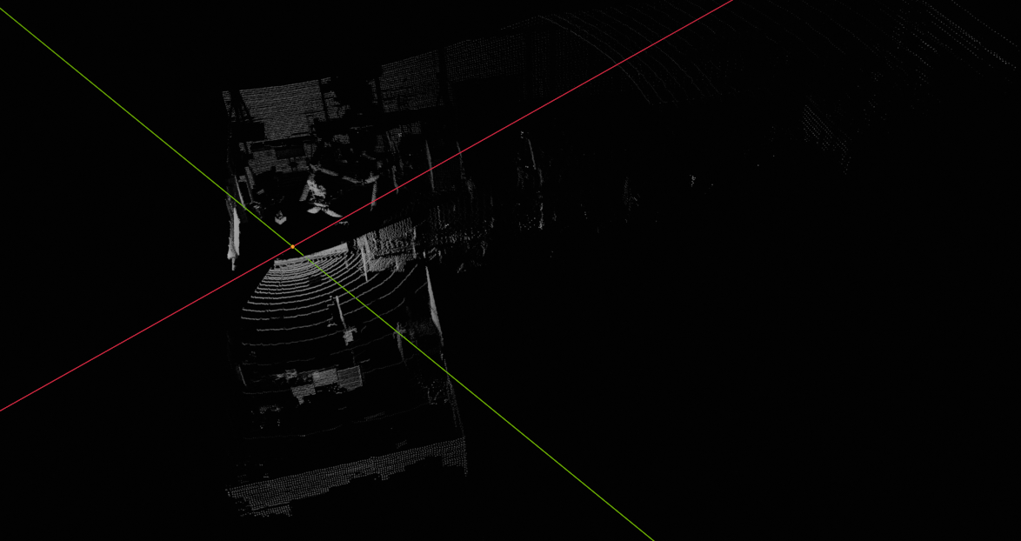

Slide 13
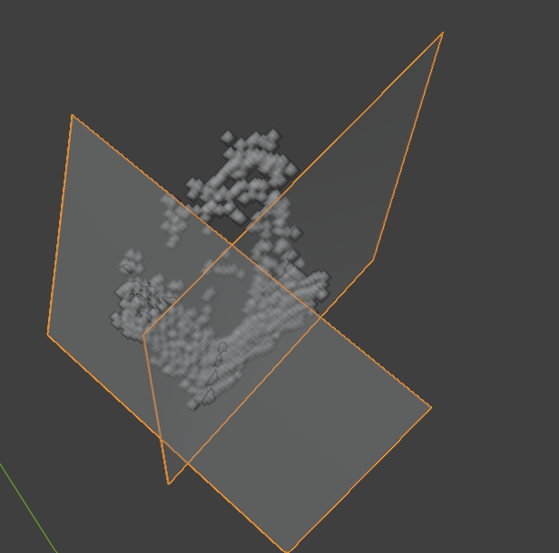
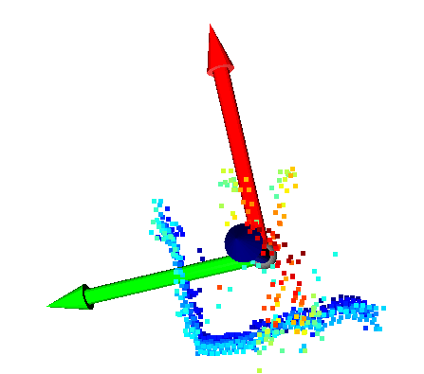
RANSAC
pick 3 random Points
1
estimate 1. plane with sufficient inliers
2
estimate 2. plane (perpendicular to 1. plane)
3
calculate 3. plane
4
select box dimension out of pointcloud
5
get center out of dimensions

Slide 14
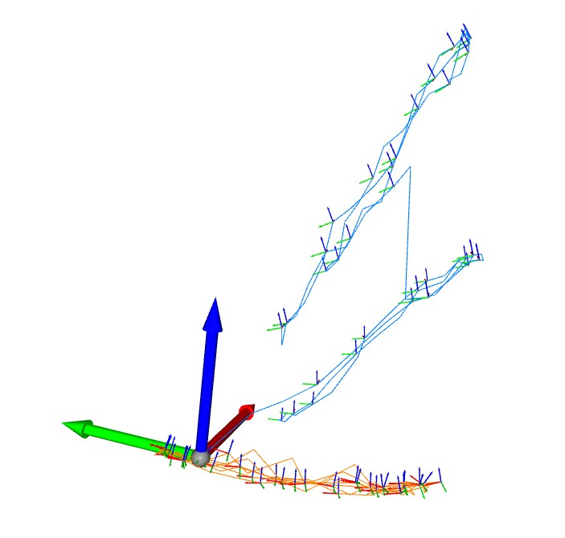
ICP
Match points from previous PC to consecutive PC
Error along normal instead of Euclidean distance
Iterate until Rotation and Translation converge
Problems:
  only relative Rotation and Translation
  relative large drift

Slide 15
Q3 – Camera-Lidar Fusion
25 points

Slide 16
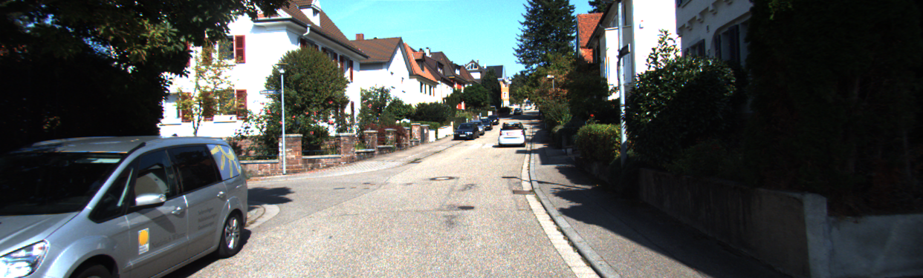
The KITTI data set
Sensors: 2 stereo camera pairs (grayscale and color), Velodyne HDL-64E lidar, GPS/IMU, mounted on a car driving through city, rural and highway scenes.
Files per sample: image_2 (left color image, 1242 x 375 px), velodyne (about 117,000 points with x, y, z and reflectance), calib (camera matrices) and label_2 (annotations).
Labels: one line per object with class (e.g. Car, Pedestrian, Cyclist), truncation, occlusion, 2D box in pixels, 3D size and 3D location in the camera frame. We use them as ground truth.
Example image of sample 007303
P2 3x4, projection matrix of camera 2 (contains the intrinsic matrix)
R0_rect 3x3, rectification of the camera
Tr_velo_to_cam 3x4, extrinsic matrix lidar → camera

Slide 17
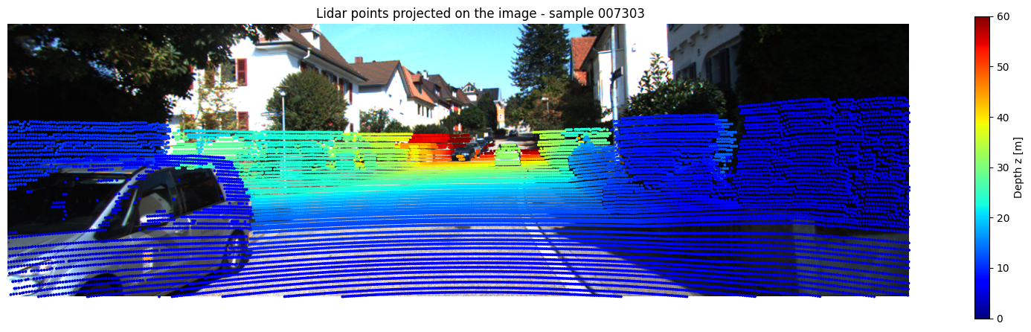
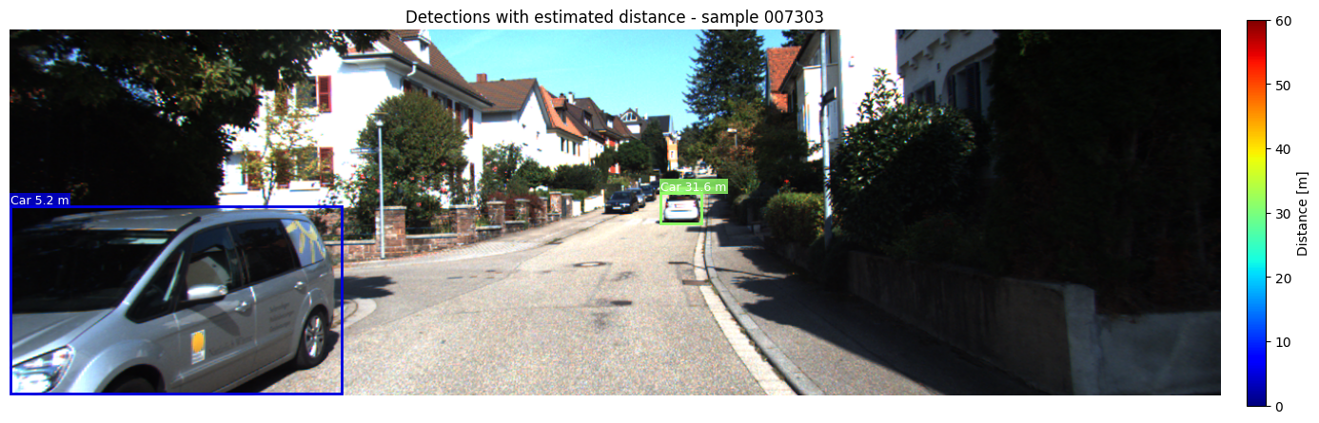
Results (b-i, b-ii)
(b-i) Lidar points projected on the image, colored by depth
Points on the car and on the houses fit the image; far points are red
YOLO gives the box, the distance is the median depth of the lidar points in the center of the box
(b-ii) Detections with estimated distance

Slide 18
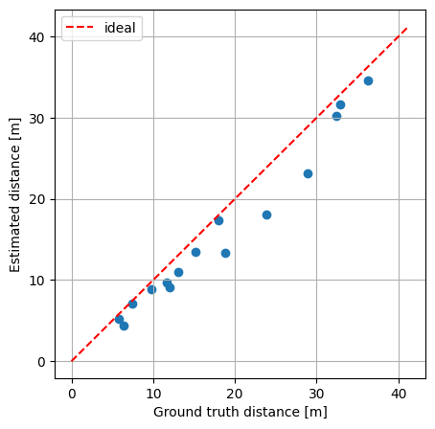
Results (b-iii) Validation
Sample | Estimated [m] | Ground truth [m] | Error [m] | Error [%]
000666 | 30.17 | 32.42 | -2.25 | -7.0
000666 | 18.09 | 23.80 | -5.71 | -24.0
000666 | 23.10 | 28.89 | -5.79 | -20.0
000666 | 13.40 | 18.79 | -5.39 | -28.7
001376 | 34.63 | 36.29 | -1.66 | -4.6
001376 | 4.45 | 6.35 | -1.90 | -29.9
001376 | 13.44 | 15.12 | -1.68 | -11.1
001376 | 9.74 | 11.63 | -1.89 | -16.3
005595 | 8.89 | 9.73 | -0.84 | -8.6
005595 | 10.99 | 13.07 | -2.08 | -15.9
005595 | 17.31 | 17.96 | -0.65 | -3.6
005595 | 7.14 | 7.45 | -0.31 | -4.1
005595 | 9.12 | 12.00 | -2.88 | -24.0
007303 | 31.60 | 32.86 | -1.26 | -3.8
007303 | 5.18 | 5.78 | -0.60 | -10.3
Mean absolute error 2.33 m, RMSE 2.93 m
All errors are negative: the ground truth is the center of the car, the lidar hits its rear surface

Slide 19
Q4 – Autonomous navigation and slip estimation
25 points

Slide 20

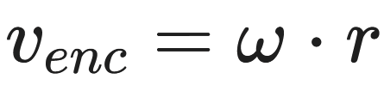
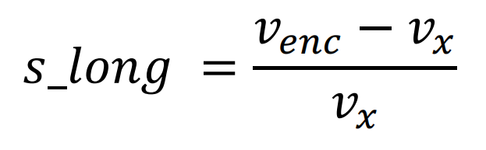
Objective & Method
Objective: Simulate the autonomous navigation of a robot in Webots toward a predefined target, implementing obstacle avoidance.
Method:
  Navigation and Collision Avoidance
  Speed ​​Calculation:
  Slip Estimation:

Slide 21
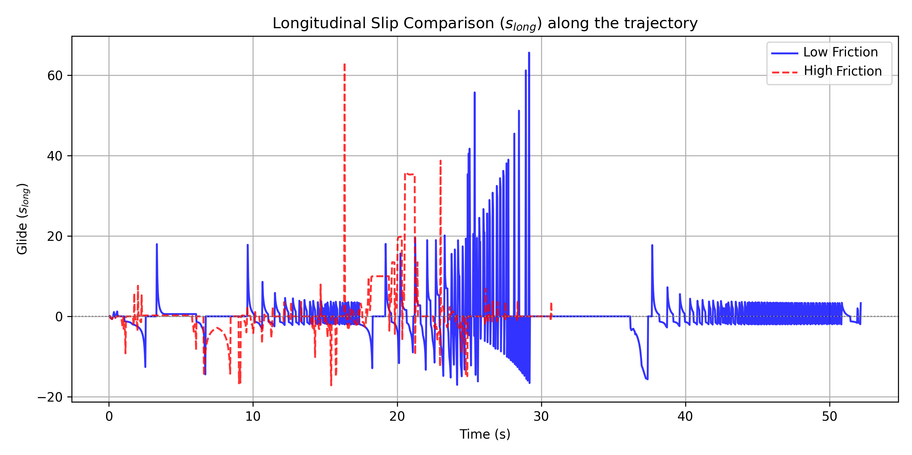
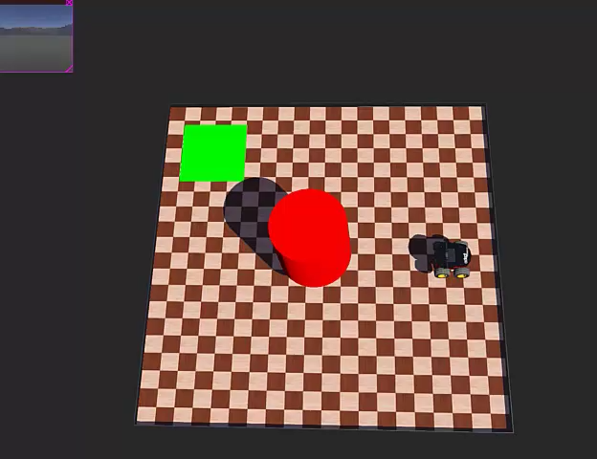
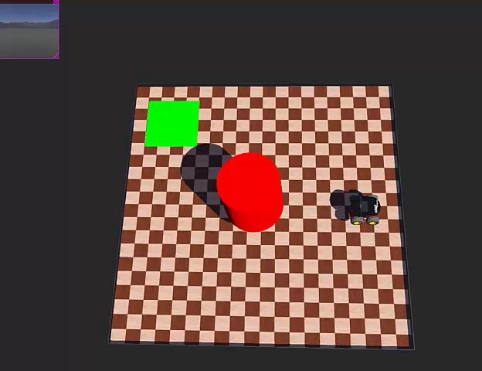
Results
Low Friction
High Friction

