Slide 1

prideBnB
Travel With Pride
NIU-HACKATHON 2022
TEAM C.O.D.E

Slide 2


Prospects of prideBnB
01
Motive of App
Why prideBnB?
Societal Impacts
02
Technicalities
Working of prideBnB
Features
Enhancements Proposed
03
Team Roles
Workflow Management
Roles and Responsibility

Slide 3
Problems Faced
We’re not welcome — or safe — in all parts of the world.
People make a lot of assumptions about us.
We worry a lot about coming out — or being outed.
Stats and Reviews by Booking.com
34 percent of LGBTQ+ travelers from India would like increased breadth of information and visibility on a destination’s LGBTQ+ friendliness, including local laws, cultural information, hate crime statistics and religious sensibilities.

Slide 4

An app to assist LGBTQ+ community to find hotels and destinations with good hospitability.
It gives curated list of destinations based on rating where LGBTQ+ communities are welcomed.
It is important to ensure safety and the locations recommended here are safe.
It helps to be a part of greater facilitator in travel and tourism needs of LGBTQ+ communities.

Slide 5
Why prideBnB?
Categories
Maps
Community
prideBnB provides different categories of hotels, beaches, marriage destinations which are LGBTQ friendly.
Get pin point map locations and contact information of the hotels
One place for planning tour and travel across India.
Reviews
Popular Results
Find reviews of hotels , resorts, beaches about their hospitality.
Give ratings too
The Results are indexed based on ratings given to the particular hotels and destinations

Slide 6
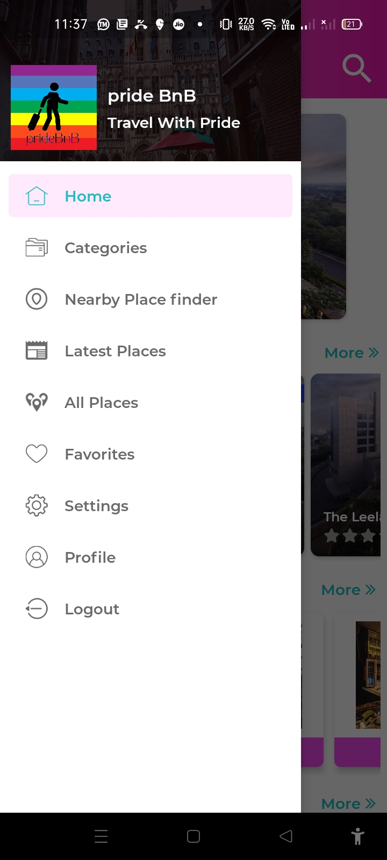
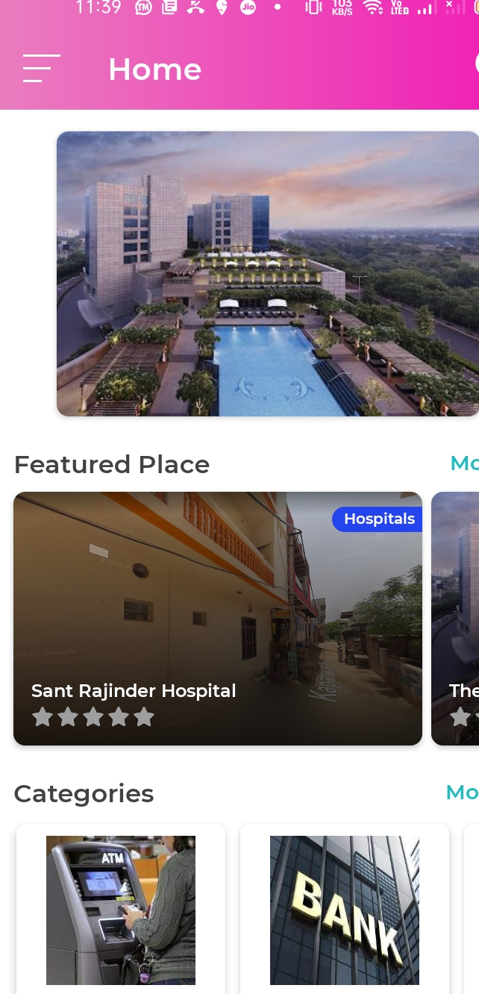
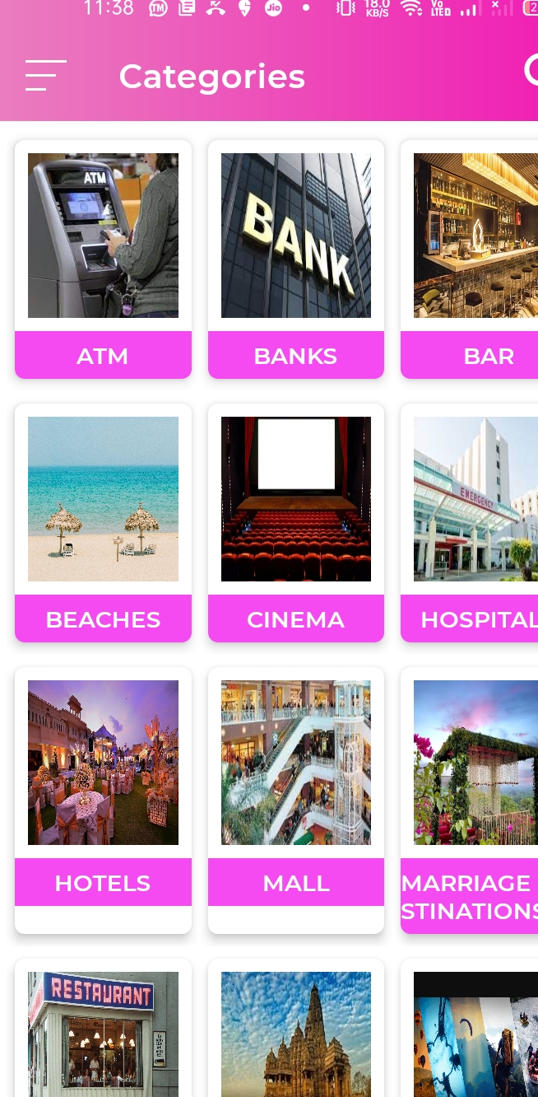

Slide 7
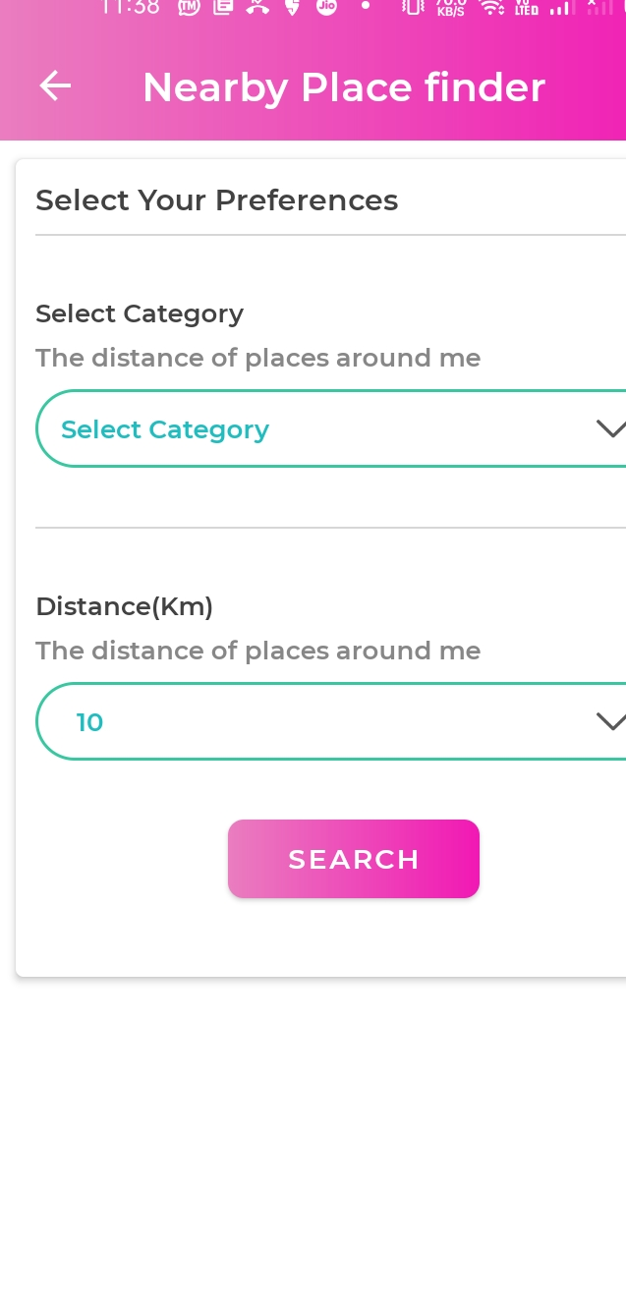
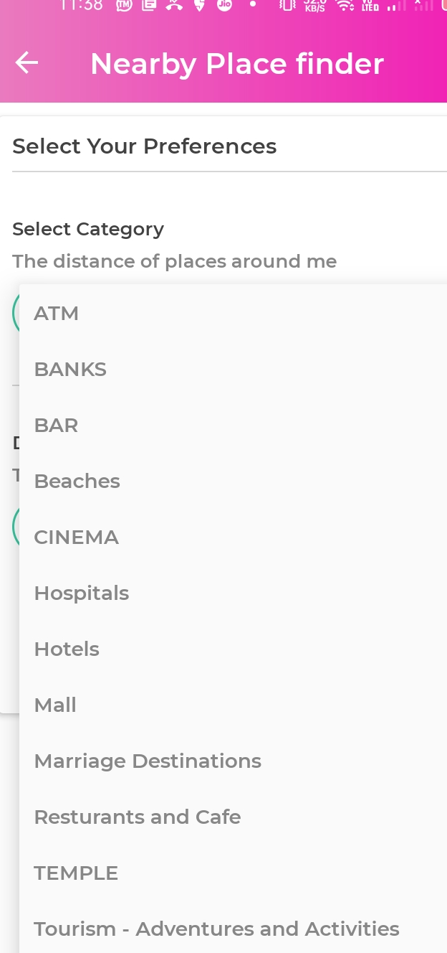
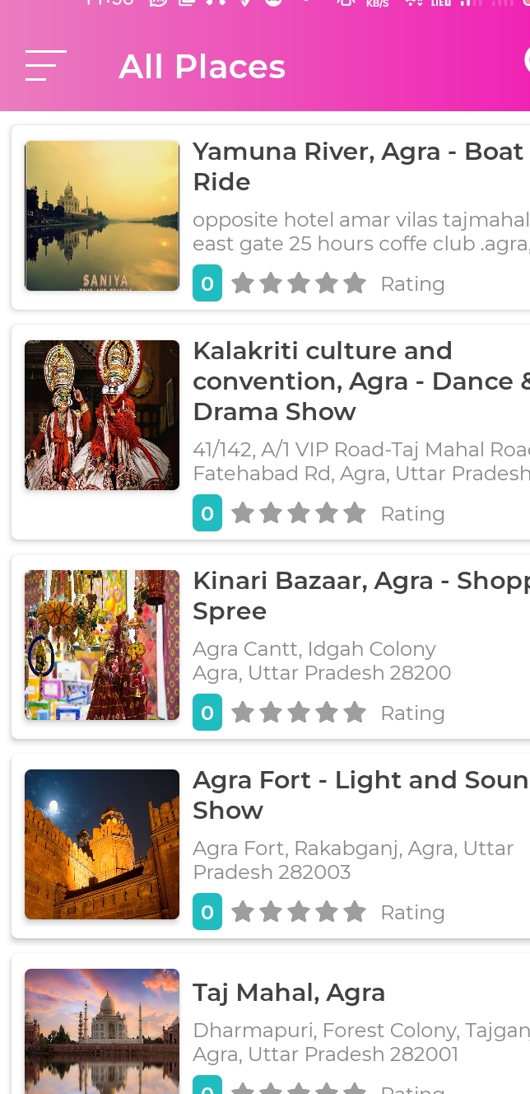

Slide 8
Technology Stack Used
Android-JAVA
PHP
One Signal for push notifications
Firebase login
MySQL
Cpanel- Dashboard
Domain Provider- freenom

Slide 9
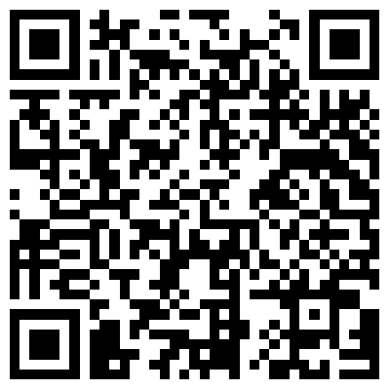
Download App

Slide 10
THANK YOU
Team C.O.D.E

