Slide 1
Version Control & GitHub Basics

Slide 2
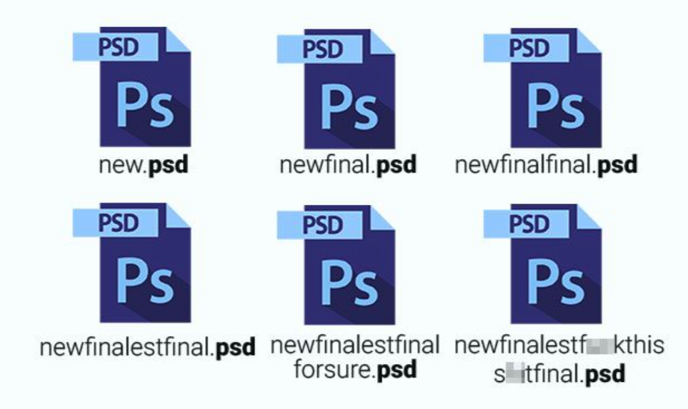
Problem Without Version Control
Lost code
Overwritten files
No history
Team conflicts

Slide 3
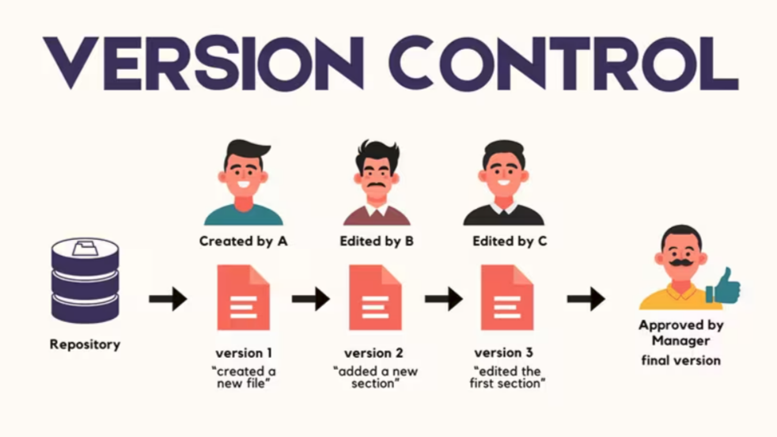
What is Version Control
Tracks changes
Saves history
Restore versions
Supports teamwork

Slide 4
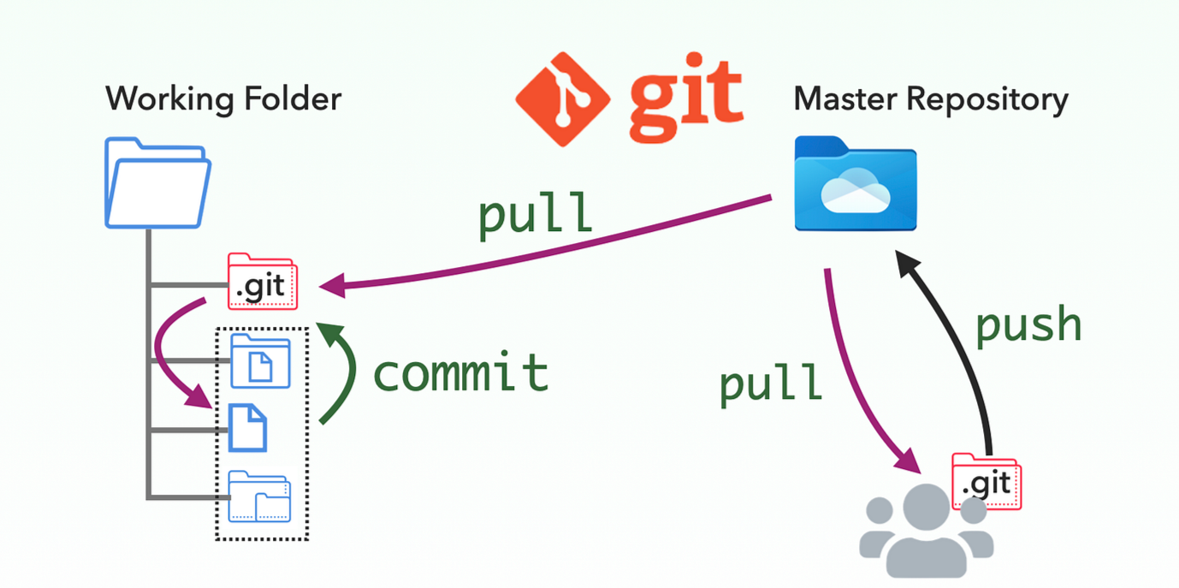
Git
Local tool
Tracks changes

Slide 5
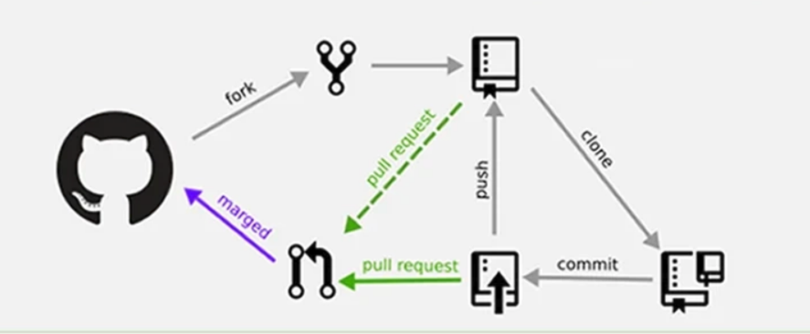
GitHub
Cloud platform
Stores repos
Enables collaboration

Slide 6

Git vs GitHub
Git → local
GitHub → online

Slide 7

Core Concepts
Repo → project
Commit → snapshot
Branch → parallel work
Merge → combine

Slide 8
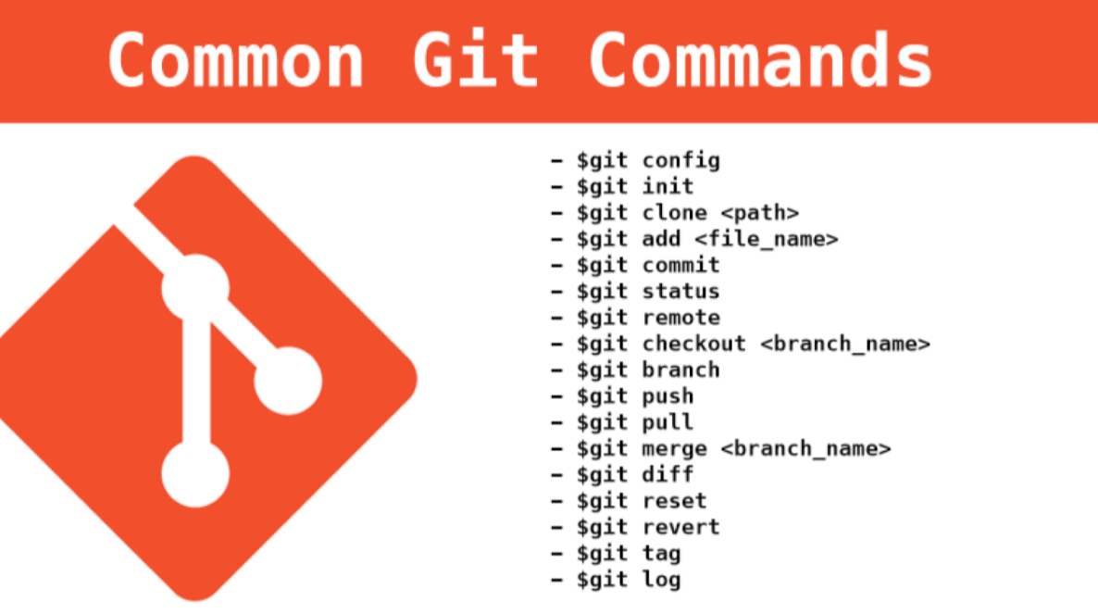
Commands
init
add
status
commit
push
pull

Slide 9
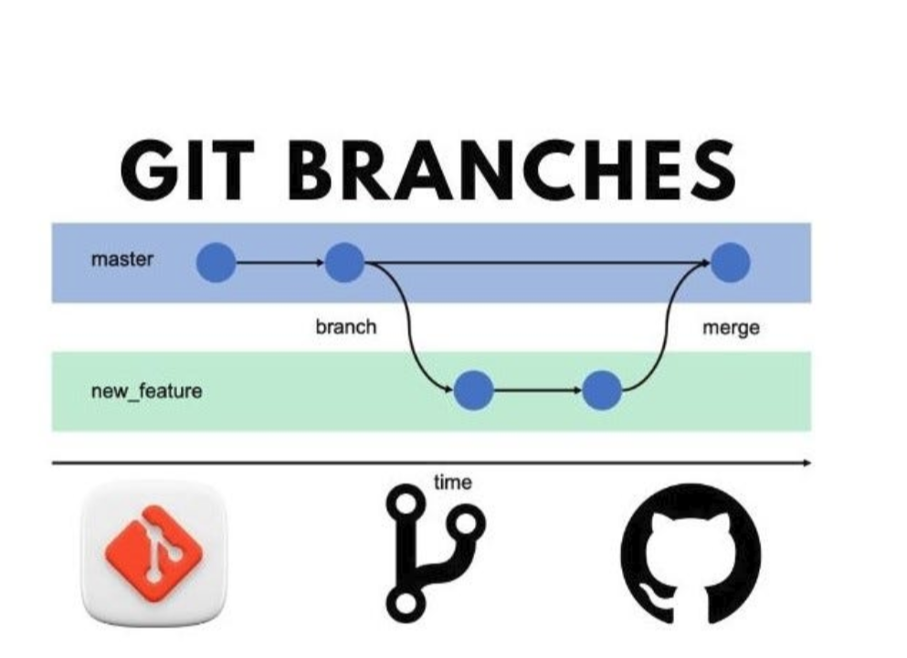
Branching
Main/dev = stable
Feature = new work
Safe changes

Slide 10
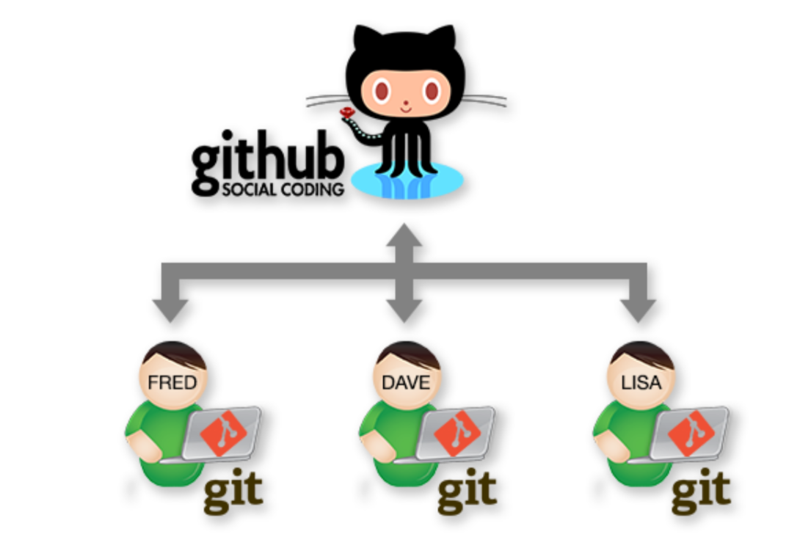
Collaboration
Multiple developers
Pull requests
Code review

Slide 11
Thank you for your attention
Questions?

