Slide 1
Phishing Awareness Training
Recognize phishing emails and fake websites.
By Ritvik Jha

Slide 2
Agenda
Recognize phishing emails and fake websites
Social engineering tactics
Best practices and detection checklist
Real-world examples
Interactive quizzes

Slide 3
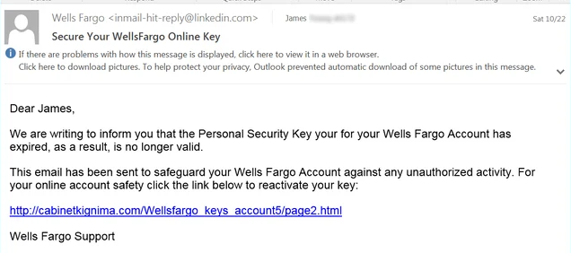
How to Recognize Phishing Emails
Check sender address vs display name and return-path
Hover links to inspect actual href; avoid clicking shorteners
Look for urgent language, unexpected attachments, spelling errors
Verify domain, SSL certificate, and presence of brand pages
Check authentication headers (SPF, DKIM, DMARC) for failures

Slide 4
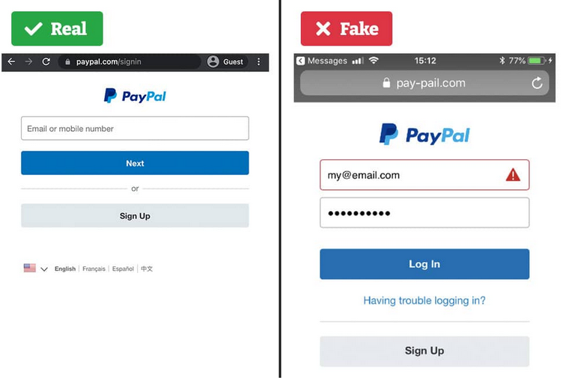
How to Recognize Fake Websites
URL anomalies: IP hosts, punycode, extra subdomains, suspicious TLDs
Certificate mismatch or self-signed TLS warnings
Look for password fields on non-official domains
Visual UI inconsistencies: logos low-res, broken CSS, mismatched content
Unexpected redirects, query parameter obfuscation, long URLs

Slide 5

Social Engineering Tactics Used by Attackers
Brand impersonation and spoofed support messages
Urgency and fear to bypass rational checks
Credential harvesting via fake login pages
Multi-step scams combining email, phone, and SMS
Use of image-only emails and obfuscated links

Slide 6
Best Practices and Detection Checklist
User Hygiene
1
• Enable multi-factor authentication (MFA) everywhere possible
2
• Verify sender identity before responding or clicking
3
• Do not enter credentials from email links; use bookmark or search
4
• Keep OS, browsers and plugins up to date
5
• Use dedicated browsers/profiles for sensitive logins
6

Slide 7
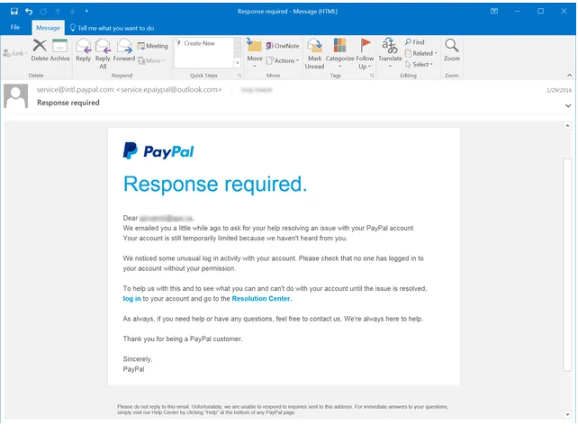
PayPal-style credential phishing (email)

Slide 8
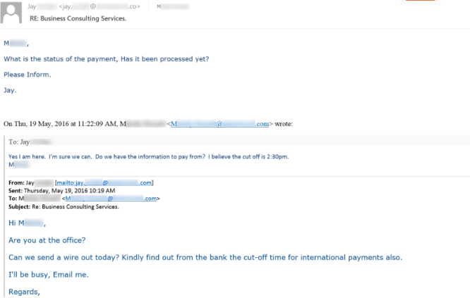
Ceo Impersonation Emails
Phishing Awareness Training — Prepared by Security Team

Slide 9

Interactive Quiz
1. Q1. You receive an email asking to 'verify account' with a link. The link domain is different from sender. Action?
2. Q2. Sender claims 'urgent payment' from CEO. Email asks to wire funds to new account. Action?
3. Q3. Email has attachment invoice.exe. Action?

