Slide 1



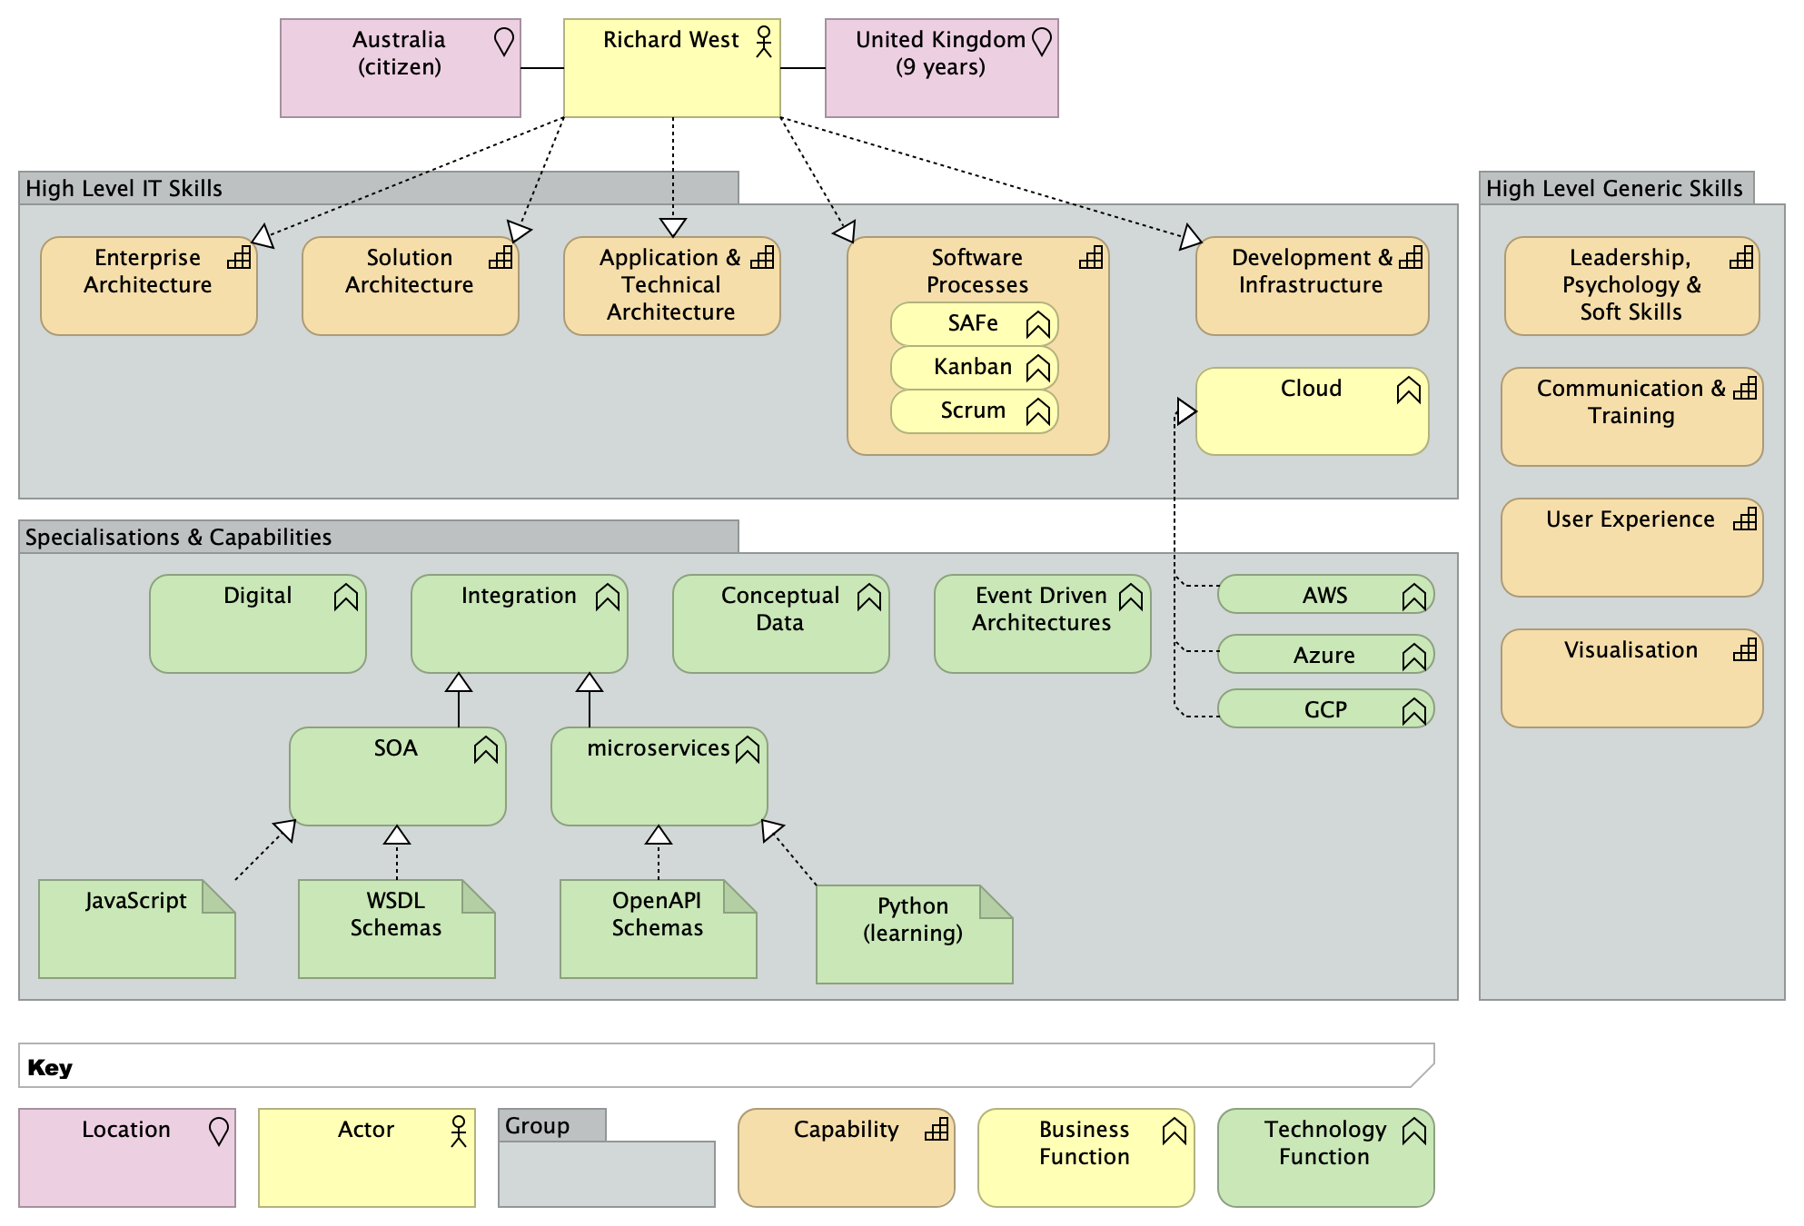

Richard West – Poly Architect & Future Chief Architect : https://www.linkedin.com/in/rwest/ richard.west.biz@me.com 0421 499 3259
Career Summary
Experienced Enterprise, Solution and Technical Architect with specialisations in Cloud / Distributed Systems, Digital and Integration
15 years experience as an Enterprise and Solution Architect
20 years Digital experience using Responsive Web, Tablet and Mobile to craft Customer Experiences
20 years of creating Integration and Service based architectures, including SOA and MicroServices
20 Years Agile/XP and Certified Scrum Master and Kanban Certified Practitioner including coaching
Broad experience across Energy, Utilities, Finance, Insurance, Health, Media and Telecom Sectors
Performed Governance, Process and Technical Design Authority roles at the Enterprise level
Creation of Digital Infrastructure and Content Management using AEM and Sitecore on AWS and Azure
Patterns / Blueprints Experience, producing and using them at Enterprise, Solution and Technical levels
6-8 figure programmes for companies such as Atlassian, CBA, NAB, Telstra, Thames Water, CGI / UK Smart Metering, Lloyds TSB, IFDS, XChanging, RSA, Vodafone, British Gas, Prudential, TNT, and BAE / Defence
RFx/SoW and evaluations for South-East Water, Thames Water, British Gas, Vodafone and many others
Supplementary skills in Requirements along with Business, Information and Conceptual Data Modelling
Used UML for 20 years and ArchiMate for the past 10 with a variety of tools
Certifications
Certified Scrum Master - Scrum Alliance
The Open Group Architecture Framework
Kanban Certified Practitioner
Rational Unified Process
Kepner-Tregoe Project Management
Member
Association of Computing Machinery (ACM)
Australian Computer Society (ACS)
Education
Bachelor of Science in Computer and Instrumental Science: Swinburne University of Technology, Australia
HSC at Camberwell Grammar School, Victoria, Australia
Core Skills
Architectural:
Cloud: Equal Azure and Amazon Web Services, with some IBM, Google and OpenShift
Digital: Designed and implemented using Web, Portals, Caching, Mobile
Enterprise Architecture Frameworks: ArchiMate, TOGAF, Zachman, IFW and DoDAF
MicroServices & SOA: Created end-to-end Enterprise to Logical to Physical Architectures
Patterns: Erl SOA, Hohpe SOA / EAI, J2EE, Gang of Four and Custom
Solution Architecture & Design: Across Cloud, JavaScript, J2EE, .NET and Mainframe
Other:
Hobbies: Boating, Electronic Music and Photography
Misc Skills: Project Management, Mentoring, Usability, Training and Process
Soft Skills: Design Thinking, 6 Hats Thinking, Team Leadership, Mentoring Communication
Software Processes: Agile, XP, Scrum, Lean, Unified Process, V Model, Waterfall
Technical:
Cloud: Azure, Amazon Web Services, with some RedHat OpenShift
ESBs: WebSphere Message Broker, WebMethods, Mule and FUSE
Java / J(2)EE: Up to Java 8 & JEE 7 on WebSphere, WebLogic, Tomcat and JBoss
Miscellaneous: Drools (Rules Engine), and Vaadin (RIA)
Mobile: PhoneGap, Ionic (Cordova+Angular) with Bootstrap, Android, iOS
Web Content Management: Adobe CQ / Experience Manager (AEM) and Sitecore
Workflow: PEGA and Bonita
Above Model is browsable at https://riczwest.github.io/cv/browse/index.html
Text for this page from a Markup/Python notebook

Slide 2












Richard West – Poly Architect & Future Chief Architect : https://www.linkedin.com/in/rwest/ richard.west.biz@me.com 0421 499 3259
Senior Architect – Permanent
Solution Architect – Long Term Contract
Solution Architect
Enterprise Designer & Toolsmith
Solution Architect
Digital & AEM Solution Architect
AIA Vitality
2017
Aus Red Cross Blood
Telstra
NAB
South East Water
2021
Accenture
2018
2019
Current
Fill position for a few months while permanent person finished up their role
Upgraded AEM skills to version 6.2
Finished of Solution Design for new Insurance Product Quotation system
Created High-Level Solution Design for new Insurance Product website, including mapping to and estimations for AEM standard and custom components and helped with costings for total project
Archi, AEM Tooling, Atom and Eclipse
AEM – Adobe Experience Manager
Part of SWAT Team to help next-generation Donor Portal project achieve desired timeframes
Created Solution Architecture for Digital component of “next generation system”
Ensured timely delivery of various components on an aggressive schedule
Agile Coach to team to accelerate delivery of critical components
Visio, Orbus
Oracle Service Cloud
Worked in Strategy & Programmes team for Office of the CTO to help develop and implement new architectural approaches
Mentored groups in Design Thinking for various projects
Helped run and facilitate Design Thinking for Open Source Strategy
Prototyped Business Architecture tooling in JIRA, Confluence, Sparx Enterprise Architect with Node.js microservices on AWS
Developed base Knowledge Management Architecture for CTO-Architecture team and implemented it in Office 365 SharePoint
Design Thinking, Atom, JIRA, Confluence, Sparx Enterprise Architect and ArchiMate
SharePoint 365, Node.js
Created various Solutions
End to end solution (People, Process and Technology) for new Card
High-level AWS designs for various Infrastructure and Microservices
Database (Oracle & MS SQL) and Application migration to AWS
Key input to “best practice” Jira and Confluence patterns and templates for doing Solution Architectures on various Projects
Trialed the use of ArchiMate notation for Solution Architecture
Confluence, Jira, Visio, Alfabet
AWS, Oracle, MS SQL, Verint (call recording)
Performed a variety of duties at the Enterprise and Solution level including
Established Solution and Technical Patterns
Oversaw Solution Deployment Architectures for Dell Boomi and PEGA by outsourcer
Took Public Web Site and Health Safety and Environment from RFx to Design and Implementation
Created new microservice template for Confluence
Created various Solution and microservice designs for AI based data matching, water meter readings and leakage detection
Confluence, Jira, Visio, Orbus, Visual Code, Swagger
Azure, SAP PeopleSoft, SAI, Boomi and PEGA
Work on Bids and Enterprise, Solution & Technical Architectures for clients
Currently on highly complex technical bid for Energy Sector involving distributed “calculation engine”, including Linear Programming & Constraint Rules
Worked on Technology Transformation bid for major Australian bank
Created High Level Technical Solution for Digital system for major Australian bank
Re-architected Logistics and Quoting Application
Created Solution for Ideation System for major branded Australian software company
Confluence, Jira, Archi, Swagger
Azure, GCP, Git, Visual Code, Python, Jupyter Notebooks and Lab
Application & Solution Architect
Enterprise Solution Architect
Interim Digital Architect
Integration Architect
Enterprise SOA / Integration Architect
Digital Solution Architect
2016
2012
Xchanging / Lloyds
2013
IFDS
2014
CGI
2015
Thames Water
2016
Health Ed’n England
DB Results
Global Core Insurance solutions, including the London Insurance Market at Lloyd’s of London.
Create Solution Architectures for Xchanging’s new programmes, including an iPad application (X-presso) for Insurance Brokers in the London Insurance Market. Helped develop Claims State Model.
Part of Boston-based State Street Corporation, the world’s leading provider of services to institutional investors.
Architect, Manage and Implement a new Service Oriented Architecture and perform SOA Migration to WebMethods.
CGI were engaged by the UK Government
to create the “bus” for Smart Metering infrastructure between the consumer and suppliers.
Introduce SOA practices to a Component oriented design for the UK Smart Meter project and build architecture to support Enterprise level capabilities for the smart meter “backbone”
Thames Water’s service the “Greater London Area” and have a customer base of roughly 20M
Create Baseline Digital Architecture for Thames Water’s Transformation including Reference Solution and Technical Architectures using SiteCore and Ionic on Private Cloud, AWS and Azure.
HEE Manage are a sub-organisation of NHS England for the training across the UK
Create 5 year Enterprise Roadmap for Health Education England using a Scrumban process which we then trained HEE staff in by co-creation and involvement in its iteration.
DB Results are a small Australian consultancy firm.
Architected Business Self Service Portal for ATO deployed on AWS
Developed Integration Strategy for Vodafone.
Refined Agile methodology and Solution Architecture approach
Prior to 2012
Worked in Insurance, Banking, Consulting, Defense, Electrical Utilities, Vendors and Academia
• Enterprise, SOA, Solution, Application and JEE Architect
• Architected and Implemented Websites for up to 20M users
• Created Architectural Processes and Approaches from the ground up
• Coached organisation and created courses for Scrum (certified) and Kanban
• Built and managed teams of up to 20 Architects and Developers
• Created technology which resulted in a Patent Application
• Created and Delivered various courses on Industrial and Lecturer for Academic subjects
• #FunFact I did 2 years’ work experience in Sweden, so spoke fluent Swedish
All files and sources hosted in Git: https://github.com/RiczWest/cv – check here for latest version as I’m doing this iteratively and will update more 🙂

