Slide 1
PROJECT REPORT NAME: RIDHAM KHAZANCHI

Slide 2
Task: Learn and document ways to identify web elements using XPath and CSS Selectors.
XPath allows you to navigate and select elements based on their structure and relationships in the HTML document.
Examples:
Relative XPath: //input[@id='username’]
Text-Based XPath: //button[text()='Submit’]
XPath with Axes: //div[@class='form']//following-sibling::input
CSS Selectors are patterns used to select elements based on their attributes like ID, class, or type.
Examples:
ID Selector: #username
Class Selector: .input-field
Attribute Selector: input[type='text']

Slide 3
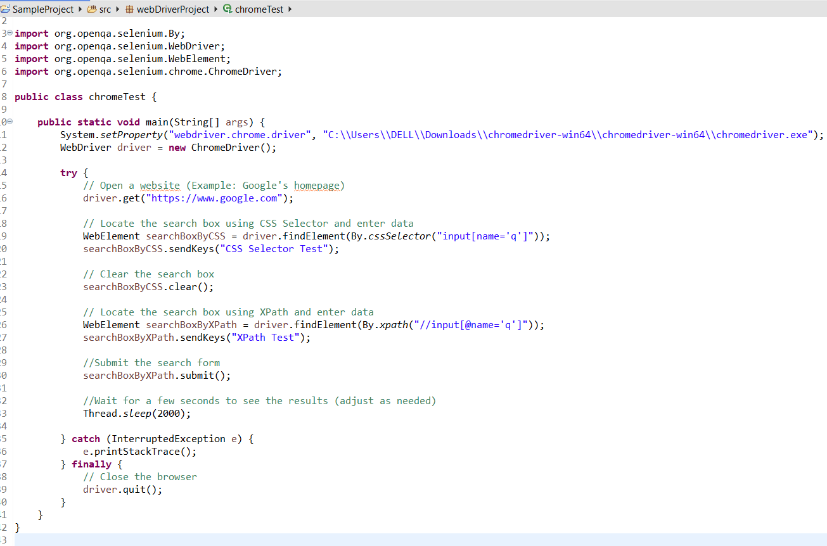
Use of xpath and css selector

Slide 4
Task: Download and configure Java WebDriver for Firefox and Chrome browsers.
For Chrome:
Go to the ChromeDriver download page.
Download the version matching your Chrome browser.
Extract the downloaded file.
For Firefox:
Go to the GeckoDriver download page.
Download the version matching your Firefox browser.
Extract the downloaded file.
Download the WebDriver for Chrome and Firefox.
Place the WebDriver executables in a known directory.
Configure your project to use the WebDriver.
Add Selenium dependencies to your project.
Write and run sample code to verify configuration.

Slide 5
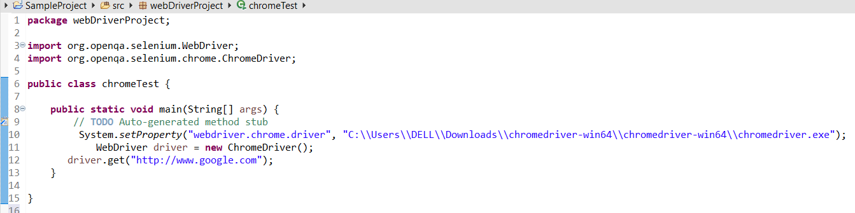
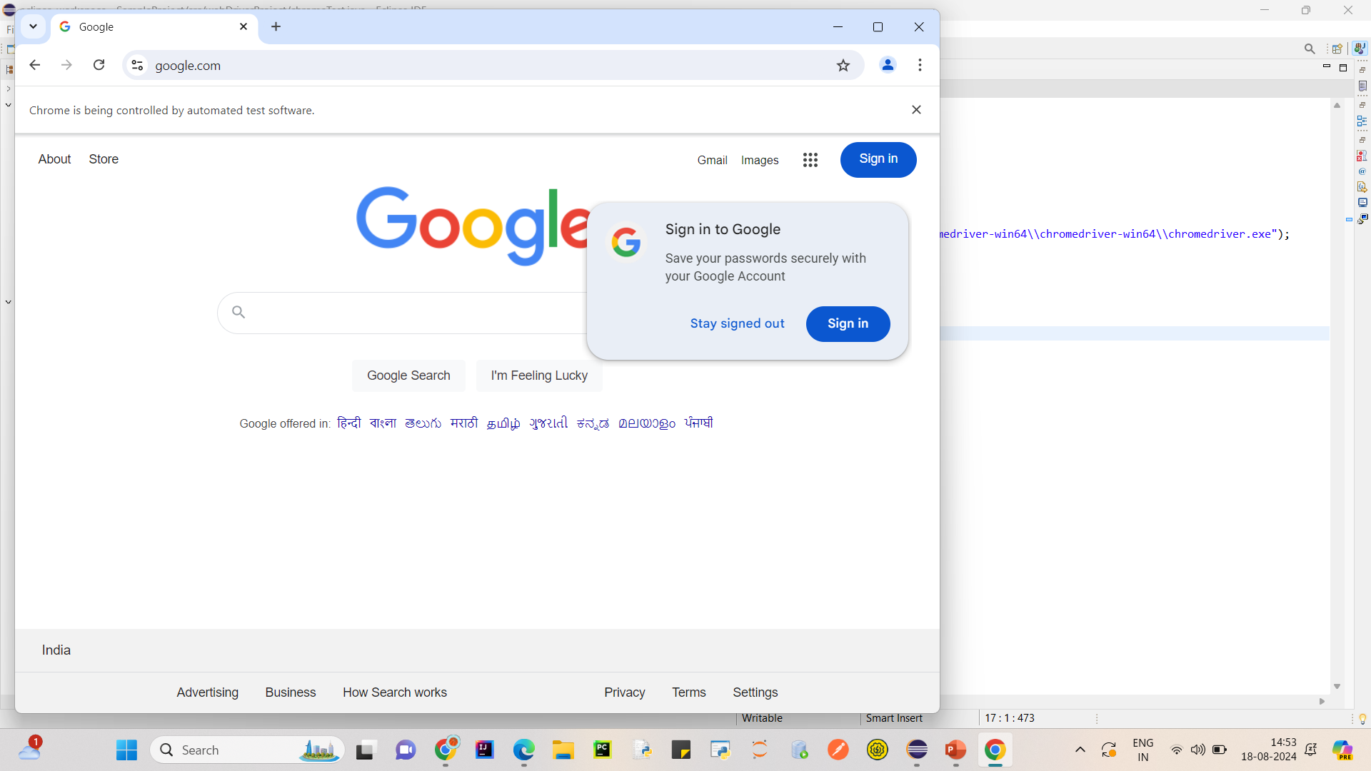
Chrome Driver

Slide 6
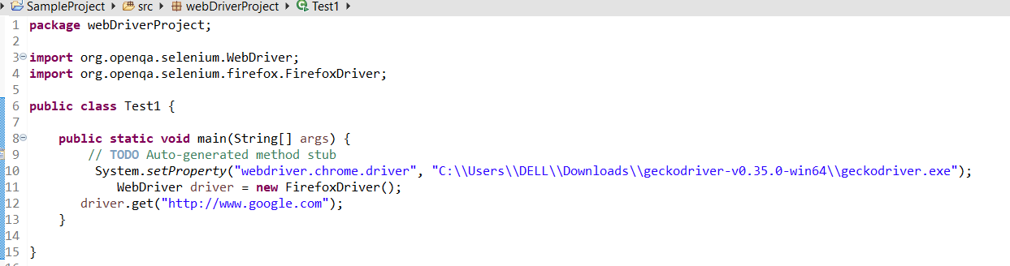
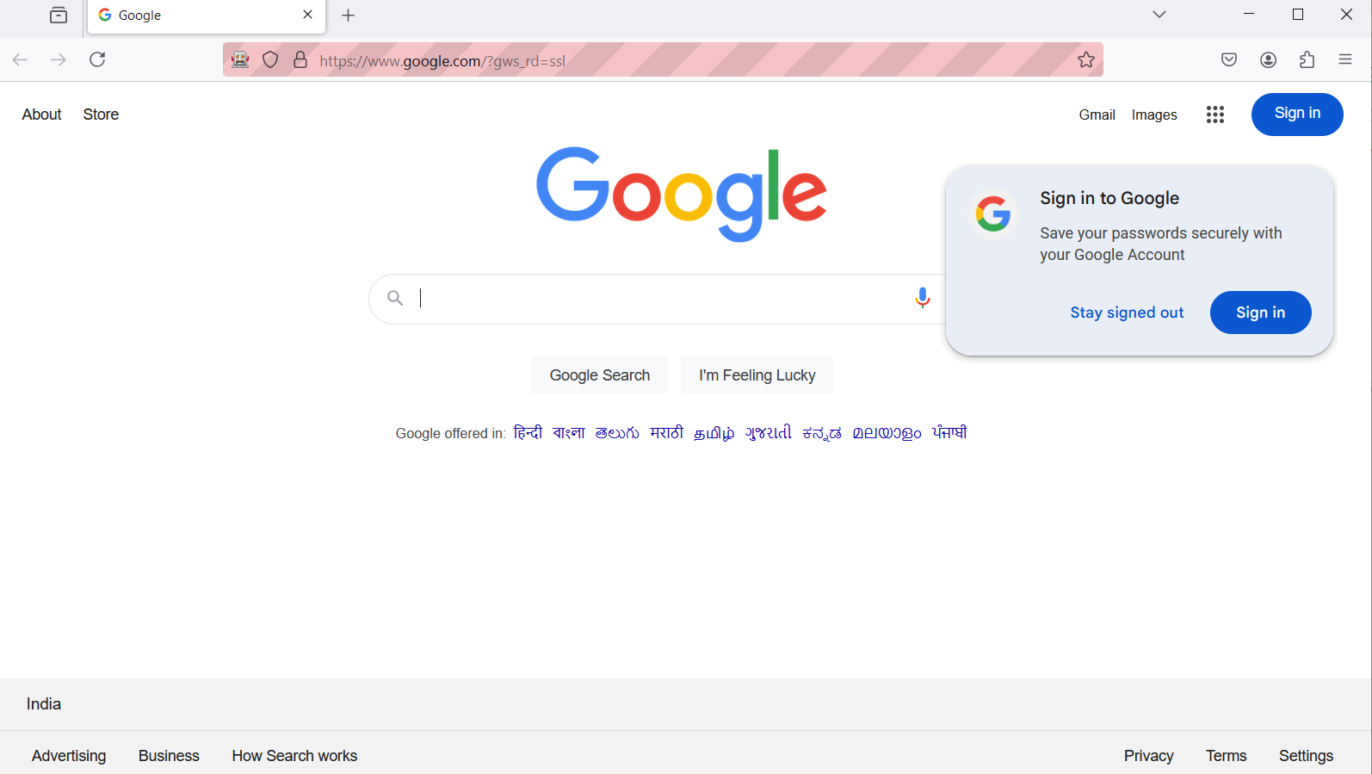
Firefox Driver

Slide 7
Task: Write scripts to handle different types of web elements on the DemoQA Forms page: input boxes, buttons, list/selection/drop-down boxes, radio buttons, and checkboxes.
The script sets up a ChromeDriver instance to automate interactions on the DemoQA Forms page. It fills out the form by entering text into input fields, selecting radio buttons, setting the date of birth, choosing subjects and hobbies, uploading a picture, and selecting the state and city from dropdowns. After filling out the form, it submits the form and then closes the browser.

Slide 8
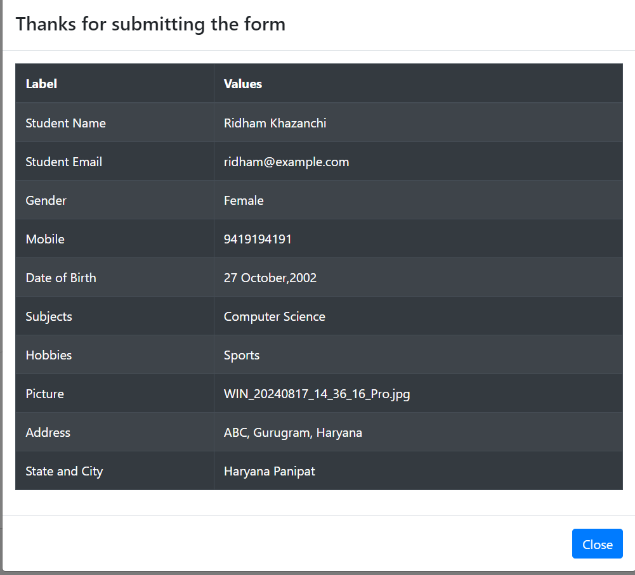

Slide 9
Extract all links and other web elements from the Wikipedia Main Page. Implement synchronization using implicit and explicit waits.
This Selenium WebDriver script is designed to interact with the Wikipedia homepage by performing a series of actions including navigating to the site, extracting and clicking on language links, selecting a language from a dropdown, and conducting a search.
The script starts by setting up the Chrome WebDriver and opening the Wikipedia homepage. It then finds all the language links on the page and iteratively clicks each one, waits for the page to load, and navigates back to the main page.
After interacting with the language links, the script selects "English" from the language dropdown using the Select class and performs a search for "Selenium WebDriver" in the search box.
Synchronization is handled through basic Thread.sleep() calls to ensure that the script waits for the necessary elements to be ready before interacting with them.
Finally, the script handles exceptions gracefully and ensures that the browser is closed properly at the end of the execution.

Slide 10
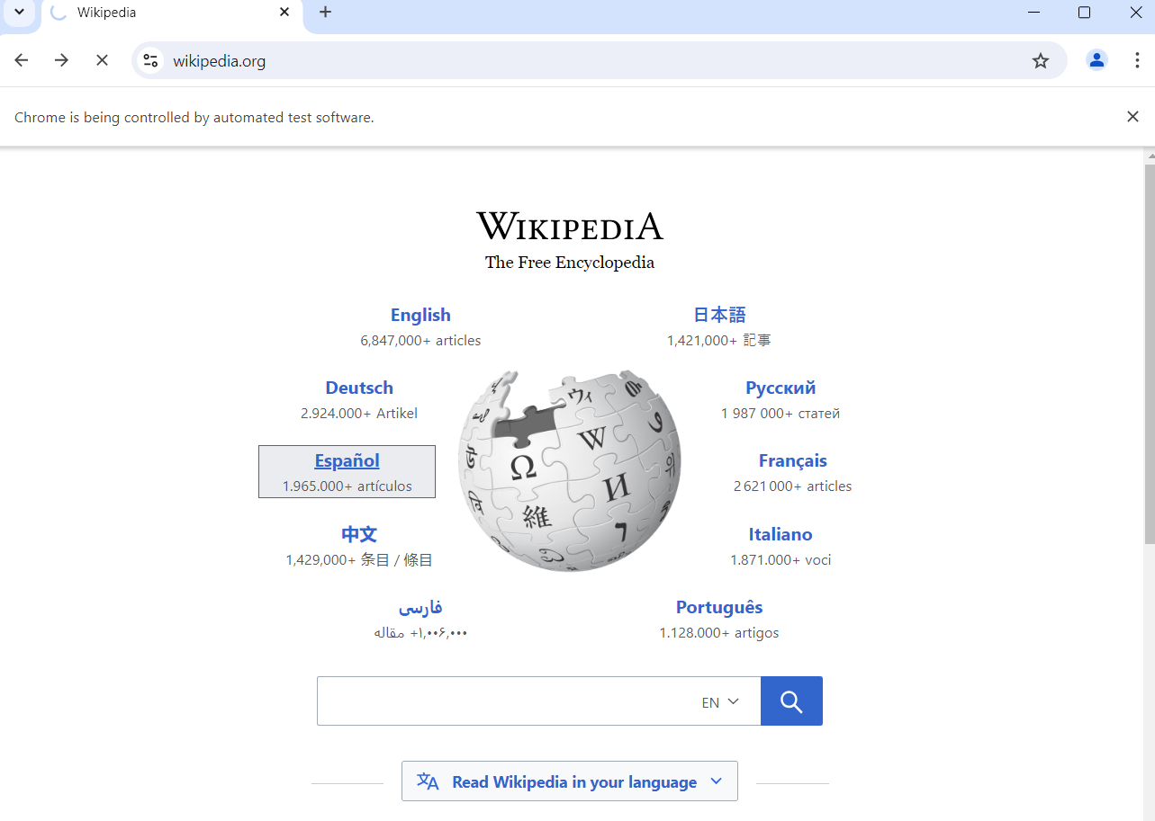
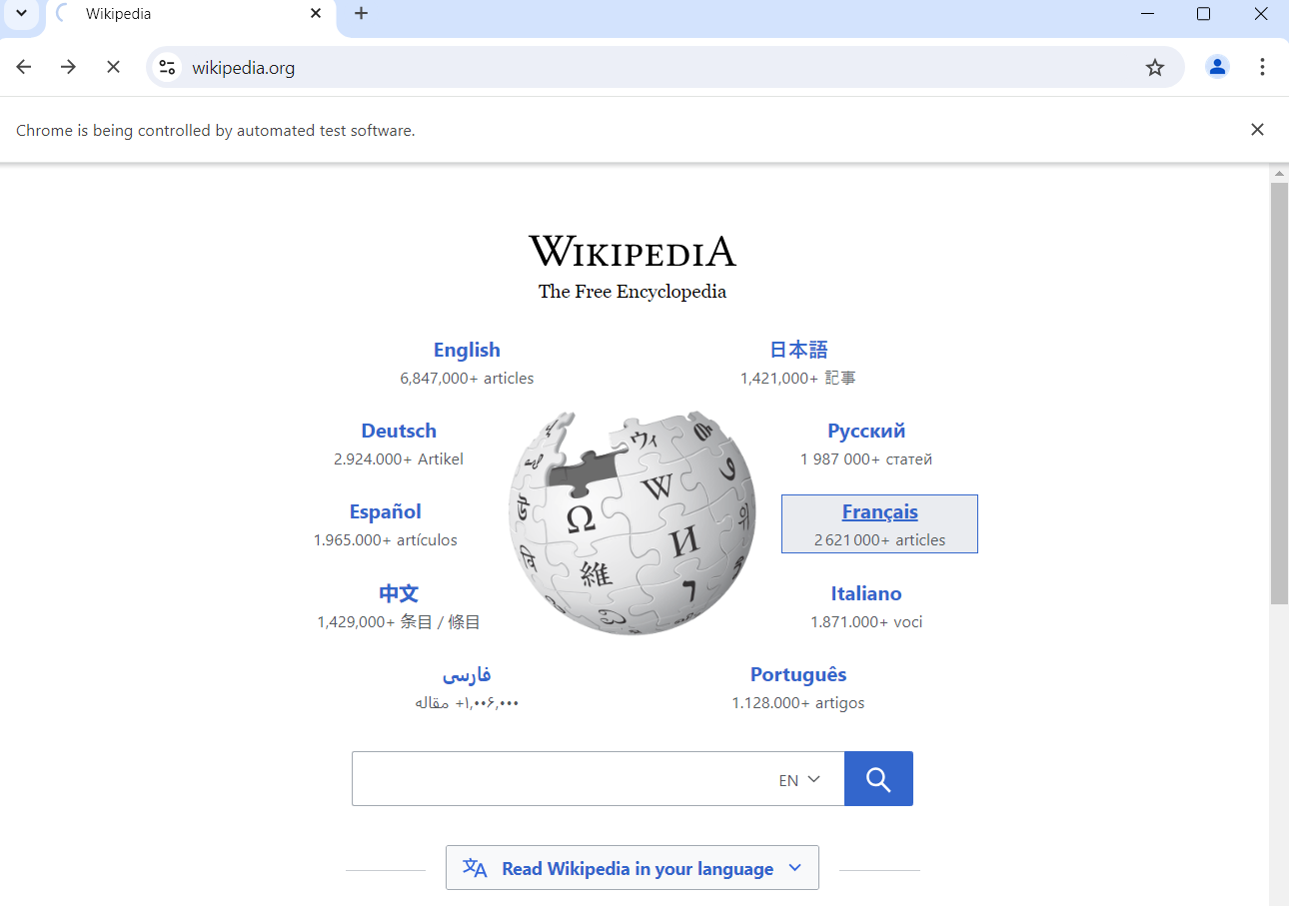

Slide 11
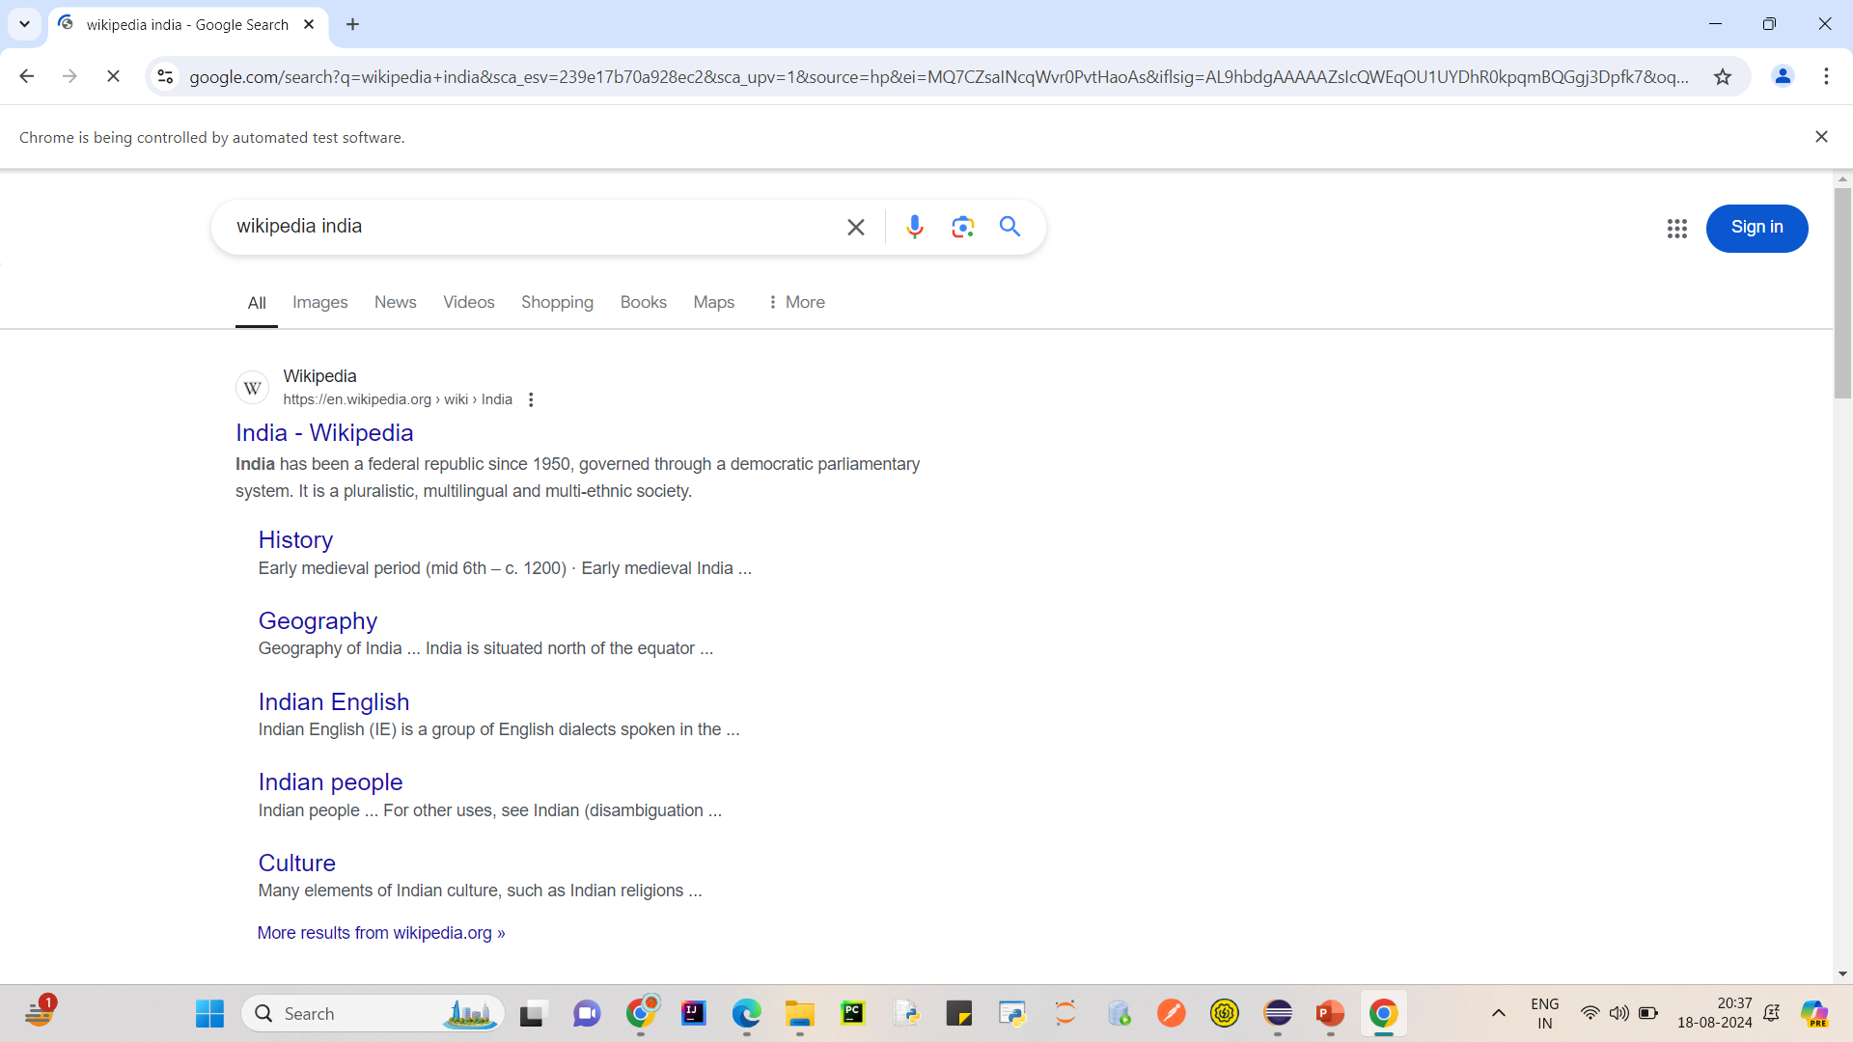
Task: Simulate keyboard and mouse actions on the Google Search Page. For instance, perform a search and handle search suggestions.
This Selenium WebDriver script automates a search on Google by simulating keyboard actions.
It begins by navigating to the Google homepage and typing "Wikipedia" into the search box.
The script then simulates pressing the down arrow key twice to navigate through the search suggestions and selects one by pressing Enter.
Finally, it waits for the search results page to load and prints the page title before closing the browser.

Slide 12
Task: Debug a provided Selenium script that interacts with the Selenium Official Site to identify and fix issues.
PROBLEM 1: We have given the wrong name of the search box, this could have been a typo, but leads to giving error and not taking any input.
FIX: This can be handled by easily writing the correct piece of code.
PROBLEM 2: We have given the wrong name of the search box. The code is expected to break but should be handled such that driver is closed successfully and we see the exception trace clearly.
FIX: This could have been handled gracefully by using try catch finally block. The try block would hold the logic, the catch block is responsible for printing the exception trace and the finally block for closing the opened driver.

Slide 13
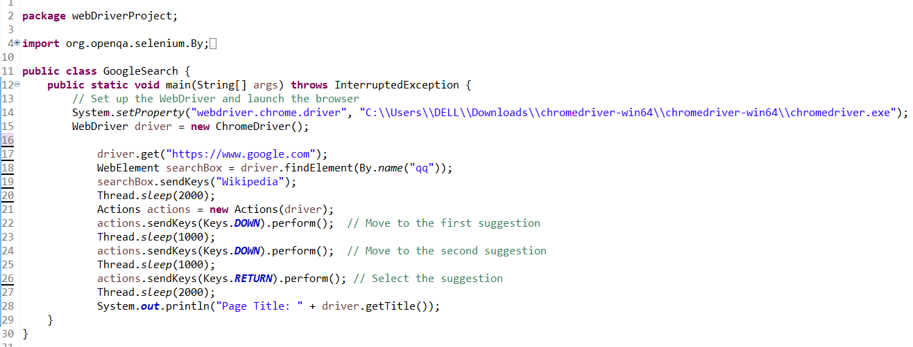
Sample Script with issues

Slide 14
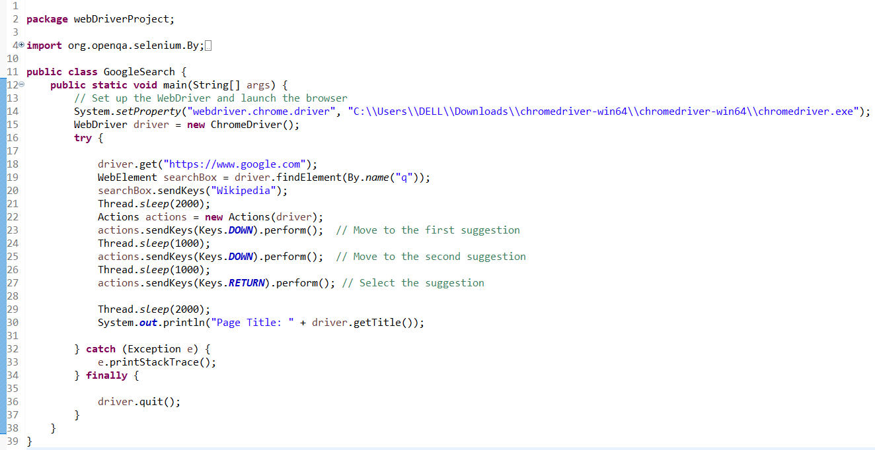
Corrected Code

Slide 15
Task: A report explaining POM, its advantages, and its implementation.
Page Object Model (POM) is a design pattern in Selenium WebDriver that enhances test maintenance and reduces code duplication by creating an object repository for web elements.
In POM, each web page is represented as a class, and the various elements on the page are defined as variables within that class. Actions that can be performed on those elements are implemented as methods.
The main advantages of POM include improved code readability, reusability, and ease of maintenance, as changes to the UI are confined to the page classes, minimizing the impact on test scripts.
Implementing POM involves creating a separate class for each web page, defining the elements using locators, and writing methods to interact with those elements. This separation of page structure and test logic helps in managing complex automation projects effectively.

