Slide 1

Public Issue Resolution Tracker
Report a civic issue, watch it get fixed in public.
TEAM NAME: TINKERERS
TEAM ID: TH22-0072-04
TEAM MEMBERS
PS ID: WEB03- Public Issue Resolution Tracker
  Kaushik Ranjan Rajkumar
  Mriganka Mahanta
  Rittam Dutta
  Nidarshana Kafley

Slide 2

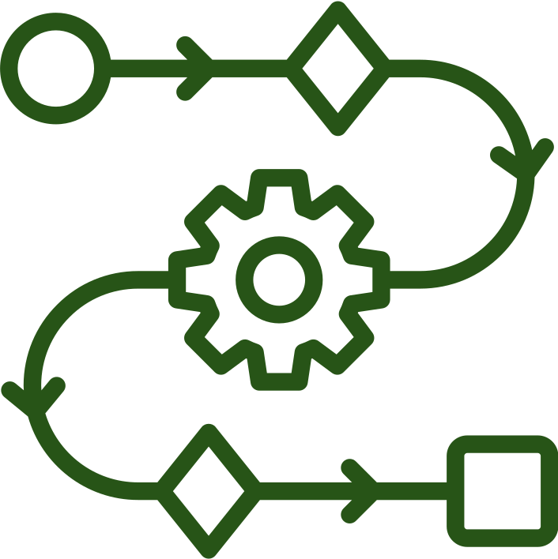
The problem affects real people
WHO FACES IT?
WHY DOES IT MATTER?
Complaints pile up with no visibility into who is handling them or what stage they are at
Primary user group: Daily commuters, local residents, and municipal field officers
Cost, delay or risk caused:Duplicate issues wastes time and genuine issues get delayed.
The problem occurs in connecting public complaints to authorities when civic amenities fail
eg: Guwahati's recurring waterlogging and drainage failure
Our project groups duplicate complaints, track progress, and verify fixes
2 / 5

Slide 3




SOLUTION
https://www.loksamadhan.online/
FEATURES
A public portal where citizens submit issues, likely duplicates are linked instead of lost and every report is tracked from submission to resolution.
Civic Issue Reporting
Role-based Access Control
Public Feed with Map & Filters
Issue Lifecycle Tracking
Real-time Duplicate Detection
Officer Dashboard
Email verification and Updates at Every Resolution Stage
AI Powered Resolution Verification
3 / 5

Slide 4

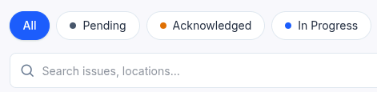

TECHNICAL IMPLEMENTATIONS
Frontend:
  Core Framework: - React 19
  Build Tool:- Vite 8
  Styling & Design System: - Tailwind CSS
  Maps & Geo-Visualization:- Leaflet
CHALLENGE CARD
USEFUL FILTERS
Backend:
  Runtime: Node.js
  Web Framework:- Express.js
  Authentication & Security- JWT, CORS, bcryptjs, OAuth
  File Upload Processing: Multer
The public issues are filtered as per status, location, category and department in the feed.
Database: MongoDB
Main data flow: Citizen reports → Issue stored with location → Officer assigns & updates → Public tracks status.
External API:
  OpenStreetMap: Provides the interactive map tiles displayed
  Cloudinary: Stores uploaded issue photos
  MyMemory & Google Cloud Translation API: Traslation
  Groq Cloud API: AI Vision & LLM
  Google OAuth 2.0 & Identity APIs: Authentication
  SMTP Email Service: Notifications & OTP Verification
  WhatsApp Click-to-Chat URL API: share civic issues directly to WhatsApp
4 / 5

Slide 5



Today’s Progress, Tomorrow’s Plan
Designed to serve both citizens and public authorities
LIMITATIONS
No integration with actual municipal ERPs, GIS databases, or government grievance redressal portals
Enforced Public-Safe Data Serialization:
Citizen personal information is never included in public API responses.
No phone/Aadhaar identity verification for citizens
Resolution requires a note or evidence:
An officer cannot mark an issue as Resolved without documenting how it was resolved.
THANK YOU
5 / 5

