Slide 1
EduFaceSync: AI-based Expression Detection System
Submitted To:
Sir Samyan Wahla Submitted By:
2022-CS-116
2022-CS-118

Slide 2
Introduction
EduFaceSync is an AI-powered emotion detection system designed for online education platforms.
Objective: Improve teacher-student engagement by analyzing students' emotional responses during online classes.
Real-time Emotion Detection: Based on facial expressions captured through a webcam.
Key Benefit: Helps teachers adjust teaching methods based on students’ emotional states.

Slide 3
Overview
EduFaceSync is an AI-based platform designed to enhance online learning experiences by analyzing students' emotions in real-time during live classes. The system uses facial expression recognition to track and assess student engagement, attendance, and emotional reactions. By providing teachers with insights into students' emotional states, EduFaceSync aims to foster a more interactive, personalized, and effective learning environment.

Slide 4
Functional Requirements
User Registration: Teacher and student sign-up with roles defined.
Login/Authentication: Secure login for teachers and students.
Course Creation: Teachers can create and manage courses.
Class Attendance: Automatic attendance tracking through facial recognition.
Emotion Detection: Real-time detection of emotions such as happy, sad, angry, etc.
Reports: Teachers get engagement reports based on students’ emotional responses.

Slide 5
System Architecture
Frontend: User interface for teachers and students to interact with the system.
Backend: Data processing, storage, and model inference.
Emotion Detection: Convolutional Neural Network (CNN) based model for emotion recognition.
Attendance & Reports: Real-time tracking of students' emotional states during online classes.

Slide 6
CNN Model for Emotion Detection
Convolutional Neural Network (CNN): Used for facial expression recognition.
7 Emotion Classes: Angry, Disgusted, Fearful, Happy, Neutral, Sad, Surprised.
Model Training: Trained on facial emotion datasets for accuracy.
Performance Evaluation: Based on classification metrics such as accuracy, precision, and recall.

Slide 7
Emotion Detection Process
Capture video feed from webcam.
Detect faces using Haar cascade for face detection.
Preprocess the face region and resize it for model input.
Predict emotion using the trained CNN model.
Display the predicted emotion on the screen in real-time.

Slide 8
Use Case Workflow
Teacher: Creates a class, starts live session, monitors student engagement, and receives reports.
Student: Joins class, interacts, and emotions are detected and analyzed.
Automatic Reports: Emotion-based reports are generated for teacher review.

Slide 9
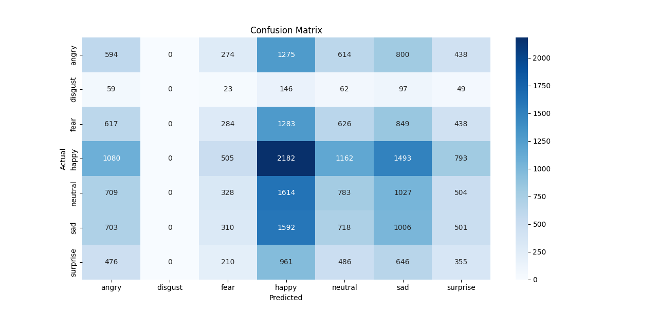
Evaluation and Results
Model Performance:
Accuracy: 18%
Precision, Recall, and F1-Score: High for most emotion classes.
Confusion Matrix: Evaluates how well the model predicts different emotions

Slide 10
Non-Functional Requirements
Performance: Fast and efficient real-time emotion detection.
Scalability: Handle increasing number of users as the system grows.
Security: Secure login and data encryption.
Usability: Easy-to-use interface for both teachers and students.
Reliability: High system uptime and stability during class sessions.

Slide 11
Future Work and Improvements
Accuracy Improvements: Fine-tuning the model for higher accuracy.
Multi-language Support: Implementing support for different languages to detect emotions across regions.
Integration with Learning Management Systems: Expanding to integrate with platforms like Moodle or Google Classroom.

Slide 12
Conclusion
EduFaceSync is a powerful tool for improving online learning experiences by enhancing teacher-student interaction through emotion analysis.
The system's potential can be expanded with more features, including better accuracy and multi-language support.
Future work includes scaling the system for broader use in various educational settings.

Slide 13
ANY Question?

Slide 14
Thank YOU!!!

