Slide 1

CS-566 Deep Reinforcement Learning
Bipedal Walker - Normal Version
Course Instructor: Dr Nazar Khan
Presented by: Rida Shahid - MSCSF25M015
Department of Computer Science
University of the Punjab

Slide 2
Introduction
What is it?
A 4-joint walker robot on uneven terrain simulation built on the Box2D physics engine.
Part of Gymnasium's Box2D environment suite.
Problem:
The robot must learn to walk across uneven terrain using only raw sensor data, no coordinates, just hull angles, joint states, and LIDAR.
Goal:
Accumulate 300+ points by moving as far right as possible, as efficiently as possible, within the step limit — without the hull ever touching the ground.
A bipedal walker

Slide 3
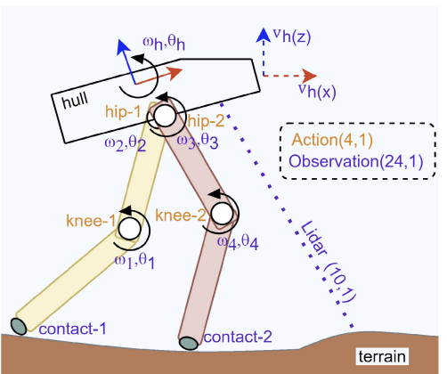
Environment: Bipedal Walker - Normal version
Action Space:
Type: Continuous — Box(-1.0, 1.0, shape=(4,), float32)
Controls motor speed for 4 joints: 2 hips + 2 knees.
Values range from −1 to +1.
Observation Space:
Type: Continuous—Box([lower bound], [upper bound], shape=(24,), float32)
Includes:
Hull angle, angular velocity.
Horizontal & vertical speed.
Joint positions & angular speeds, LIDAR, etc.
Reward:
+300 for reaching the far end.
-100 if the hull hits the ground.
Small penalty per motor torque applied.
Action and observation states of robot

Slide 4
Training Setup
Algorithm:
As a result of the study¹, the Soft Actor-Critic (SAC) reinforcement learning algorithm proved to be the most suitable approach, achieving high training stability and the highest performance score. Therefore, SAC was selected to train the Bipedal Walker agent.
Hyperparameters:
The training hyperparameters were selected based on values optimized in the paper¹ using TPE optimization.
Learning Rate (η) = 2.52e⁻³
Discount Factor (γ) = 0.96667
Polyak update (τ) = 1.68e⁻¹
Hardware & Software:
CPU: 2.9 GHz 6-Core Intel Core i9
RAM: 32GB
Platform: Google Colab
Libraries: Stable-baselines3/Gymnasium
O. Aydogmus, M. Yilmaz: Comparative Analysis of Reinforcement Learning Algorithms for Bipedal Robot Locomotion

Slide 5
Results - Soft Actor-Critic (SAC)
1M Training Timesteps
(Robot is struggling)
2M Training Timesteps
(Robot is taking smooth steps)

Slide 6
Statistics of trained SAC agent
Experimental Reproduction:
Soft Actor-Critic algorithm with optimized hyperparameters were tested 10 times in the same environment, and a performance analysis was conducted. SAC, consistently scored approximately 325 points in all tests, resulting in a satisfactory average of 325 points.
The reproduced results closely matched the paper’s¹ reported performance, indicating stable and reliable training behavior.
SAC | 1M Timesteps | 2M Timesteps
Training Time | ~11 hours | ~20 hours
Mean Reward | 302.2 | 325.1
Mean Step Count | 1010 | 660

Slide 7
Other Algorithm Results: Proximal Policy Optimization (PPO)
1M steps
5M steps
10M steps
PPO | 1M Timesteps | 5M Timesteps | 10M Timesteps
Training Time | 40 Minutes | 3 Hours | 5.5 Hours
Mean Reward | 184.5 | 200.8 | 146.5
Mean Step Count | 1267 | 654 | 667

Slide 8
Optimal Hyperparameters used for training for PPO & SAC
Hyperparameters were optimized using TPE (Tree-structured Parzen Estimator), a Bayesian hyperparameter search method.
Hyperparameters¹ | PPO | SAC
Learning Rate (η) | 8.27e⁻⁴ | 2.52e⁻³
Discount Factor (γ) | 0.96979 | 0.96667
GAE Parameter (λ) | 0.92680 | -
Entropy Coef. (β) | 1.99e⁻⁵ | -
Polyak update (τ) | - | 1.68e⁻¹

Slide 9
SAC vs PPO Comparison
Comparison
SAC wins on performance, PPO wins on speed.
Continuous control favors off-policy methods like SAC.
SAC showed more stable training behavior with less variance in rewards, while PPO's reward actually dropped from 5M to 10M timesteps showing instability.
 | SAC | PPO
Training Time | Very slow | Very fast
Mean Reward | 325 | 180
Sample Efficient | Yes | No

Slide 10
Thank You!

