Slide 1
Title: Banking Marketing Campaign Analysis
Subtitle: Insights from Telephonic Marketing Data
Name: Rida Arshad
Date: March 23, 2025

Slide 2
Introduction
Objective:
Analyze banking data to identify key customer segments and behaviors.
Improve telemarketing campaign efficiency by understanding factors influencing term deposit subscriptions.
Dataset Overview:
Contains 45,211 rows and 18 columns collected from May 2008 to November 2010.
Includes customer demographics, financial status, contact details, and past campaign responses.
Key Focus Areas:
Customer demographics (age, job type, marital status, education).
Loan and credit status.
Contact methods and campaign interactions.
Subscription patterns and influencing factors.

Slide 3
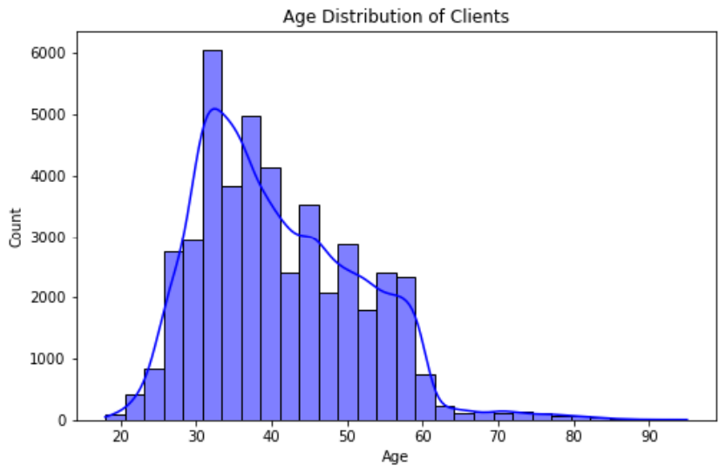
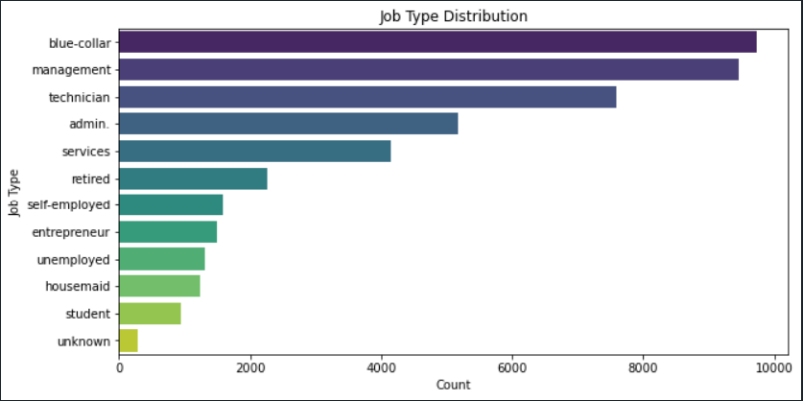
Age and Job Type Distribution of Clients
Insights:
Most clients are in the 30-40 age range, and majority work in management, blue-collar, and technician roles.

Slide 4
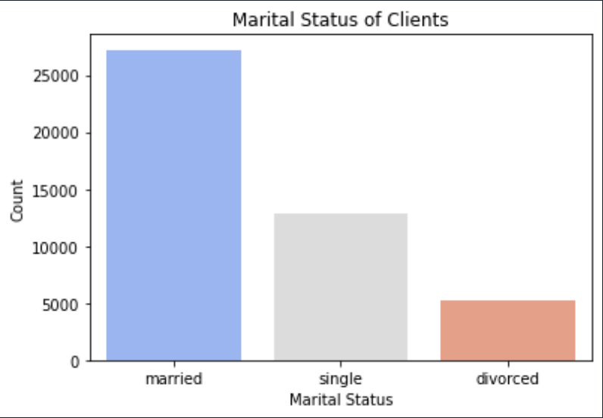
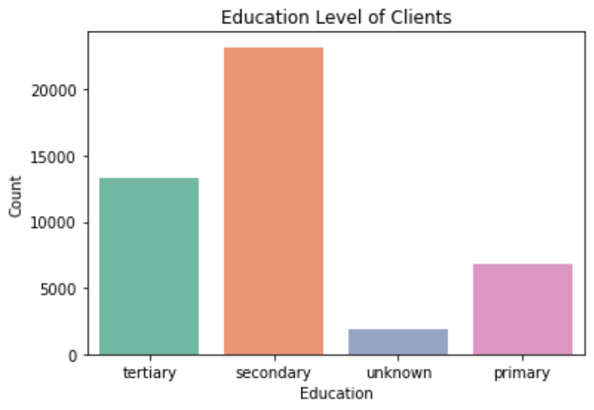
Marital Status and Education Levels of Clients
Insights:
Married individuals form the largest group, followed by single and divorced clients.
Most clients have secondary education, followed by tertiary and primary.
Higher education may improve financial product understanding, influencing subscriptions.

Slide 5
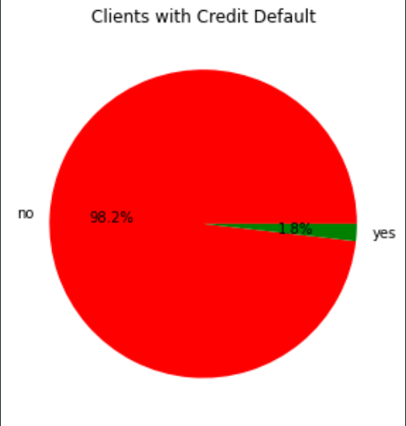
Credit Card Default
Insights:
Only a small percentage of customers have defaulted on credit, but they may pose a higher financial risk.
A significant number of customers have housing loans, suggesting financial stability.
Fewer customers have personal loans, possibly due to stricter eligibility criteria or preferences for secured loans.

Slide 6
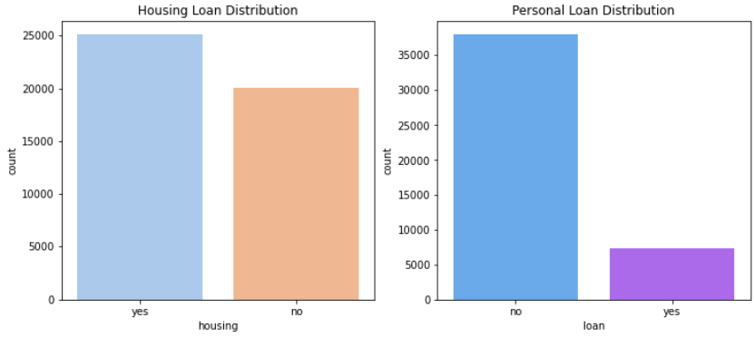
Housing and Personal Loan Distributions
Insights:
More clients have housing loans compared to personal loans.
Homeownership is common, while fewer opt for personal loans due to stricter criteria or preferences.

Slide 7
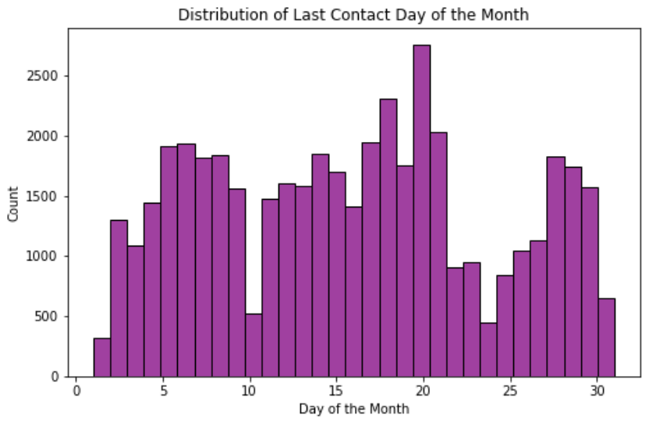
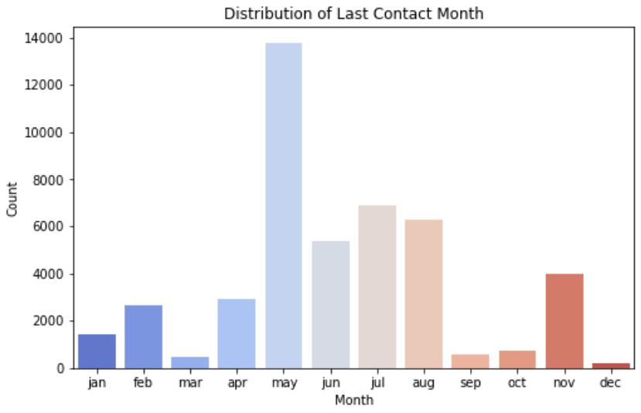
Last Contact Timing Analysis
Insights:
Certain days of the month see a spike in contact frequency, possibly aligning with salary credit cycles or financial decision-making periods.
The highest campaign activity was in May, which may suggest seasonal trends influencing customer engagement.

Slide 8
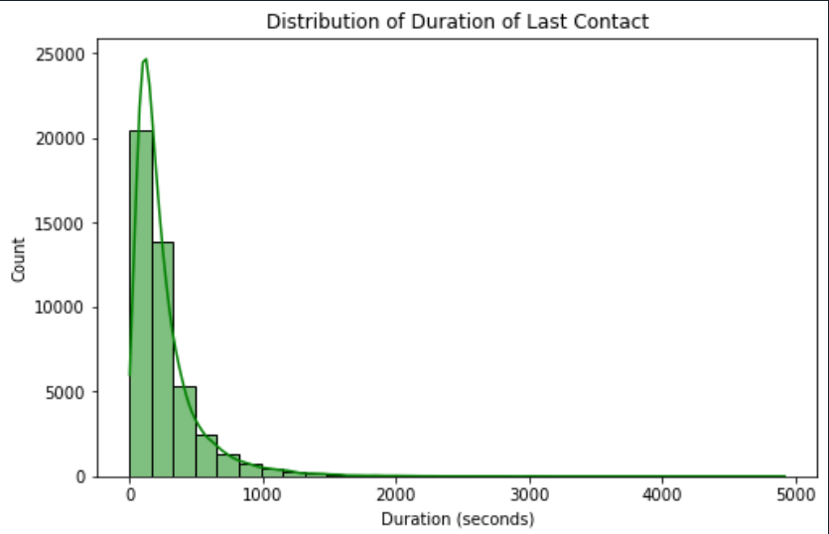
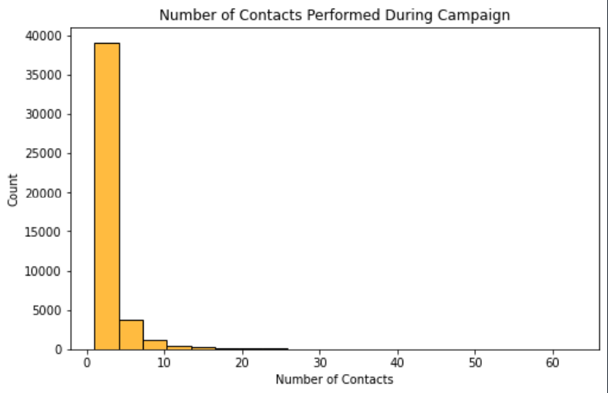
Call Duration and Campaign Contacts
Insights:
Longer calls correlate with higher subscription rates, suggesting that more detailed conversations increase conversions.
The majority of customers were contacted only a few times, implying that persistent follow-ups could lead to better engagement.

Slide 9
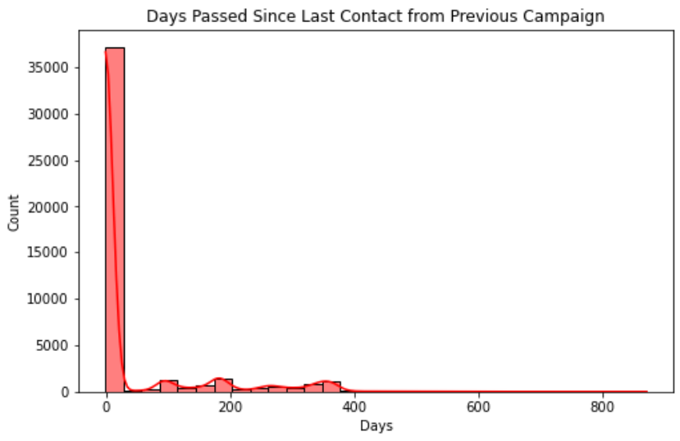
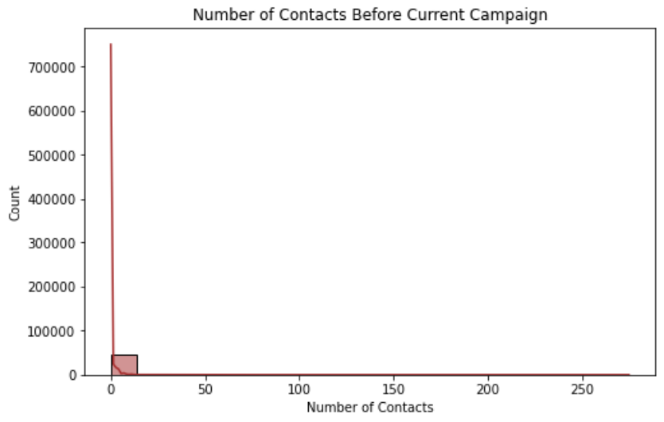
Previous Contact Lists
Insights:
Many customers were never previously contacted, meaning a significant portion is new to the campaign.
Clients contacted after a long gap showed reduced conversion rates, highlighting the importance of maintaining regular engagement.

Slide 10
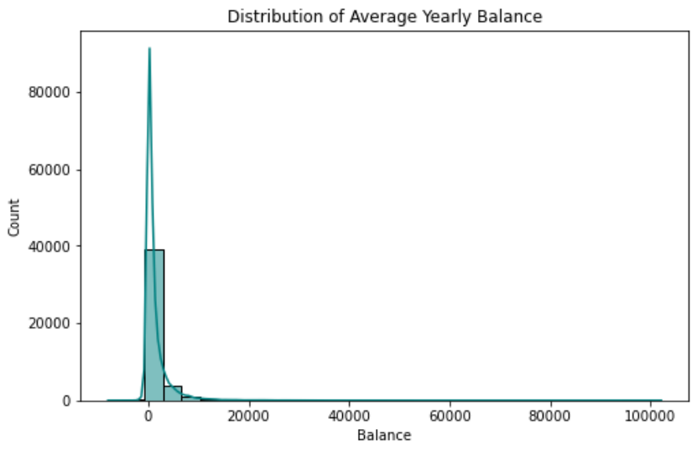
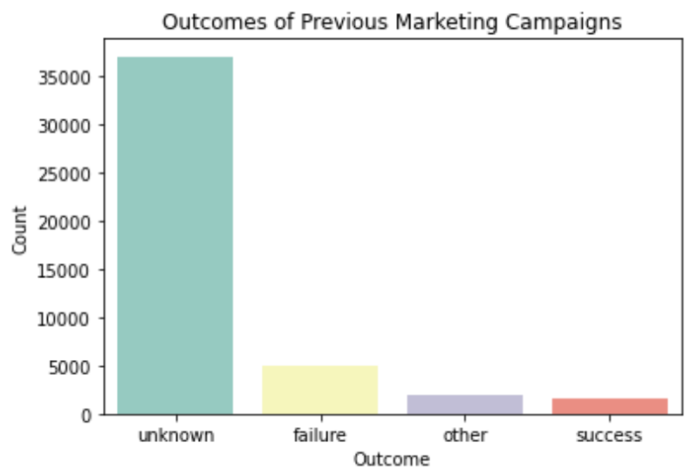
Financial Status and Previous Campaign Outcomes
Insights:
Clients with higher average yearly balances are more likely to subscribe, as they may have more disposable income.
Most campaigns failed, highlighting the need for better targeting and communication.

Slide 11
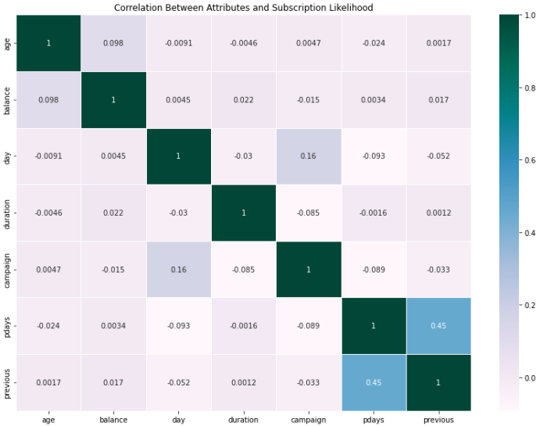
Correlation Analysis
Insights:
Call duration has the strongest correlation with subscription likelihood, reinforcing the importance of engaging conversations.
A successful past campaign contact increases the probability of future conversions, indicating the value of maintaining relationships with past subscribers.
Other demographic attributes (such as job and education) show weaker correlations, suggesting that campaign success depends more on interaction strategy rather than demographics alone.

Slide 12
Conclusion
Key Findings:
Recommendations:
Majority of customers are 30-40 years old, working in management, blue-collar, or technician roles.
Married individuals with secondary education form the largest segment.
Few credit defaults, but housing loans are more common than personal loans.
Longer calls & past positive responses increase conversion likelihood.
Higher average balances correlate with a higher subscription rate.
Optimize Call Timing – Focus on high-engagement months (May) & peak response days.
Improve Call Strategies – Train agents for longer, engaging conversations.
Re-engage Past Subscribers – Higher chance of repeat conversions.
Segment Based on Financial Standing – Target higher balance customers for term deposits.
Increase Strategic Follow-ups – Avoid long gaps to maintain engagement.

