Slide 1
AR Day Activity Instructions

Slide 2
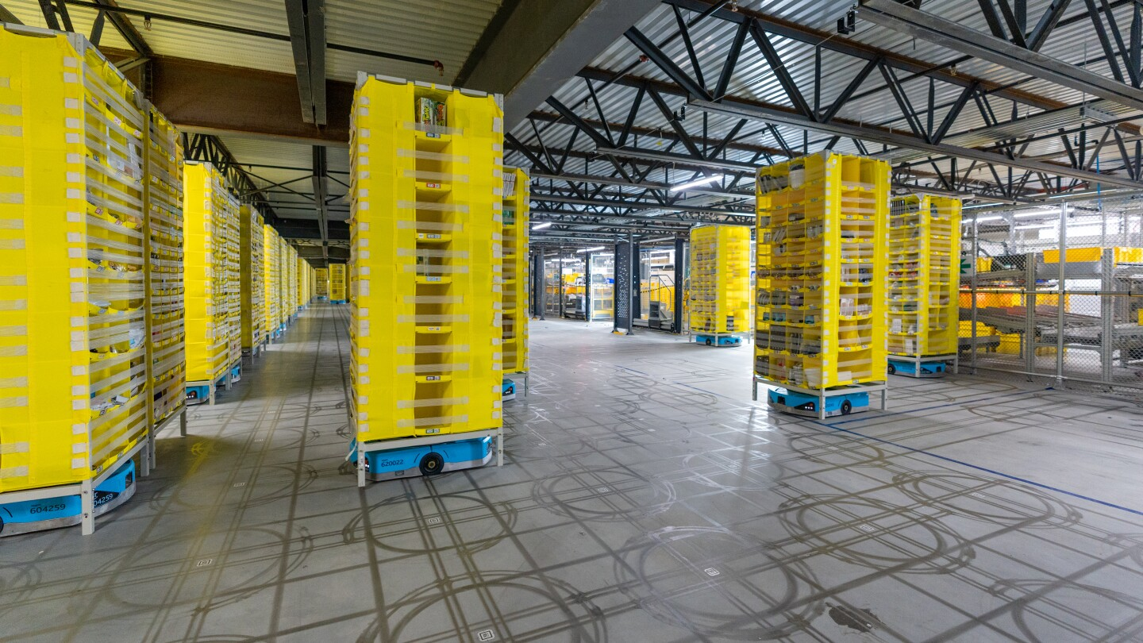
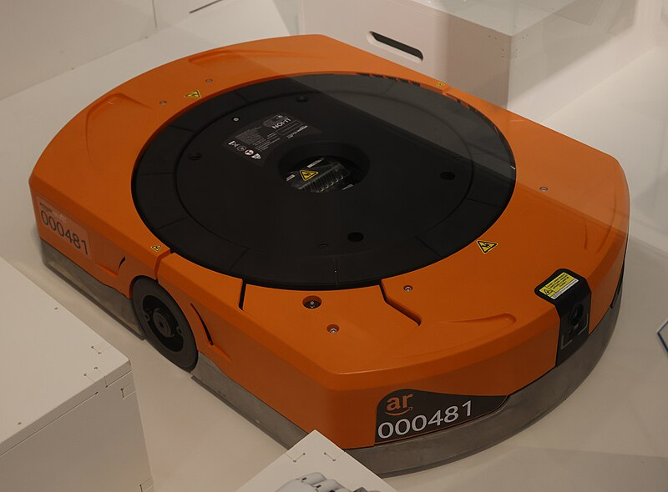
Summary
You will be writing code to control a robot in an AR Field
The player robot is orange and AI robots are blue
Player
AR Field
https://en.wikipedia.org/wiki/File:Amazon_warehouse_robot_2020.JPG
https://www.amazon.science/latest-news/amazon-robotics-autonomous-drive-units-hercules-pegasus-xanthus-xbot

Slide 3
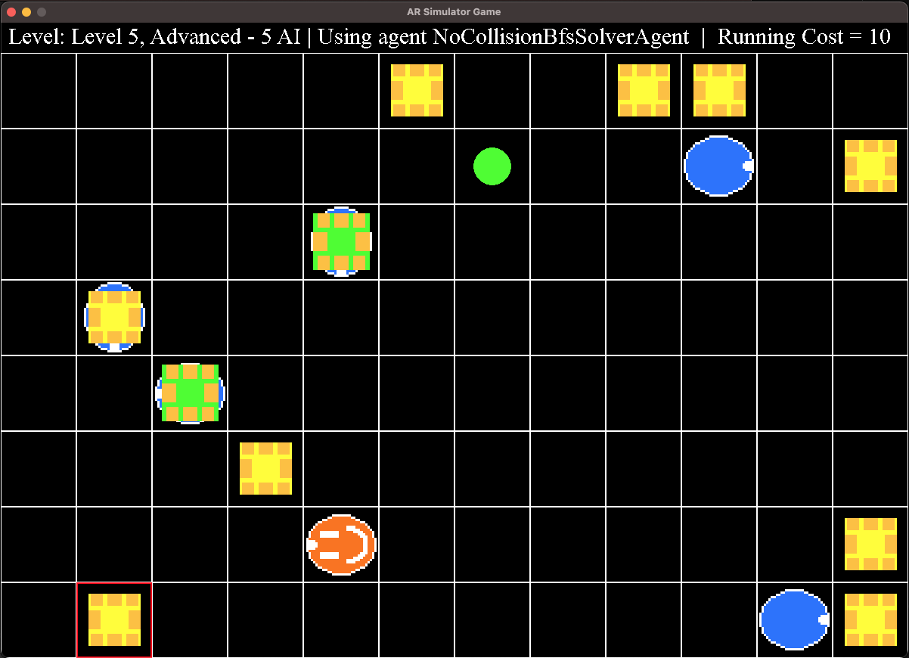
AR Objects Overview
This game is modeled after an AR field
Summary video: https://www.youtube.com/watch?v=jBQxLwhSSOw
https://en.wikipedia.org/wiki/File:Amazon_warehouse_robot_2020.JPG
https://www.amazon.science/latest-news/amazon-robotics-autonomous-drive-units-hercules-pegasus-xanthus-xbot

Slide 4
Game Goal
The primary objective is to get the player robot to pick up each pod and move it to a goal location in an efficient manner
Closest Goal Location
Target Pod (Red Outline)
Player Drive

Slide 5
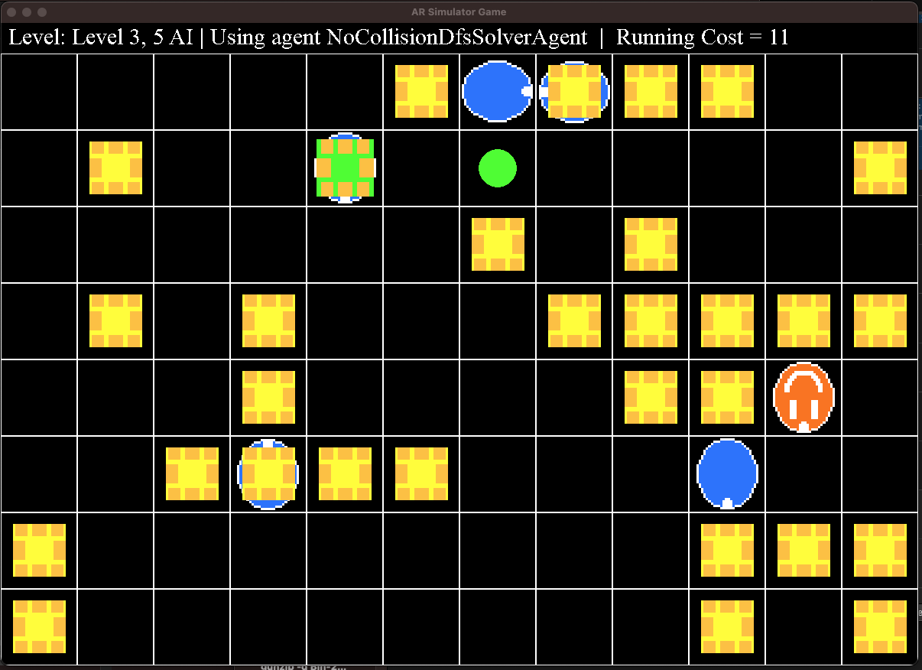
AI Logic
The AI will move randomly and a new random seed will be used for the final competition
[TIP] Test your code using different random seeds (set in main.py)
Goal Location
AI Drive carrying Pod
Idle Pod
Player Drive
AI Drive

Slide 6
Game Interaction with Player
Game Orchestrator
init_player(id, is_level_advanced_mode)
init_ai()
while game not ended:
move=player.get_next_move(sensor_data)
move_player(move)
move_all_drives()
check_endgame_conditions()
Player Class
__init__(id, is_level_advanced_mode):
# your logic
get_next_move(sensor_data):
move = # your logic
return DriveMove.move
Rules:
You can only modify the player agent file – all other files will be taken from the remote repo for the competition
Player moves first each turn
AI Drives will not crash into anything (safe to assume they won’t run into the player)
Game ends if player exits the field, crashes into another drive, max turn limit is exceeded (1000). If the player drive is not carrying a pod, it can drive under other pods
If player drive is carrying a pod, it can no longer drive under other pods

Slide 7
Game Controls
You can control the robot by returning a value from a set of moves
Moves are defined in the src.Constants.DriveMove enum:
Possible moves are:
DriveMove.NONE – Do nothing
DriveMove.UP – Move 1 tile up (positive y direction)
DriveMove.DOWN – Move 1 tile down (negative y direction)
DriveMove.RIGHT – Move 1 tile right (positive x direction)
DriveMove.LEFT – Move 1 tile left (negative x direction)
(Advanced mode only)
DriveMove.LIFT_POD – If a pod is in the same tile, pick it up The pod will now move with the drive until it is dropped
DriveMove.DROP_POD – If a pod is in the same tile, drop it The pod will now stay in this position until it is picked up

Slide 8
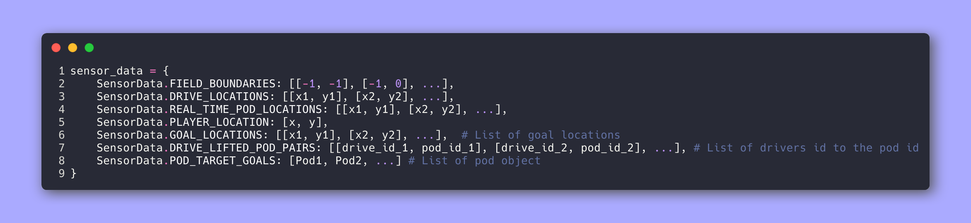
Player Sensor Data
Each turn you will receive a sensor data dictionary with information about other game objects:
Use this data to find the pods and goals and determine the optimal path to them!

Slide 9
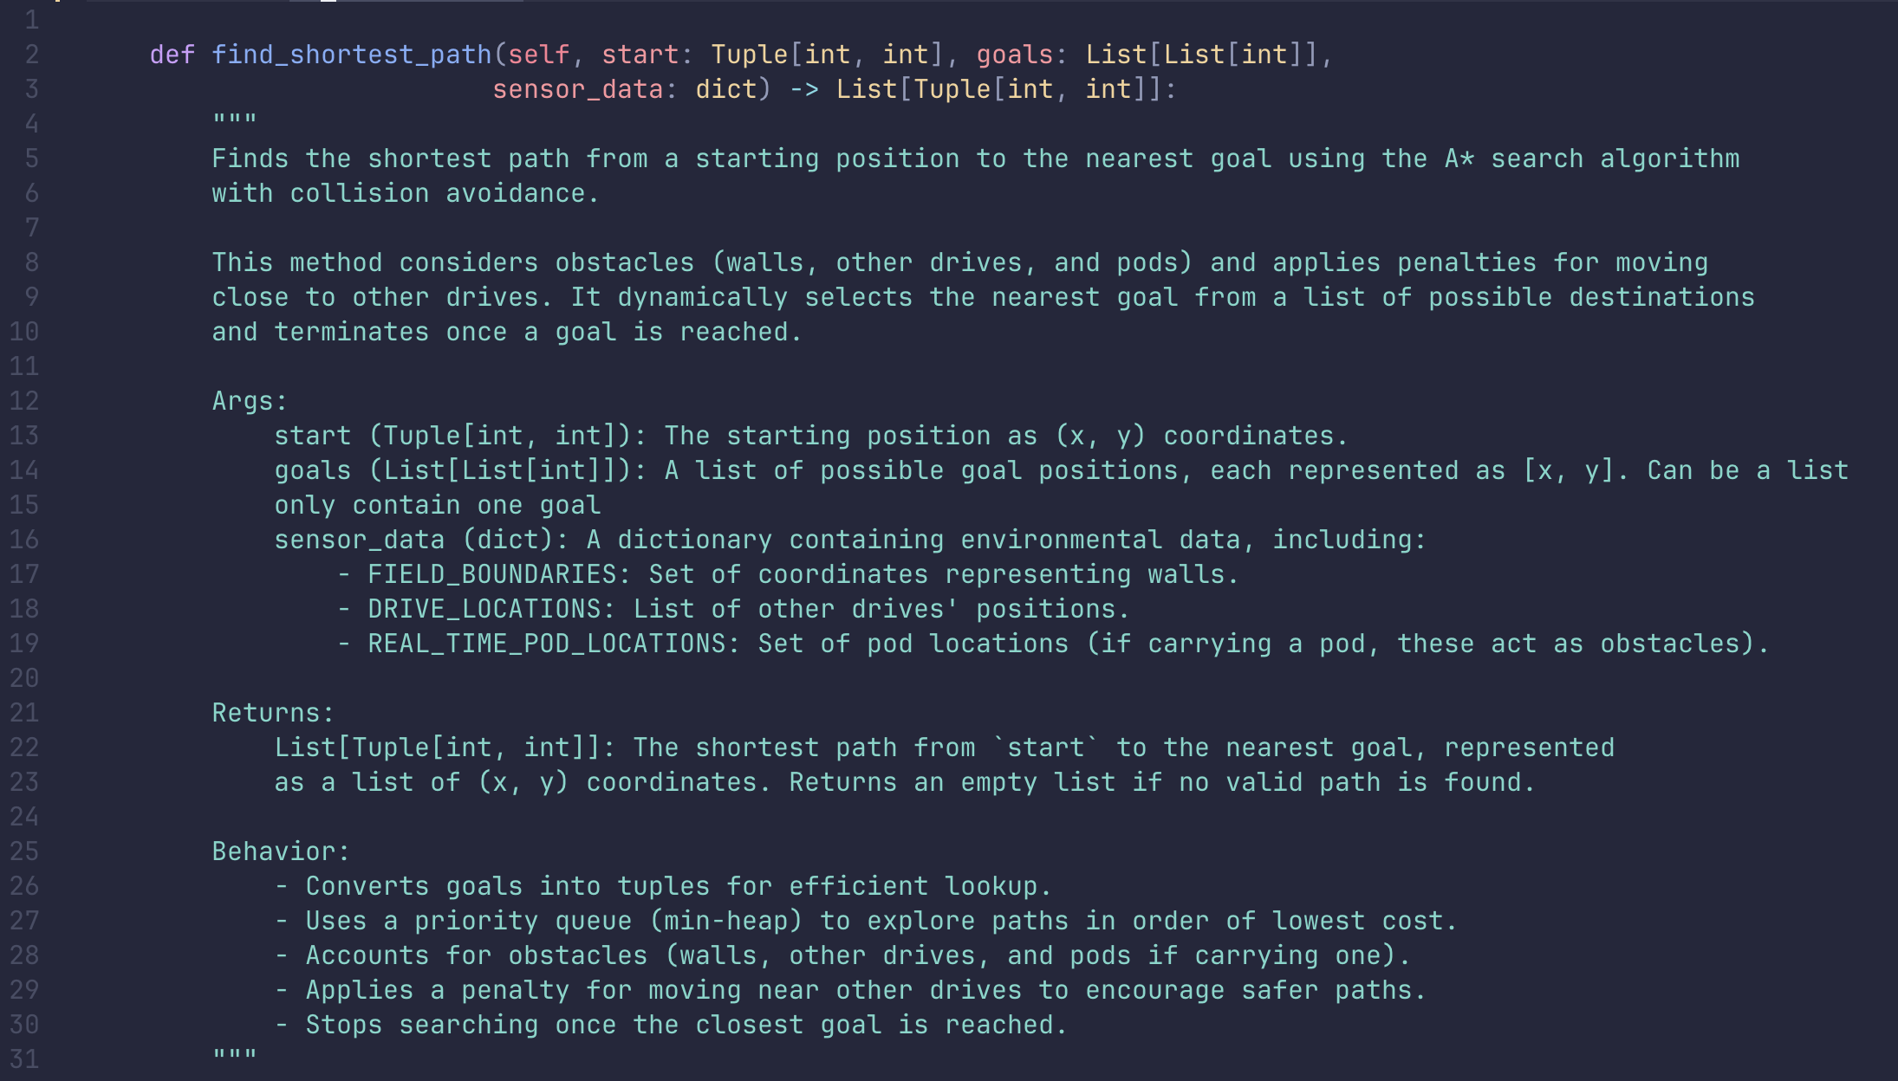
Helper Code
find_shortest_path function is given in the file. Use this helper function as a search algorithm to find the shortest path and determine the next move

Slide 10
How to Run the Game
Make sure you have Python installed (preferably 3.9 or later)
Check by running `python3 --version`
https://www.python.org/downloads/release/python-3115/
Setup the game source code:
Download or clone the starter code from https://github.com/collinwzw/AR_Day_2025
cd into the directory
Install requirements with `python3 -m pip install -r requirements.txt`
Run the game with `python3 main.py`

Slide 11
How the Game Decides What to Run
In the top level directory of the game code is a file:
player_agents_list.txt
The main.py function will try to run all levels of the game for every agent class listed in this file
Agents must be separated by a newline
If an agent fails a level, the remaining levels will not be run
[TIP] To test your code faster, modify the agent list file to only have your agent
[TIP] The game currently runs at a speed of 5, adjust this parameter in GameConfig.py to make your tests run faster
[TIP] To test one level at a time, comment out unwanted levels in the GAME_LEVELS variable in src/GameConfig.py

Slide 12
How the Game is Scored
Each move costs 1 point, you want to have the lowest cost
Score is displayed in the upper left corner of the game window
The game will timeout after 1000 turns
Agent scores are sorted in the following order:
Number of levels completed
Tiebreak: Score for last level

Slide 13
Code Submission
Name your Agent class and class Python file with the following formats:
Class name: `class YourName:`
File name: `YourName.py`
Once your agent code is complete, submit your file here:
https://forms.gle/4V5ttpQFLyexmVQY6

Slide 14
Extra Robotics Articles
Fun resources:
https://www.amazon.science/blog/predicting-congestion-in-fleets-of-robots
https://www.amazon.science/blog/maximizing-the-efficiency-of-amazons-own-delivery-networks
https://www.amazon.science/latest-news/the-quest-to-deploy-autonomous-robots-within-amazon-fulfillment-centers

