Slide 1
StockSense
One little inventory app, taken all the way from my laptop to a monitored, self-healing Kubernetes cluster
Ridaa Mirza
RollNo. 24BCS10394
github.com/Ridaa10394/devops-project
Notes:
Hello everyone, I'm Ridaa Mirza, enrollment number 24BCS10394, and this is my DevOps final project: StockSense.
StockSense is a small warehouse inventory dashboard. The app itself is deliberately simple - the point of the project is everything around it. I took this one application from code on my laptop through testing, Docker images, a CI/CD pipeline with security gates, infrastructure as code for AWS, Kubernetes with Helm, monitoring with Prometheus and Grafana, GitOps with Argo CD, and finally a troubleshooting challenge where I broke it on purpose - and once by accident.
The little box is Stocky, the project mascot - it'll pop up between sections.
Everything you'll see was actually run: every screenshot comes from a real run on my machine, and all the code is in the repo github.com/Ridaa10394/devops-project.

Slide 2
What I'll walk you through
1
The app & its API
2
Architecture & toolbox
3
Tests & Docker images
4
5
DevSecOps security gate
6
Kubernetes, Helm & HPA
CI/CD pipeline
7
8
9
Troubleshooting, lessons & demo
Terraform on AWS
Monitoring & GitOps
Notes:
Here's the plan for the talk, in nine stops.
First, what the app does and its REST API. Then the architecture and the tools I used. Third, how it's tested and packaged into Docker images. Fourth, the CI/CD pipeline that runs on every push, and fifth, the DevSecOps security gate inside it - including the time it blocked my release.
Sixth, running it on Kubernetes: raw manifests, a Helm chart, and autoscaling under real load. Seventh, the Terraform code for AWS. Eighth, monitoring with Prometheus and Grafana, and GitOps with Argo CD. And last, the seven troubleshooting scenarios, what I learned, how it maps to the rubric, and a live demo.

Slide 3
The app
01
What StockSense does, its API, and how all the pieces fit together
Notes:
Part one: the application itself - what it does, its API, the architecture, and the toolbox I used to build and run it.

Slide 4
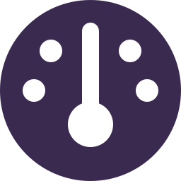
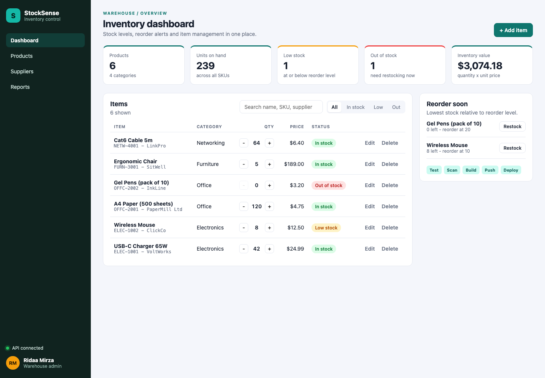

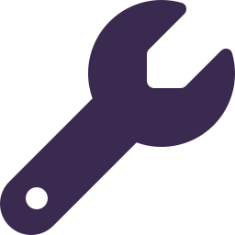

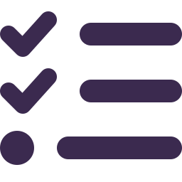
Meet StockSense
Live KPI cards
products, units on hand, low stock, out of stock, inventory value
Search & filter
by SKU, name, category or supplier
Add, edit, delete
plus one-click - ship and + restock buttons
Reorder soon
a panel of items at their reorder level
Smart status
IN_STOCK · LOW_STOCK · OUT_OF_STOCK
The real app running under Docker Compose
Notes:
StockSense is a warehouse inventory dashboard. I picked my own domain because the rubric says the DevOps layers can follow the reference TaskBoard project, but the application has to be our own.
What it does: the top of the page shows live KPI cards - number of products, units on hand, how many are low or out of stock, and the total inventory value. You can search and filter items by SKU, name, category or supplier. You can add, edit and delete items, and there are quick minus and plus buttons to ship or restock one unit. There's a "Reorder soon" panel listing items that hit their reorder level, with a one-click restock.
Every item gets a computed status: IN_STOCK, LOW_STOCK when the quantity is at or below its reorder level, or OUT_OF_STOCK. The screenshot on the right is the real app running with Docker Compose. The UI is also responsive - it works at phone width.

Slide 5
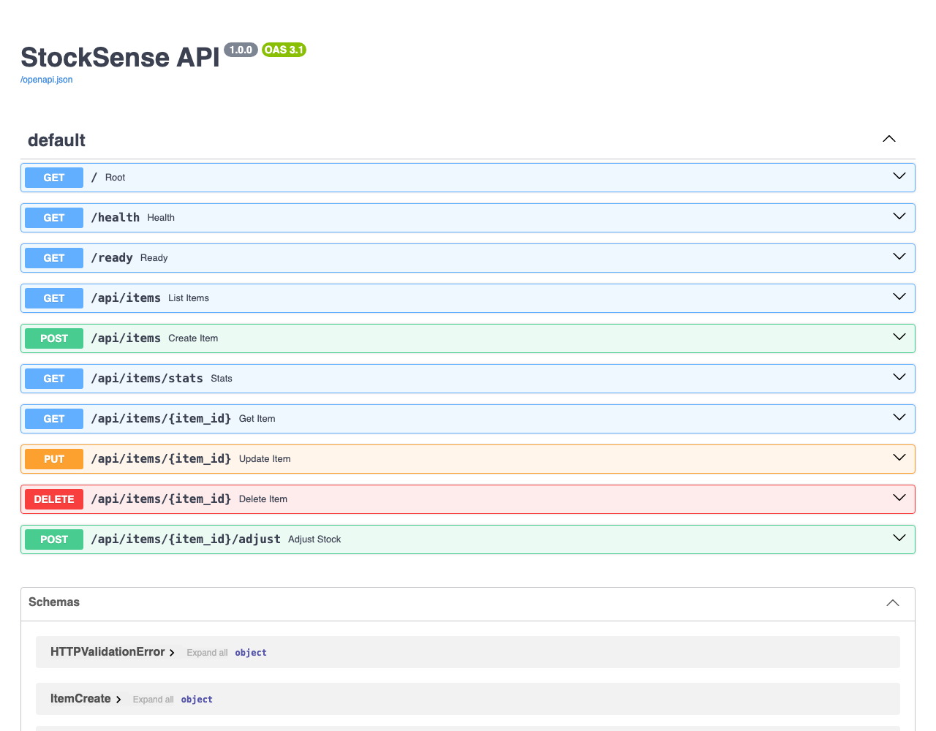
10 REST endpoints, documented by Swagger
GET
/health
liveness, no DB call
GET
/ready
readiness: SELECT 1
GET
/metrics
Prometheus metrics
GET
/api/items
list, search, filter
GET
/api/items/{id}
one item (404)
POST
/api/items
create (409 dup SKU)
PUT
/api/items/{id}
partial update
POST
/api/items/{id}/adjust
ship / restock
DELETE
/api/items/{id}
delete (204)
GET
/api/items/stats
KPI numbers
Notes:
The backend is FastAPI, and it exposes ten endpoints. FastAPI generates the Swagger UI at /docs automatically - that's the screenshot on the right.
Three are for operations: /health is the liveness check - it only says the process is up and deliberately doesn't touch the database. /ready is the readiness check - it runs SELECT 1 against Postgres and returns 503 if the database is down. /metrics is for Prometheus.
The rest is the inventory API: list items with search and filters, get one item (404 if it doesn't exist), create (409 if the SKU is a duplicate, 422 on bad input), partial update with PUT, adjust - which takes a delta, minus three to ship, plus ten to restock, and refuses to go negative - delete, which returns 204, and stats, which feeds the KPI cards.
So the rubric's "at least four REST endpoints with GET, POST, PUT and DELETE" is covered with room to spare.

Slide 6
How the pieces fit together
git push
My laptop
GitHub repo
GitHub Actions
9-stage pipeline
GHCR images
:git-sha
Terraform
Kubernetes · minikube today, EKS in production
AWS
VPC + EKS
frontend x2
React + nginx
Prometheus
/
Ingress
nginx
scrapes /metrics
Argo CD
GitOps
/api
backend x2-5
FastAPI + HPA
PostgreSQL
StatefulSet + PVC
Grafana
pulls the Helm chart from GitHub and keeps the cluster in sync
Notes:
This is the whole system on one slide.
Top row is the delivery path: I push code from my laptop to GitHub. GitHub Actions runs a nine-stage pipeline - tests, security scans, image builds - and if everything passes on main, it pushes the images to the GitHub Container Registry, tagged with the git commit SHA, never "latest".
The dashed box is the Kubernetes cluster - minikube on my laptop, and EKS on AWS in production. Traffic comes in through the nginx Ingress: slash goes to the frontend pods (React served by nginx), and /api goes to the backend pods (FastAPI). The backend has a Horizontal Pod Autoscaler that scales it between 2 and 5 pods. Data lives in PostgreSQL, running as a StatefulSet with a persistent volume.
Prometheus scrapes the backend's /metrics endpoint and Grafana visualises it.
On the right: Terraform creates the AWS infrastructure - a VPC and an EKS cluster. And Argo CD does GitOps: instead of the pipeline pushing into the cluster, Argo CD pulls the Helm chart from GitHub and keeps the cluster matching what's in Git.

Slide 7




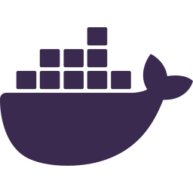
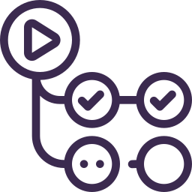

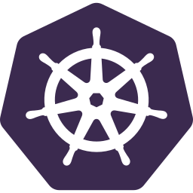

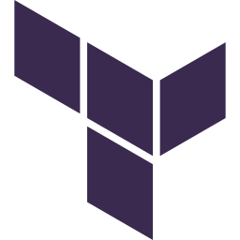

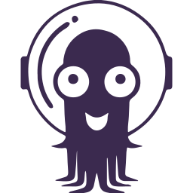
My toolbox
React + Vite
frontend
FastAPI
backend API
PostgreSQL 16
database + Alembic
pytest + ruff
tests, 80% coverage gate
Docker
multi-stage, non-root
GitHub Actions
CI/CD, GHCR
Trivy + friends
bandit, pip-audit, gitleaks
Kubernetes
minikube / EKS
Helm
one chart, dev + prod
Terraform
AWS VPC + EKS
Prometheus + Grafana
metrics + dashboard
Argo CD
GitOps, self-heal
Notes:
These are the tools I used, roughly in the order the code meets them.
React 19 with Vite for the frontend, FastAPI for the backend, PostgreSQL 16 with Alembic migrations for the database. pytest and ruff for tests and linting, with an 80% coverage gate.
Docker with multi-stage builds and non-root users. GitHub Actions for CI/CD, pushing to the GitHub Container Registry. For security: Trivy for image, filesystem and infrastructure-as-code scans, plus bandit for Python code, pip-audit and npm audit for dependencies, and gitleaks for secrets.
Kubernetes - minikube locally, EKS on AWS. Helm to package it as one chart with dev and prod values. Terraform for the AWS infrastructure. Prometheus and Grafana for monitoring. And Argo CD for GitOps with self-healing.

Slide 8
Build, test & ship
02
Tests, Docker images, the CI/CD pipeline and its security gate
Notes:
Part two: how the code gets from my editor to a trusted image - tests, Docker images, the pipeline and the security gate.

Slide 9
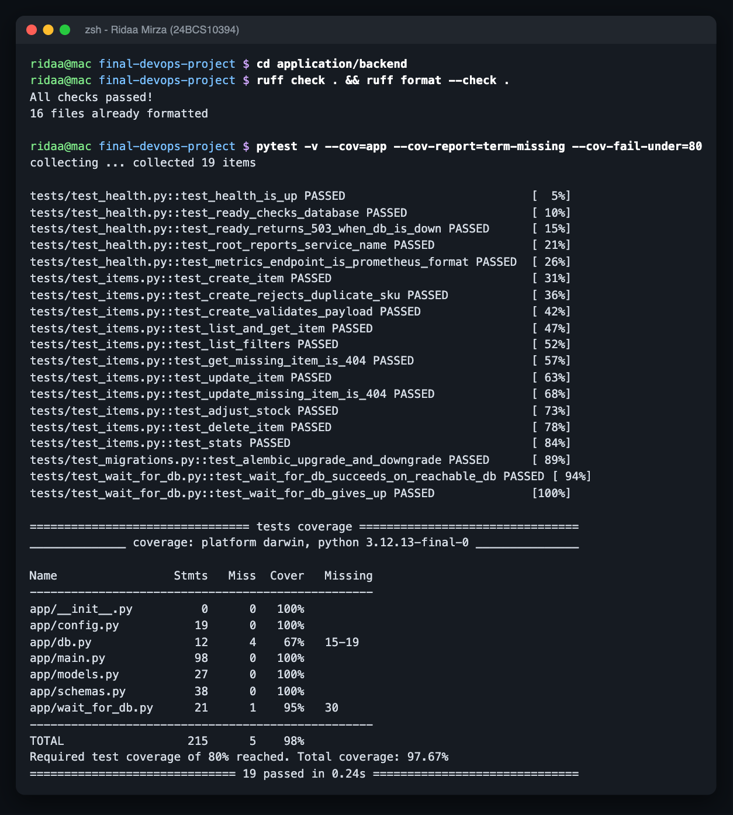
Tested before it ships
19
tests passed
97.7%
code coverage (gate: 80%)
0
ruff lint issues
Tests run against SQLite and against a throwaway PostgreSQL container
2 Alembic migrations: create the items table, seed demo data
Notes:
Testing is the first quality gate - nothing gets built into an image unless the tests pass.
I have 19 pytest tests covering health, readiness, every CRUD endpoint, validation errors, duplicate SKUs, the adjust endpoint refusing to go negative, and the stats endpoint. Coverage is 97.7%, and the pipeline fails if it ever drops below 80%. ruff, the linter, reports zero issues.
The tests normally run against SQLite so they're fast, but I also ran the whole suite against a real throwaway PostgreSQL container, and in CI they run against a Postgres service container - so I know the SQL works on the real database.
The schema is managed by Alembic: migration one creates the items table, migration two seeds demo data. On the right is the real terminal output of ruff and pytest.

Slide 10
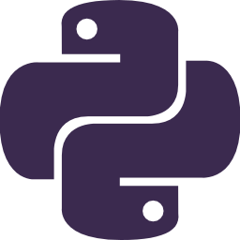
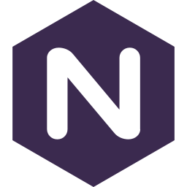
Two small, non-root Docker images
Backend
Frontend
python:3.12-slim · runs as UID 10001
nginx-unprivileged · runs as UID 101
2 stages: build a venv, copy it into a clean image
pip removed from the runtime (Trivy found CVEs in it)
Waits for the DB, runs migrations, then starts uvicorn
Stage 1: node builds the React app
Stage 2: only dist/ is copied into nginx
apk upgrade patches the base image
docker compose: postgres → backend → frontend, each one waits until the one before is healthy
Notes:
Both images are small and run as non-root users.
The backend image has two stages: the first builds a Python virtual environment, the second copies just that venv into a clean python 3.12 slim image. I also uninstalled pip from the runtime image - the security scan found high-severity CVEs inside pip's own vendored libraries, and the app never needs pip at runtime anyway. It runs as user 10001. The entrypoint waits for the database, runs the Alembic migrations, and then starts uvicorn.
The frontend is a classic multi-stage build: a Node stage runs npm ci and builds the React app, then only the built dist folder is copied into nginx-unprivileged, which runs as user 101. apk upgrade patches the Alpine base image.
For local development, Docker Compose starts all three containers, and each one waits until the one before it passes its health check.

Slide 11
A 9-stage pipeline on every push
1
2
3
4
5
Build & test
ruff, pytest, npm build, helm lint, terraform validate
SAST
bandit scans the Python code
SCA
pip-audit, npm audit, trivy fs
Secret scan
gitleaks
Docker build
backend + frontend
9
8
7
6
Deploy
kind + helm install + helm test
Push to GHCR
main only, SHA tag
Security gate
one policy file decides
Image scan
Trivy, fail on fixable HIGH
Images are built once, scanned, and that exact image ships · SHA tags only, never latest · owner name lower-cased for GHCR
Notes:
This is the GitHub Actions pipeline. It runs on every push and pull request to main.
Stage one runs in parallel: backend lint and tests against a Postgres service with the 80% coverage gate, the frontend build, and infrastructure checks - helm lint, kustomize, and terraform fmt and validate.
Then the security stages. Two is SAST - bandit reads the Python source looking for insecure code. Three is SCA - software composition analysis - pip-audit, npm audit and trivy fs check the dependencies for known CVEs. Four is gitleaks, scanning for committed secrets.
Five builds both Docker images. Six scans those images with Trivy. Seven is the security gate: one Python script with one policy file reads every report and decides whether the release is allowed. Every scanner only reports; the gate decides.
Only on pushes to main: eight pushes the exact images that were scanned to GHCR, tagged with the commit SHA. And nine deploys them to a throwaway kind cluster inside the runner, runs helm install and helm test, and smoke-tests with curl.
Three design choices worth pointing out, along the bottom: images are built once and that same tarball is scanned and pushed, so what was scanned is exactly what ships. SHA tags only, never latest. And the owner name is lower-cased, because GHCR rejects upper-case image names - the reference project's workflow would actually fail on that.

Slide 12
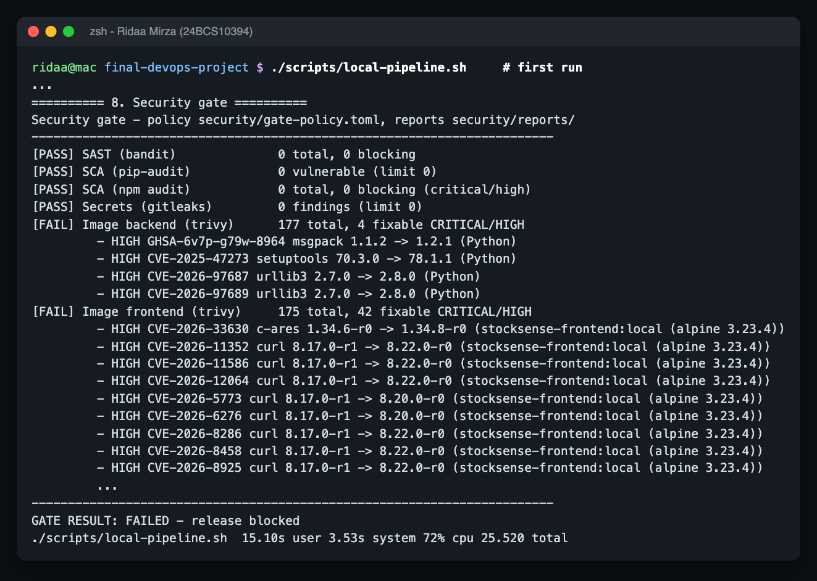
The security gate said no, and it was right
1
46 fixable HIGH CVEs
4 in the backend (inside pip), 42 in the frontend's Alpine base
2
Fixed at the source
removed pip from the runtime image, added apk upgrade
3
Run 2: gate passed
0 fixable HIGH/CRITICAL, secrets, SAST, SCA all clean
Run 1: release blocked
bandit · pip-audit · npm audit · trivy fs / image / config · gitleaks · gate.py
Notes:
My favourite moment of the project: the first time I ran the pipeline, the security gate blocked the release.
The screenshot is the real output. SAST, the dependency audits and the secret scan all passed, but Trivy found fixable high-severity CVEs in both images: 4 in the backend - and they weren't even in my dependencies, they were inside pip's own vendored libraries, urllib3, msgpack and setuptools - and 42 in the frontend, from outdated Alpine packages in the nginx base image.
I fixed them at the source rather than suppressing them: the backend runtime image doesn't need pip, so I removed it, and the frontend runtime stage now runs apk upgrade.
On the second run the gate passed: zero fixable high or critical findings, and everything else clean.
The lesson: scanners find problems in code you didn't write, and the best fix is often to remove what you don't need at runtime. And the gate design - one policy file, every scanner only reporting, and a missing report counts as a failure - means a scan that silently didn't run can't let a release through.

Slide 13
Run it on Kubernetes
03
Raw manifests, a Helm chart, autoscaling under load, and Terraform for AWS
Notes:
Part three: running StockSense on Kubernetes - the raw manifests, the Helm chart, autoscaling under real load, and the Terraform code for AWS.

Slide 14
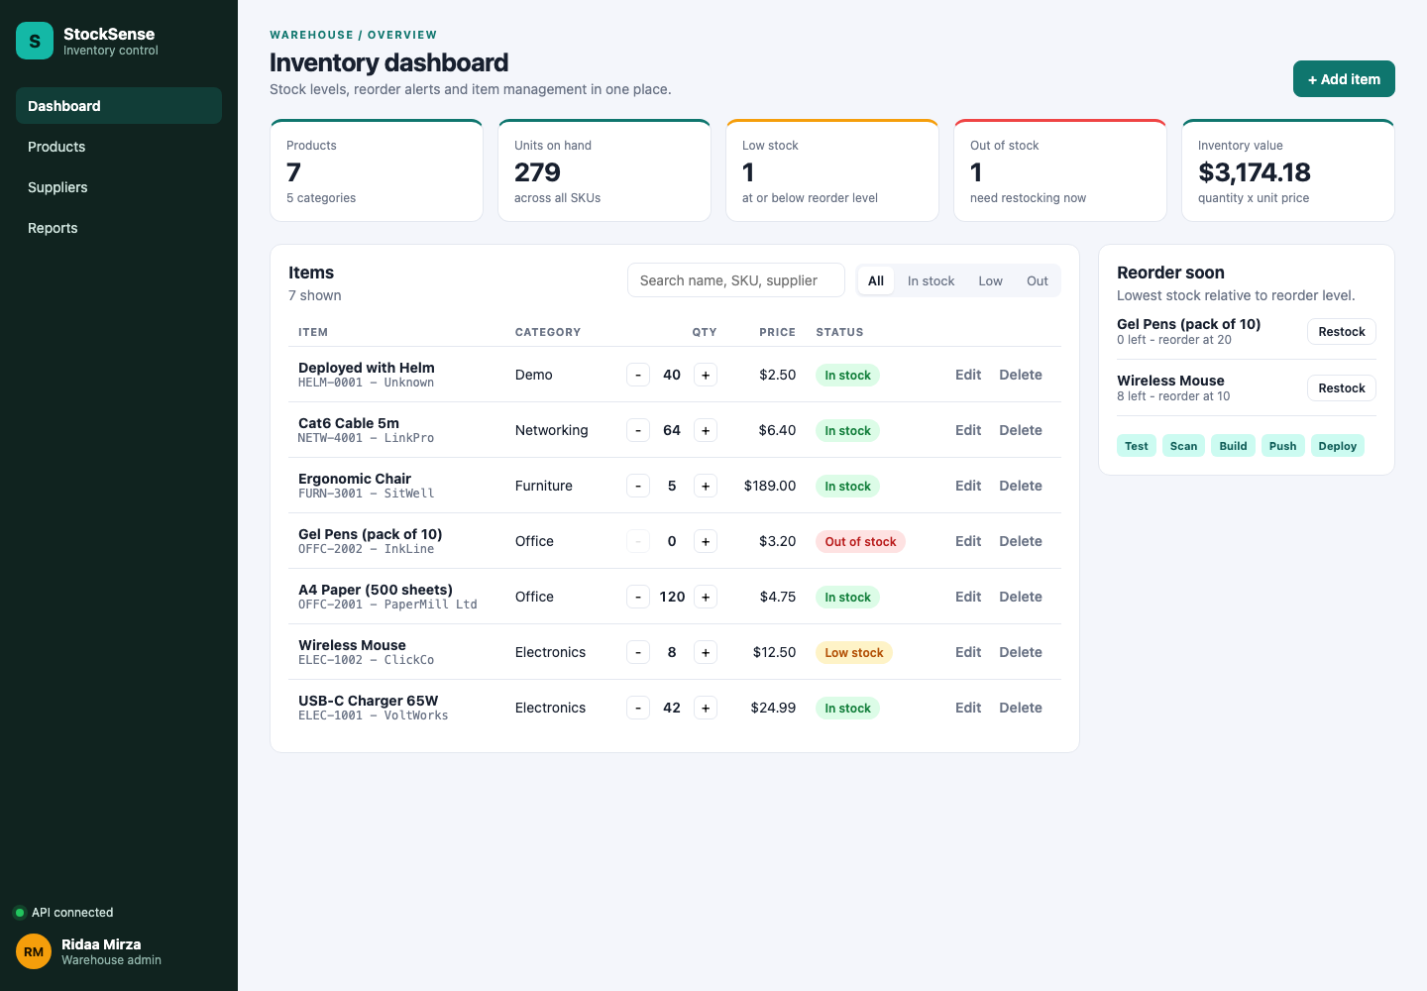

Everything the cluster needs
Namespace
final-app
ConfigMap
DB host, port, env
Secret
DB user + password
StatefulSet + PVC
Postgres, 1 Gi volume
Deployments
2 replicas each
Services
ClusterIP + headless
Ingress
/ and /api routing
HPA
backend 2-5 @ 60% CPU
3 kinds of probes
startup, readiness, liveness
Locked-down pods
non-root, read-only, no caps
StockSense served through the Kubernetes Ingress
Notes:
Before Helm, I wrote plain Kubernetes manifests so I understood every object. Everything the rubric asks for is here.
A namespace, final-app. A ConfigMap with non-secret settings like the database host and port, and a Secret with the database user and password - a fake, dev-only value; production uses an existing Secret that never touches Git. PostgreSQL runs as a StatefulSet with a 1 gigabyte persistent volume claim, so the data survives pod restarts. The backend and frontend are Deployments with two replicas each, behind ClusterIP Services. The Ingress routes slash to the frontend and /api to the backend. And there's an HPA for autoscaling.
Each backend pod has three probes: a startup probe so slow starts aren't killed, a readiness probe that checks the database, and a liveness probe that doesn't - so a database outage takes pods out of rotation instead of restarting all of them for nothing.
Every pod is locked down: non-root, read-only root filesystem, all Linux capabilities dropped, and the default seccomp profile. The screenshot is the app served through the Ingress on minikube.

Slide 15
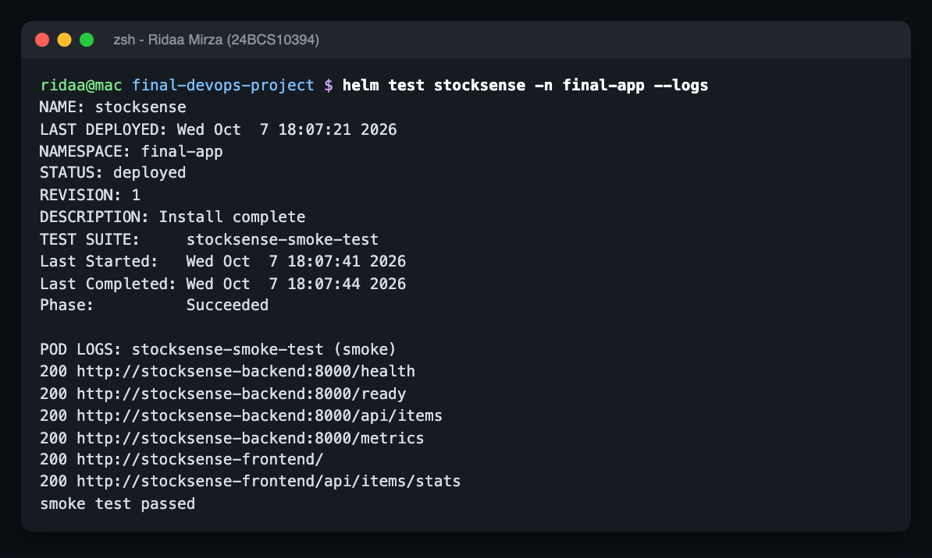
One Helm chart for dev and prod
values.yaml
defaults, GHCR images
values-dev.yaml
minikube
values-prod.yaml
EKS, TLS, gp3
install
helm test
upgrade
rollback
helm test runs a pod that checks health, readiness, the API, /metrics and the frontend proxy
A checksum annotation rolls the pods automatically when config changes
The chart also ships the ServiceMonitor, alert rules and Grafana dashboard
Notes:
Then I packaged everything as one Helm chart, helm/stocksense.
There are three values files: values.yaml with the defaults and the GHCR images, values-dev.yaml for minikube, and values-prod.yaml for EKS - which uses an existing Secret instead of one in Git, the gp3 storage class, and TLS on the Ingress.
The lifecycle I tested: helm install, then helm test, then an upgrade and a rollback. helm test runs a pod inside the cluster that checks health, readiness, the API, the /metrics endpoint, the frontend, and the frontend's /api proxy - the screenshot on the right is that passing.
A checksum annotation on the pods means that when the config changes, Helm rolls the pods automatically - the upgrade and rollback both did that. And the chart also ships the monitoring pieces: the ServiceMonitor, the alert rules and the Grafana dashboard.

Slide 16
Autoscaling under real load
2 → 5 → 2
backend pods
330%
peak CPU of the request
~73k
requests in 4 minutes
Notes:
This chart is real data from the load test. scripts/load-test.sh starts a curl pod inside the cluster with 8 workers hammering the stats endpoint for four minutes - about 73 thousand requests.
The top chart, in pink, is the backend's CPU usage as a percentage of its CPU request; the HPA target is 60%. As soon as the load starts, CPU jumps to 203% and the HPA scales the backend from 2 pods straight to its maximum of 5 - that's the purple line in the bottom chart. CPU peaks at 330% of the request.
When the load stops, CPU drops to almost nothing, but the pods don't disappear immediately: the HPA waits out its scale-down stabilisation window, then goes back to 2.
One gotcha I hit, and it's troubleshooting scenario 6: the HPA measures utilisation as a percentage of the CPU request, so if a pod has no request, the HPA shows unknown and never scales.

Slide 17

AWS infrastructure as code
VPC 10.42.0.0/16
Status
Availability zone A
Availability zone B
terraform init
public subnet
public subnet
terraform fmt
private subnet
private subnet
terraform validate
internet gateway + 1 NAT
plan · apply · destroy
EKS 1.33 cluster
managed node group: t3.medium, min 1 · desired 2 · max 3
Notes:
The production environment is defined in Terraform, using the official community modules for the VPC and EKS.
The VPC is 10.42.0.0/16 across two availability zones, each with a public and a private subnet. There's an internet gateway, and a single NAT gateway to keep the cost down. The EKS cluster runs in the private subnets with a managed node group of t3.medium instances - minimum 1, desired 2, maximum 3, using spot instances in dev.
Security-wise, the cluster admin CIDR has no default and rejects 0.0.0.0/0 - Trivy's config scan flagged an open API endpoint, so I fixed it. The tfvars example is committed; the real tfvars, state and .terraform folder are gitignored, and an S3 remote backend block is ready.
init, fmt and validate all pass, and the same checks run in the pipeline on every push. To create the infrastructure you run terraform plan, apply and destroy against an AWS account. It takes about 15 minutes, and costs roughly 15 cents an hour while the cluster exists, so it gets destroyed right after use.

Slide 18
Watch, heal & fix
04
Monitoring, GitOps, seven troubleshooting scenarios and what I learned
Notes:
Part four: operating it - watching it with monitoring, healing it with GitOps, and fixing it when things break.

Slide 19
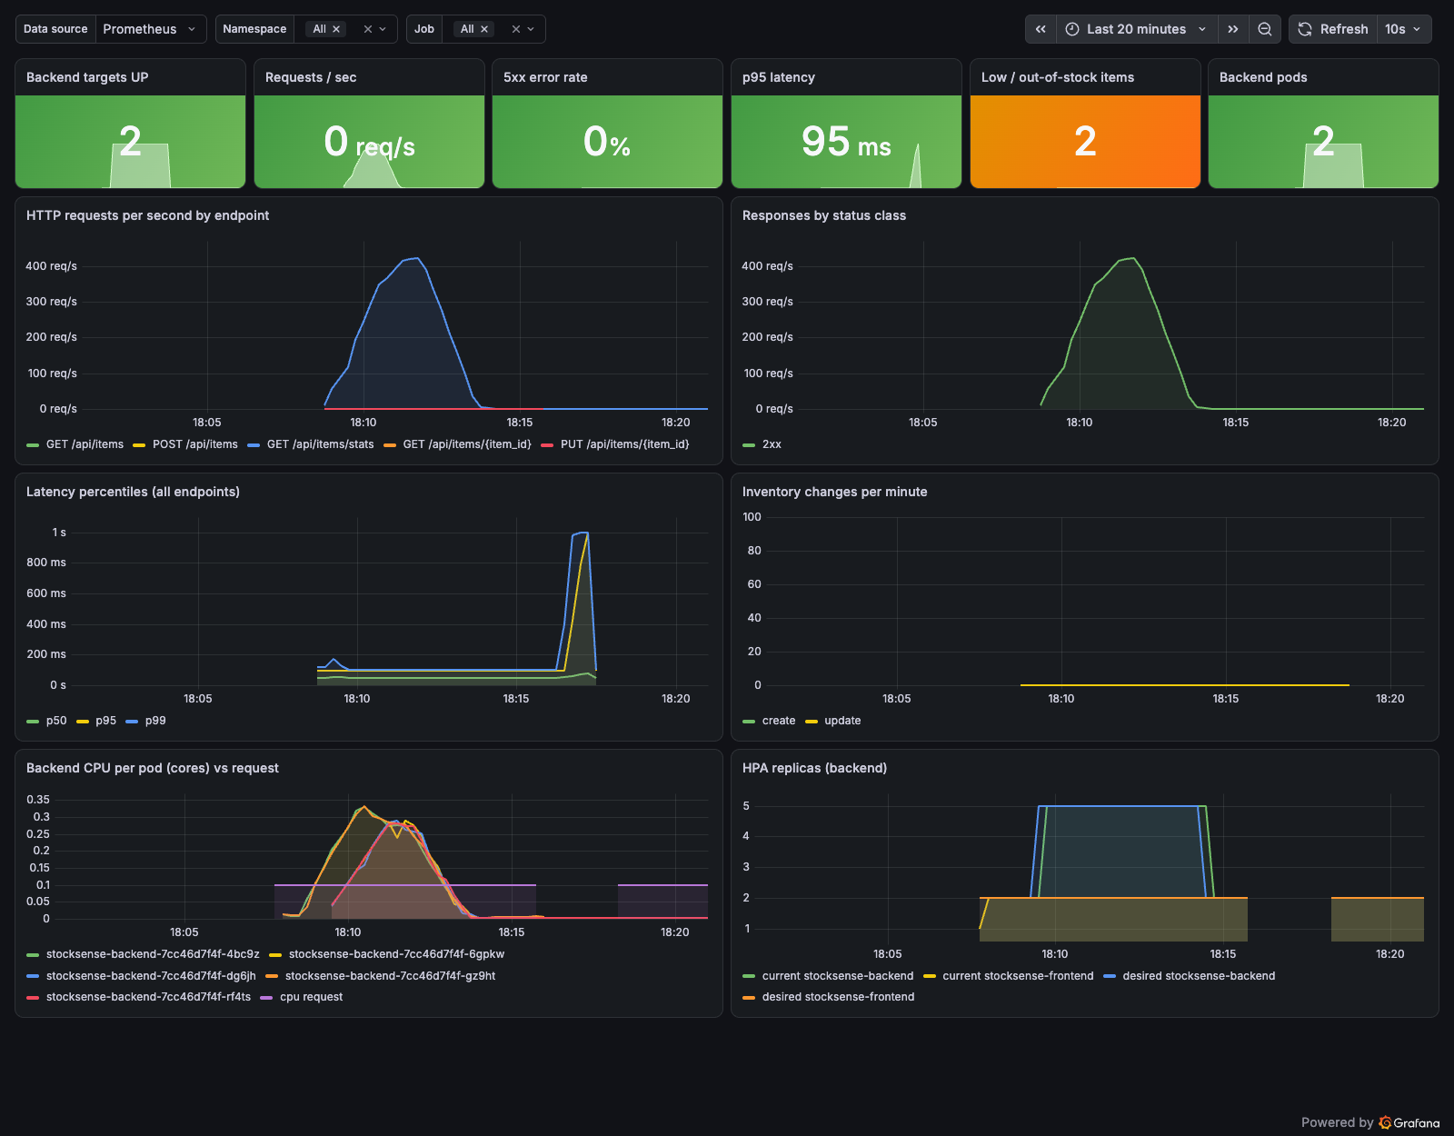


Watching it: Prometheus + Grafana
5 / 5 targets UP
Prometheus scraping every backend pod via a ServiceMonitor
~420 req/s peak
live from the load test, with p50 / p95 / p99 latency
5 alert rules
loaded through a PrometheusRule
Custom metrics
inventory changes + low-stock items
Notes:
For monitoring I installed kube-prometheus-stack, and the app's Helm chart adds a ServiceMonitor so Prometheus discovers the backend pods automatically.
During the load test the HPA had scaled to 5 pods, and Prometheus showed all 5 targets UP. The backend exposes standard HTTP metrics through prometheus-fastapi-instrumentator, plus two custom metrics of my own: inventory changes per minute and the number of low-stock items.
On the right is my Grafana dashboard, "StockSense - Application Overview", with live data from the load test: requests per second by endpoint peaking around 420, responses by status class, the latency percentiles p50, p95 and p99, backend CPU per pod against its request, and the HPA replicas going 2 to 5 and back to 2. Five alert rules are loaded through a PrometheusRule.
That covers the rubric's observability module: /metrics, Prometheus scraping the app, Grafana installed, and a panel with live application metrics.

Slide 20
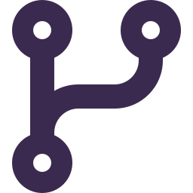

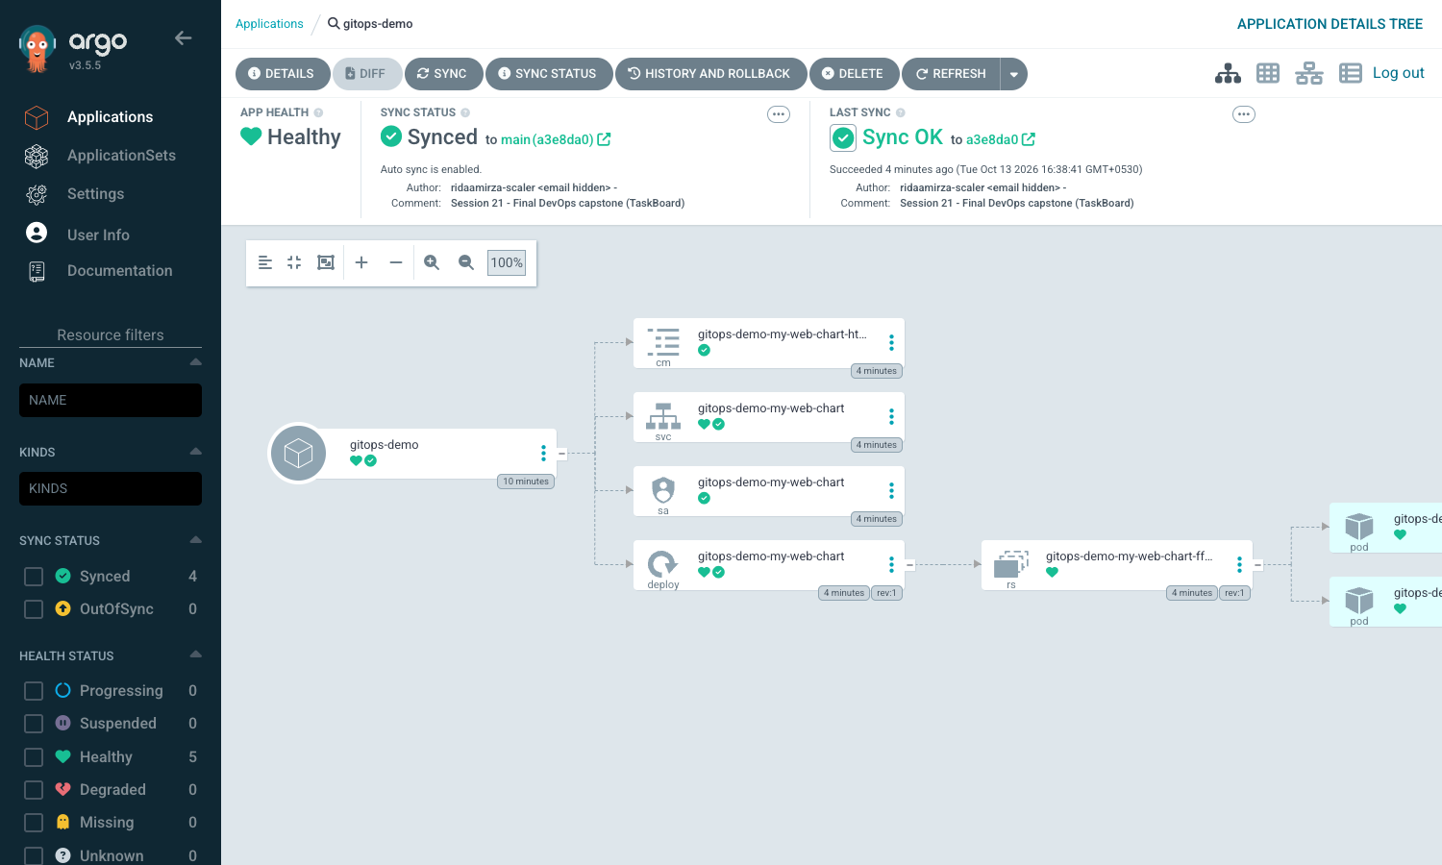
Git is the source of truth
commit
GitHub
Argo CD
cluster
Self-heal test
1
I scaled the Deployment to 5 replicas by hand
2
Argo CD saw the drift: Synced → OutOfSync
3
About a second later it was back to the 2 replicas Git says
CI pushes images; the cluster pulls its config from Git.
Notes:
GitOps flips the direction of deployment. Instead of the pipeline pushing changes into the cluster, Argo CD runs inside the cluster, watches the Git repo, and pulls the desired state - so Git is the single source of truth.
My Argo CD Application points at the Helm chart in this repo with automated sync, prune - resources removed from Git get removed from the cluster - and self-heal.
To prove self-heal, I scaled the Deployment to 5 replicas by hand with kubectl. Argo CD immediately saw the drift - the app went from Synced to OutOfSync - and about a second later it had put it back to the 2 replicas that Git says. That was the moment GitOps clicked for me.
The screenshot is the real Argo CD application tree. For the live sync demo I pointed it at a Helm chart on GitHub, and the real StockSense Application in the gitops folder points at this repo's chart and syncs the same way. Promoting a new build is just changing the image tag in Git: pull request, merge, and Argo CD syncs.

Slide 21
7 things I broke (one by accident)
1
Bad image tag
2
Selector typo
3
Wrong DB password
4
Missing ConfigMap key
SYMPTOM
ImagePullBackOff
FIX
rollout undo, right tag
SYMPTOM
503, no endpoints
FIX
fix the label
SYMPTOM
pods stuck in init
FIX
restore the Secret
SYMPTOM
CreateContainerConfigError
FIX
restore the key
5
Ingress → port 8080
6
No CPU requests
7
Grafana (real!)
SYMPTOM
503 on /api
FIX
point it at 8000
SYMPTOM
HPA shows <unknown>
FIX
add resource requests
SYMPTOM
restart loop, API stall
FIX
probe delay + CPU limit
Notes:
For the troubleshooting challenge I broke the deployed project on purpose, six times, and once it broke by itself. For each one I identified the symptom, investigated with kubectl, found the root cause, fixed it, and verified - all with before and after outputs in troubleshooting/README.md.
1. A backend image tag that was never built: the new pods went into ImagePullBackOff, but because the Deployment uses maxUnavailable zero, the old pods kept serving. Fix: rollout undo and the right tag.
2. A typo in the frontend Service selector: 503 on the homepage, because the Service had no endpoints. Fix the label.
3. I changed the database password in the Secret: new pods got stuck in their init container with "password authentication failed", because the Secret no longer matched the password stored in Postgres. Restore the Secret and restart.
4. A renamed ConfigMap key: CreateContainerConfigError, because a configMapKeyRef pointed at a key that didn't exist.
5. The Ingress pointing /api at port 8080: 503 on /api, because the Service only exposes 8000 - this was actually a bug in the reference project.
6. Removing the backend's resource requests: the HPA shows unknown and "missing request for cpu", because utilisation is a percentage of the request.
7. And the real one: Grafana got stuck in a restart loop because its liveness probe was shorter than its real startup time, and later, without a CPU limit, it stalled the whole shared API server for about two minutes. Fixed with a longer probe delay and a CPU limit.
The common thread: the symptom is never where the problem is.

Slide 22





What I learned
The symptom is never where the problem is
a 503 was a label typo; <unknown> was a missing CPU request
Liveness ≠ readiness
readiness checks the DB, liveness doesn't, or one DB blip restarts everything
maxUnavailable: 0 saved the app
broken new pods never replaced the working old ones
Scanners find what you didn't write
the CVEs were inside pip and the nginx base image
Limits protect neighbours
one pod with no CPU limit stalled the whole API server
GitOps flips the direction
CI pushes images, the cluster pulls config from Git
Notes:
Six things I'm taking away from this project.
One: the symptom is never where the problem is. A 503 was a label typo. Unknown in the HPA was a missing resource request. A stuck rollout was a password. Events, endpoints and init-container logs found them, not the application logs.
Two: liveness and readiness are different jobs. My readiness probe checks the database, my liveness probe doesn't - otherwise a single database blip would restart every backend pod for nothing.
Three: maxUnavailable zero saved the app in three of the scenarios. The new pods were broken, but they never replaced the old working ones.
Four: scanners find problems in code you didn't write. The high CVEs were inside pip and the nginx base image, not my own dependencies, and the best fix was removing what isn't needed at runtime.
Five: limits protect your neighbours. One pod without a CPU limit stalled the API server for the whole cluster.
Six: GitOps flips the direction. CI pushes images, the cluster pulls its config from Git, and self-heal reverting my manual change in a second made that click.
And one more: reference code isn't automatically correct. The TaskBoard reference's Terraform didn't even parse, and its Ingress pointed at a Service that didn't exist. Running everything for real is the only way to know.

Slide 23


Live demo: commit → pipeline → deploy
1
2
3
4
Change & commit
edit a visible text in the frontend, git commit, git push
Watch the pipeline
Actions runs all 9 stages: tests, scans, gate
New image in GHCR
stocksense-frontend tagged with the new commit SHA
Deployment updates
new SHA in Git → Argo CD syncs → refresh the browser
Notes:
Now the live demo - the rubric's "commit a change, watch the pipeline run, see the deployment update".
Step one: I change a visible piece of text in the frontend, commit it, and push to main.
Step two: in the GitHub Actions tab you'll see the run start. The build-and-test jobs run in parallel, then SAST, dependency scans, secret scan, image build, Trivy, and the security gate. This takes a few minutes, so I'll talk through the stages while it runs.
Step three: when the gate passes, the pipeline pushes the new images to GHCR, tagged with the new commit SHA - I'll show the package page.
Step four: the deployment updates. The pipeline's own deploy stage installs it into a kind cluster and runs helm test, and on my cluster I set the new SHA in Git, Argo CD syncs it, and when I refresh the browser the changed text appears.
If the network is slow on the day, the README has the real output and screenshots of every one of these steps as a backup.

Slide 24
Thank you!
That's StockSense
Ridaa Mirza · 24BCS10394
github.com/Ridaa10394/devops-project
Notes:
That's StockSense: one small inventory app, tested, scanned, containerised, deployed with Helm, autoscaled, monitored, kept in sync with GitOps, and broken and fixed seven times along the way.
Thank you for listening - I'm happy to take any questions. The code, the README and every output are in github.com/Ridaa10394/devops-project.

