Slide 1

Capstone Project1
MANUFACTURING EQUIPMENT OUTPUT PREDICTION WITH LINEAR REGRESSION
Team Members
T120100319: Keerthanapriya S
T120100328: Rida Afnar
T120100329: Rukhaiya Raheem
T120100332: Sinchana H S
T120100336: Nailah Fathima
T120100337: Sameen Mehnaz Fathima

Slide 2
Table of Contents
Problem Statement
Overview of the Project
Data generation & Loading
Data Exploration & Understanding
Exploratory Data Analysis
Data Preprocessing & Feature Engineering
Model Building & Training
Model Evaluation & Performance Analysis
Stream API Deployment
Docker Deployment
Conclusion

Slide 3
Problem Statement
The problem Statement is mainly focused on this project is related to optimizing manufacturing efficiency.
Manufacturing industries frequently experience inefficiencies caused by fluctuations in process parameters such as temperature, pressure, and cycle time
Goal: Develop a predictive model that uses machine and process data to estimate the Efficiency Score and enhance manufacturing performance. This model will help industries optimize production settings, minimize downtime, and maintain consistent product quality.

Slide 4
Overview of the Project
End-to-end Data Science workflow.
Dataset: manufacturing_dataset_1000_samples.csv
Target variable: Parts produced per hour.
Techniques: Linear Regression, EDA, Feature Engincering.
Deployment plan: FastAPI+ Docker.
The tools includes:
Python for data analysis and modeling
Scikit-Learn for ML algorithms
Matplotlib/Seaborn for data visualization
The final outcome is a model that can predict the machine efficiency.

Slide 5
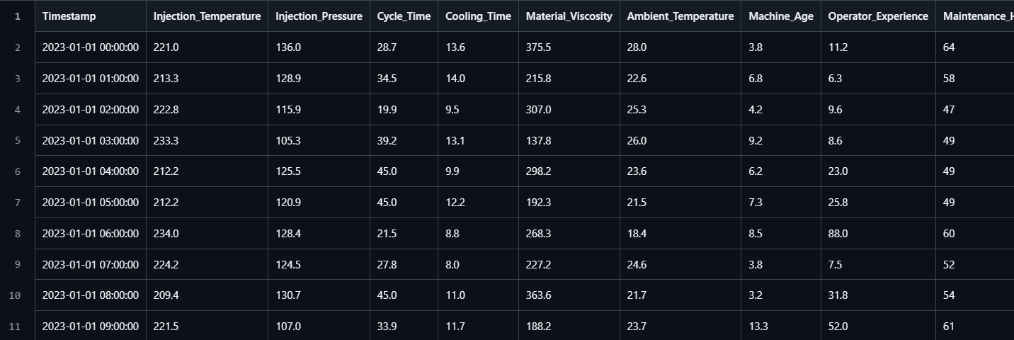
Data generation & Loading
The dataset contains 19 features, including Injection_Temperature, Injection_Pressure, Cycle_Time, Cooling_Time, Material_Viscosity, Ambient_Temperature, Machine_Age, Operator_Experience, Maintenance_Hours etc.
The target variable is Parts produced per hour.
The data was loaded using Pandas and checked for missing values,data types, and distributions.Missing values: Material_Viscosity, Ambient_Temperature, Operator_Experience 20 missing values each (980 non-null).

Slide 6
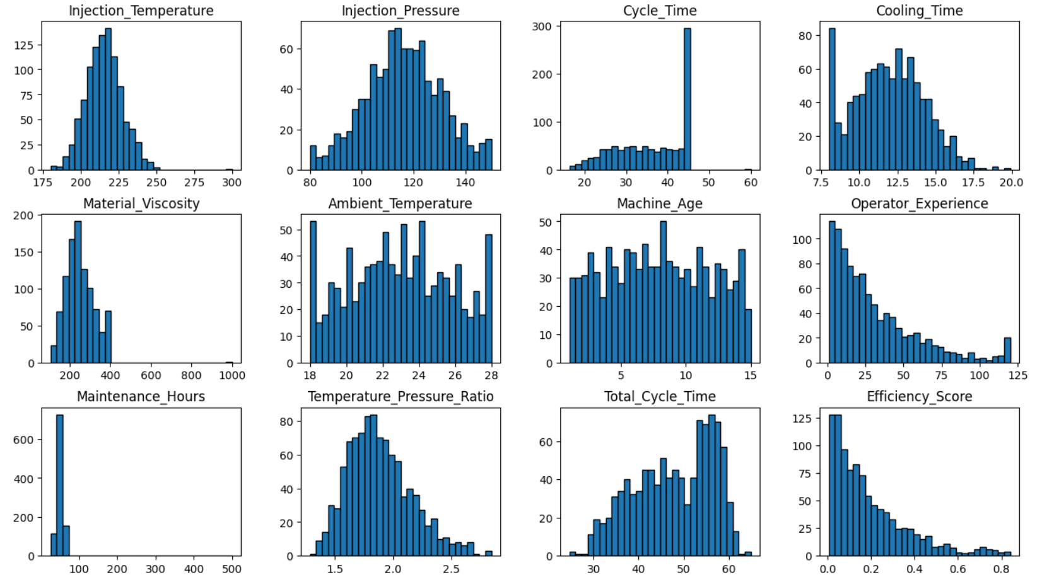
Data Exploration & Understanding
Dataset shape & summary statistics checked.
Finding missing values & outliers identified.
Distribution of target variable (Output) analyzed.
Summarizing the data using statistics or
visualizations to see patterns or trends.
Purpose: To make sure the data is clean,
meaningful, and ready for analysis or modeling.

Slide 7
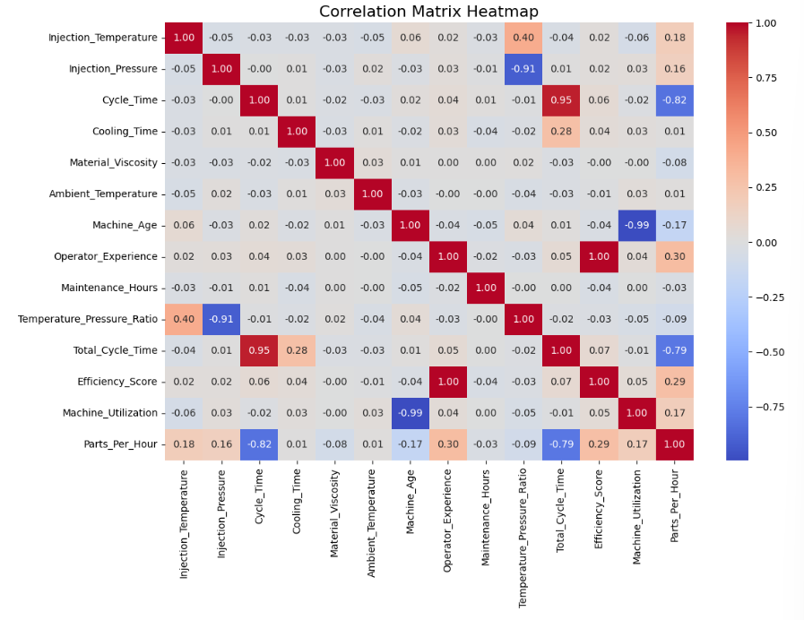
Exploratory Data Analysis
Discover patterns and relationships in manufacturing data to understand how machine settings and operations affect production output.
Histograms for all features distribution patterns.
Correlation matrix relationships among variables.
Scatter plots impact of cycle time, temperature, pressure on output.
Identified optimal operating ranges for parameters.

Slide 8
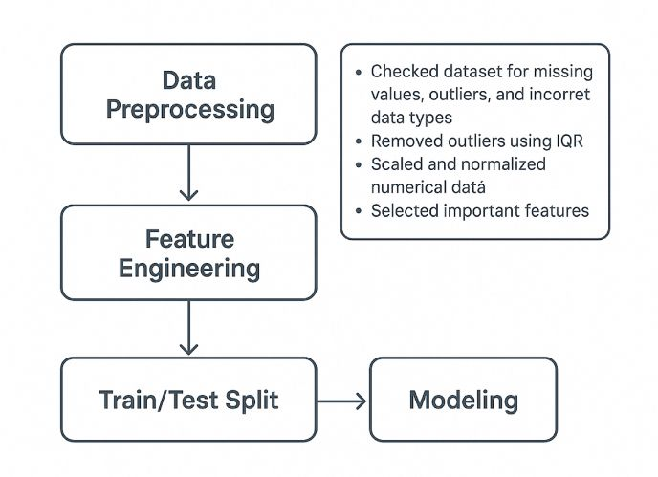
Data Preprocessing &Feature Engineering
Checked dataset for missing values, outliers, and incorrect data types.
Used IQR method to remove outliers for better accuracy
Created new derived features like efficiency ratios to add more insights.
Scaled and normalized numerical data to maintain consistency
Selected important features such as:
Injection Temperature
Injection Pressure
Cycle Time
Cooling Time
Material Viscosity
Split dataset into Training (80%) and Testing (20%) sets.
Ensured data was clean, consistent, and ready for modeling
Goal: Prepare high-quality data that helps the model learn accurate patterns.

Slide 9
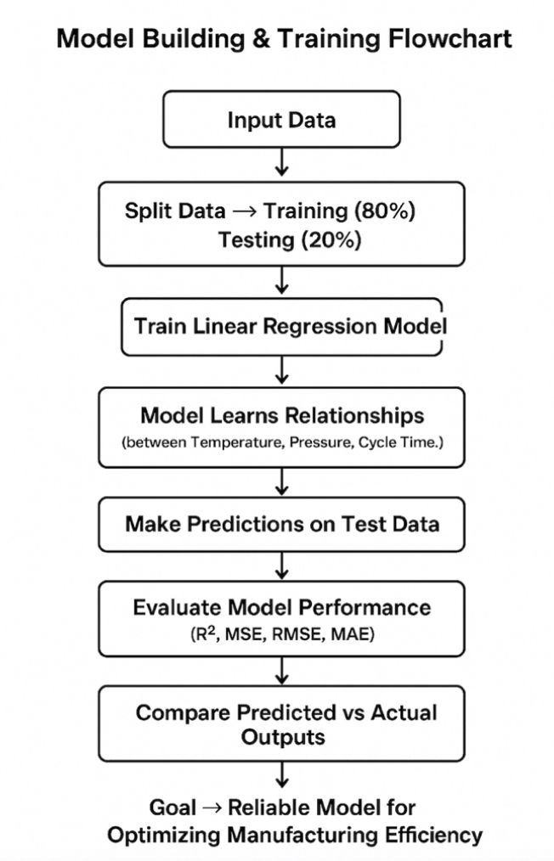
Model Building & Training
Built a Linear Regression Model to predict hourly machine output
Trained the model using training data (80%) and tested on test data (20%)
Model learned relationships between features like temperature, pressure, and cycle time with the output
Used random state to ensure reproducible results
Made predictions on test data to check accuracy
Evaluated performance using:
R² Score (aimed > 0.75)
MSE, RMSE, and MAE for error analysis
Compared predicted vs actual values to validate the model.
Helped identify which machine parameters most affect production efficiency.
Goal: Build a reliable model to predict output and improve manufacturing performance

Slide 10
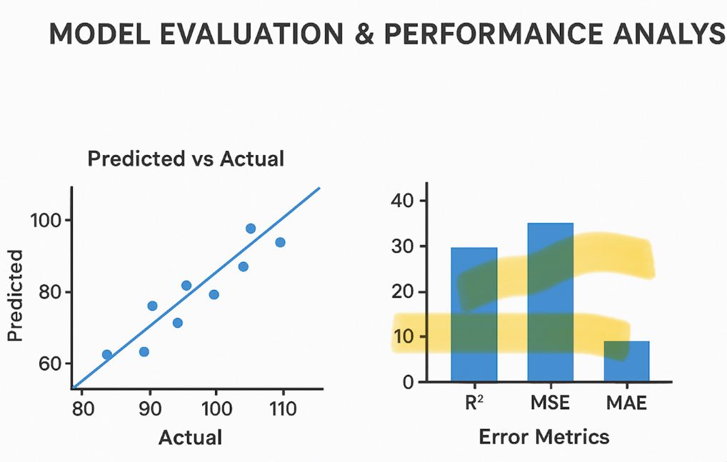
Model Evaluation & Performance Analysis
Evaluated the Linear Regression model to check its accuracy and reliability
Used key metrics for evaluation:
R² Score → Measures how well the model fits the data (target > 0.75)
MSE (Mean Squared Error) → Average squared difference between predicted and actual values
RMSE (Root Mean Squared Error) → Shows prediction errors in the same unit as output
MAE (Mean Absolute Error) → Average of absolute prediction errors
Plotted Predicted vs Actual values to visualize model performance
Created Residual Plots to check for model consistency and identify any bias
Found that the model performs well with high R² and low error values
Goal: Ensure the model predicts accurately and can be trusted for real-world

Slide 11
Stream API Deployment
Deployed the trained model using Streamlit, a simple and interactive web framework
Created a user-friendly interface to input parameters like Temperature, Pressure, and Cycle Time
The app displays the predicted machine output instantly based on the inputs
Model and preprocessing components were saved using Pickle for easy loading
Streamlit app runs locally or can be hosted for production use
Enables manufacturing teams to test and optimize settings in real time
This deployment makes the machine learning model practical and easy to use, even for non-technical users
It bridges the gap between data analysis and real-world application, helping teams make faster, data-driven decisions
Goal: Make the predictive model accessible and usable through a web interface

Slide 12
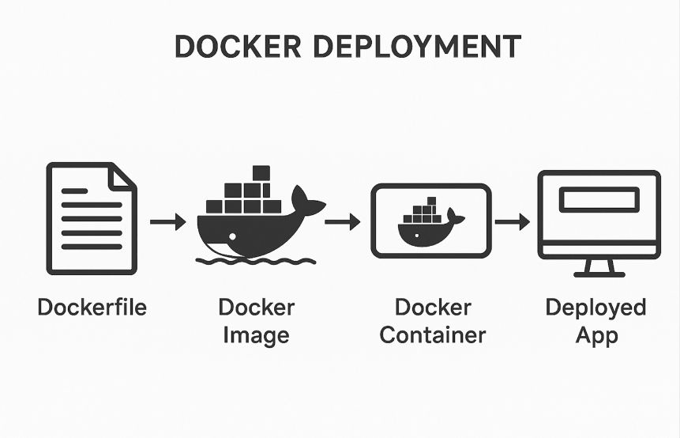
Docker Deployment
Used Docker to containerize the Streamlit app for easy deployment
A Dockerfile was created with all required dependencies and setup instructions
This allows the entire project (model + app) to run the same way on any system
Used docker-compose to manage multiple services if needed
Added a .dockerignore file to skip unnecessary files and improve efficiency
Docker ensures the app is portable, scalable, and easy to maintain in real-world environments
It simplifies sharing, testing, and updating the application without compatibility issues
Overall, Docker makes the project fully production-ready and efficient for real-world manufacturing use
Goal: Make deployment smooth, consistent, and ready for production use

Slide 13
Conclusion
The project successfully built a Linear Regression model to predict machine output based on key manufacturing parameters
Through data processing and feature engineering, the dataset was cleaned, refined, and made ready for modeling
The model achieved strong accuracy (R² > 0.75), proving its reliability in predicting production performance
Streamlit deployment made the model interactive and easy for users to test in real time
Docker deployment ensured smooth, consistent performance across different systems
Overall, the project combined data science, automation, and business insights to help manufacturers optimize efficiency, reduce downtime, and make data-driven decisions
A complete end-to-end solution — from data to deployment — for smarter manufacturing

Slide 14
Any Queries ???

