Slide 1
Database

Slide 2

Pengertian database adalah sekumpulan data yang sudah disusun sedemikan rupa dengan ketentuan atau aturan tertentu yang saling berelasi sehingga memudahkan pengguna dalam mengelolanya juga memudahkan memperoleh informasi.

Slide 3
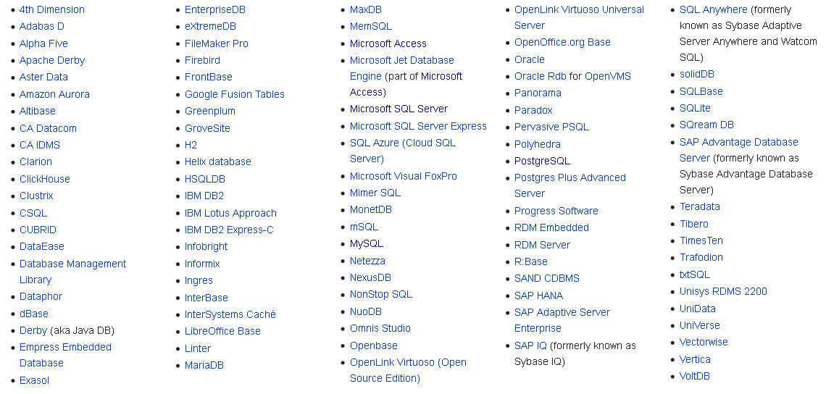
Macam Database:

Slide 4

PostgreSQL / post-gress-Q-L
PostgreSQL adalah sebuah sistem basis data yang disebarluaskan secara bebas menurut Perjanjian lisensi BSD. Peranti lunak ini merupakan salah satu basis data yang paling banyak digunakan saat ini, selain MySQL dan Oracle.

Slide 5
DDL & DML
perintah SQL dibagi dalam 2 kategori besar sesuai fungsinya, yaitu :
DDL - Data Definition Language :
merupakan kumpulan perintah SQL yang digunakan untuk membuat, mengubah dan menghapus struktur dan definisi metadata dari objek-objek database.
DML - Data Manipulation Language :
merupakan kumpulan perintah SQL yang digunakan untuk proses pengolahan isi data di dalam table seperti memasukkan, merubah dan menghapus isi data - dan tidak terkait dengan perubahan struktur dan definisi tipe data dari objek database.

Slide 6
DDL (Data Definition Language)
Create DB
Create Table
Update Table
Rename Table
Add Column
Modify Column
Drop Column
Drop Table

Slide 7
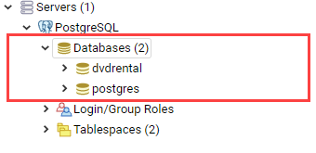
Databases
A database is a container of other objects such as tables, views, functions, and indexes.
Create DB
CREATE DATABASE [databasename]

Slide 8
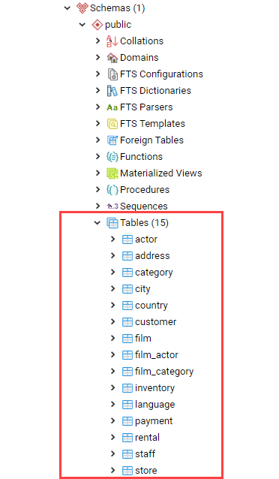
Tables
table is used to store the data.
can have many tables in a database

Slide 9
Create Tabel
alter Tabel
CREATE TABLE pegawai
( id_pegawai integer PRIMARY KEY,
umur integer,
Nama_pegawai TEXT
);
ALTER TABLE table_name
RENAME TO new_table_name;
Show all Tabel
Rename colom Tabel
SELECT * FROM pg_catalog.pg_tables;
ALTER TABLE table_name
RENAME COLUMN column_name TO new_column_name;
alter colom variable type
ALTER TABLE nama_table ALTER COLUMN nama_colom TYPE VARCHAR using NAME_COLUMN::VARCHAR;
alter colom add column
ALTER TABLE table_name
ADD COLUMN new_column_name data_type;

Slide 10
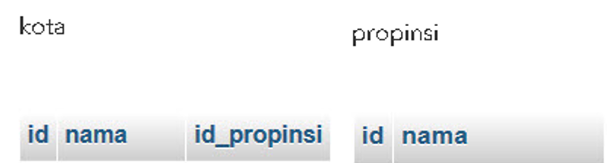
Nama table kota
Contoh isi
Id : 1,2,3,4
Nama : Nordic 2
Id_propinis : 1,2,3,4
Nama table propinsi
Contoh isi
Id : 1,2,3,4
Nama : Bosnia selatan

Slide 11
DB Data type
Name | Store size | Range
smallest | 2 bytes | -32768 to +32767
integer | 4 bytes | -2147483648 to +2147483647
bigint | 4 bytes | -9223372036854775808 to 9223372036854775807
decimal | variable | If you declared it as decimal datatype ranges from 131072 digits before the decimal point to 16383 digits after the decimal point
numeric | variable | If you declare it as the number, you can include number up to 131072 digits before the decimal point to 16383 digits after the decimal point
real | 4 bytes | 6 decimal digits precision
double | 8 bytes | 15 decimal digits precision
Name | Description
varchar(n) | Allows you to declare variable-length with a limit
Char(n) | Fixed-length, blank padded
Text | Use can use this data type to declare a variable with unlimited length

Slide 12
DML (Data Manipulation Language)
Insert Data
Update Data
Select Data
Select Data dengan Kondisi:
Kondisi pasti : where Column = KataKunci
Kondisi tidak pasti: where column like ‘%katakunci%’
Order By
Group By
Sum
Count

Slide 13
DML, Existence data
Insert data
Insert multiple data
INSERT INTO table (column1, column2, …)
VALUES
(value1, value2, …),
(value1, value2, …) ,...;
INSERT INTO pegawai(
id_pegawai, umur, nama_pegawai)
VALUES (?, ?, ?);
Update data
UPDATE pegawai
SET id_pegawai=?, umur=?, nama_pegawai=?
WHERE <condition>;
Delete data
DELETE FROM public.pegawai
WHERE <condition>;

Slide 14
Select
One of the most common tasks, when you work with the database, is to query data from tables by using the SELECT statement.
SELECT
select_list
FROM
table_name;
The following example uses the SELECT statement with an expression. It omits the FROM clause:
SELECT 5 * 3;
A column alias allows you to assign a column or an expression in the select list of a SELECT statement a temporary name.
SELECT column_name AS alias_name
FROM table_name;
SELECT column_name alias_name
FROM table_name;

Slide 15
When you query data from a table, the SELECT statement returns rows in an unspecified order. To sort the rows of the result set, you use the ORDER BY clause in the SELECT statement.
SELECT
select_list
FROM
table_name
ORDER BY
sort_expression1 [ASC | DESC],
...
sort_expressionN [ASC | DESC];
The DISTINCT clause is used in the SELECT statement to remove duplicate rows from a result set. The DISTINCT clause keeps one row for each group of duplicates. The DISTINCT clause can be applied to one or more columns in the select list of the SELECT statement.
SELECT
DISTINCT column1
FROM
table_name;

Slide 16
The SELECT statement returns all rows from one or more columns in a table.
To select rows that satisfy a specified condition, you use a WHERE clause.
SELECT select_list
FROM table_name
WHERE condition
ORDER BY sort_expression

Slide 17
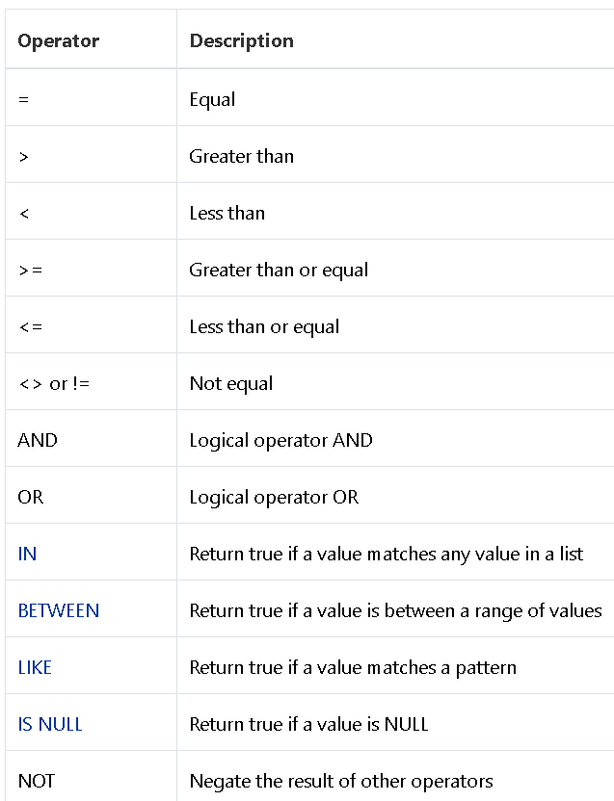

Slide 18
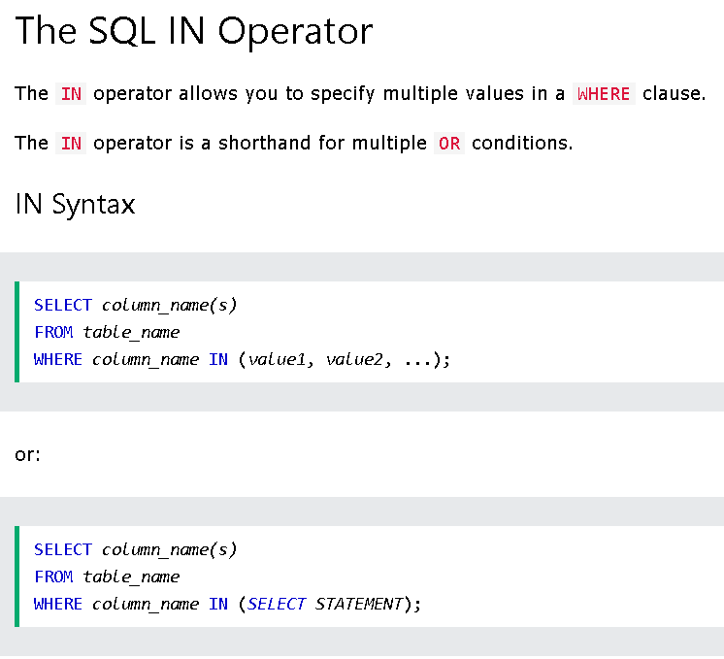

Slide 19
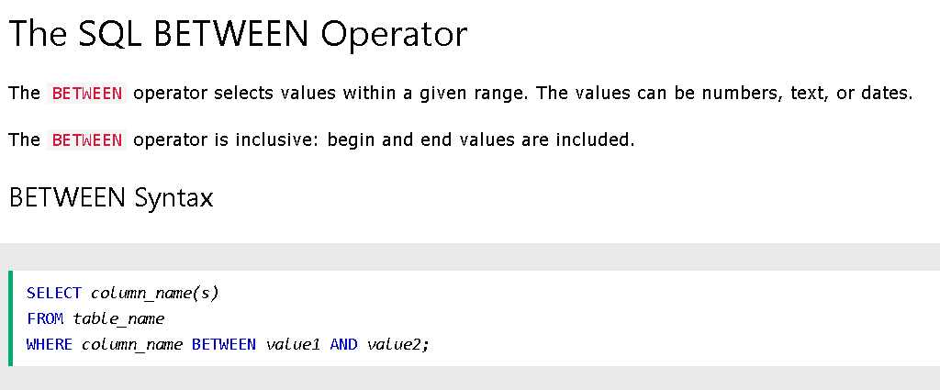

Slide 20
Where like
To find a string that matches a specified pattern, you use the LIKE operator. The following example returns all customers whose first names start with the string Ann:
SELECT
first_name,
last_name
FROM
customer
WHERE
first_name LIKE 'Ann%'

Slide 21
Fungsi agregate
Aggregate functions perform a calculation on a set of rows and return a single row. PostgreSQL provides all standard SQL’s aggregate functions as follows:
AVG() – return the average value.
COUNT() – return the number of values.
MAX() – return the maximum value.
MIN() – return the minimum value.
SUM() – return the sum of all or distinct values.
You can use aggregate functions as expressions only in the following clauses:
SELECT clause.
HAVING clause.

Slide 22
The AVG() function is one of the most commonly used aggregate functions in PostgreSQL. The AVG() function allows you to calculate the average value of a set.
SELECT AVG(amount)
FROM payment;
The COUNT() function is an aggregate function that allows you to get the number of rows that match a specific condition of a query.
The COUNT(*) function returns the number of rows returned by a SELECT statement, including NULL and duplicates.
SELECT
COUNT(*)
FROM
table_name
WHERE
condition;

Slide 23
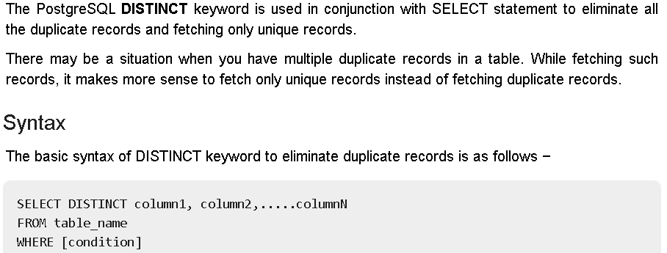
Select Distinct

Slide 24
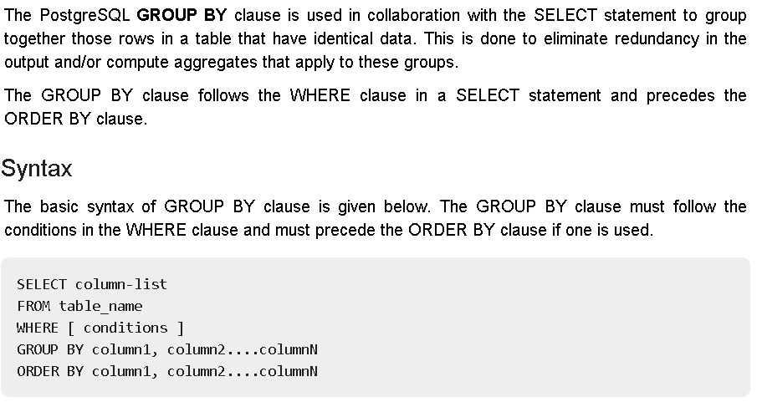
Group By

Slide 25
Subquery
A Subquery or Inner query or a Nested query is a query within another SQL query and embedded within the WHERE clause.
A subquery is used to return data that will be used in the main query as a condition to further restrict the data to be retrieved.
Subqueries can be used with the SELECT, INSERT, UPDATE, and DELETE statements along with the operators like =, <, >, >=, <=, IN, BETWEEN, etc.
SELECT column_name [, column_name ]
FROM table1 [, table2 ]
WHERE column_name OPERATOR
(SELECT column_name [, column_name ]
FROM table1 [, table2 ]
[WHERE])

Slide 26
DML (Data Manipulation Language) 2
Subquery
Join Table
2 Table
3 Table
4 Table

Slide 27
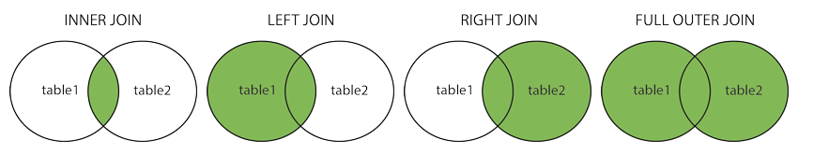
Join tabel
Perintah JOIN dalam SQL digunakan untuk menampilkan data pada table yang saling berhubungan atau berelasi. Artinya kita dapat menampilkan data dalam beberapa table hanya dengan satu kali perintah.

Slide 28
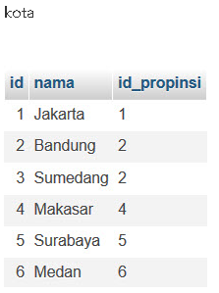
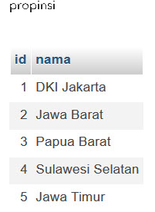
Contoh Join tabel

Slide 29
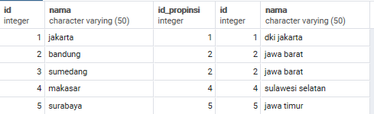
Inner join
select * from kota INNER join propinsi
On
kota.id_propinsi = propinsi.id

Slide 30
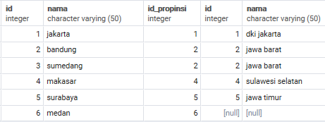
Left join
select * from kota left join propinsi
On
kota.id_propinsi = propinsi.id

Slide 31
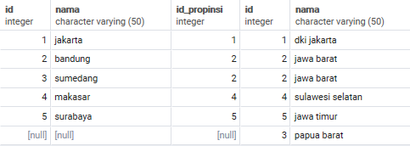
Right join
select * from kota right join propinsi
On
kota.id_propinsi = propinsi.id

Slide 32
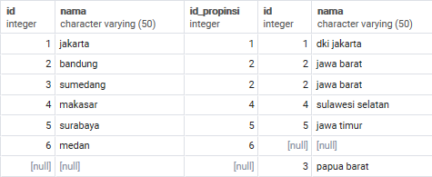
Full outer join
select * from kota FULL OUTER join propinsi
on kota.id_propinsi = propinsi.id

Slide 33

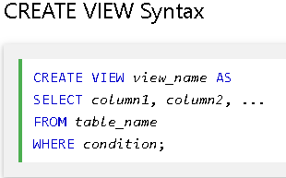
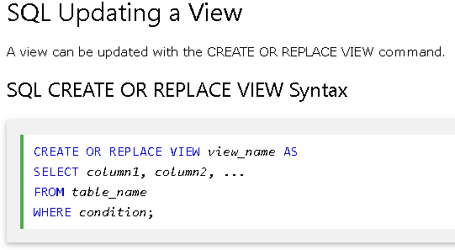
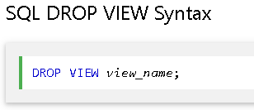
View
In SQL, a view is a virtual table based on the result-set of an SQL statement.

Slide 34
Concat
Introduction to PostgreSQL CONCAT function
Concatenation/merangkai dua atau lebih string
Syntax ( < 9.1):
SELECT
'Concatenation' || ' ' || 'Operator' AS result_string;
Syntax ( < 9.1):
CONCAT(str_1, str_2, ...)

Slide 35
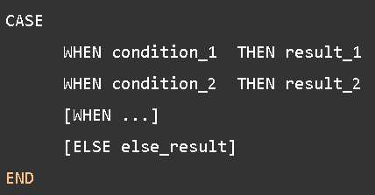
Conditional Case
CASE PostgreSQL sama dengan pernyataan IF/ELSE dalam bahasa pemrograman.
memungkinkan untuk menambahkan logika if-else ke sql untuk membantu menyelesaikan kasus.

Slide 36
Coalesce
Replace null dengan karakter.
Umumnya di gunakan pada statement SELECT untuk menghandle null
Syntax: COALESCE (argument_1, argument_2, …);

Slide 37
waktu :
NOW();
Mendapatkan waktu full saat ini. Return type dari now() adalah timestamp dengan zona waktu
DATE_PART(field,source);
Mengeluarkan bagian waktu dari nilai tanggal atau waktu.
Field :
century
decade
year
month
day
hour
minute
second
microseconds
Milliseconds
dll,.
Source : expression bernilai TIMESTAMP, TIME, INTERVAL dan DATE.
TO_DATE(text,format);, merubah STRING ke DATE.
Ex: SELECT TO_DATE('20170103','YYYYMMDD’);
Fungsi AGE() menghitung dua nilai TIMESTAMP, mengurangi nilai kedua dari yang pertama dan mengembalikan dalam interval sebagai returnya.

Slide 38
Limit
SELECT
film_id,
title,
release_year
FROM
film
ORDER BY
film_id
LIMIT 5 OFFSET 6;

