Slide 1


DESIGN A MICROSTRIP ANTENNA FOR ULTRA WIDE BAND
Course: EMFW
Group No. G-20
Group Members Name (id):
Riddhesh Sawant(2017AAPS0261G)
Ashish Sinha(2017AAPS0400G)
3. Ishan Bansal(2017AAPS0356G)
4. Parambir Singh Chadha(2017AAPS0993G)

Slide 2
Group No.: G-20
Proposed Antenna Size: Ex.: 13*13*1.5
Proposed Band width: Ex.: 2 to 11 GHz
Actual Band width: Ex.: 4.3 to 11.9 GHz

Slide 3
OUTLINE
ANTENNA DESIGN & EVOLUTION
SIMULATED RESULTS (S11)
SIMULATED GAIN
SIMULATED RADIATION EFFICIENCY
SIMULATED RADIATIONS PATTERN
DIRECTIVITY
CONCLUSION

Slide 4

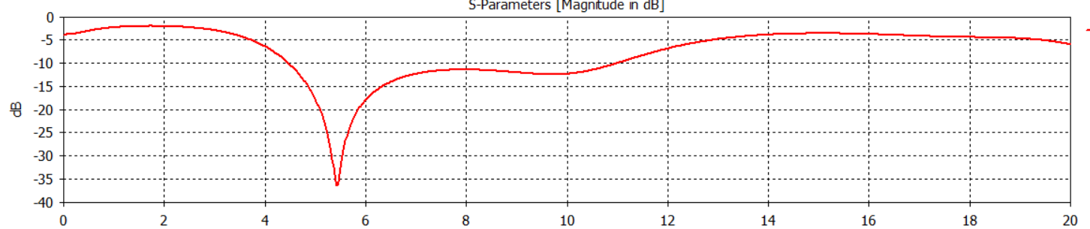

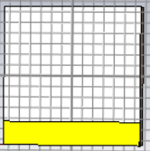
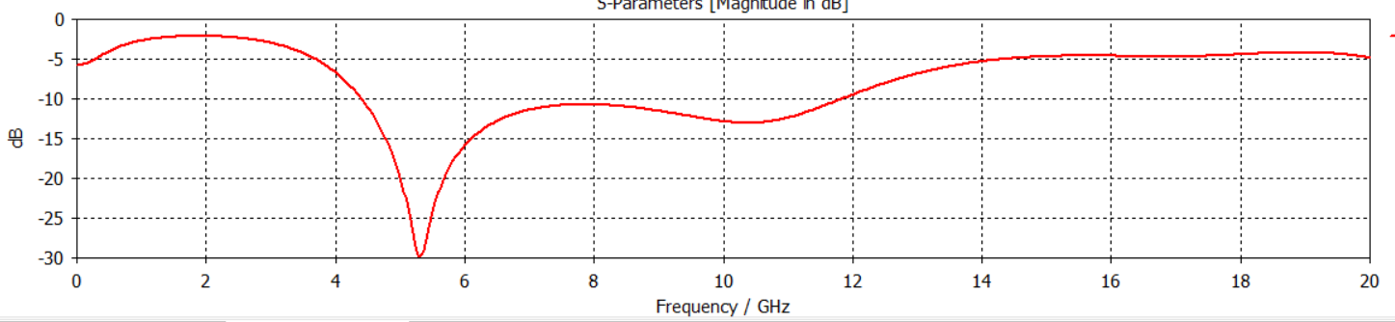
1. ANTENNA DESIGN & EVOLUTION

Slide 5
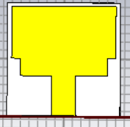
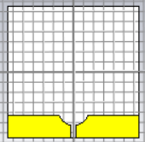
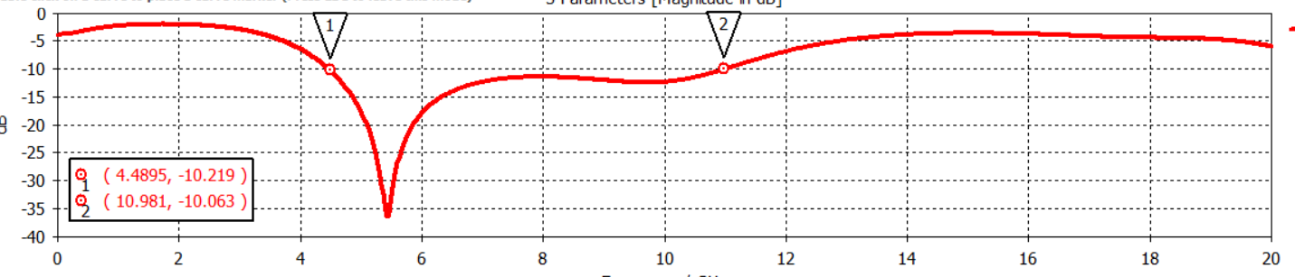
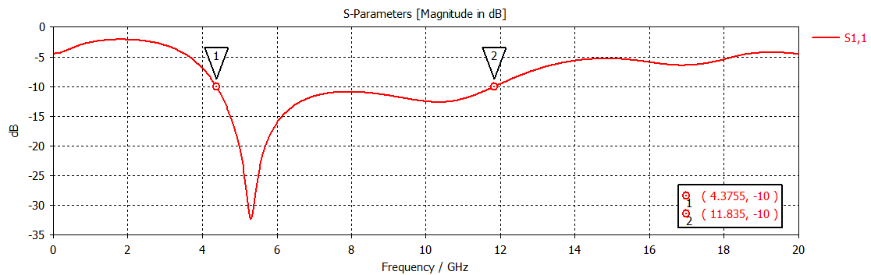

ANTENNA DESIGN & EVOLUTION

Slide 6
2. SIMULATED RESULTS (S11)

Slide 7
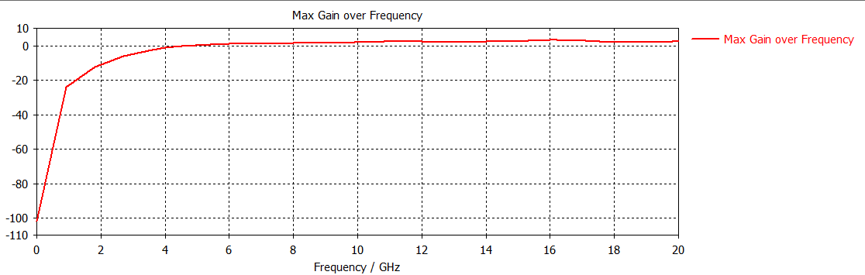
3. SIMULATED GAIN

Slide 8
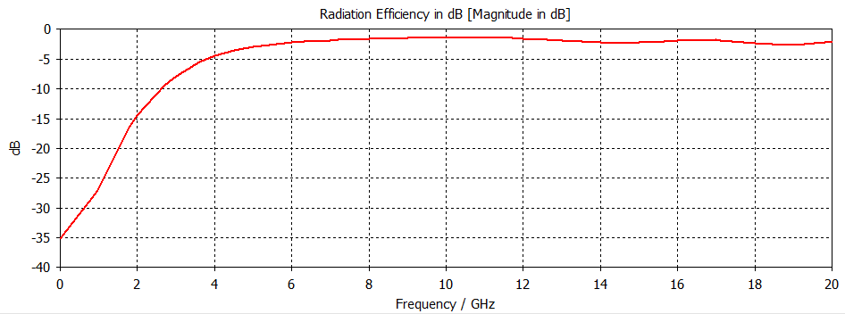
4. SIMULATED RADIATION EFFICIENCY

Slide 9
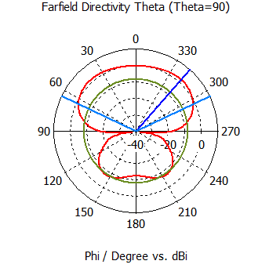
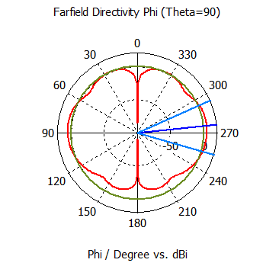
5. SIMULATED RADIATIONS PATTERN

Slide 10
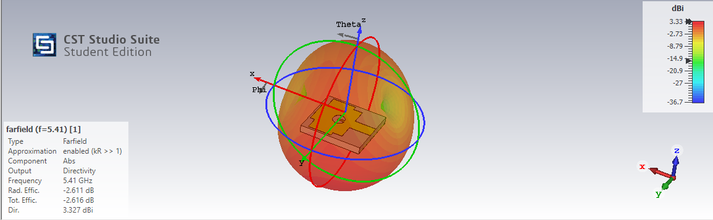
6. DIRECTIVITY

Slide 11
7. CONCLUSION
The proposed antenna has an overall size of 13*13*1.5 cubic millimeter.
The total fractional bandwidth of the proposed is 92.03% (GHz 4.37– 11.9GHz).
The Peak gain and the radiation efficiency of the proposed antenna is 2.5 dB and 72.3% respectively.
It covers 4.37-11.9 GHz of bandwidth and is used in wireless audio, data and video distribution, ground penetrating radar, asset tracking etc.

Slide 12
Thank You
18

