Slide 1
Model Pruning
Presented by:
Riddhi Chatterjee

Slide 2

What is Model Pruning?
Technique of removing connections between neurons.
Sometimes weights are removed and sometimes entire channels or filters are removed.
Why Model Pruning?
Deep neural networks tend to be over-parameterized.
Multiple features convey the same information and thus we can get rid of these redundancies.
Reduces inference time and inference cost.
Copyright of Shell International B.V.

Slide 3
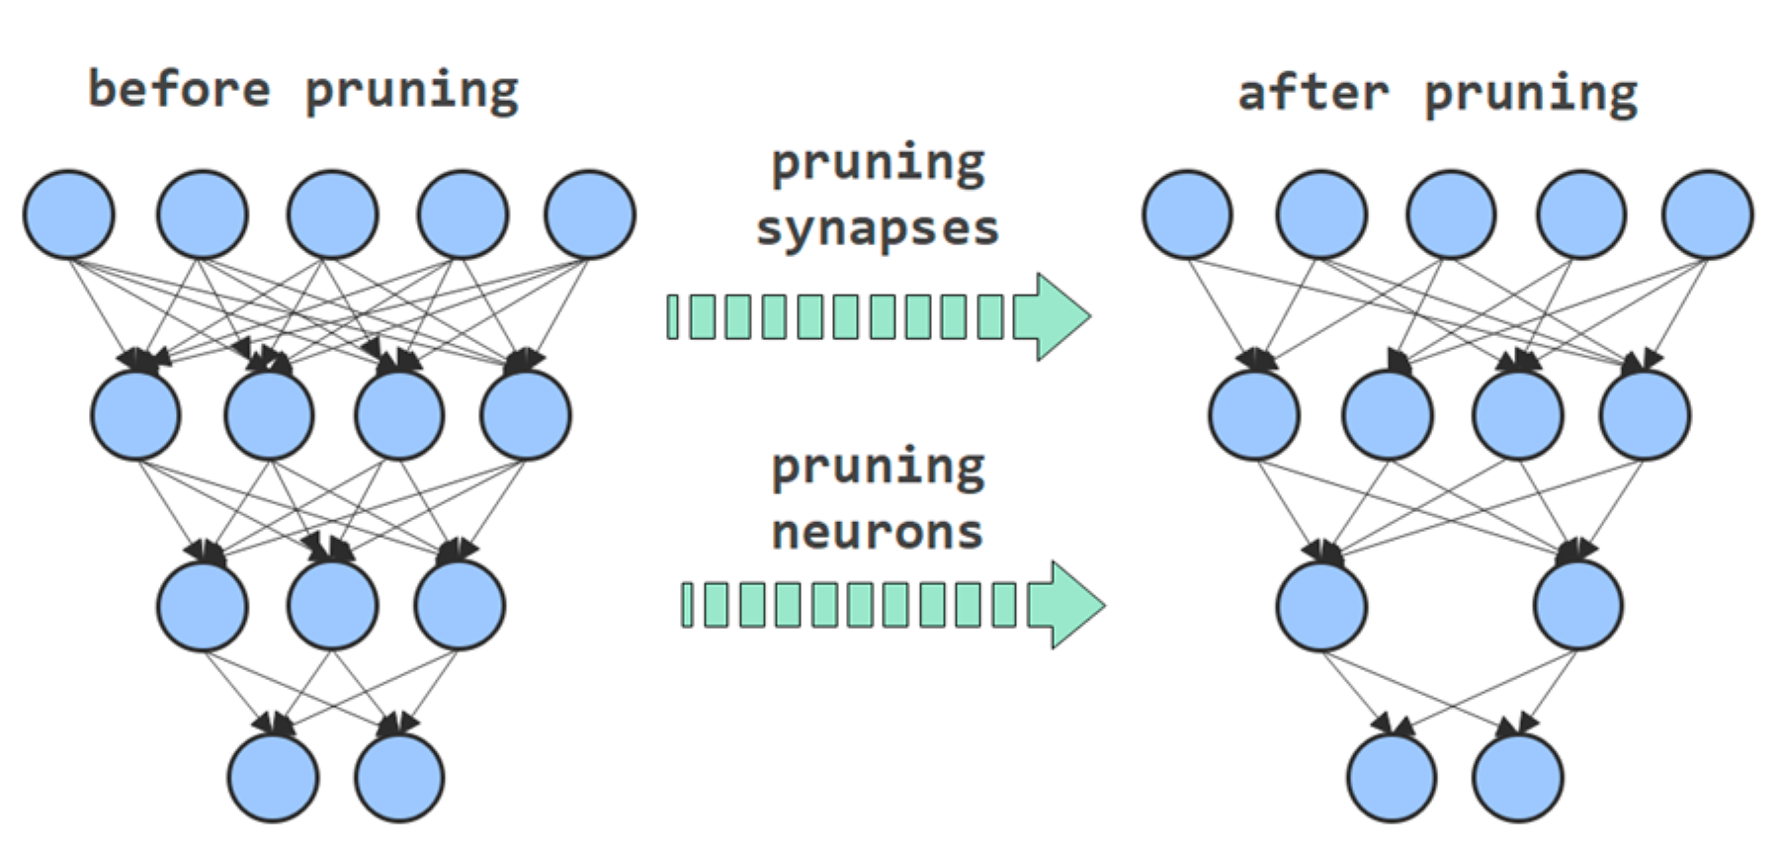
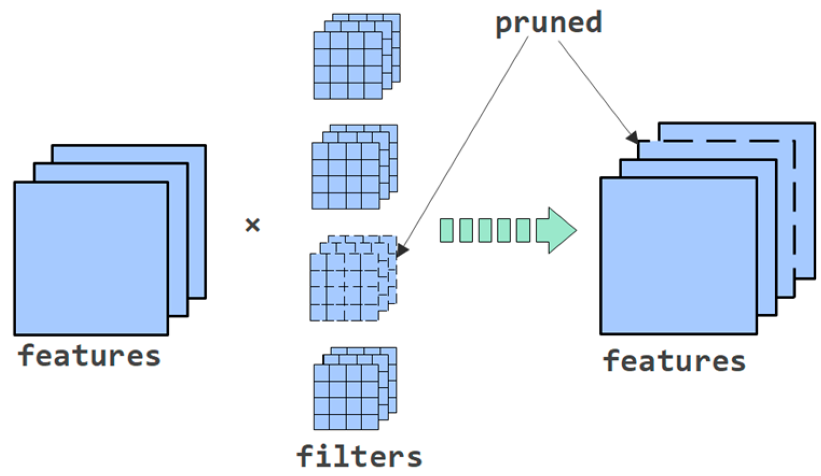
Types of pruning
Unstructured Pruning:
Involves removal of individual weights
Results in much higher sparsity
Requires specialised hardware/software to see performance gains
Structured Pruning:
Involves the removal of entire neurons/filters/channels
Lesser sparsity than unstructured pruning
More challenging but offers performance gains “off the shelf”
Copyright of Shell International B.V.

Slide 4
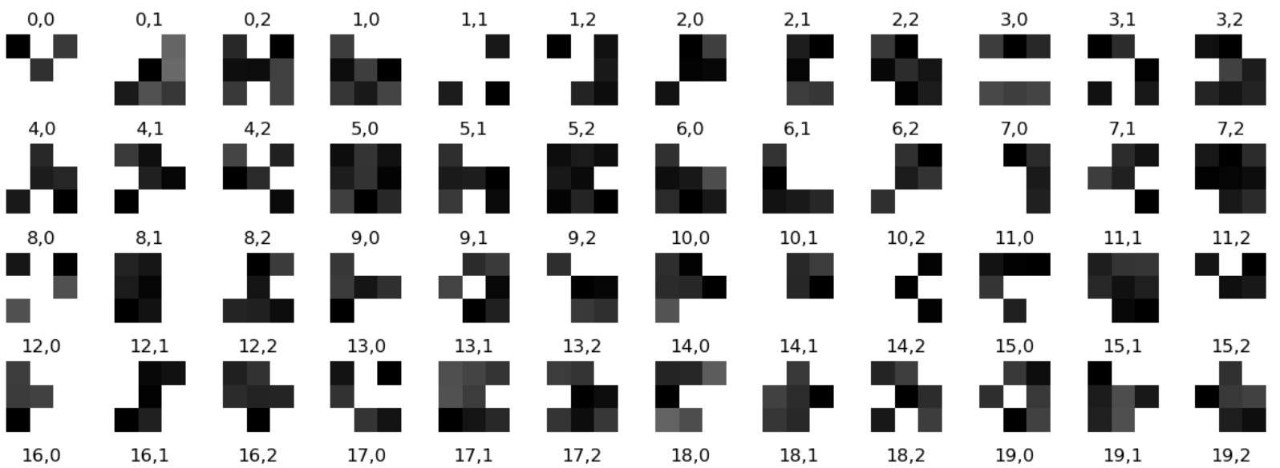
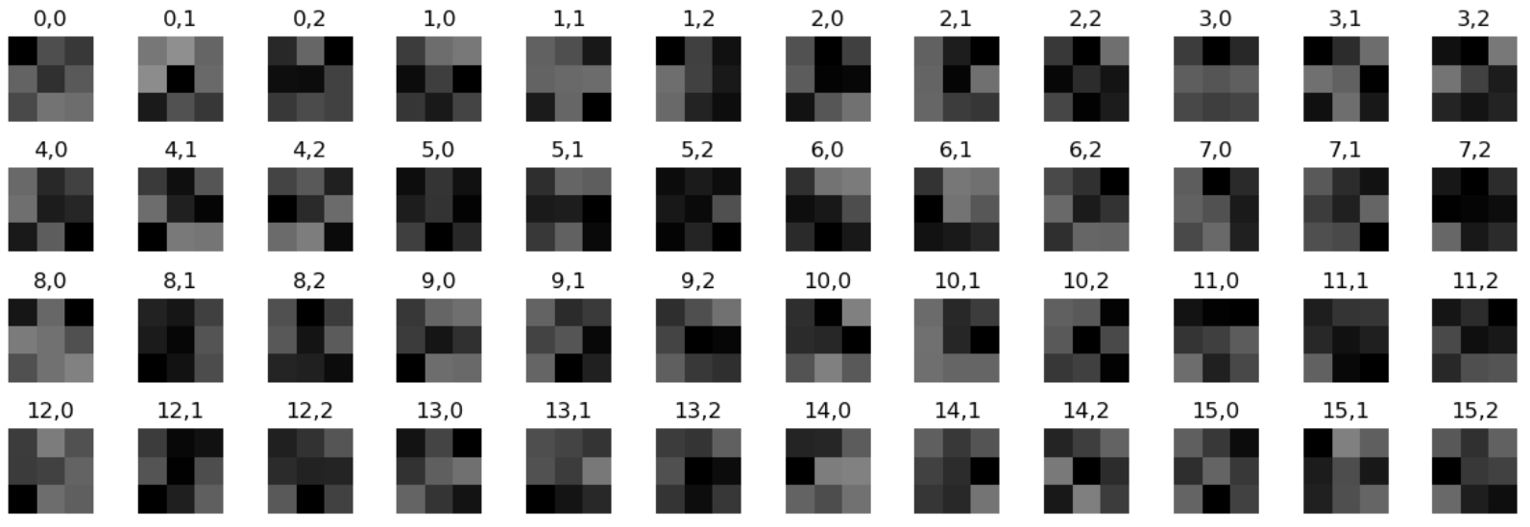
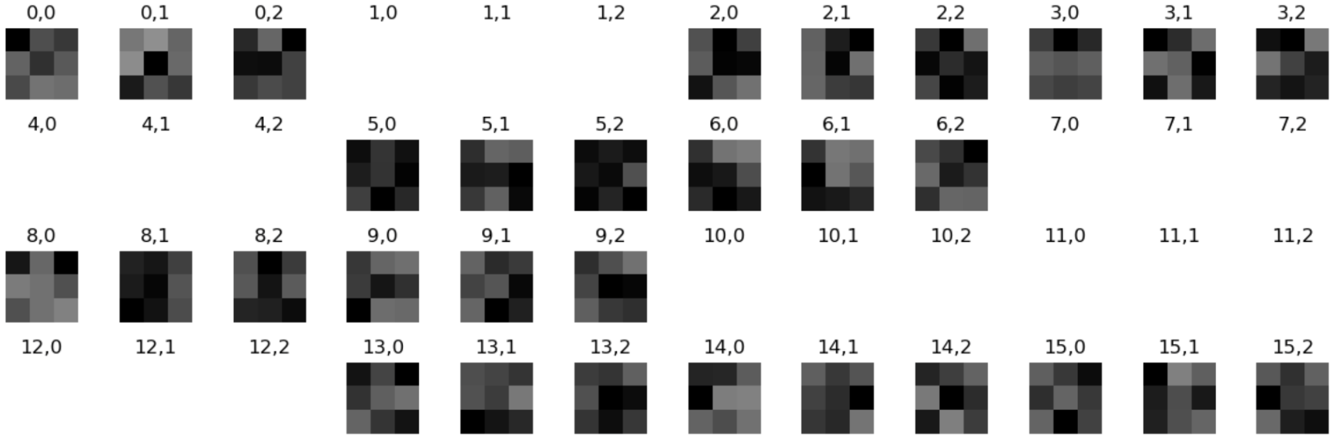
Visualising L1 Structured and L1 Unstructured Pruning
Pruned Conv filters (L1 Unstructured):
Unpruned Conv filters:
Pruned Conv filters (L1 Structured):
Copyright of Shell International B.V.

Slide 5
Torch-Pruning library – for performing architecture modifications
Refer: https://github.com/VainF/Torch-Pruning
For pruning – either zero out the parameters or actually remove them from the neural network
There won’t be any instant performance gains if the pruned parameters aren’t actually removed – need to modify the model architecture
PyTorch’s inbuilt pruning mechanisms only support zeroing out the weights
Physically removing parameters of some layer involves physically pruning other dependent layers as well – further reduction in model test accuracy possible
torch-pruning deploys a graph algorithm called DepGraph to remove parameters and channels physically
Copyright of Shell International B.V.

Slide 6
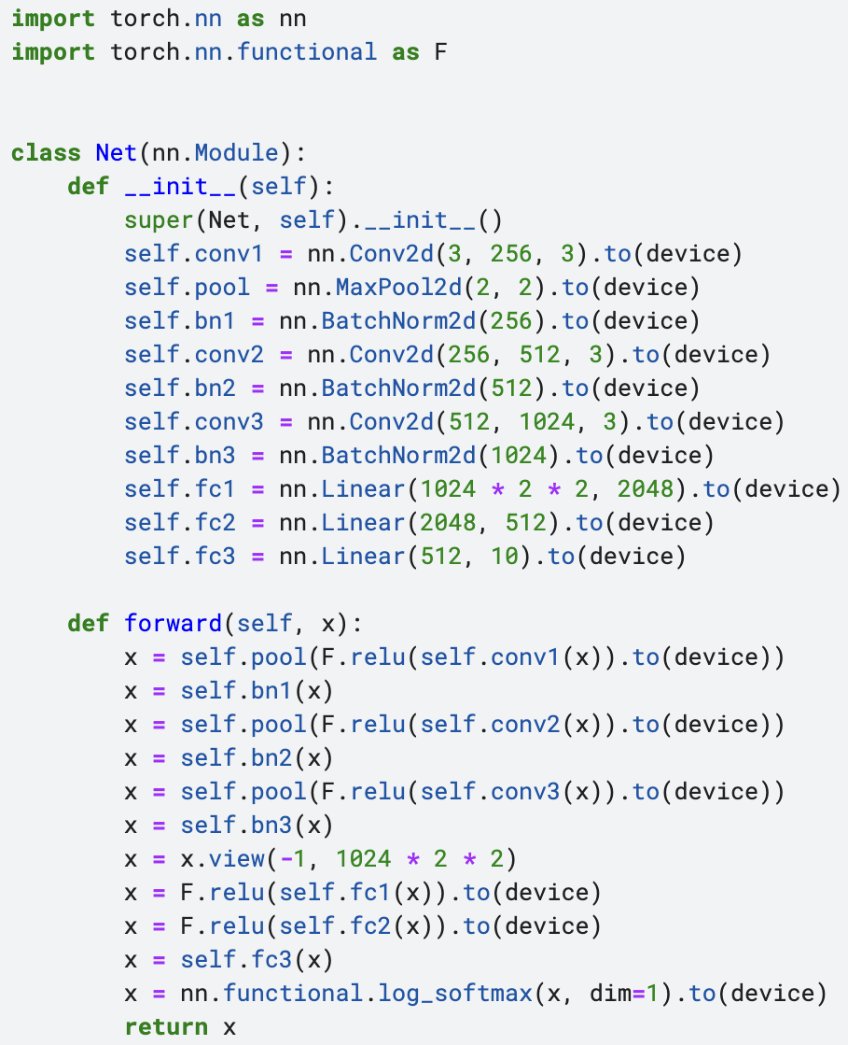
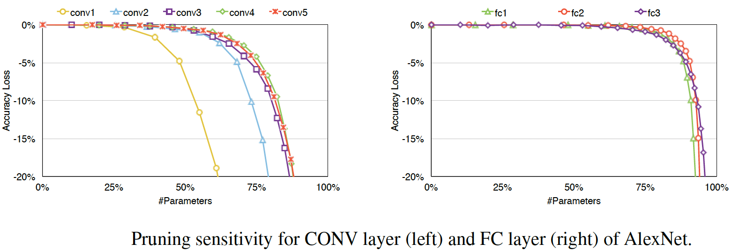
Experiments using PyTorch’s inbuilt pruning mechanisms
Refer:
https://github.com/Riddhi-Chatterjee/Model-Pruning/tree/main/Basic-Experiments
https://pytorch.org/tutorials/intermediate/pruning_tutorial.html
Model used for experiments:
Pruning sensitivity for different layers:
Copyright of Shell International B.V.
Notes:
The ratio of important to unimportant weights is much higher in lower Conv layers as compared to deeper Conv layers.
A comparison between accuracy drops of structured and unstructured pruning:
Random Unstructured pruning results in a much higher accuracy drop as compared to Random Structured pruning.
This is unlike the pruning performed based on L1 norm, where there is negligible difference between accuracy drops of structured and unstructured variants.
Note: Ideally, in structured pruning, we are supposed to prune not only the channels of the ‘weight’ parameter, but also the corresponding channels of the ‘bias’ and the appropriate entries of all the filters of the next layer. For most of the experiments performed above, only the ‘weight’ parameter has been pruned (i.e. zeroed out).

Slide 7
Experiments using PyTorch’s inbuilt pruning mechanisms (Using cifar10 dataset → 10 classes)
 |  | Unpruned model |  |  |  | Pruned model with only parameters zeroed out |  |  | Pruned model with architecture modifications
Pruning type | Units pruned | Total trainable parameters | Model accuracy | Inference time | Model size | % of parameters pruned | Accuracy after pruning | Accuracy drop after pruning | Accuracy after pruning | Accuracy drop after pruning | Inference time | Model size
Random Unstructured | Conv1’s weight & bias | 15355402 | 79.67% | 1s 311ms | 61.45 MB | 0.0187 | 21.66% | 58.01% | — | — | — | —
 | Conv1’s weight | 15355402 | 79.67% | 1s 311ms | 61.45 MB | 0.018 | 34.88% | 44.79% | — | — | — | —
L1 Unstructured | Conv1’s weight & bias | 15355402 | 79.67% | 1s 311ms | 61.45 MB | 0.0187 | 71.45% | 8.22% | — | — | — | —
 | Conv1’s weight | 15355402 | 79.67% | 1s 311ms | 61.45 MB | 0.018 | 72.13% | 7.54% | — | — | — | —
Random Structured Pruning | Conv1’s weight | 15355402 | 79.67% | 1s 311ms | 61.45 MB | 0.0179 | 66.78% | 12.89% | 70.25% | 9.42% | 1s 145ms | 59.55 MB
 |  | 15355402 | 79.67% | 1s 311ms | 61.45 MB | 0.0186 | 70.27% | 9.4% | 63.74% | 15.93% | 1s 145ms | 59.55 MB
Ln Structured Pruning | Conv1’s weight | 15355402 | 79.67% | 1s 311ms | 61.45 MB | 0.0179 | 75.11% | 4.56% | 72.36% | 7.31% | 1s 175ms | 59.55 MB
 |  | 15355402 | 79.67% | 1s 311ms | 61.45 MB | 0.0186 | 74.04% | 5.63% | 71.6% | 8.07% | 1s 175ms | 59.55 MB
Pruning multiple parameters | All Conv and Linear layers’ weight and bias | 15355402 | 79.67% | 1s 311ms | 61.45 MB | 36.144 | 76.99% | 2.68% | — | — | — | —
Global Pruning | All layers’ weight and bias | 15355402 | 79.67% | 1s 311ms | 61.45 MB | 75.00 | 69.16% | 10.51% | — | — | — | —
Custom Pruning | Conv1’s weight and bias | 15355402 | 79.67% | 1s 311ms | 61.45 MB | 0.0233 | 17.13% | 62.54% | — | — | — | —
Copyright of Shell International B.V.

Slide 8
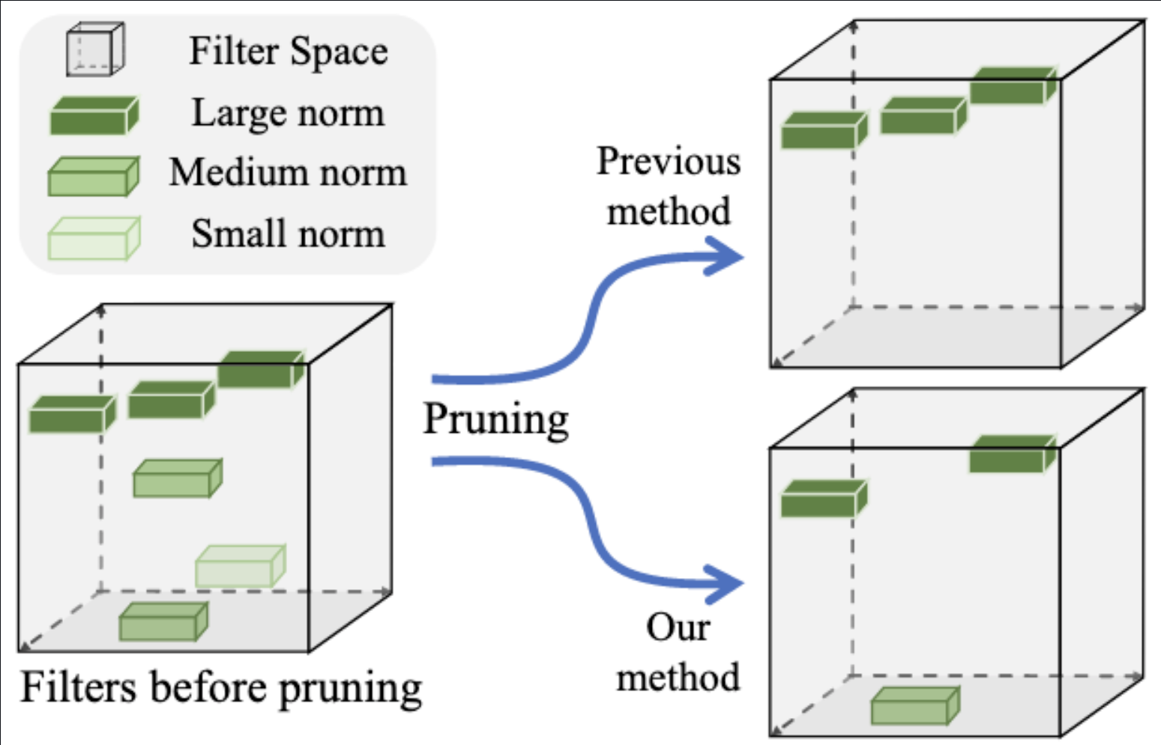
FPGM - Filter Pruning via Geometric Median
Refer: https://github.com/he-y/filter-pruning-geometric-median
For performing Structured pruning of convolutional filters.
Two requirements for norm based pruning which are not always met:
The norm deviation of the filters should be large.
The minimum norm of the filters should be small.
FPGM gets rid of the above requirements — compresses CNN models by pruning “filters with redundancy”.
For a set of points in d-dimensional space, the geometric median is defined to be a point in d-dimensional space that minimises the sum of Euclidean distances to them. The geometric median of filters within a layer represents the common information among all the filters of the layer.
We calculate the Geometric Median (GM) of the filters within the same layer. According to the characteristics of GM, the filter(s) near it can be represented by the remaining ones. Therefore, pruning those filters will not have substantial negative influences on model performance.
Layer-wise thresholds are used, based on pruning sensitivity, for determining number of filters to prune.
Finding the geometric median is computationally expensive. An optimization would be to find the filter which minimises the summation of the distances from other filters.
Copyright of Shell International B.V.

Slide 9
Experiments using FPGM
Refer: https://github.com/Riddhi-Chatterjee/Model-Pruning/tree/main/FPGM-Experiments
 |  |  |  | Unpruned model |  |  |  | Pruned model with only parameters zeroed out |  |  | Pruned model with architecture modifications
Model Architecture | Purpose | Number of classes | Pruning type | Total trainable parameters | Model accuracy | Inference time | Model size | % of parameters pruned | Accuracy after pruning | Accuracy drop after pruning | Accuracy after pruning | Accuracy drop after pruning | Inference time | Model size
VGG16 | Classification on the cifar10 dataset | 10 | 40 epochs of iterative pruning+fine-tuning | 14710464 | 93.6% | 1s 549ms | 60.03 MB | 44.11% | 93.51% | 0.09% | 93.11% | 0.49% | 1s 474ms | 21.65 MB
VGG16 | Classification on the cifar10 dataset | 10 | 160 epochs of iterative pruning+fine-tuning | 14710464 | 93.6% | 1s 668ms | 60.03 MB | 44.11% | 93.74% | -0.14% | 93.5% | 0.1% | 1s 501ms | 21.65 MB
VGG16 | Classification on the cifar100 dataset | 100 | 160 epochs of iterative pruning+fine-tuning | 14710464 | 66.99% | 1s 526ms | 60.21 MB | 44.11% | 66.48% | 0.51% | 65.92% | 1.07% | 1s 757ms | 21.84 MB
AlexNet | Classification on the flowers102 dataset (2040 training (train+val) samples, and 6149 test samples) | 102 | 135 epochs of iterative pruning+fine-tuning | 61666702 | 86.8% | 18s 514ms | 246.69 MB | 1.36% | 84.13% | 2.67% | 78.55% | 8.25% | 15s 244ms | 179.15 MB
ResNet110 | Classification on the cifar100 dataset | 100 | 200 epochs of iterative pruning+fine-tuning | 1719216 | 63.97% | 6s 644ms | 7.24 MB | 38.69% | 66.06% | -2.09 | 1% (needs less aggressive pruning) | 62.97% (needs less aggressive pruning) | 6s 339ms | 552.73 kB
ResNet152 | Classification on the ImageNet dataset | 1000 | 100 epochs of iterative pruning+fine-tuning | 60192808 | 77% (online source) | — | — | — | — | — | — | — | — | —
Copyright of Shell International B.V.

Slide 10
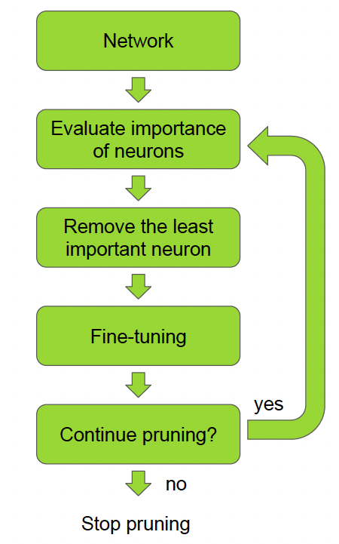
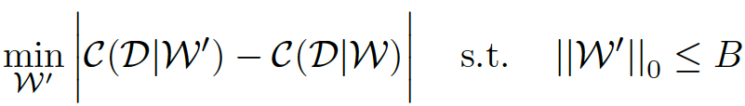

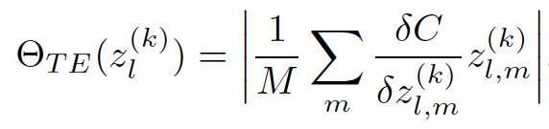
Gradient based Pruning
Refer: https://github.com/insomnia250/channel-prune
Can be used for both Structured and Unstructured pruning.
For a set of training examples D, the network’s parameters W are optimised to minimise a cost value C(D|W). The pruning objective is as follows:
Iteratively identify and remove the least important parameters — ensures the eventual satisfaction of the bound on the number of non-zero parameters in W’.
A feature map corresponding to the lth layer and kth channel is computed as follows: where, g, w, and b denote the pruning gate, weights and bias of the lth layer and kth channel respectively.
Using Taylor expansion, we approximate the change in the loss value resulting from the removal of a particular parameter. For a feature map, this turns out to be as follows:
Copyright of Shell International B.V.
Notes:
In the paper the authors have used this approach for structured pruning. But this technique can be applied for individual weights of the network and thus can be adapted for unstructured pruning as well.

Slide 11
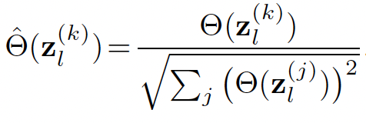

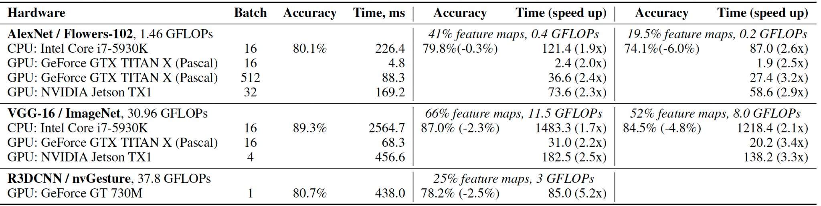
Gradient based Pruning
Gradient based Pruning
A simple layer-wise L2 normalisation can achieve adequate rescaling across layers:
FLOPs regularization:
Results:
Copyright of Shell International B.V.
Notes:
In the paper the authors have used this approach for structured pruning. But this technique can be applied for individual weights of the network and thus can be adapted for unstructured pruning as well.

Slide 12
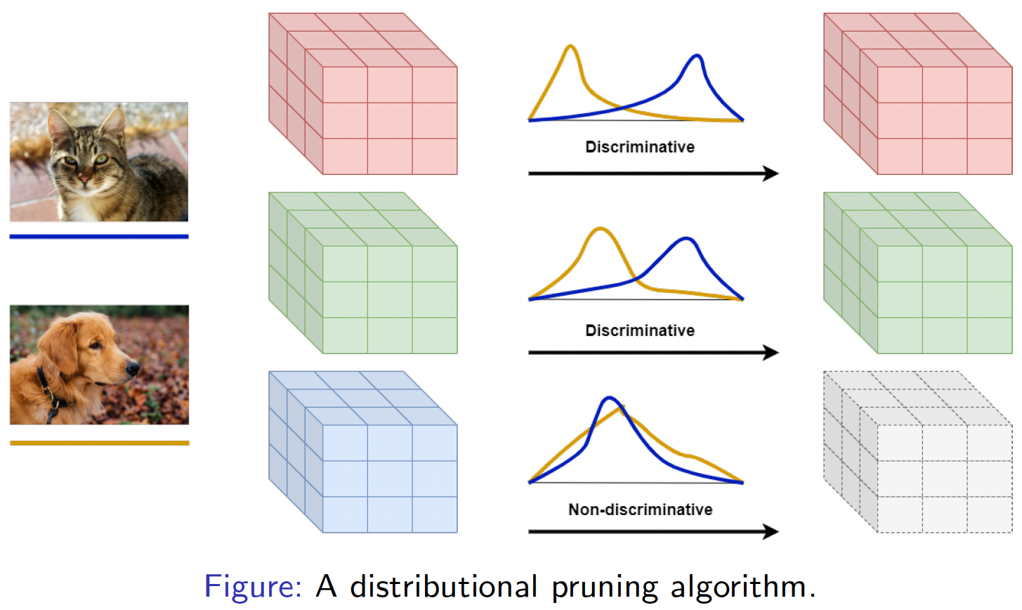
TVSPrune – Pruning Nondiscriminative Filters via Total Variation Separation of Intermediate Representations without fine tuning
Refer: https://github.com/chaimurti/TVSPrune
For performing Structured pruning
No access to training dataset or loss function – Distributional Pruning
Discriminative Filters: Class conditional distributions of its outputs are “well separated”
Criterion used: Least TV Distance between pairs of classes.
For a particular filter, the mean of the filter outputs for every class is computed.
Difference between filter outputs is computed for every pair of classes.
The minimum norm of such filter output differences represents the discriminative capability of the filter.
For generalization purposes it is sufficient to retain those filters which discriminate well between classes.
Copyright of Shell International B.V.

Slide 13
Experiments using TVSPrune
Refer: https://github.com/Riddhi-Chatterjee/Model-Pruning/tree/main/TVSPrune-Experiments
 |  |  |  | Unpruned model |  |  |  | Pruned model with only parameters zeroed out |  | Pruned model with architecture modifications
Model Architecture | Purpose | Number of classes | Units pruned | Total trainable parameters | Model accuracy | Inference time | Model size | Accuracy after pruning | Accuracy drop after pruning | Accuracy after pruning | Accuracy drop after pruning | Inference time | Model size
VGG11 | Classification on the cifar10 dataset | 10 | Thresholds are computed automatically for each convolutional layer | 9756426 | 92.34% | 306ms | 39.08 MB | 81.7% | 10.64% | 81.58% | 10.76% | 315ms | 30.41 MB
VGG16 | Classification on the cifar10 dataset | 10 | Thresholds are computed automatically for each convolutional layer | 14710464 | 93.6% | 1s 668ms | 60.03 MB | 79.86% | 13.74% | 79.76% | 13.84% | 666ms | 38.18 MB
Copyright of Shell International B.V.

Slide 14
Q&A

Slide 15
Thank You

