Slide 1
Traffic Light Controller
Designed for Single 4-Way Road Intersection
Riddhi Chatterjee (IMT2020094)
N V Sai Likhith (IMT2020118)
Tarun Gupta (IMT2020061)

Slide 2
Motivation
Importance of effective traffic management
Efficient traffic management is crucial for urban planning, environmental sustainability, and public safety.
As urban areas grow and vehicle density increases, traffic congestion and related issues such as air pollution and accidents can become significant challenges.
Proper traffic management aims to optimize traffic flow, reduce congestion, minimize accidents, and decrease environmental impact.
How can Reinforcement Learning help?
Reinforcement Learning can be used to dynamically adjust traffic light phases based on real-time traffic conditions.
Real-world traffic varies a lot over time. Thus traditional rule-based traffic light control mechanisms (for example: fixed traffic-phase durations) may not always be the optimal approach.
RL based techniques can learn to adapt to these dynamic changes in traffic.

Slide 3
State Space
Queue length: A vector representing the queue length (number of halted vehicles) of each lane.
Vehicle count: A vector representing the total number of vehicles (halted + moving) in each lane.
Average waiting time: A vector representing the average waiting time of the vehicles in each lane.
Current phase: A single value (or one-hot encoded vector) representing the current phase of the traffic light system at the road intersection (0 to 11 for our case).
Next phase: A single value (or one-hot encoded vector) representing the next phase of the traffic light system at the road intersection (0 to 11 for our case).
Vehicle grid: An image/grid representation of vehicles’ positions.

Slide 4
Action Space
The two possible actions that the RL-agent or any other traffic light control algorithm can take are as follows:
Action = 1 : This will result in a change in the phase of the traffic light system from the current phase to the next phase.
Action = 0 : This will preserve the current phase of the traffic light system.

Slide 5
Reward Function Design
Our reward function is a weighted sum of 9 individual “reward factors” each representing some aspect of traffic management that must be optimised:
Queue Length: Sum of queue lengths of each lane.
Waiting time: Sum of average waiting times of the vehicles in each lane.
Phase change: Number of times the phase of the traffic light system changes.
Vehicle delay: Sum of delay factors for each vehicle. The delay factor for a vehicle is given by DF = (1 - (vehicle’s speed / vehicle’s allowed speed))
Vehicles passed: Number of vehicles which have reached their destination and are removed from the road network.
Environmental cost: Sum of CO2 and CO emission rates of all vehicles.
Sudden phase change: Represents the cases when the traffic light phase changes too quickly.
Collision: Number of vehicles which were involved in a collision.
Vehicle travel time: Average time taken by a vehicle to exit the road network after the last action.

Slide 6
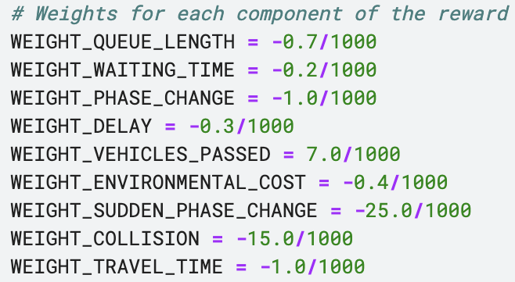
Reward Function Design
Motivation behind our choice of the reward function:
The image to the right shows the weights that we had assigned to each component of our reward function
We wanted to penalise long queues of vehicles, high vehicle waiting times, travel times and delays. Also, our goal was to penalise high emission rates of CO2 and CO, collisions between vehicles.
To prevent the agent from continuously changing the traffic light phase we have discouraged too many phase changes. Also, we don’t want the RL agent to change the phase too quickly (from say a green light suddenly to a yellow/red light). This can lead to traffic accidents and thus “Sudden phase changes” have been heavily penalised.
We have encouraged a high value of “Vehicles passed” as it’s a measure of efficient traffic flow.

Slide 7
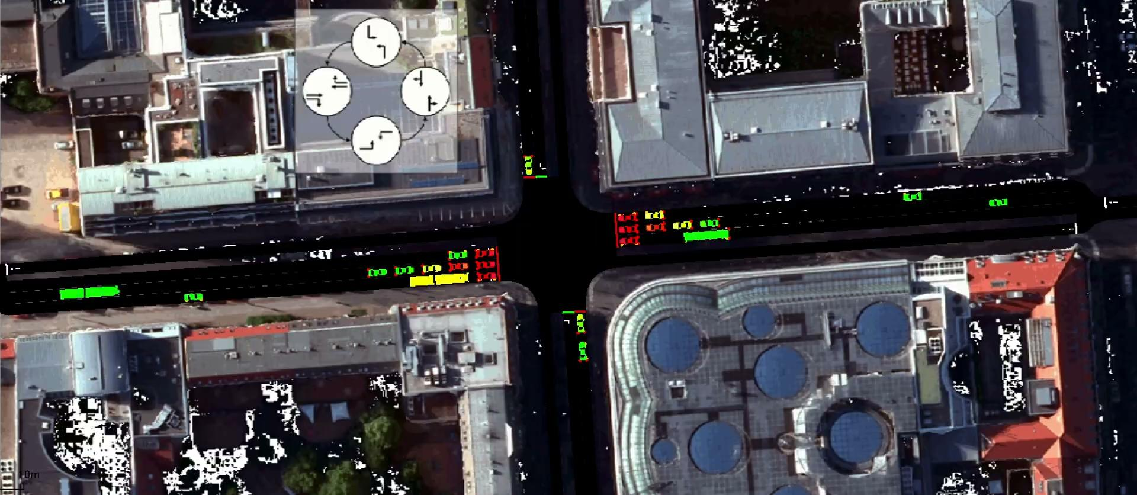
SUMO: Simulation of Urban MObility
SUMO is an open-source traffic simulation software designed for the modeling, analysis, and simulation of transportation systems.
We have used SUMO for obtaining synthetic traffic data, which have been used to train, evaluate and analyse various algorithms for “traffic light control”.

Slide 8
Reward Function Design
Limitations of our reward function:
Since SUMO is a simulation of the real-world traffic environment, it doesn’t model the real world scenario with full accuracy.
In a real-world setting, if we continuously keep on changing the traffic light phase, then we are bound to have many collisions between vehicles. But here in SUMO, we have noticed that it’s practically impossible to make the vehicles collide. The vehicles are programmed such that they slow down to prevent collisions even if the traffic light signal is green.
We decided to keep a penalty for “too many phase changes” and “sudden phase changes”. But it’s a tradeoff. Increase the penalty too much and the agent would prefer not to change the phase, while a small penalty would be ignored by the agent and it would prefer to change the phase quickly.
Thus it was difficult for us to teach the RL agent that it should not change the traffic light phase too quickly. A lot more experiments were needed to figure out the optimal weight factors corresponding to the “Phase change” and “Sudden phase change” reward factors.

Slide 9
Traffic Light Control Algorithms
We have applied the following algorithms for traffic light control:
Fixed timing approach: This approach involves setting a fixed time-table for the traffic-light phase changes. This serves as a perfect baseline to compare with our RL based algorithms.
DQN based approach: An RL based algorithm based on the Q-learning framework. It features a controllable exploration parameter. Relatively simple approach
Soft Actor Critic based approach: A RL based approach based on the actor-critic framework. Features entropy based exploration. Relatively complex approach.
DDQN based approach: Another RL based approach based on the Q-learning framework. Uses two Deep Q-Networks to mitigate the problem of maximisation bias. Also features a controllable exploration parameter.
DDPG based approach: The Deep Deterministic Policy Gradient approach is another RL based approach based on the actor-critic framework. This is a sample efficient policy gradient algorithm.

Slide 10
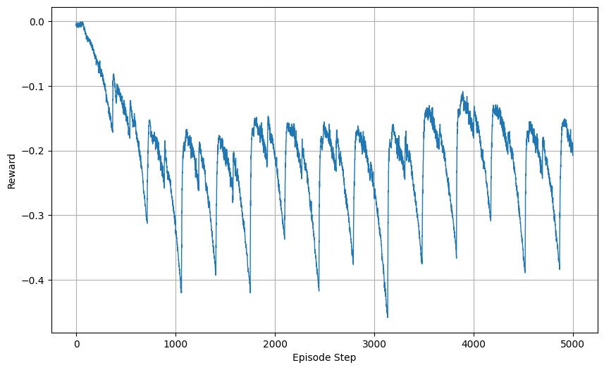
Fixed Timing Approach Evaluation
Link to Kaggle notebook: https://www.kaggle.com/code/riddhich/traffic-light-controller-fixedtiming
Variation of Reward with episode steps

Slide 11
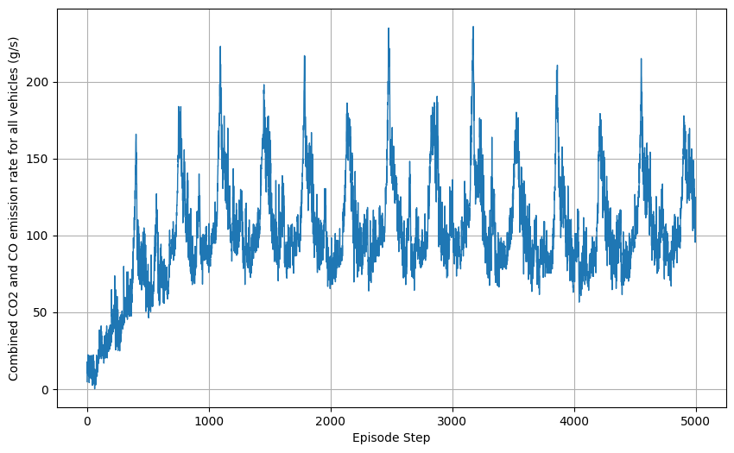
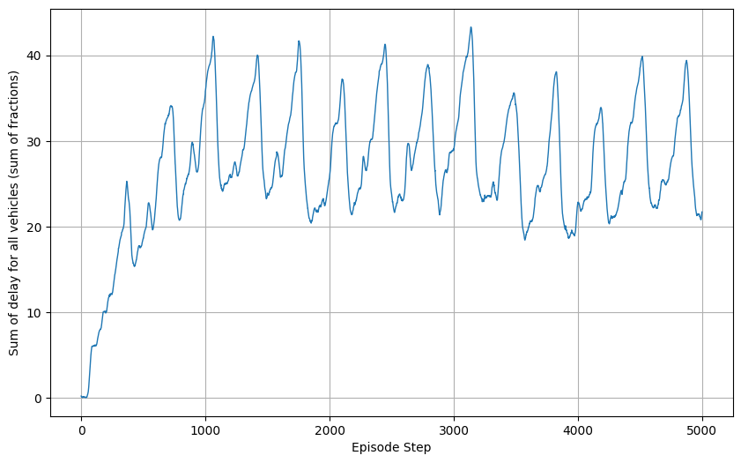
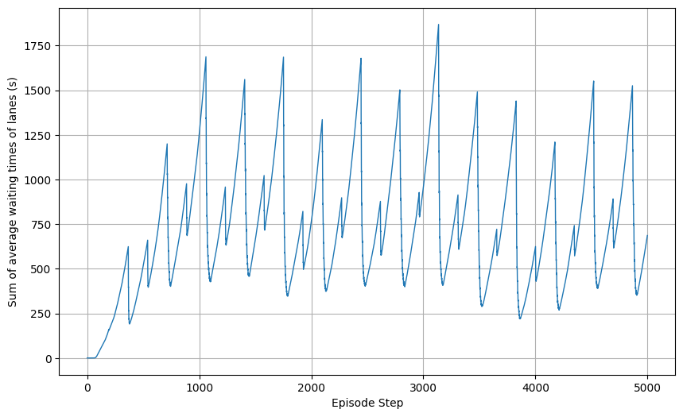
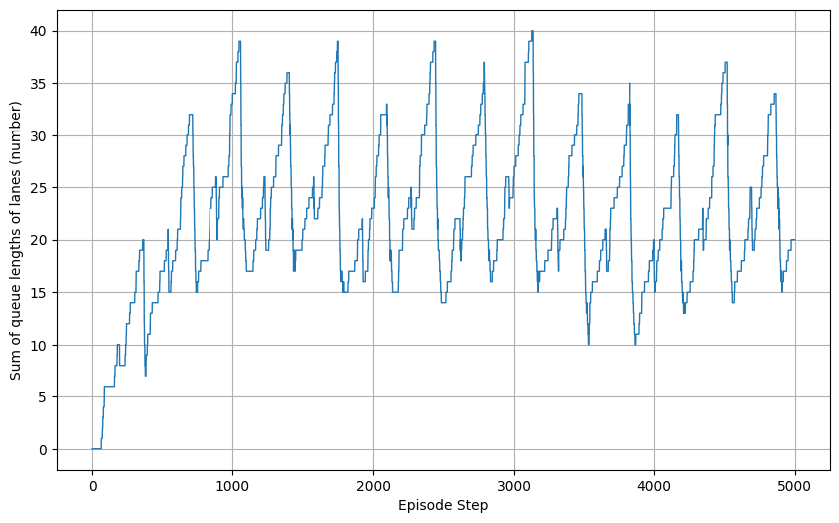
Fixed Timing Approach Evaluation
Variation of Vehicle Delay, Average Waiting Time, Queue Length and Emissions with episode steps

Slide 12
Fixed Timing Approach Evaluation
Some more evaluations
Metric | Min | Max | Mean | Cumulative
Reward | -0.458 | -0.000444 | -0.2107 | -1053.6859
Emissions | 0.0 | 235.954 | 101.827 | –
Vehicle Delay | 0.0309 | 43.2877 | 26.6813 | –
Waiting Time | 0.0 | 1868.6 | 736.965 | –
Queue Lengths | 0.0 | 40.0 | 21.8426 | –

Slide 13
DQN based Approach (Model Arch)
Link to the architecture diagram: https://drive.google.com/file/d/1j-F98tao3ujK7l6ggUZgrPO0MPnFtkJ_/view?usp=share_link
We have some initial linear layers acting on the input vectors (for vehicle grid we have a CNN block since its an image).
Next we sum up the output vectors from all the linear layers and the CNN block.
Next we pass it through what we call “Phase Stream”, which are individual (linear + activation) branches designed to cater to each traffic light phase.
After this we use the “current phase” to select the output of the appropriate branch. This selected output is the output of the DQN Model.

Slide 14
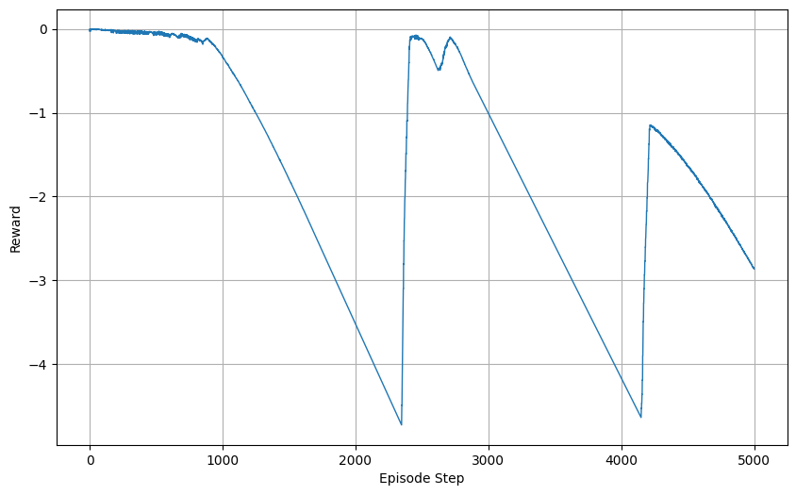
DQN based Approach Evaluation
Link to Kaggle notebook: https://www.kaggle.com/code/riddhich/traffic-light-controller-dqn
Variation of Reward with episode steps

Slide 15
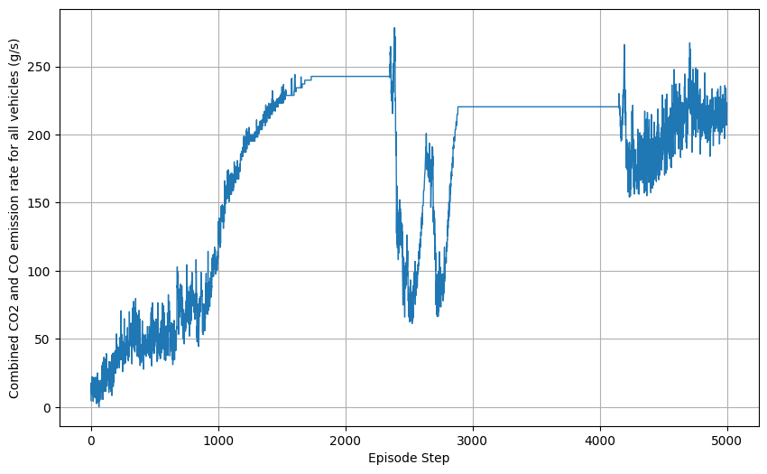
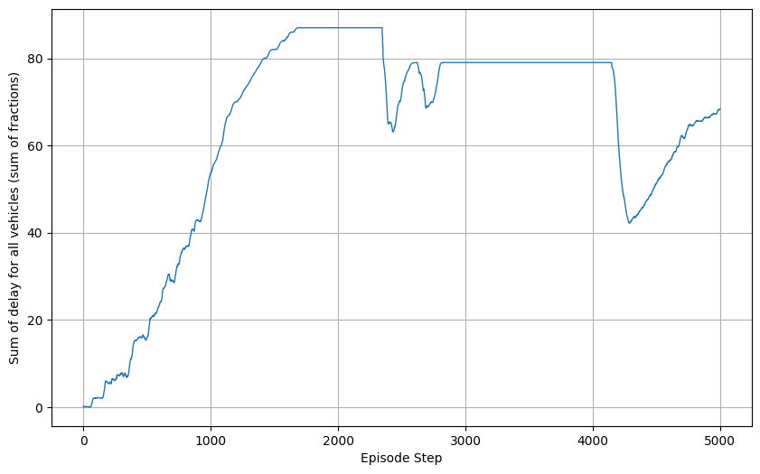
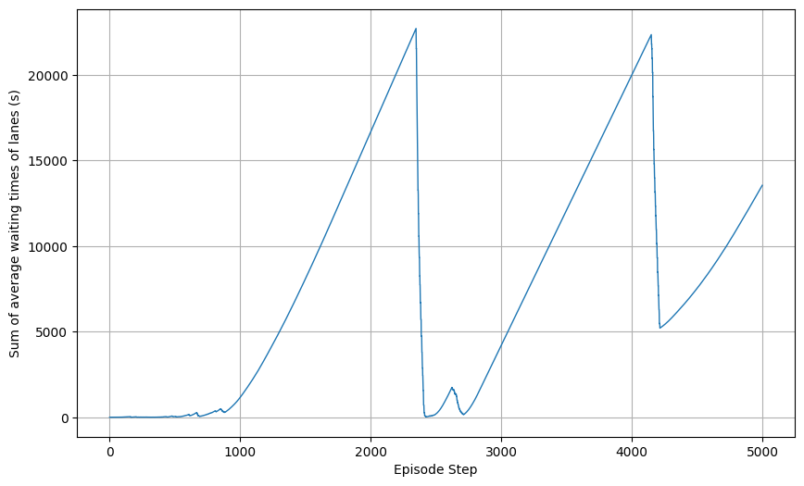
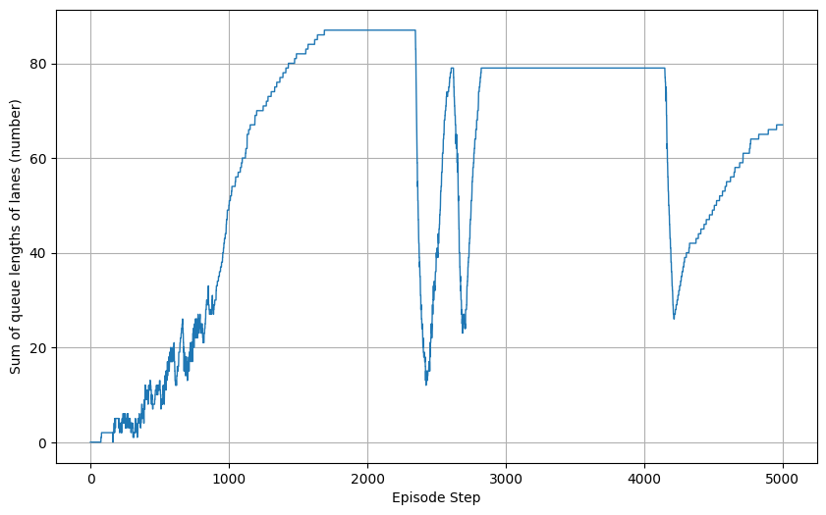
DQN based Approach Evaluation
Variation of Vehicle Delay, Average Waiting Time, Queue Length and Emissions with episode steps

Slide 16
DQN based Approach Evaluation
Some more evaluations
Metric | Min | Max | Mean | Cumulative
Reward | -4.728 | -8.3609 | -1.7221 | -8610.929
Emissions | 0.0 | 278.4038 | 175.5157 | –
Vehicle Delay | 0.030940 | 87.0 | 63.455 | –
Waiting Time | 0.0 | 22722.199 | 7953.857 | –
Queue Lengths | 0.0 | 87.0 | 58.9436 | –

Slide 17
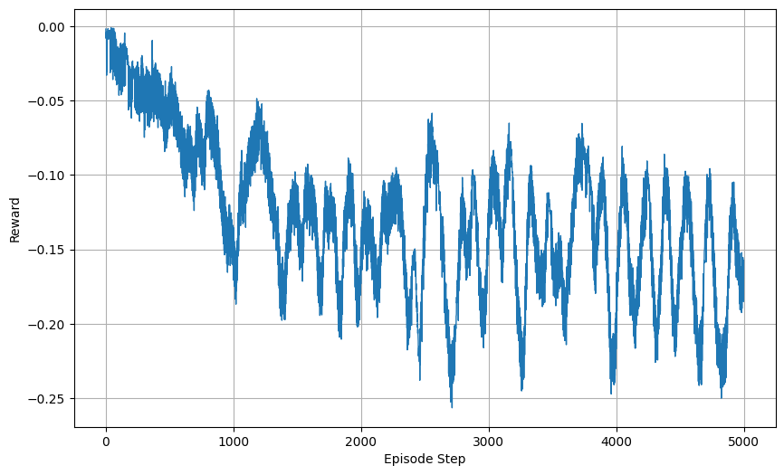
Soft Actor Critic based Approach Evaluation
Link to Kaggle notebook: https://www.kaggle.com/code/riddhich/traffic-light-controller-softactorcritic
Variation of Reward with episode steps

Slide 18
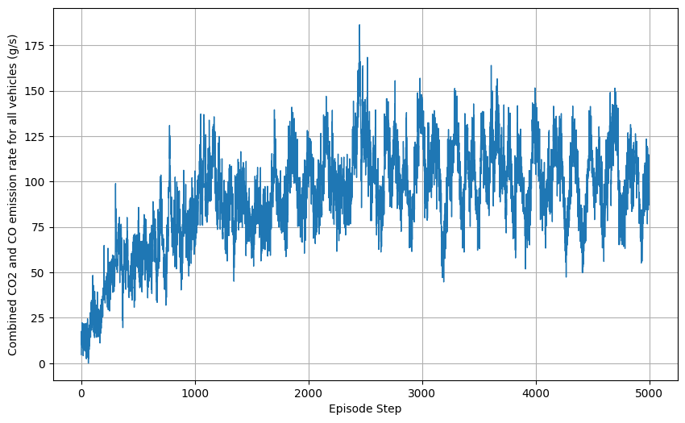
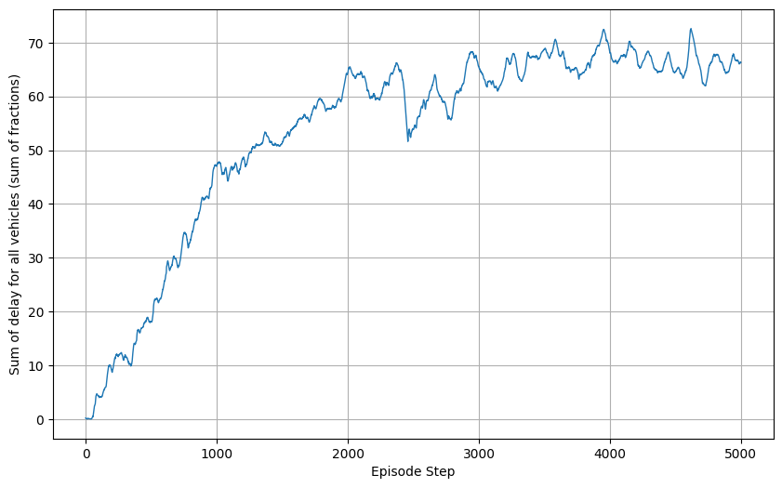
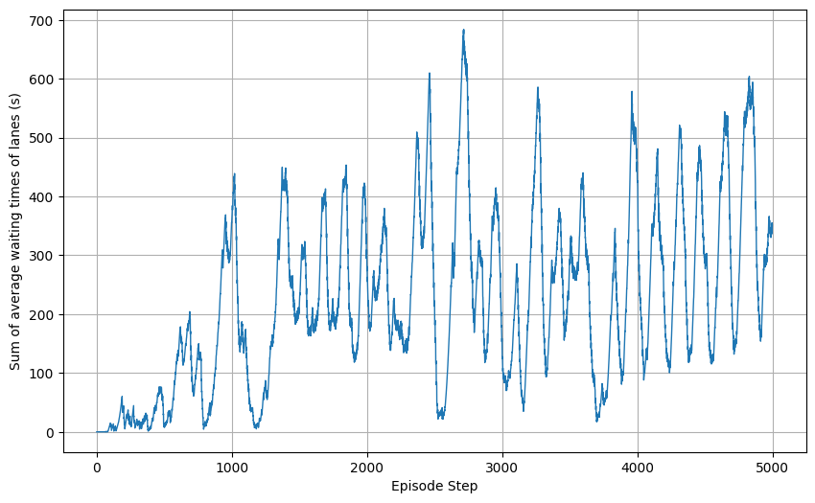
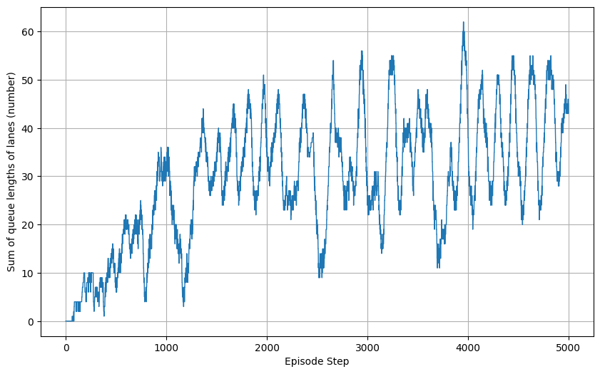
Soft Actor Critic based Approach Evaluation
Variation of Vehicle Delay, Average Waiting Time, Queue Length and Emissions with episode steps

Slide 19
Soft Actor Critic based Approach Evaluation
Some more evaluations
Metric | Min | Max | Mean | Cumulative
Reward | -0.2564 | -0.00111 | -0.1255 | -627.935
Emissions | 0.0 | 186.390 | 91.7013 | –
Vehicle Delay | 0.0309 | 72.599 | 53.653 | –
Waiting Time | 0.0 | 683.800 | 224.694 | –
Queue Lengths | 0.0 | 62.0 | 29.568 | –

Slide 20
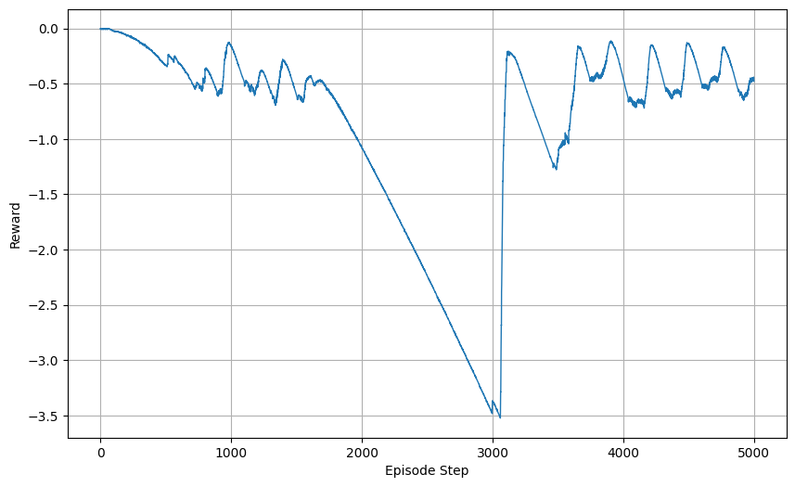
DDQN based Approach Evaluation
Link to Kaggle notebook: https://www.kaggle.com/code/riddhic777/traffic-light-controller-ddqn
Variation of Reward with episode steps

Slide 21
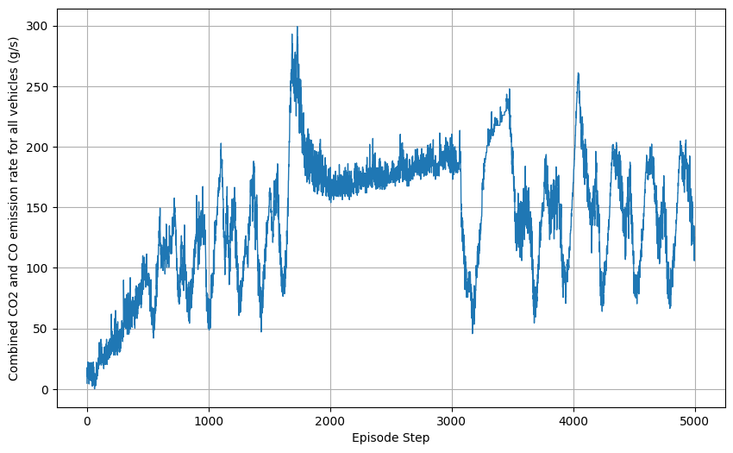
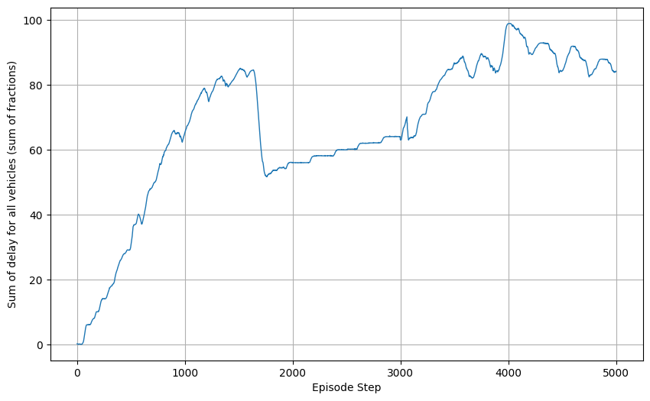
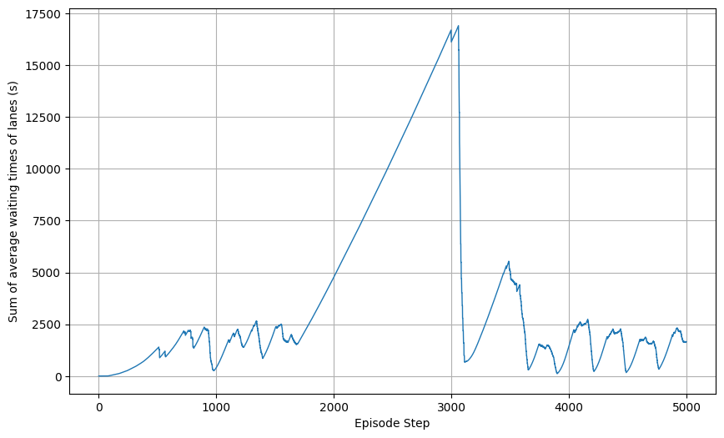
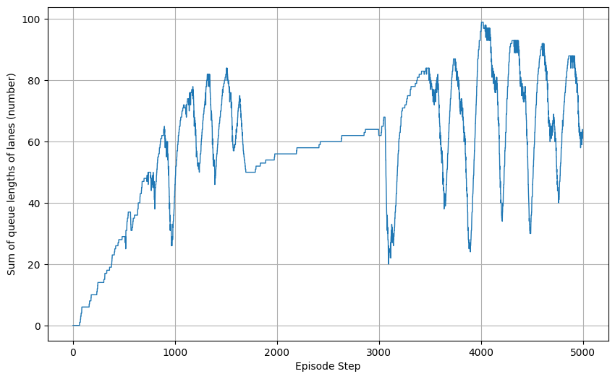
DDQN based Approach Evaluation
Variation of Vehicle Delay, Average Waiting Time, Queue Length and Emissions with episode steps

Slide 22
DDQN based Approach Evaluation
Some more evaluations
Metric | Min | Max | Mean | Cumulative
Reward | -3.524 | -0.000444 | -0.8611 | -4305.965
Emissions | 0.0 | 299.169 | 141.460 | –
Vehicle Delay | 0.03094 | 98.998 | 67.1132 | –
Waiting Time | 0.0 | 16905.999 | 3709.446 | –
Queue Lengths | 0.0 | 99.0 | 58.0814 | –

Slide 23
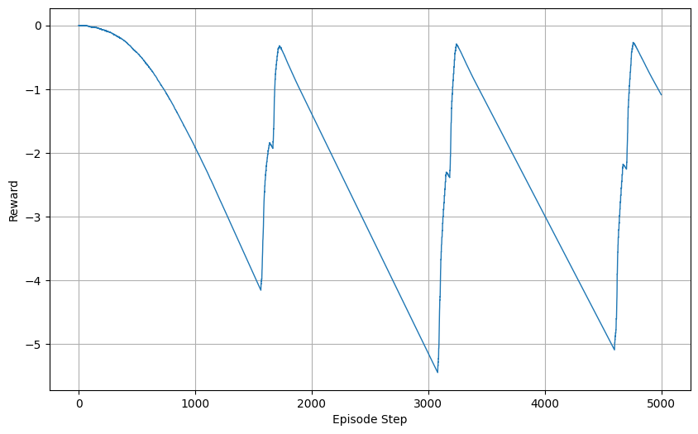
DDPG based Approach Evaluation
Link to Kaggle notebook: https://www.kaggle.com/code/riddhic777/traffic-light-controller-ddpg
Variation of Reward with episode steps

Slide 24
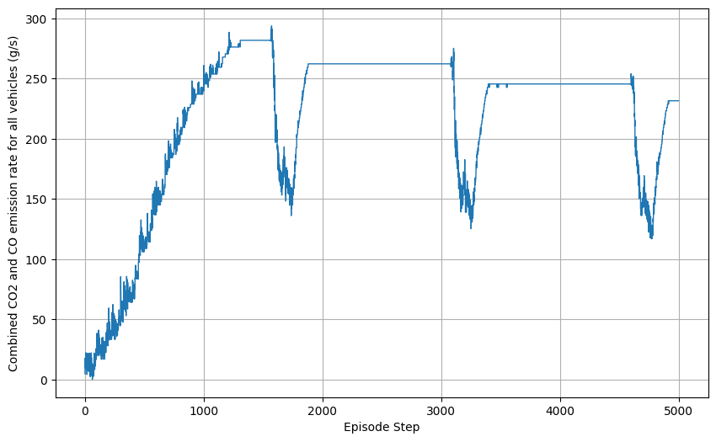
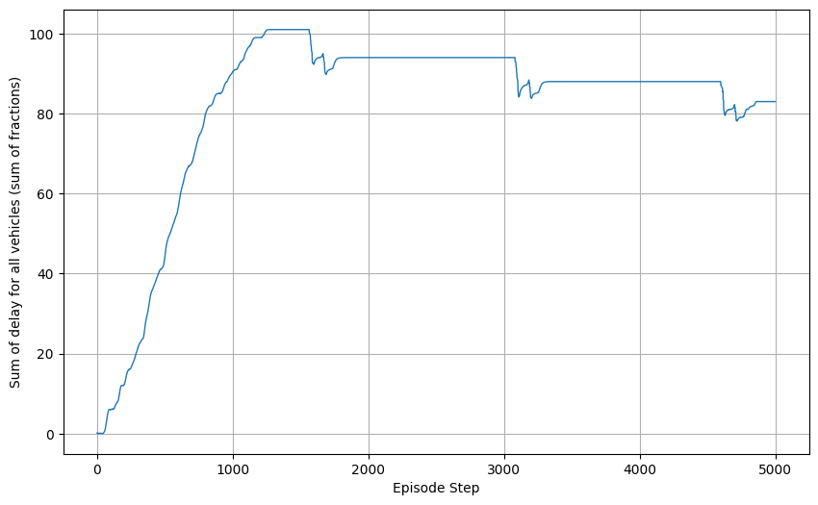
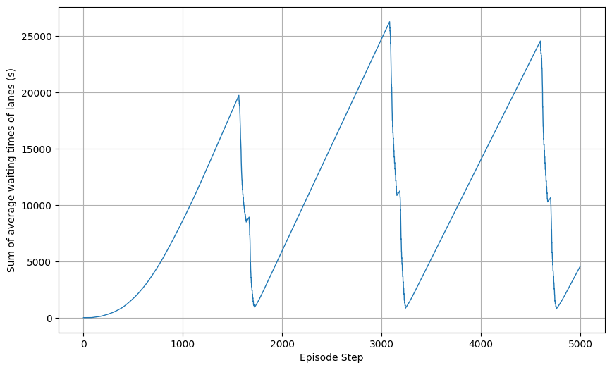
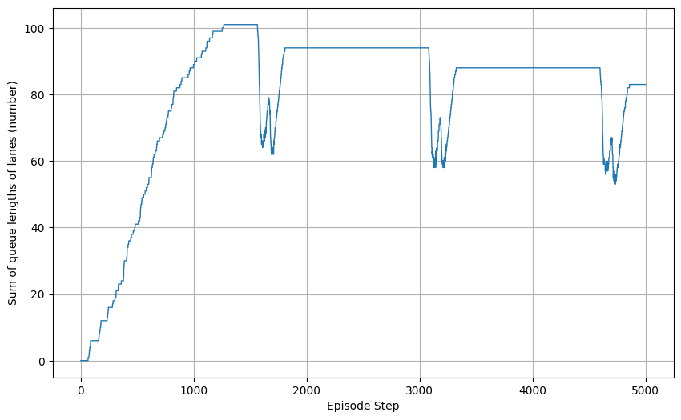
DDPG based Approach Evaluation
Variation of Vehicle Delay, Average Waiting Time, Queue Length and Emissions with episode steps

Slide 25
DDPG based Approach Evaluation
Some more evaluations
Metric | Min | Max | Mean | Cumulative
Reward | -5.452 | -0.000444 | -2.2316 | -11158.1527
Emissions | 0.0 | 293.750 | 216.068 | –
Vehicle Delay | 0.0309 | 101.0 | 81.8948 | –
Waiting Time | 0.0 | 26267.6 | 10326.998 | –
Queue Lengths | 0.0 | 101.0 | 78.9656 | –

Slide 26
Analysis of Results
Based on the results obtained above we can observe the following:
Both the DQN and DDQN based approaches don’t change the traffic light phase too much or too quickly. But their evaluation cumulative reward values aren’t great, which might be explained by the fact that these are relatively simpler algorithms.
The performance of DDPG isn’t good, with a very low evaluation cumulative reward value and no occurrence of phase change at all.
The Soft Actor Critic based approach is the best performer and is the only one which beats the baseline (i.e. the fixed timing approach) in terms of all the evaluation metrics.
We can further analyse the plots and metric values given earlier to obtain more insights into the performance of our traffic light control approaches.
Limitations:
We have tried our best to perform as many experiments as possible. Due to resource and time constraints we weren’t able to train our RL based traffic light control algorithms further.
Upon further training and fine tuning of the state, action and reward formulations, we believe that the RL based approaches can perform even better.

