Slide 1
Car Attributes
By: Riddhi Saha, Patrick Bernabe

Slide 2
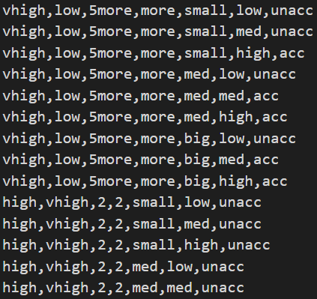
About Data Set
Attribute Values: ( 7Attributes in Total)
buying : v-high, high, med, low
maint : v-high, high, med, low
doors : 2, 3, 4, 5-more
persons : 2, 4, more
lug_boot : small, med, big
safety : low, med, high
class : acc, unacc

Slide 3
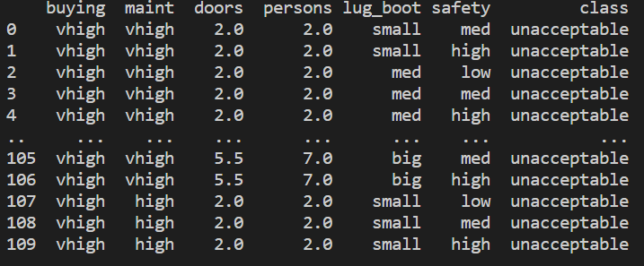
Cleaning the Data
We first assigned column header for each feature , in order to organize the data set values.
Next we replaced the words for acc and unacc to acceptable and unacceptable because the abbreviations were unclear.
We checked and cleared duplicates.
We also fixed two more columns which was the number of people that could fit into a car and the number of doors by taking the mean of the doors and people and replacing them in place of string data in the column so that we can change the column type to float/ stringer for further statistical analysis

Slide 4
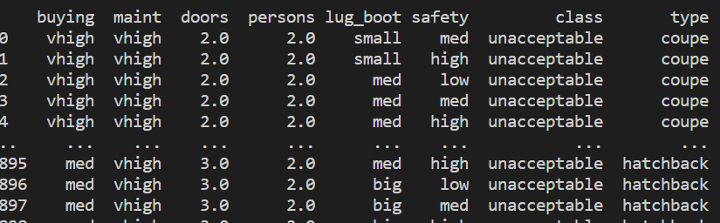
Adding a Column
We added a column to categorize the different type of cars for example car with 2 seats we named them coupe and cars with 3 seats we named them hatchbacks and cars with 4 seats we named them sedan and more than 4 seats were named family hatchbacks. This was to firstly avoid confusion because 2 and 3 doors cars essentially have 2 doors but the difference is in their bonnet.

Slide 5
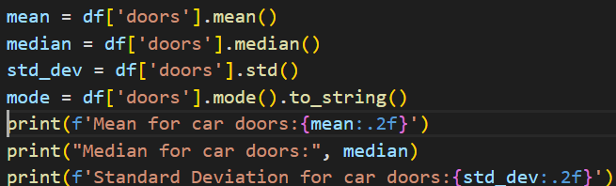

Statistics
In our code we calculated the values for the mean, median, mode, and standard deviation for specific values in data that displayed a rational comparison.
Calculated the mean, median, mode and standard deviations for the number of doors column.
Calculated mode for luggage boot size.

Slide 6
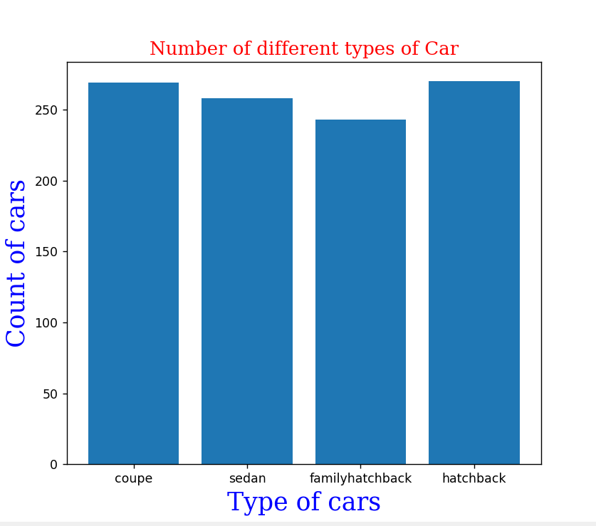
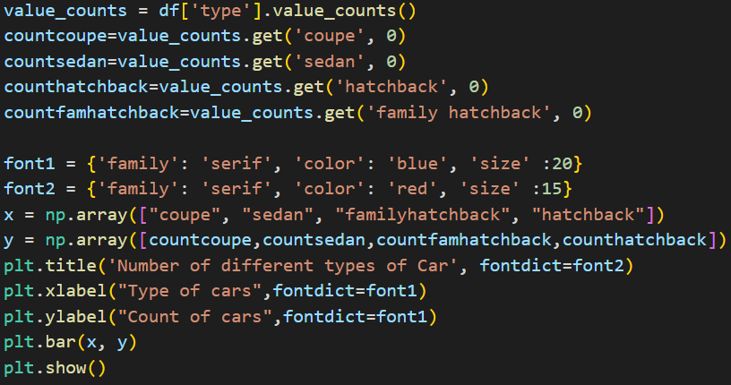
Comparison of Car Types and Their Frequency in Dataset
For Data Visualization we created a bar chart which counted the number of different types of car in the data set.
The dataset had highest number of coupe and
Hatchbacks and lowest number of family hatchbacks.

Slide 7
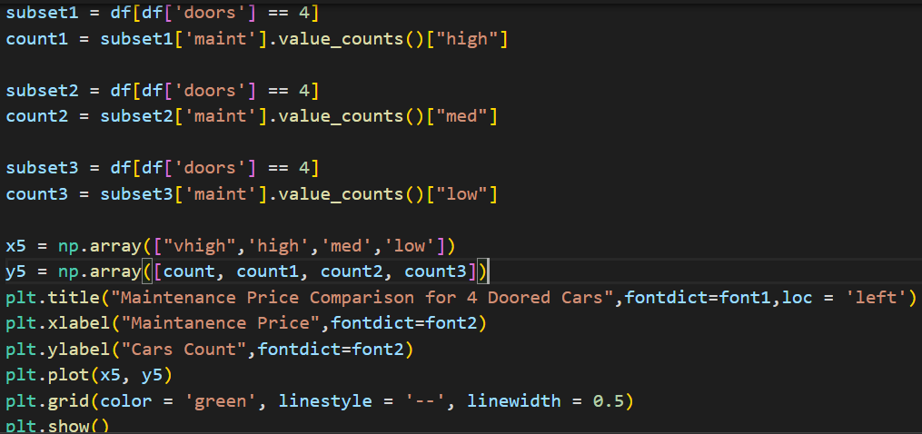
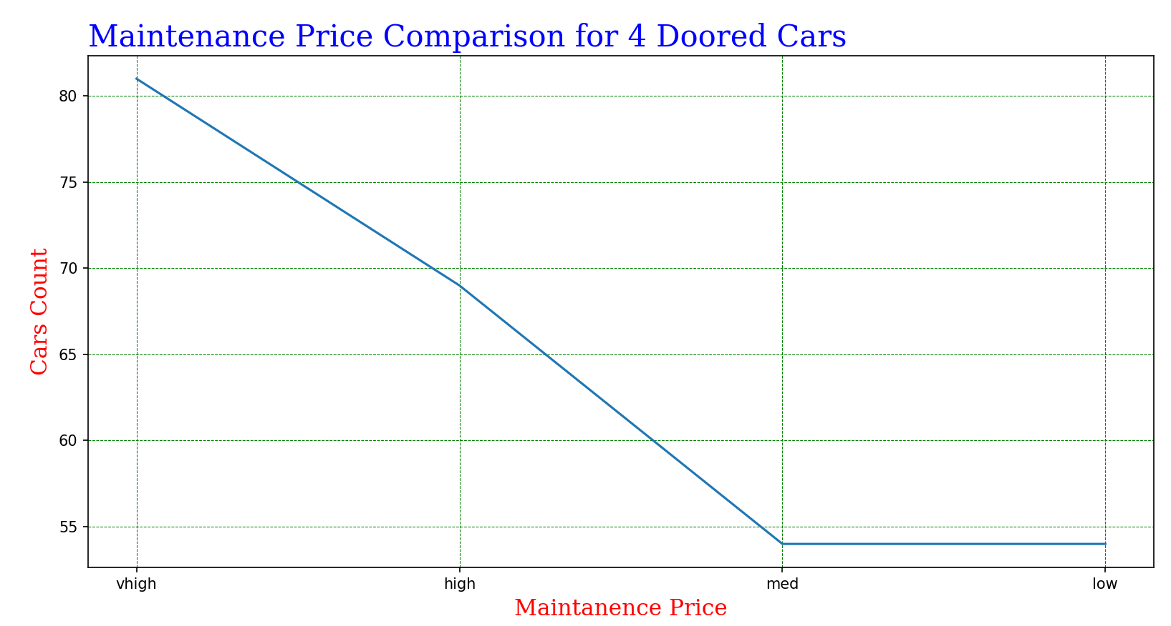
Maintenance Price Variation for 4 Doored Cars

Slide 8
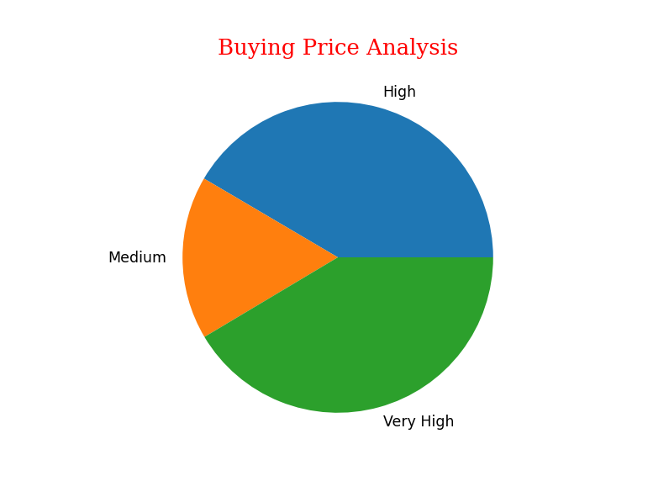
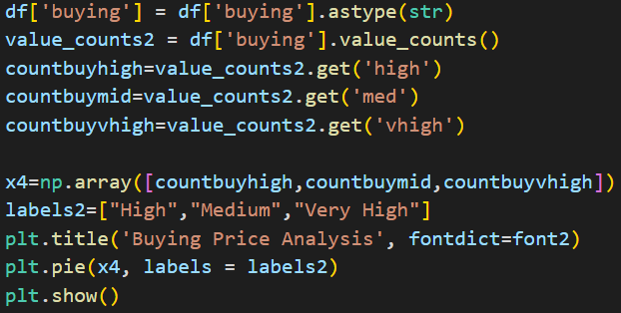
Car Buying Prices Analysis
This pie Chart represents the Price Range between all the cars listed in the data set, which are assorted between medium, high, and very high.
The ratio of the chart displays that data set contained a larger amount High and Very High priced cars compared to the medium priced ones.

Slide 9
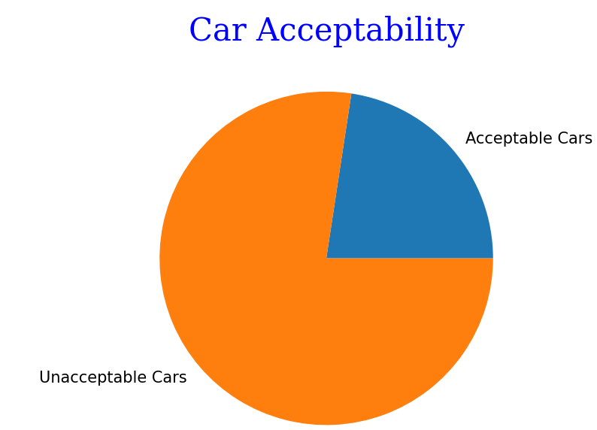
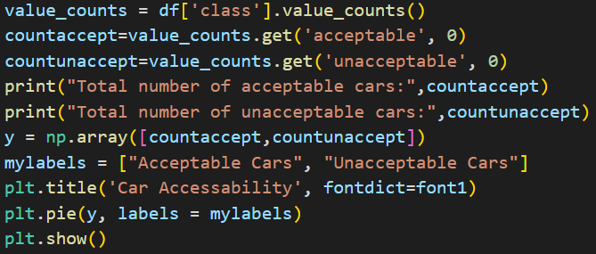
Car Acceptance
This pie chart displays ratio in the data set between acceptable and unacceptable cars. As you can see the data set contains more cars that are unacceptable then acceptable.

Slide 10
Car Data Summary
Overall, the dataset contained a lot of similar values and outcomes as shown in our bar and one specific pie chart. The dataset had less variations in values which made it difficult to do more in-depth analysis on the data set. For example, values that exceeded the count of 4 were just labeled as '5more' instead of holding actual specific numerical values. After replacing them with the mean, we calculated and analyzed the data and viewed many aspects of the data had almost the same number of class values. With that being said, the data held more cars that were 'unacceptable' than 'acceptable', because the variation for car prices were heavily favored on the high end (“vhigh”, “high”). In terms of improvement, the data set can be improved by doing further research on the cars in the dataset and replacing values in columns where the data set had vague estimations.

