Slide 1

Hospital Management system
By- team arambh
15.11.2022

Slide 2
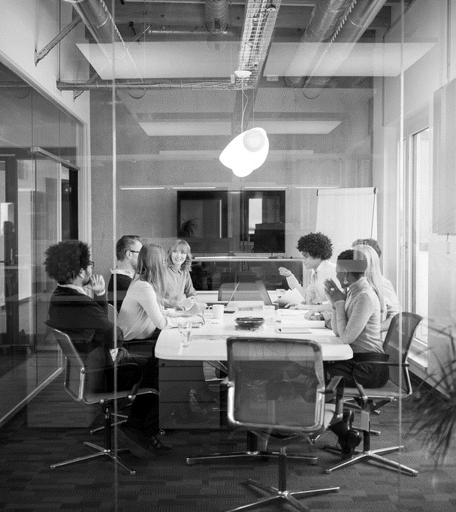
MEET THE TEAM
RIDDHI GUPTA
SHIVAM KUMAR
NIKHIL SINGH
RANA ANURAG SINGH

Slide 3
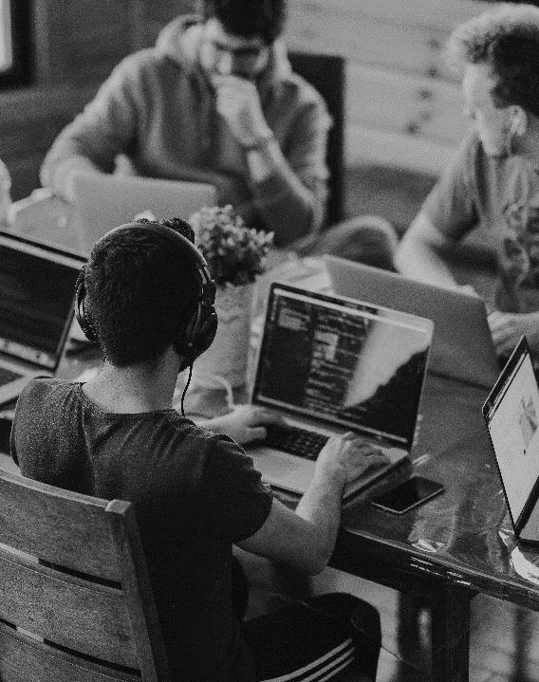
ACKNOWLEDGMENT
We are cherished
We would like to express our profound gratitude to Mr. (name of the HOD), of ____ (designation and department name) department, and Mr. Harsh Vardhan and Mr. Vikas Khattar Sir of KIET Group of Institution for guiding us on project titled _____.
We would like to express our special thanks to our team members for their time and efforts We are eternally grateful to you all.
We would also like to acknowledge that this project is completed entirely by our team and not by someone else.

Slide 4

MEDICAL FECILITES OF COLLEGES
Let’s Dive In

Slide 5
WHAT IS THE PROBLEM?
So Hello everyone!
Don’t worry we won’t tell you some long sad stories that will make you cry like Judges do in Scripted Reality TV show! Annoying Right?
But you know what’s more annoying Medical facilities of our country like you may have heard a lot of stories where patients die last minute due to delay in availability of medicines and doctors well, this a vey wide picture let us first discuss about the medical facilities at our home or Our College. To be honest we know that medical facilities provided by colleges for there students is just pathetic due to which Hostellers & students have to suffer a lot I mean what is this that medical facilities will only be provided for an hour or two! Being a human we don’t have a superpower to control our health issues as if when we are supposed to fall ill or not its not in our hand.
Don’t worry we are not trying to make riots in campus neither we are complaining for that, We are too lazy for that!
But we need to help those students right?
So we have found a possible solution for that It won’t only help students from our college but also help students from other college and slowly citizens as well after Humanity is way more important than IND vs PAK match!

Slide 6
So, WHAT IS THE SOLUTION ACOORDING TO US?
Hospital Management System
As we have already discussed the problem that due to delay in medical facilities, many patients lost their lives. So how about if we bring these medical facilities to AI? In our hospital management system, we have designed a three-way ultimate solution for any health problem
let’s start with our
First system which is an AI CHATBOT SYSTEM , In this we have designed a python generated A.I chatbot. User can simply communicate with the AI chatbot through text for:
Health related question
Medication
Consultancy
Appointment services
We have given way two access For this chatbot system as the user while logging in our web will have to give a different contact as well that can be guardian or Warden(in case of hosteller) this will give access to the student’s health portal.

Slide 7
So, WHAT IS THE SOLUTION ACOORDING TO US?
Hospital Management System
Coming to the next step solution that is On Clinic Visit in this user will search for a doctor in the nearby location and the cloud will give them a list of all the registered and licensed doctors operating in their location they can even filter their choice based on:
Fee of doctor
Expertise
Location
Our third way is that doctors will Visit the hostel or the accommodation to see the patient, in this method the student will select the doctor according to their need and ask them for a hospital visit. When the doctor will accept the same the doctor will receive a safety card to visit the premises
For every consultancy, the student will do an AI generated acknowledgment message that will be send to the registered guardian of the student.
Student or patient will be responsible for the payments and not the college.

Slide 8
-John Sculley
“Healthcare has been the last major industry that hasn’t been touched by technology in terms of productivity and consumer adoption in the way so many other industries have.”

Slide 9
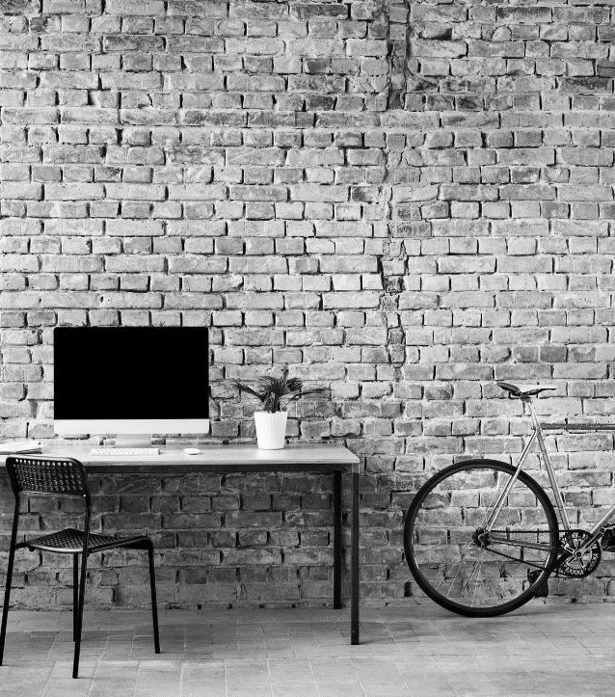
Technology used
aspects

Slide 10
Python (PyPi)
Artificial Intelligence
Chatbot
HTML
React
CSS
AWS Location Services

Slide 11

Goals for future
We are planning to achieve the desired technological goals.
Shift our idea to application.
Make it wide so that citizens can also use this.

Slide 12
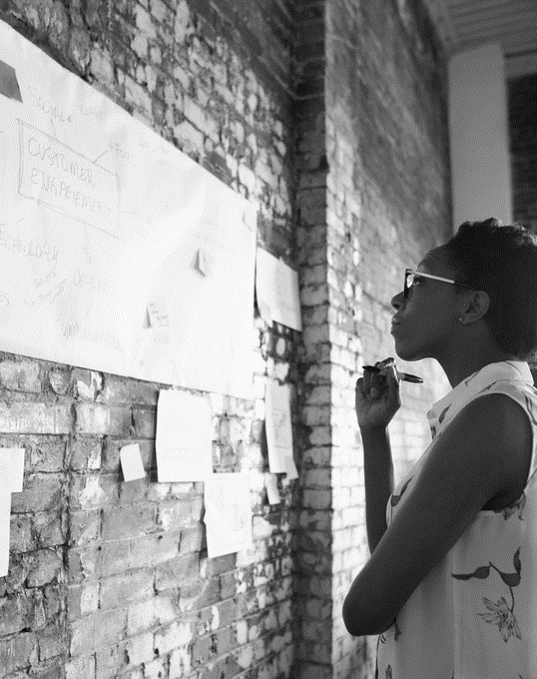
SUMMARY
We have designed a one stop solution for Health solutions.
Keeping in a small circle now i.e., for college students.
User is responsible for payments.
We’re working to reducethe death ratio due to lack of medical help in INDIA.
This number is 1.6 million as of past year.
Planned to expand our idea to application-based system.

Slide 13



THANK YOU
RIDDHI GUPTA
SHIVAM KUMAR
NIKHIL SINGH
RANA ANURAG SINGH
+91 8527279085
+91 8287377405
+91 9310153892
+91 7838865232
riddigupta18@gmail.com
shivam02774@gmail.com
nikhilsingh3482@gmail.com
asranacoc@gmail.com

