Slide 1
Trishul StayEase 🏡
Direct Booking Engine for Eco-Homestays & Sustainable Tourism
Final Internship Evaluation Presentation • Full Stack Development (WD-05)
Candidate Name: Riddhi Kumari
Intern ID: 26100462
University / College: [Your University / College Name]
Project Domain: Full Stack Web Development (FastAPI + React + MongoDB Atlas + Gemini AI)
Live Demo: https://trishul-stay-ease.vercel.app

Slide 2
SECTION 1 & 2
What Problem Are We Solving?
Addressing challenges faced by eco-homestay owners and sustainable travellers
💸 High OTA Commission Rates
• Traditional travel platforms charge 15% - 25% commission fees per booking.
• Heavily reduces profit margins for small, family-run rural homestay owners.
• Forces eco-hosts to inflate prices for end guests.
🔍 Fragmented Eco-Discovery
• Mindful travellers struggle to find authentic, verified sustainable stays.
• Greenwashing makes it difficult to verify authentic eco-practices.
• Lack of dedicated filters for local cultural & eco-activities.
⚡ Complex Direct Booking & Planning
• Small homestays lack digital infrastructure for direct, commission-free reservations.
• Manual scheduling leads to double bookings and slow response times.
• Travellers lack personalized, budget-friendly sustainable itineraries.

Slide 3
SECTION 3
Tech Stack Selected Along with Reasons
Modern, scalable, and type-safe architecture for maximum developer productivity
🎨 Frontend: React 19 + Vite
UI & Client Architecture
• Lightning-fast Hot Module Replacement (HMR) & sub-second build times.
• Component-driven modularity with React Router 7 for fluid SPA navigation.
• Context API for state management (Auth, Dark/Light theme).
⚡ Backend: FastAPI (Python 3.11)
High-Performance ASGI REST API
• Asynchronous execution handling high-concurrency requests seamlessly.
• Pydantic v2 for automatic request/response data validation and sanitization.
• Auto-generated interactive Swagger & OpenAPI documentation.
🗄️ Database: MongoDB Atlas + Motor
Cloud Document Database
• Motor async driver provides non-blocking I/O queries for the FastAPI event loop.
• Flexible JSON schema accommodates dynamic amenities, image arrays & reviews.
• Managed cloud high availability with zero server maintenance.
🤖 AI: Google Gemini 1.5 Flash
Intelligent Itinerary Generator
• State-of-the-art inference speed and structured JSON output guarantee.
• Built-in server-side TTL caching reduces redundant API overhead.

Slide 4
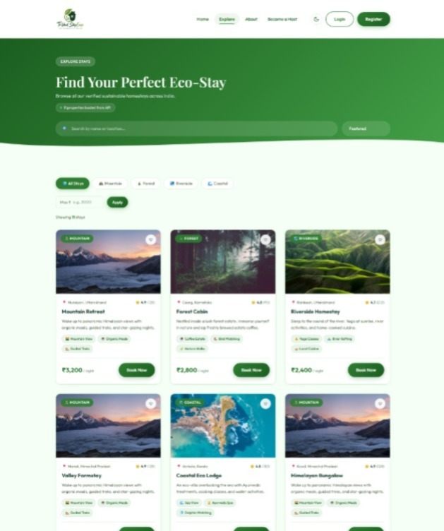
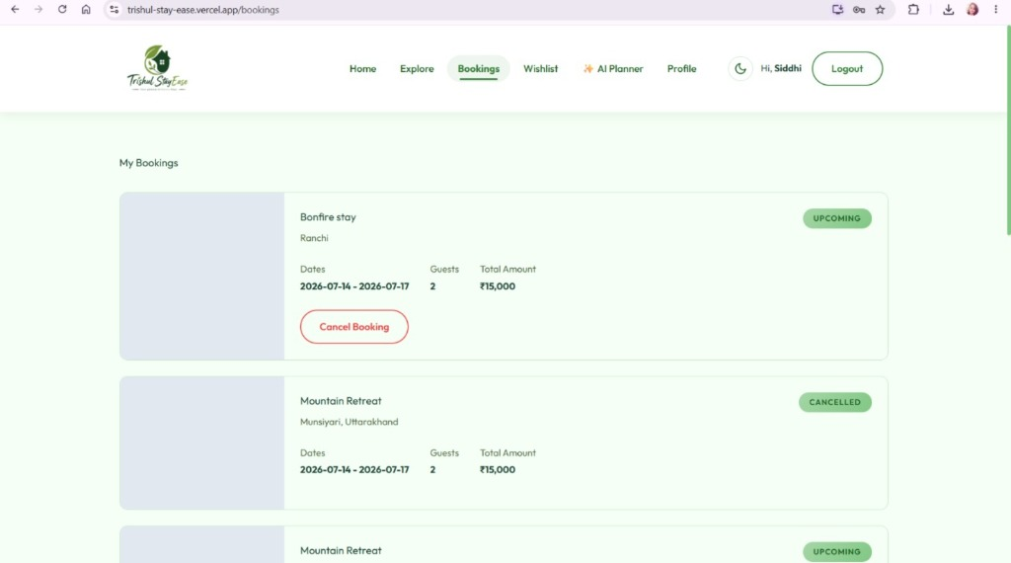
SECTION 4
Frontend Experience & Live Features
Clean, responsive, accessible, and themeable user interface
Key Frontend Highlights
• 🔍 Explore & Multi-Filter: Instant debounced search by location or property title with category chips (Mountain, Forest, Riverside, Coastal).
• 📅 Dynamic Booking Modal: Interactive calendar date picker with date sequence validation & real-time multi-night price calculation.
• 📊 Host Management Dashboard: Dual-role authorization with dedicated dashboard showing live revenue and occupancy metrics.
• 🛡️ Production UX & Polish: Global React ErrorBoundary to prevent blank-screen crashes, dark mode support with localStorage persistence.
🌐 Live Frontend URL: https://trishul-stay-ease.vercel.app

Slide 5
SECTION 5
Backend: Top 2 APIs & Implementation
Robust asynchronous endpoints with strict input validation and error handling
API 1: POST /api/ai/travel-plan (AI Eco Planner)
Purpose: Generates customized sustainable travel itineraries.
Working Mechanism:
1. Accepts destination, budget, trip duration, guest count, and travel style.
2. Evaluates in-memory TTL cache to return instant cached responses for duplicate prompts.
3. Invokes Google Gemini 1.5 Flash with structured JSON system prompts.
4. Validates schema integrity and gracefully handles API quota boundaries.
Status Code: 200 OK | Rate Limited | Cached
API 2: POST /auth/register & /auth/login (JWT & OAuth Auth)
Purpose: Provides enterprise-grade authentication & dual role management.
Working Mechanism:
1. Password hashing with Bcrypt (12 salt rounds) via Passlib.
2. SlowAPI rate limiting (5 req / 15 min) prevents brute-force credential attacks.
3. Issues stateless 24-hour HS256 JWT access tokens.
4. Supports one-click Google OAuth 2.0 token verification.
Status Code: 201 Created / 200 OK | Strict CORS & Security Headers
📖 Live Swagger UI & Interactive Documentation: https://trishul-stayease.onrender.com/docs

Slide 6
SECTION 6
Database Selection & Schema Design
MongoDB Atlas: Fully managed cloud NoSQL database with async Motor driver
📁 properties Collection
• id: int (Auto-increment PK)
• title: string
• location: string
• price: int (Nightly rate)
• type: string (mountain, forest...)
• status: available | booked
• amenities: array of strings
• images: array of URLs
• host_id: string
👤 users Collection
• id: ObjectId (PK)
• full_name: string
• email: string (Unique Index)
• phone: string (Unique)
• password_hash: string
• role: guest | host
• avatar_url: string
• created_at: timestamp
📅 bookings Collection
• id: int (PK sequence)
• property_id: int
• guest_id: string
• host_id: string
• start_date: date
• end_date: date
• total_price: int
• status: upcoming | completed | cancelled
🔢 counters & wishlists
• counters: Atomic auto-increment sequence generation via $inc operator.
• wishlists: Stores user favorite property ID arrays for zero-friction access.
• Indexes: Compound indexes on (status, price) and unique text search on (title, location).
💡 Why MongoDB? Flexible schema matches polymorphic eco-stay amenities + zero-downtime horizontal scaling.

Slide 7
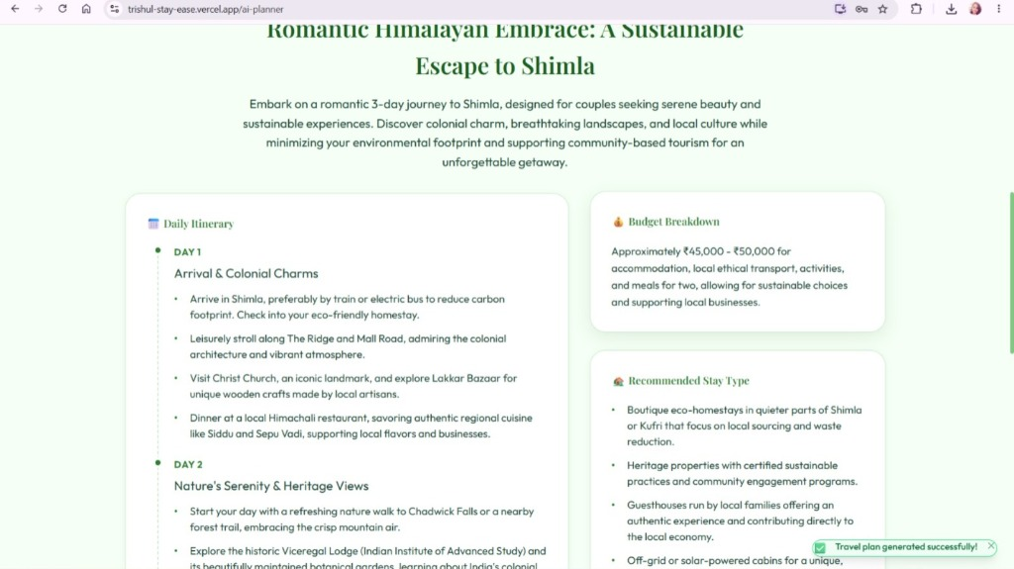
SECTION 7
AI Feature: Eco Travel Planner
Harnessing Google Gemini 1.5 Flash for personalized sustainable itinerary generation
Google Gemini 1.5 Flash Integration
• 🤖 Model & SDK: Google Gemini 1.5 Flash via official `@google/genai` Python SDK for fast token latency and strict structured JSON schema.
• 🎯 Use Case: Instant day-by-day eco itineraries tailored to budget, days, guest count, and travel style with packing & green guidelines.
• ⚡ Server-Side TTL Cache: In-memory dictionary cache returns instant responses for repeat destination queries, preventing API quota exhaustion.
• 🛡️ Schema Validation: Pydantic validation handles JSON formatting errors and markdown codeblock stripping gracefully.

Slide 8
SECTION 8 & 9
Cloud Hosting Services & All Live URLs
Production-grade multi-cloud architecture deployed on Vercel, Render & MongoDB Atlas
▲ Vercel (Frontend Hosting)
• Role: Hosts the React 19 + Vite Single Page Application.
• Features: Global CDN Edge Network, automated preview deployments on git push, automatic gzip/brotli compression.
• Live URL: https://trishul-stay-ease.vercel.app
⚡ Render (Backend Hosting)
• Role: Hosts the FastAPI Python 3.11 ASGI Web Service.
• Features: Managed Linux container, automated build pipelines from GitHub, secure environment secret injection.
• Live URL: https://trishul-stayease.onrender.com
🍃 MongoDB Atlas (Cloud Database)
• Role: Fully managed cloud database cluster.
• Features: Automatic daily backups, connection pooling, and SSL-encrypted in-transit data access.
• Cluster: M0 Free Sandbox (AWS Mumbai Region)
🐙 GitHub (Source Code Repository)
• Role: Complete open-source version controlled repository.
• Features: Modular folder structure, Postman collection, atomic commits, comprehensive README.
• Repository: https://github.com/Riddhi1204/Trishul_StayEase
🔗 All links are live, SSL secured (HTTPS), and publicly accessible without restrictions.

Slide 9
SECTION 10
Reflection on the Internship & Learnings
A transformative journey building a complete full-stack web product from scratch
🚀 Technical Growth & Mastery
• Full-Stack Integration: Built end-to-end synergy between React SPA, async FastAPI, and MongoDB Atlas.
• Authentication & Security: Implemented production JWT authentication, Bcrypt password hashing, and OAuth 2.0.
• AI Engineering: Gained practical expertise integrating Google Gemini LLM with structured prompts and caching.
• Performance Optimization: Leveraged React `useMemo`, debounce searches, and connection pooling.
💼 Engineering Best Practices & Experience
• Defensive Coding: Handled edge cases with React Error Boundaries, Pydantic validations, and CORS middlewares.
• Agile Version Control: Maintained clean, atomic git commit histories following conventional commits standard.
• Production Cloud Deployment: Managed live multi-cloud environments across Vercel, Render, and Atlas.
• Overall Experience: Incredible hands-on exposure solving real-world eco-tourism booking challenges.

Slide 10
Thank You! 🙏
Trishul StayEase — Sustainable Homestays, Direct Bookings
Candidate: Riddhi Kumari | Intern ID: 26100462
🌐 Live App: https://trishul-stay-ease.vercel.app
🐙 GitHub: https://github.com/Riddhi1204/Trishul_StayEase

