Slide 1

Steganography
IFT 520 Advanced Information System Security
Course Project
Cryptography & Network Security
1

Slide 2
Group Members
Team - 12
Riddhi Manishkumar Tamakuwala [1226810171]
Abhinav Nathari [1225973205]
Submitted to : Dr Jim Helm

Slide 3
Index
Introduction
Problem Statement
Project Scope
Process Model
Algorithm used
Block Diagram
Implementations
Results
Conclusions
References

Slide 4
Introduction
The word Steganography is derived from the Greek words – steganos (meaning hidden or covered) and the graph (meaning to write).
Steganography is the practice of hiding a file, image, or video within another file, message, image or video.
Steganography can also be referred as the technique of hiding secret data within an ordinary, non secret, file or message in order to avoid detection; the secret data is then extracted at its destination.

Slide 5
Problem Statement
How can one send message secretly to the destination.
Using steganography, information can be hidden in carriers such as image, audio files, text files, videos and data transmissions.
Image Steganography is the process of hiding information which can be text, image or video inside a cover image.
The secret information is hidden in a way that it not visible to the human eyes.

Slide 6
Project Scope
This project is developed for hiding information in any image file.
The scope of the project is to limit unauthorized access and provide better security during message transmission. To meet the requirements, the project uses the simple and basic approach of steganography.
In this project, the proposed approach finds the suitable algorithm for embedding the data in an image using steganography which provides the better security pattern for sending messages through a network.
For practically implementing the function of the discussed algorithms, python framework is used.

Slide 7
Cryptography vs Steganography
Cryptography and steganography are both methods used to hide or protect secret data. However, they differ in the respect that cryptography makes the data unreadable, or hides the meaning of the data, while steganography hides the existence of the data.
Cryptography is similar to writing a letter in a secret language: people can read it but won’t understand what it means. However, the existence of a (probably secret) message would be obvious to anyone who sees the letter, and if someone either knows or figures out your secret language, then your message can easily be read.
If you were to use steganography in the same situation, you would hide the letter inside a pair of socks that you would be gifting the intended recipient of the letter. Only the intended recipient knows what to look for, and finds the message hidden in them.

Slide 8
The BEST way
The use of Steganography can be combined with encryption as an extra step for hiding or protecting data.
Cryptography is often used to supplement the security offered by steganography. Cryptography algorithms are used to encrypt secret data before embedding it into cover files.
Cryptography can be used as extra layer of security even over the existence of file i.e. Steganography

Slide 9
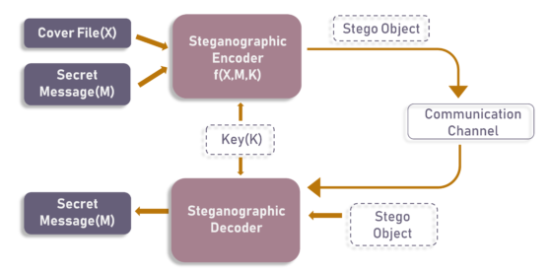
Steganographic Model
As the image depicts, both cover file(X) and secret message(M) are fed into steganographic encoder as input. Steganographic Encoder function, f(X,M,K) embeds the secret message into a cover file. Resulting Stego Object looks very similar to your cover file, with no visible changes. This completes encoding. To retrieve the secret message, Stego Object is fed into Steganographic Decoder.
Fig 1 Steganographic Model

Slide 10
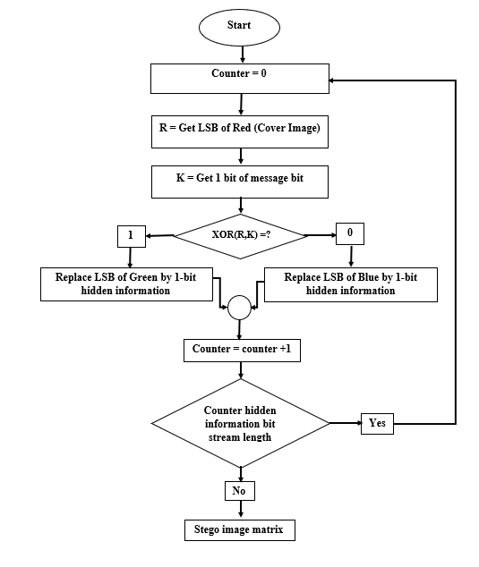
Steganographic Encryption Model
Fig 2 Encryption Model

Slide 11
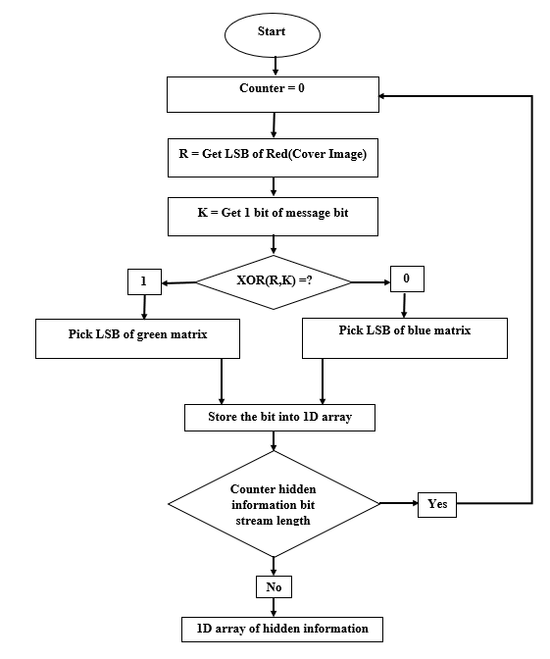
Steganographic Decryption Model
Fig 3 Decryption Model

Slide 12
Least Significant Bit (LSB)
LSB algorithm is a classic Steganography method used to conceal the existence of secret data inside a “public” cover. The LSB or “Least Significant Bit”, in computing terms, represents the bit at the unit’s place in the binary representation of a number.
For example, we can represent the decimal number 170 in binary notation as 10101010. As shown in the figure, the least significant bit, in this case, is 0.
In the simplistic form, LSB algorithm replaces the LSB of each byte in the “carrier” data with one bit from the “secret” message.

Slide 13
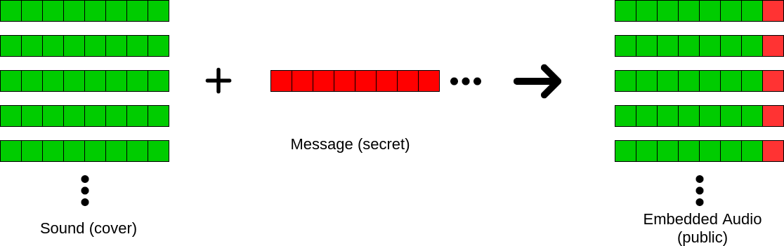
Least Significant Bit (LSB)
This concept is visualized in the diagram below.
The sender performs “embedding” of the bits of secret messages onto the carrier data byte-by-byte. Whereas the receiver performs the “extraction” procedure by reading LSB bits of each byte of received data, this way the receiver reconstructs the secret message.
Fig 4 LSB representation

Slide 14
Least Significant Bit (LSB)
Isn’t this corrupting the carrier signal?
Yes, but the main idea here is that we are trying to exploit the human perception of the integrity of the carrier signal. LSB steganography is very popular for Image Steganography, i.e. hiding secrets in images. And the change in LSB affects the color just so slightly that the change in color is not generally perceptible to the human eye. However, the human ear is more sensitive to slights changes in sound and hence the “noise” that we are adding would have a higher chance of being noticed. To overcome this problem of this trivial form of LSB algorithm, many researchers have suggested variants that increase robustness in the audio domain.

Slide 15
Types of Steganography
Different types of Steganography techniques:
📃 | 🖼️ | 🎵 | 📹
Text in Image
Image in Image
Audio in Image
Video in Image

Slide 16
Image Steganography
Text in Image, Image in Image come under Image Steganography.
Hiding the data by taking the cover object as the image is known as image steganography. In digital steganography, images are widely used cover source because there are a huge number of bits present in the digital representation of an image. There are a lot of ways to hide information inside an image.
Common approaches include:
Least Significant Bit Insertion
Masking and Filtering
Redundant Pattern Encoding
Encrypt and Scatter

Slide 17
Image Steganography
Each pixel contains three values which are Red, Green, Blue, these values range from 0 to 255, in other words, they are 8-bit values. [4] Let’s take an example of how this technique works, suppose you want to hide the message “hi” into a 4x4 image which has the following pixel values:
[(225, 12, 99), (155, 2, 50), (99, 51, 15), (15, 55, 22),(155, 61, 87), (63, 30, 17), (1, 55, 19), (99, 81, 66),(219, 77, 91), (69, 39, 50), (18, 200, 33), (25, 54, 190)]
Using the ASCII Table, we can convert the secret message into decimal values and then into binary: 0110100 0110101.
Now, we iterate over the pixel values one by one, after converting them to binary, we replace each least significant bit with that message bits sequentially
e.g. 225 is 11100001, we replace the last bit, the bit in the right (1) with the first data bit (0) and so on.
This will only modify the pixel values by +1 or -1 which is not noticeable at all.
The resulting pixel values after performing LSBS is as shown below:[(224, 13, 99),(154, 3, 50),(98, 50, 15),(15, 54, 23),(154, 61, 87),(63, 30, 17),(1, 55, 19),(99, 81, 66),(219, 77, 91),(69, 39, 50),(18, 200, 33),(25, 54, 190)]

Slide 18
ENCRYPTION PHASE:
The "Encryption phase" uses two types of files for encryption purpose. One is the secret file which is to be transmitted securely, and the other is a carrier file such as image. In the encryption phase the data is embedded into the image.
Text
Encryption Algorithm
Encoded Image
Image
Fig 5 Encryption process.

Slide 19
DECRYPTION PHASE:
The Decryption phase is reverse to encryption phase. In decryption phase, the carrier image in which the data is hided is given as an input file. decryption section uses the "Least Significant bit Algorithm" (LSB) by which the encoded bits in the image is decoded and turns to its original state and gives the output as a text document.
Decryption Algorithm
Encoded Image
Text
Fig 6 Decryption process.

Slide 20
Block Diagram
Start
Encryption
Decryption
Image
Message
Image File
Image File
Image
Message
Fig 7 Block Diagram for Steganography

Slide 21
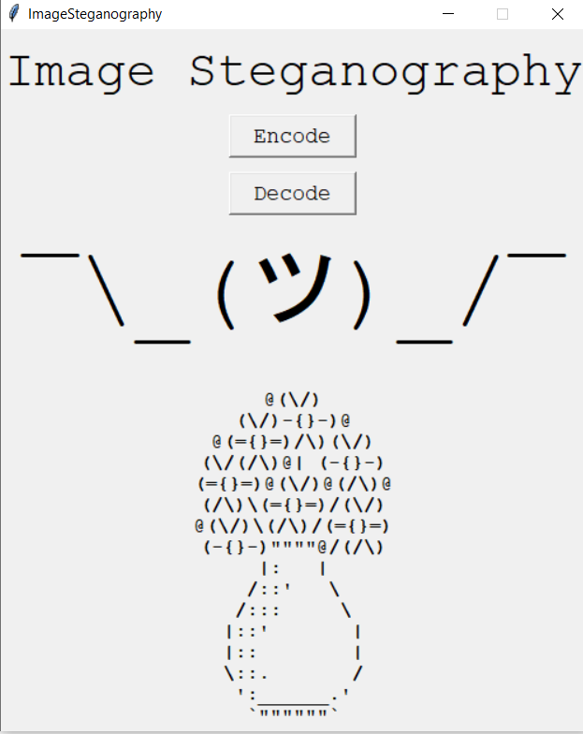
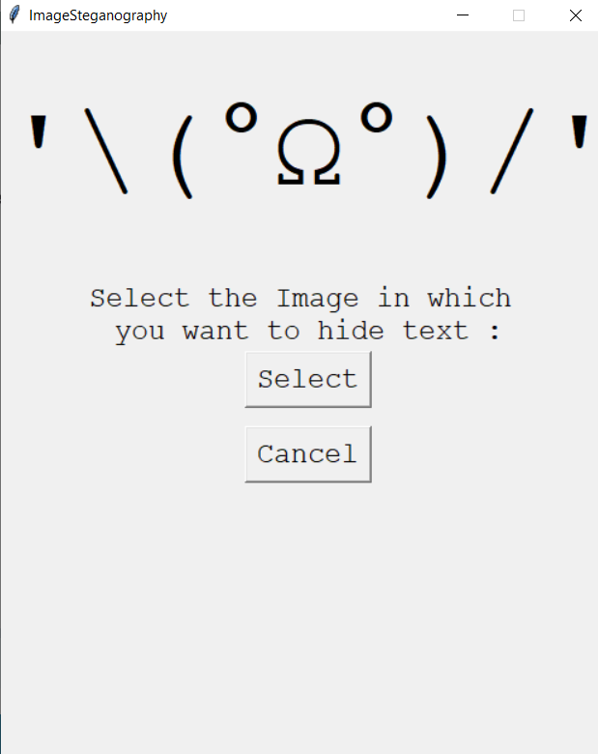
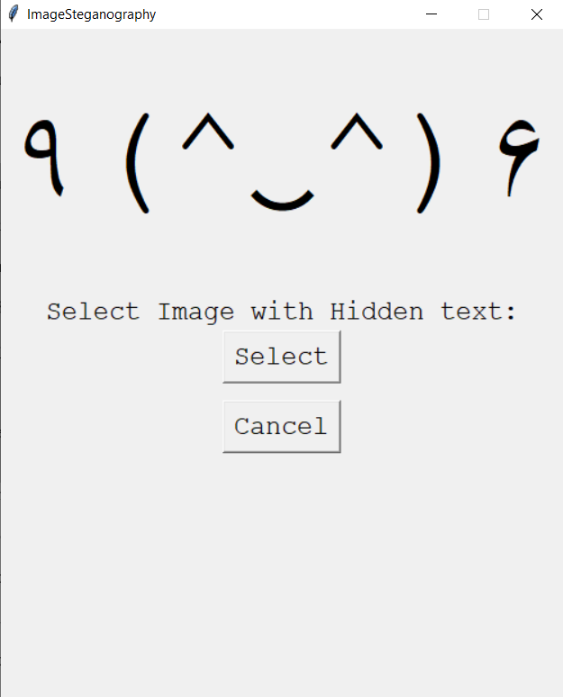
Implementation
Fig 8 Home Page
Fig 9 Encoding Module
Fig 10 Decoding Module

Slide 22
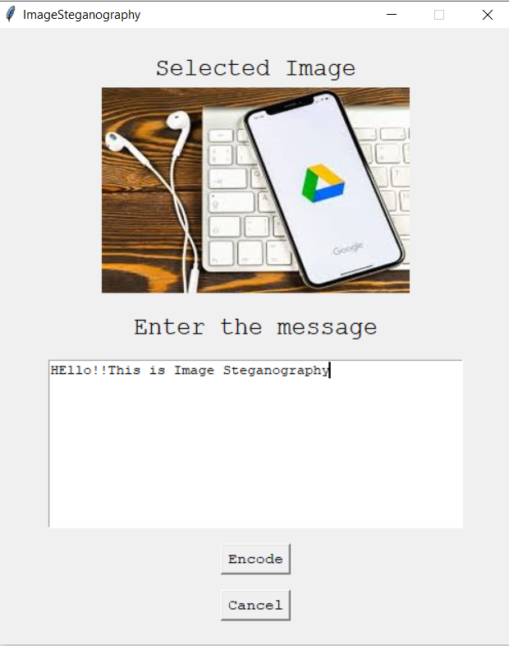
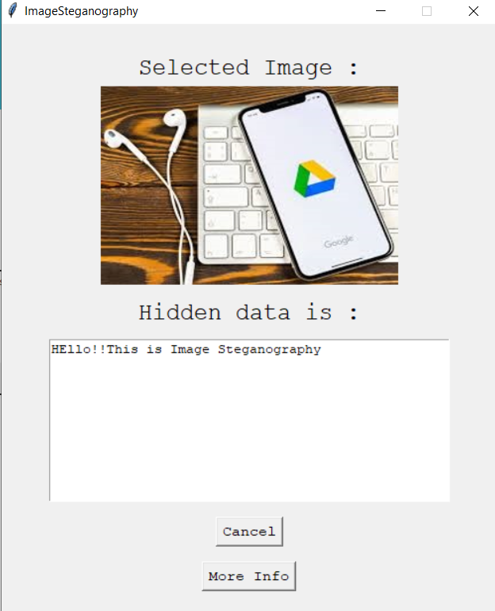
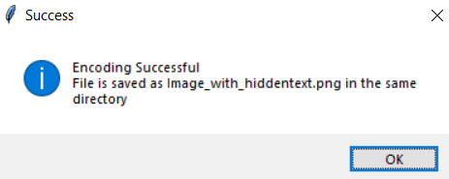
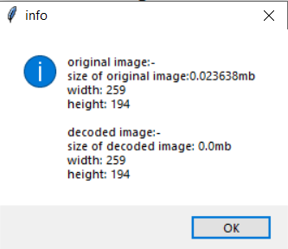
Implementation
Fig 11 Encoding image
Fig 12 Image Information
Fig 13 Decoding image

Slide 23
Results
In this project we mainly concentrated on embedding the data into an image. We have designed the steganographic application which embedded the data into the image.
Normally, after embedding the data into the image, the image may lose its resolution. In the proposed approach, the image remains unchanged in its resolution as well in size.
The speed of embedding the data into the image is also high in the proposed approach such that the image is protected and the data to the destination is sent securely.
There are many steganographic algorithms available like JSteg, F5 and LSB algorithms. Our project have used the Least Significant Bit algorithm in designing the steganographic application because LSB algorithm works efficiently when we consider bit map images .bmp files. The speed of embedding is also high when using LSB compared to the JSteg algorithm.

Slide 24
Conclusions
In the present world, the data transfers using internet is rapidly growing because it is so easier as well as faster to transfer the data to destination. So, many individuals and business people use to transfer business documents, important information using internet.
Security is an important issue while transferring the data using internet because any unauthorized individual can hack the data and make it useless or obtain information un- intended to him.
The future work on this project is to improve the compression ratio of the image to the text. This project can be extended to a level such that it can be used for the different types of formats like audio files, text files, videos in the future. The security using Least Significant Bit Algorithm is good but we can improve the level to a certain extent by varying the carriers as well as using different keys for encryption and decryption.

Slide 25
References
https://www.geeksforgeeks.org/image-based-steganography-using-python/
https://data-flair.training/blogs/python-image-steganography-project/
https://docs.python.org/3/library/tkinter.html
https://www.section.io/engineering-education/steganography-in-python/

Slide 26


