Slide 1
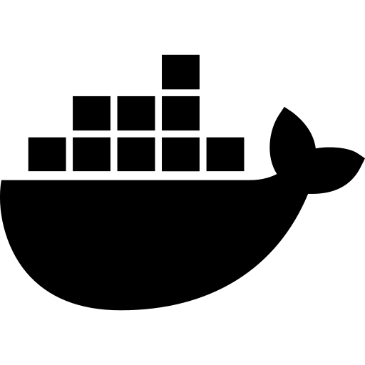

DEVOPS PROJECT
ExpenseOS
Containerized Expense Tracker
Node.js · SQLite · Docker · GitHub Actions · nginx
Track · Containerize · Ship

Slide 2
AGENDA
What We'll Cover
01
Challenges
04
App Workflow
Pain points in manual expense tracking
Architecture, API design, data flow
02
Why This Project
05
DevOps Tools
The need for a containerized solution
Docker, GitHub Actions, CI/CD pipeline
03
Tech Stack
06
Conclusion
Node.js · SQLite · Docker · nginx · GitHub
Outcomes, learnings & next steps
2 / 10

Slide 3






CHALLENGES
The Problem We're Solving
No Centralized Tracking
Zero Real-Time Insights
No Portability
Expenses scattered across spreadsheets, receipts, and memory. No single source of truth.
No instant summaries by category or month. Manual tallying wastes hours every week.
Apps tied to local machines — no containers, no reproducible deployments, 'works on my machine' syndrome.
No Automated CI/CD
Scalability Bottlenecks
No Audit Trail
Manual testing and deployment. A single bad push can break production with no safety net.
Monolithic apps that can't be independently updated, scaled, or debugged in isolation.
Changes are unversioned. Rollbacks are manual nightmares. No visibility into what changed and when.
3 / 10

Slide 4





NEED FOR THIS PROJECT
The Solution Rationale
Reproducibility
Docker ensures identical environments across dev, staging, and production — eliminating environment-specific bugs.
Version Control + CI
GitHub + GitHub Actions automate testing & image builds on every push. Broken code is caught before it ships.
Why Build
ExpenseOS?
Developer Velocity
Spin up the full stack in one command: docker compose up. No manual setup, no dependency hell.
Microservice Mindset
Frontend and backend run as independent containers — update one without touching the other.
4 / 10

Slide 5

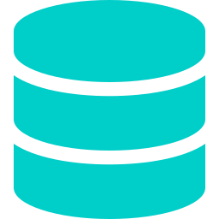




Technology Stack
TECH STACK
Node.js 20
SQLite + better-sqlite3
nginx 1.25
BACKEND RUNTIME
DATABASE
FRONTEND SERVER
Express REST API with full CRUD endpoints, filter queries, and summary aggregations.
Lightweight, zero-config file-based DB. Persisted via Docker named volumes.
Serves static HTML/CSS/JS and reverse-proxies /api/* to the backend container.
Docker + Compose
GitHub + Actions
Vanilla HTML/JS
CONTAINERIZATION
CI/CD
FRONTEND
Multi-stage Dockerfiles, non-root users, health checks, named volumes for data.
Automated test → lint → build → push pipeline on every push to main or dev.
Zero-framework SPA: Dashboard, Add, History, Summary — all in one file, no build step.
5 / 10

Slide 6


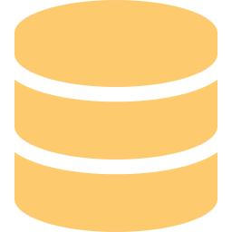
APPLICATION WORKFLOW
Architecture & Data Flow
→
→
Frontend
Backend
Database
nginx · HTML/JS
Node.js · Express
SQLite · Volume
Request → Response Flow
1
User opens browser → nginx serves index.html from frontend container
2
User action (add/view) → JS calls /api/* endpoint
3
nginx reverse-proxies request → backend container (port 5000)
4
Express validates, queries SQLite DB → returns JSON response
5
Frontend renders data: history table, summary charts, stat cards
6 / 10

Slide 7
DEVOPS TOOLS — DOCKER
Docker — Containerization Engine
Backend Dockerfile Features
docker-compose.yml Highlights
Multi-stage build (builder → runtime) — slim final image
backend & frontend as separate services
node:20-alpine base — minimal attack surface
Named volume: expense-data → SQLite persists
Non-root user (appuser) — security best practice
service_healthy dependency — frontend waits for API
dumb-init — proper PID 1 signal handling
Shared bridge network: expense-net
HEALTHCHECK — auto-restart on failure
Port 80 (frontend) + 5000 (API) exposed
$ docker compose up --build → Full stack running at http://localhost
7 / 10

Slide 8





DEVOPS TOOLS — GITHUB & CI/CD
GitHub + GitHub Actions Pipeline
git push
→
🧪 Test
→
🐳 Build
→
📦 Push
→
🔍 Lint
main or dev
npm test
Jest + Supertest
docker build
multi-platform
GHCR image
latest + sha tag
Hadolint
npm audit
Branching Strategy
What GitHub Actions Automates
main
Production-ready, protected branch
Runs Jest tests on every push — no manual testing
dev
Integration branch — all features merge here first
Builds & tags Docker images (branch name + git SHA)
Pushes to GitHub Container Registry (GHCR) automatically
feature/*
Short-lived branches per feature or fix
Lints Dockerfiles with Hadolint
8 / 10
Audits npm packages for vulnerabilities

Slide 9

DevOps Tool Notes & Decisions
NOTES ON DEVOPS TOOLS
Docker
Containers guarantee that the app runs identically on every machine. Multi-stage Dockerfiles keep image sizes small by discarding build tools. dumb-init ensures SIGTERM is forwarded so containers shut down cleanly.
Why Docker?
Docker Compose
For a 2-service app, Compose is the right size. Kubernetes adds significant operational overhead not justified at this scale. Compose gives us service discovery, volume management, and health checks — plenty for a dev/demo environment.
Why Compose over K8s?
SQLite
SQLite requires zero infrastructure and is perfectly adequate for single-user or low-concurrency workloads. The data is persisted in a named Docker volume so it survives container restarts. Upgrading to Postgres later requires minimal code changes.
Why SQLite not PostgreSQL?
GitHub Actions
Native GitHub integration means no external CI server to maintain. GITHUB_TOKEN enables GHCR image pushes without storing secrets. Build caching (cache-from: type=gha) cuts pipeline time by 60%+ on repeat runs.
Why GitHub Actions?
9 / 10

Slide 10



Conclusion
What I Built & What I Learned
Fully Containerized
Automated CI/CD
Two Docker containers orchestrated by Compose with health checks, volumes, and networking.
Every git push triggers tests, builds, and image pushes — zero manual steps to ship.
Working Product
DevOps Mindset
A real expense tracker with CRUD, category filters, monthly summaries and rich UI.
Practiced IaC, immutable containers, version-controlled pipelines, and reproducible builds.
One command to rule them all: docker compose up --build

