Slide 1

DATABASE MANAGEMENT SYSTEM PROJECT
Campus Placement and Recruitment Drive Management System
Java Swing · JDBC · MySQL
Sahasra Devunuri (25WU0101116)
Siri Raaga (25WU0101097)
Riddhi (25WU0101110)
Mohak Gupta (25WU0101074)
01 / 10

Slide 2
Manual placement tracking doesn't scale
DBMS PROJECT
Problem & objectives
Managing student records, companies, job profiles, eligibility, applications and results manually is hard to keep organized.
Centralize information
Manage drives
Student and company information
Placement drives and job profiles
Check eligibility
Track applications
Automatically check student eligibility
Applications and selection rounds
Manage offers
Simple interface
Offers and placement records
For Placement Officers and Students
02 / 10

Slide 3
Scope: two roles, one system
Student side
Officer side
View eligible drives
Apply for jobs
Track application status
View selection results
View offers
Manage students and companies
Create job profiles and drives
Configure eligibility
Manage applications and rounds
Issue offers and generate reports
TECHNOLOGY STACK
Java Swing
JDBC
MySQL
03 / 10

Slide 4
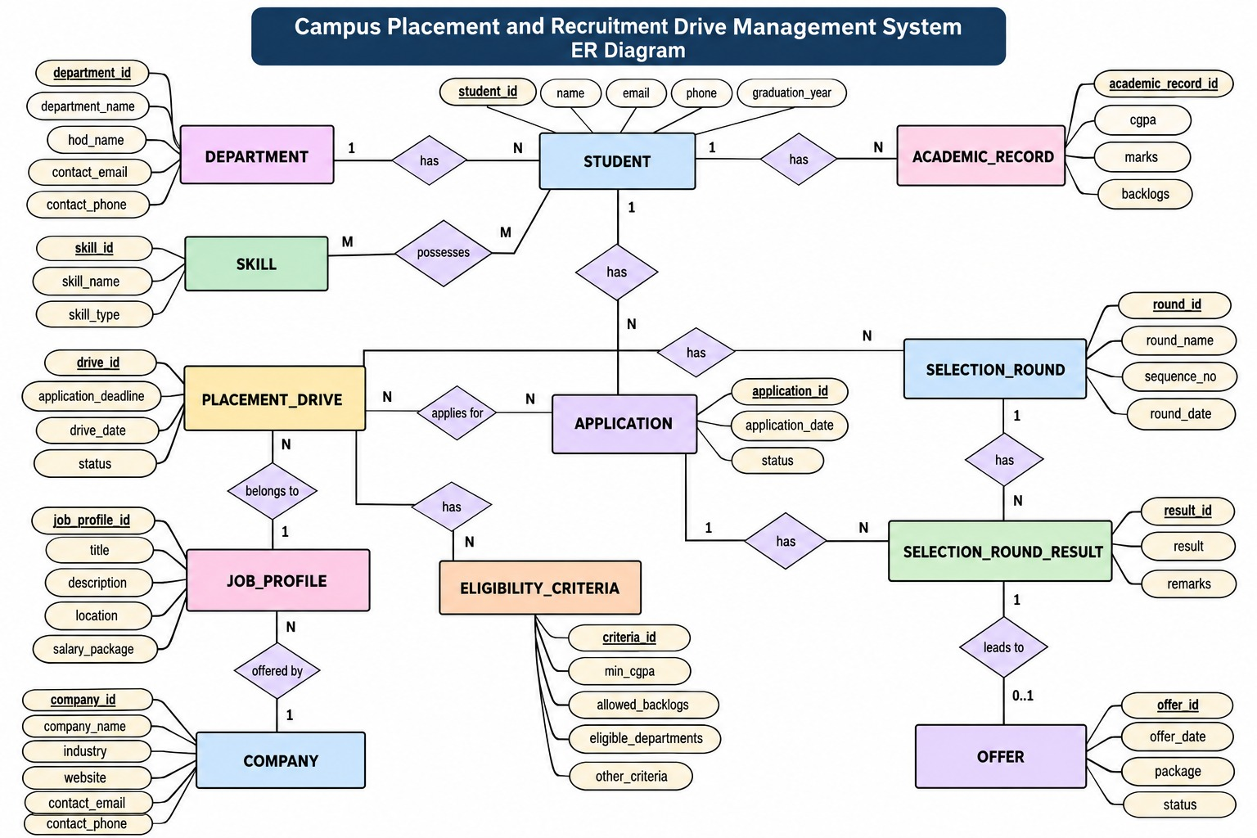
ER Diagram
DBMS PROJECT
Data model
ENTITIES
RELATIONSHIPS
Student, Department, Academic Record, Skill, Company, Job Profile, Placement Drive, Eligibility Criteria, Application, Selection Round, Round Result, Offer
Department → Students; Company → Job Profiles; Job Profile → Placement Drives; Student → Applications; Placement Drive → Applications; Application → Round Results; Application → Offer
04 / 10

Slide 5
Relational schema, normalized to 3NF
DBMS
STUDENT(student_id, name, email, phone, department_id, graduation_year) | ACADEMIC_RECORD(academic_record_id, student_id, cgpa, marks, backlogs)
COMPANY(company_id, company_name, industry, website, contact_email, contact_phone) | JOB_PROFILE(job_profile_id, company_id, title, description, location, salary_package)
PLACEMENT_DRIVE(drive_id, job_profile_id, drive_date, application_deadline, status) | APPLICATION(application_id, student_id, drive_id, application_date, status)
SELECTION_ROUND(round_id, drive_id, round_name, sequence_no, round_date) | ROUND_RESULT(result_id, application_id, round_id, result, remarks)
OFFER(offer_id, application_id, offer_date, package, status)
Schema
1NF atomic values, no repeating groups
2NF removed partial dependencies
3NF removed transitive dependencies
05 / 10

Slide 6
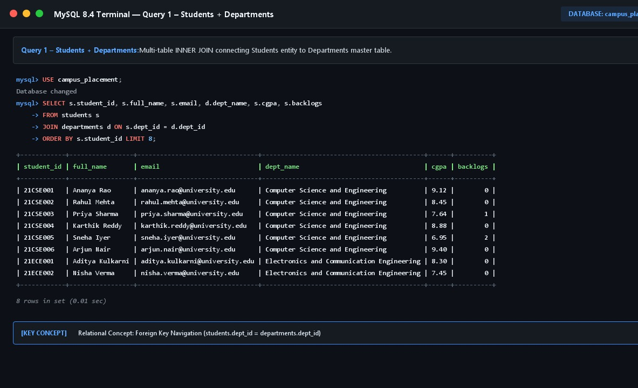
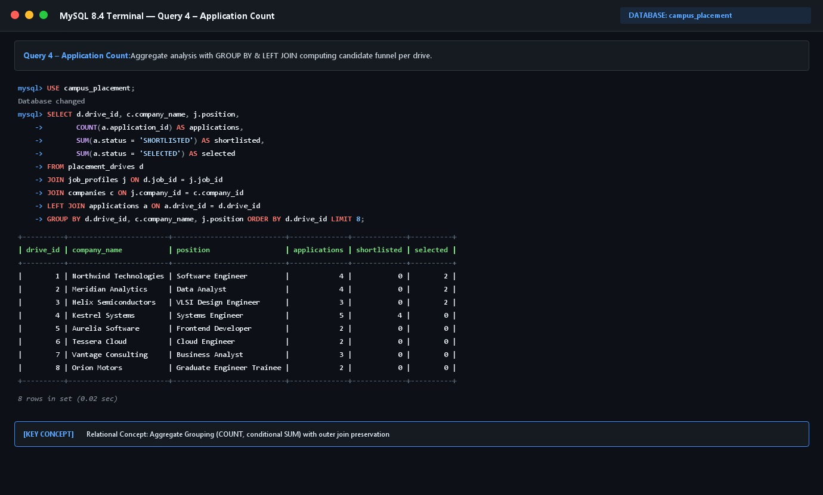
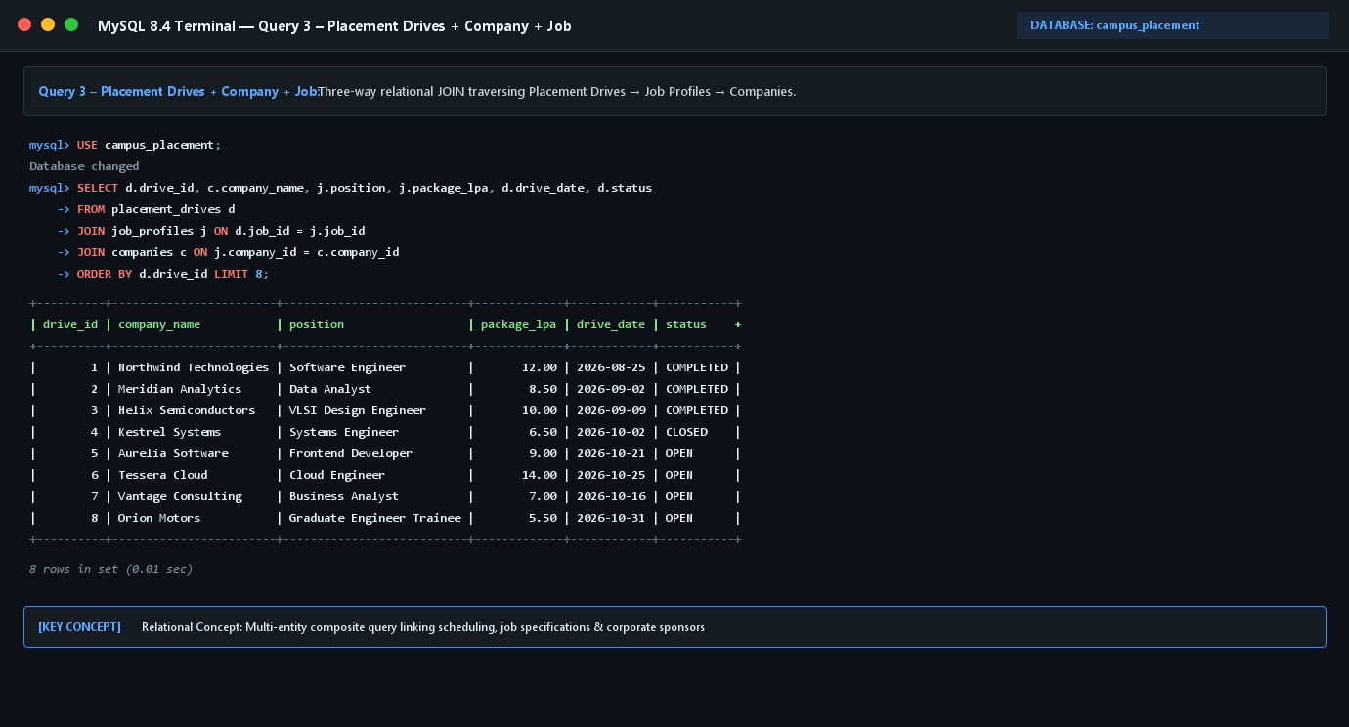
Database built and managed in MySQL
DBMS PROJECT
MySQL
CREATE DATABASE campus_placement;
CREATE TABLE students (...);
Primary Key · Foreign Key · UNIQUE · NOT NULL · CHECK
At least 5 records inserted into each table.
06 / 10

Slide 7
SQL queries
DBMS
JOIN · students + departments
Aggregate
Queries
SELECT ... FROM students s JOIN departments d ON s.department_id = d.department_id
SELECT drive_id, COUNT(*) AS applications FROM applications GROUP BY drive_id
Subquery
View report
WHERE cgpa > (SELECT AVG(cgpa) FROM students)
SELECT * FROM vw_department_placement
07 / 10

Slide 8
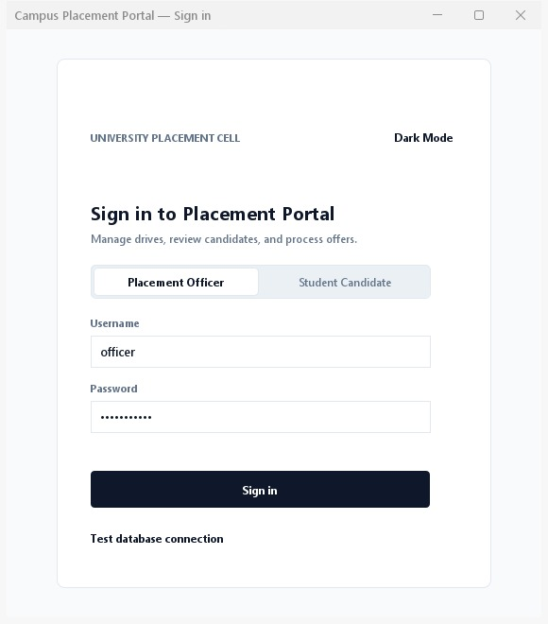
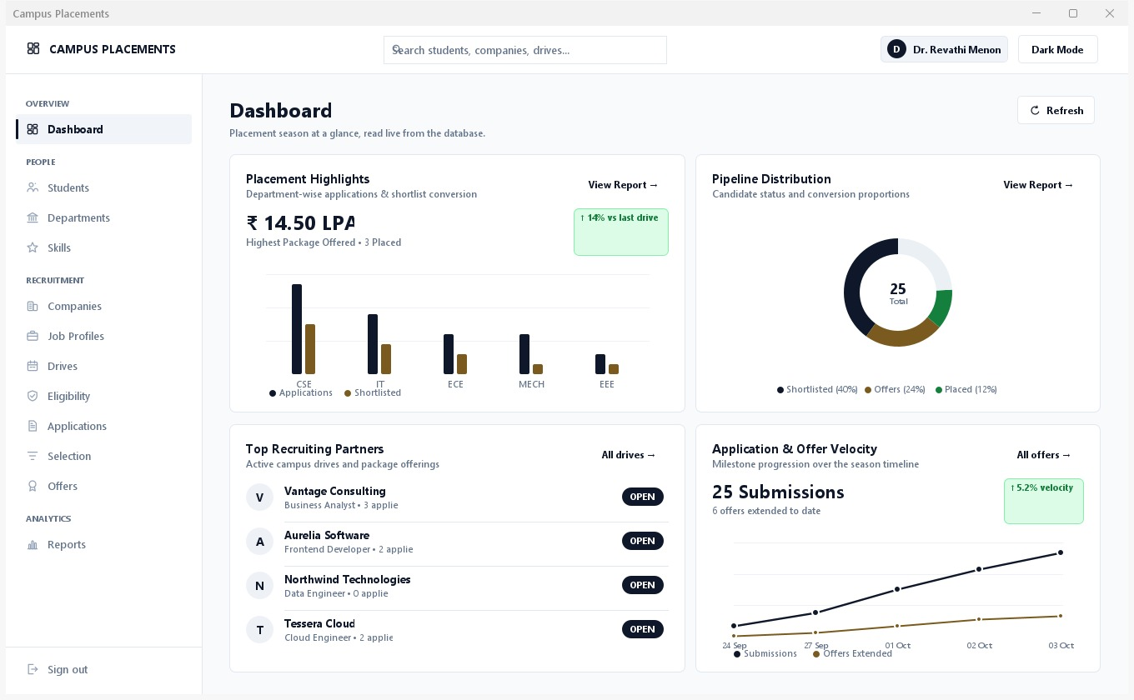
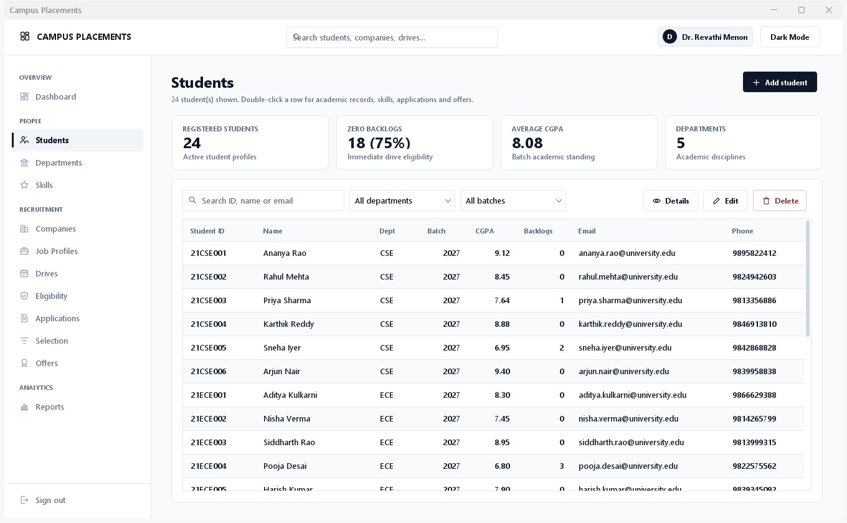
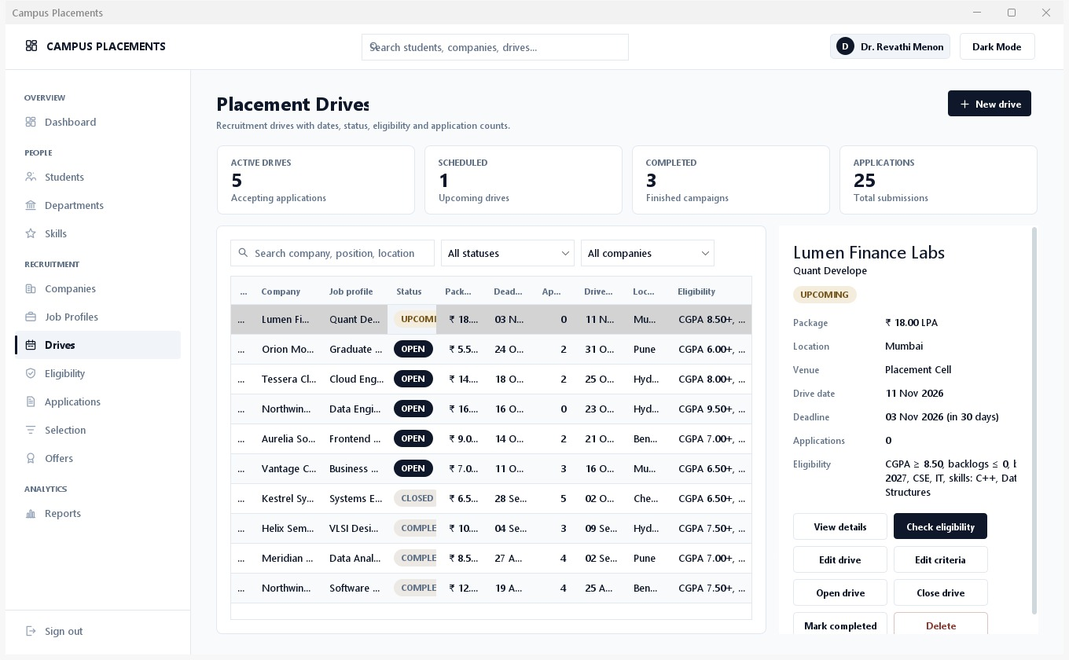
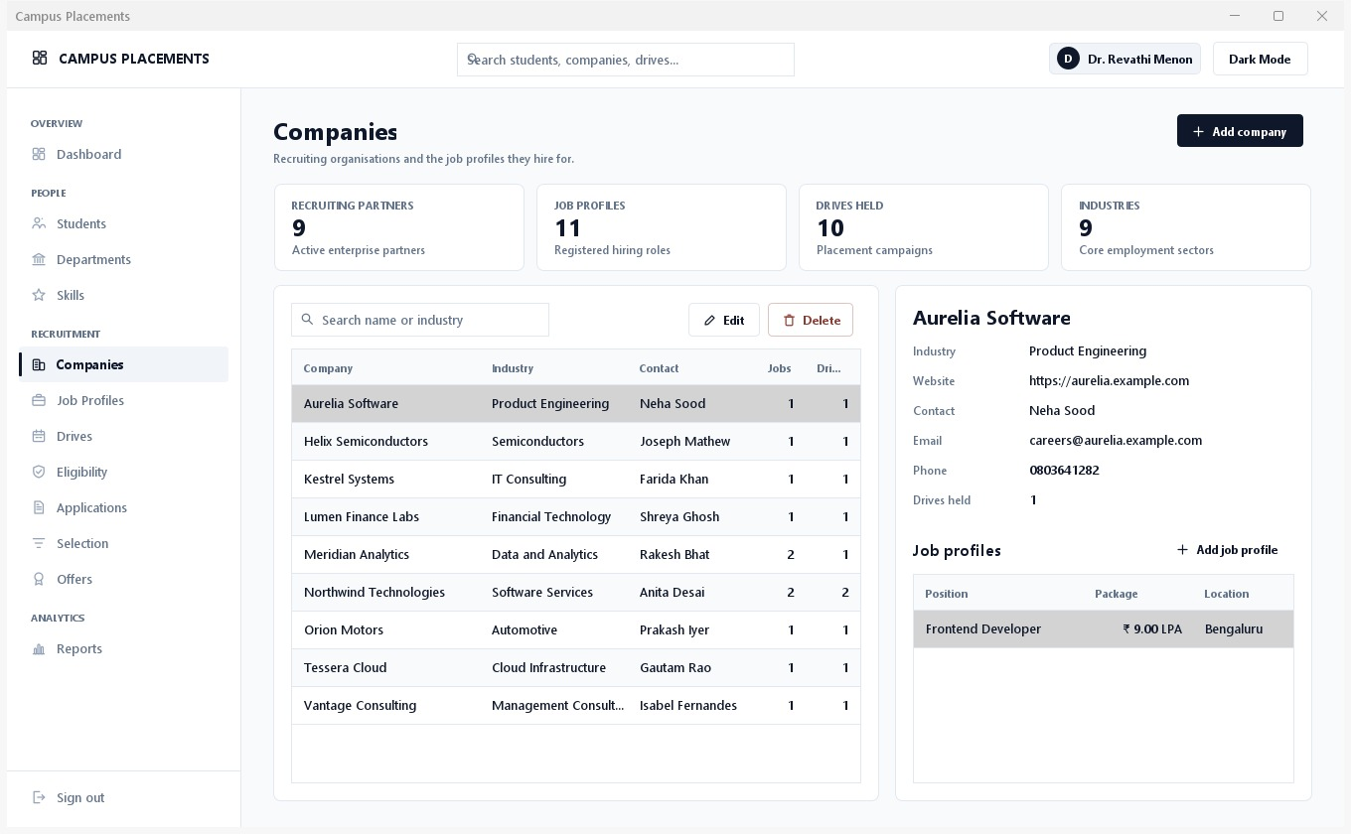
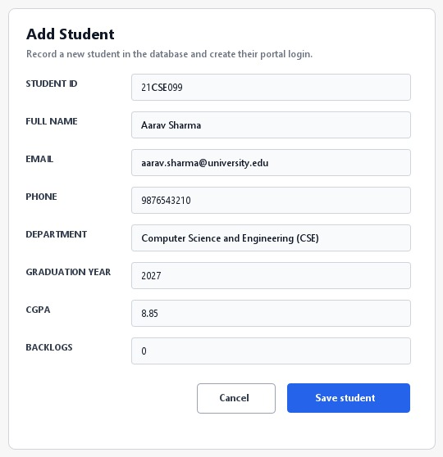
Working system: user interface
DBMS PROJECT
Interface
08 / 10

Slide 9
From login to offer
DBMS PROJECT
01
02
03
04
Workflow
Login
Student / Officer
Manage / View Placement Drives
Eligibility Check
Role-based login
Student and company management
Eligibility checking
Placement drive management
05
06
07
08
Application
Selection Rounds
Result
Offer
Application tracking
Selection round management
Offer management
Placement reports
09 / 10

Slide 10
DBMS PROJECT · CONCLUSION
Conclusion
The system gives a centralized way to manage campus recruitment, integrating Java Swing, JDBC and MySQL across students, companies, drives, applications, rounds and offers.
FUTURE
Web-based version
Cloud deployment
Email/SMS notifications
Resume management
Advanced placement analytics
Thank you. Questions?
10 / 10

