Slide 1

Health Care Analytics - Project Presentation
Section # 2 : Group # 3
Rakesh Baggu
Riddhi Deshpande
Sarabjeet

Slide 2

Prediction of SEPSIS from Clinical Data

Slide 3
Agenda
Reason for choosing Sepsis for our Analysis
Sepsis Symptoms
Objective
Role of Data Analytics
Data Set
Project Flow
Data Visualization
Machine Learning Models
Baseline model metrics
Tuning the model
Results
Challenges
Future Scope
References
Questions

Slide 4
Reason for choosing Sepsis for our Analysis
Sepsis is a life-threatening clinical condition that happens when the patient’s body has an excessive reaction to an infection and should be treated in short span of time(possibly in few hours sometimes).
Due to the urgency of sepsis, doctors and physicians often do not have enough time to perform laboratory tests and analyses to help them forecast the consequences of the sepsis episode.
In this context, machine learning can provide a fast computational prediction of sepsis severity, patient survival, and sequential organ failure by just analysing the vital signs of the patients.

Slide 5

Sepsis Symptoms
Shortness of Breath.
High Heart Rate
Fever/High body Temperatures.
Extreme Pain or Sweating
Clammy or Sweaty Skin

Slide 6
Objective
Sepsis is a major public health concern with significant morbidity, mortality, and healthcare expenses. Early detection and antibiotic treatment of sepsis improve outcomes.
Although professional critical care societies have proposed new clinical criteria that aid sepsis recognition, the fundamental need for early detection and treatment remains unmet.
In response, our objective is to perform analysis of clinical data to derive key insights and to develop the best model for early prediction of the sepsis among patients.

Slide 7

Role of Data Analytics
Identify the Patient key Vital
signs parameters.
Performing Exploratory Data Analysis.
Implement various ML models and pick the best ML model with better metrics depending on the co-related feature variables.
The ML Model can then be used to address the real-world scenarios.

Slide 8

DataSet
Dataset sourced from Physio Net.
Contains :
60,000 ICU Patients data from three
Separate hospital systems.
Feature Variables include Demographics, Vital Signs
and Laboratory values with 43 columns.
Dataset URL is provided in the References section.

Slide 9
Project Flow
Extract the Data.
Transform the Data.
Analyse the Data.
Pick the feature variables with Co-relation.
Visualize the Data.
Pick and Build the ML model.

Slide 10
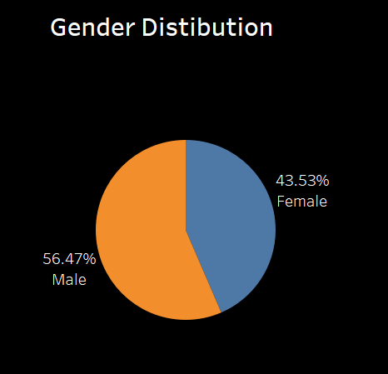
Data Visualization
Observation :
Males -56%
Females - 43%

Slide 11
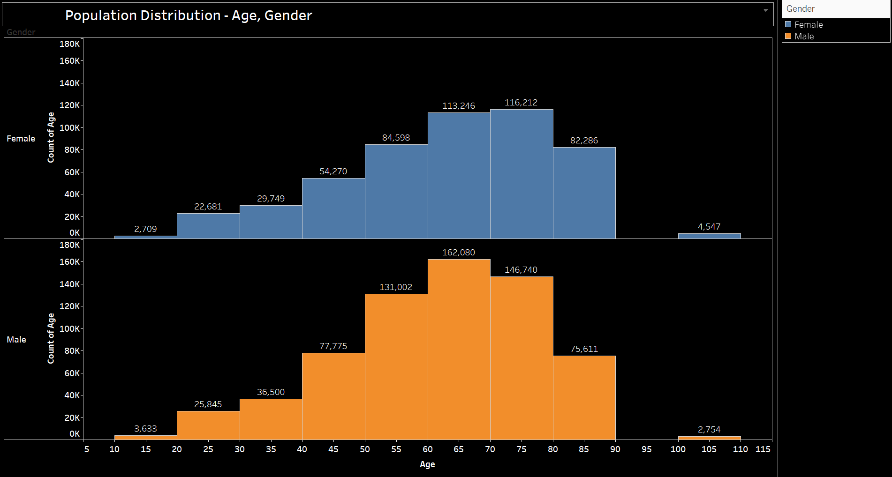

Slide 12
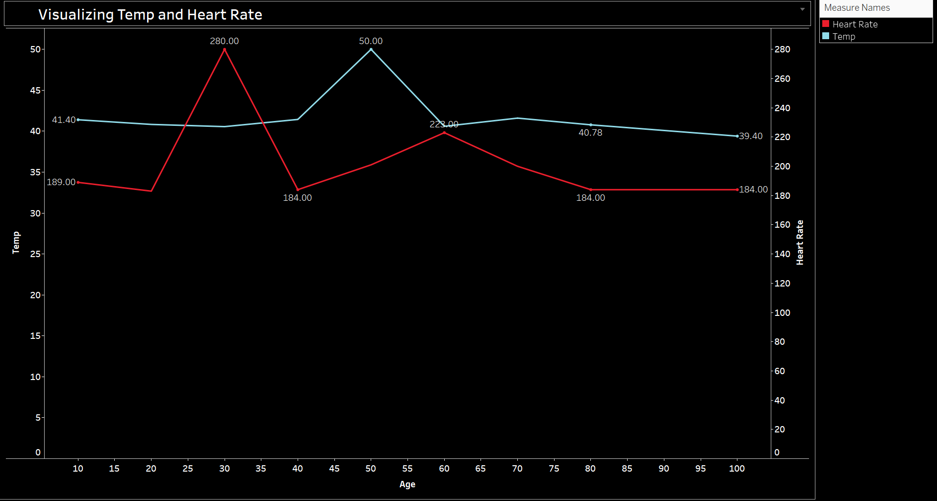
Normal Body Temp - 98.6°F (37°C)
Normal HR - 60 to 100 beats per minute

Slide 13
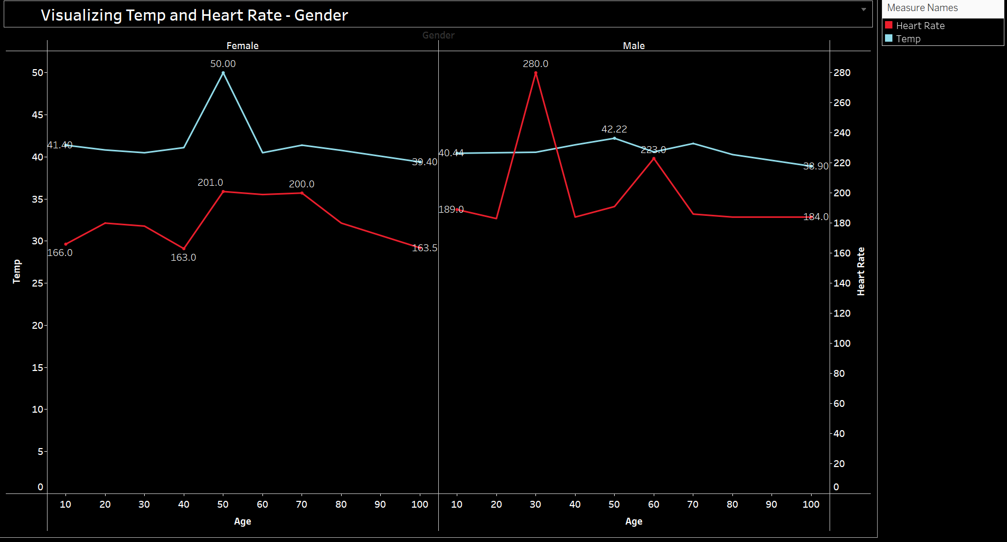

Slide 14
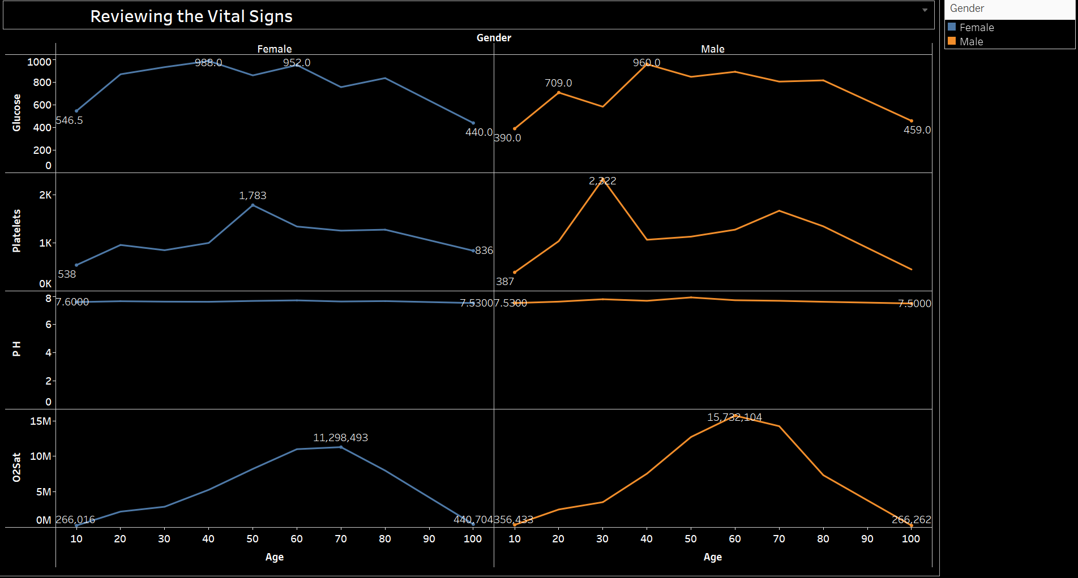

Slide 15
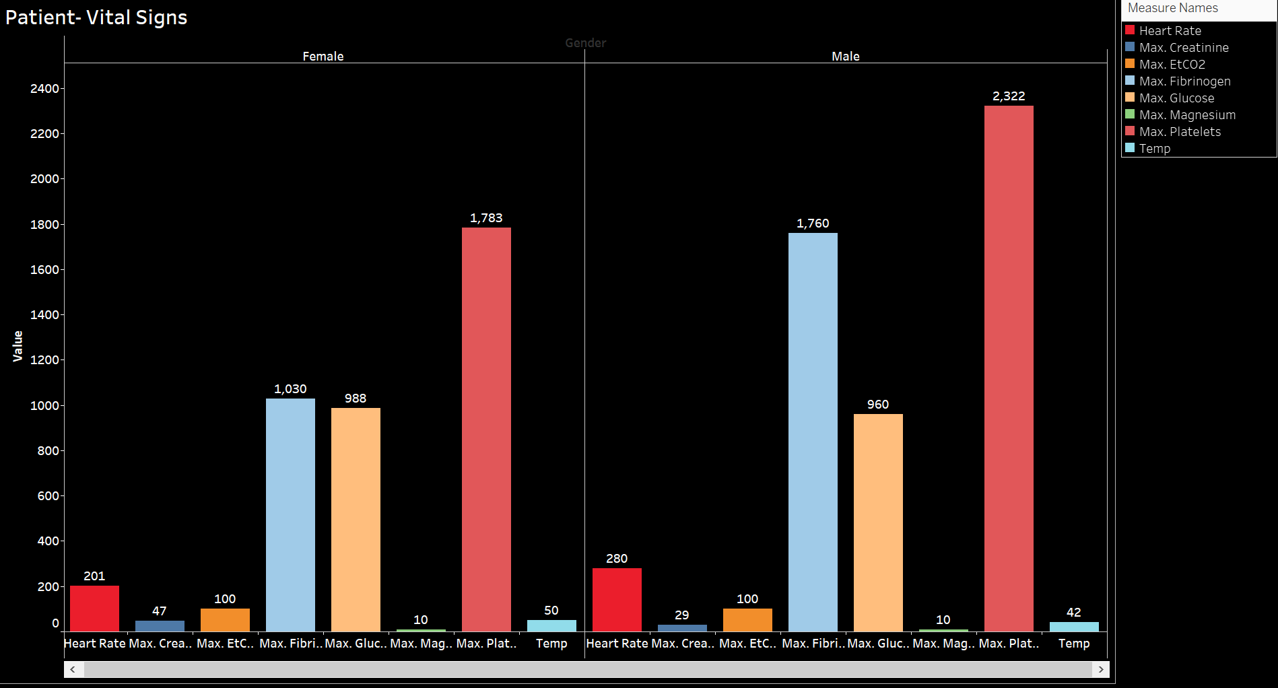

Slide 16
Machine Learning Model/s:
Split Ratio - 80:20
Machine Learning Models | Metrics
ML Model Type | Accuracy | Recall | Precision | F1 Score | Roc_auc
DummyClassifier | 0.981 | 0.5 | 0.019 | 0.495 | 0.5
GaussianNB | 0.966 | 0.516 | 0.032 | 0.517 | 0.614
MultinomialNB | 0.981 | 0.5 | 0.03 | 0.495 | 0.597
DecisionTreeClassifier-Max_depth : 5 | 0.696 | 0.595 | 0.033 | 0.438 | 0.619
DecisionTreeClassifier-min_impurity_decrease=0.01 | 0.831 | 0.545 | 0.022 | 0.474 | 0.545
Logistic Regression, C=0.1, max_iter=1000 | 0.648 | 0.585 | 0.033 | 0.418 | 0.615
Best Model :Decision Tree Classifier | 0.696 | 0.595 | 0.033 | 0.438 | 0.619

Slide 17
Base Line Model Metrics
Accuracy: 0.964584044223026
Precision_score: 0.1302149178255373
Recall score: 0.14458676960870329
F1 score: 0.1370250270225326
Higher precision means that an model returns more relevant results than irrelevant ones, and high recall means that a model returns most of the relevant results.
Accuracy : The number of classifications a model correctly predicts divided by the total number of predictions made.
Higher Recall score means that every result retrieved by a search was relevant.

Slide 18
Tuning the ML Model
criterion=entropy
max_depth=3
Achieved an Accuracy of 98%.
Tree depth is a measure of how many splits a tree can make before coming to a prediction.
Entropy helps us to build an appropriate decision tree for selecting the best splitter. Entropy can be defined as a measure of the purity of the sub split. Entropy always lies between 0 to 1.

Slide 19
Results
Fed the patient vital signs inputs features to the model and it accurately predicts the Target Variable(disease outcome) in a binary value('0' or '1').

Slide 20
Challenges
Finding the appropriate dataset
Missing values from the data.

Slide 21

Future Scope
Future work can include performing prospective clinical trials to validate and use ML Model predictions in a real-time clinical setting.
Develop an application interface using Flask /AWS Simplify integrating ML to predict sepsis outcome which can be used in Real-time clinical setting.

Slide 22
References
https://physionet.org/content/challenge-2019/1.0.0/ https://archive.physionet.org/challenge/2019/
https://journals.lww.com/ccmjournal/fulltext/2020/02000/early_prediction_of_sepsis_from_clinical_data__the.10.aspx
https://www.frontiersin.org/articles/10.3389/fmed.2021.607952/full
https://www.hindawi.com/journals/cin/2021/6522633/
Data Set URL:
Early Prediction of Sepsis from Clinical Data -- the Physio Net Computing in Cardiology Challenge 2019 v1.0.0
7. https://www.nature.com/articles/s41746-021-00504-6

Slide 23
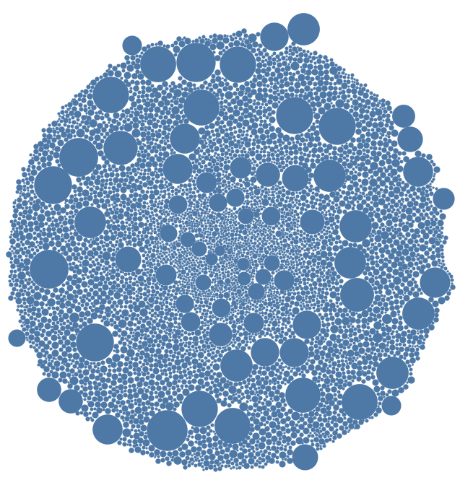
Population Distribution

Slide 24

Questions

Slide 25
Thank you

