Slide 1
DevOps Practical | Activity 9
Containerized REST API for Student Records
Python • FastAPI • SQLite • Docker
Riddhi Gopalani (34124) Om Mahajan (34140)
Sudhan Dabhade (34118) Pratik Kalburgi (34130)

Slide 2
Problem Statement & Objectives
Build a simple REST API that supports adding, viewing, and updating student records. Package the application into a Docker container and demonstrate that it can be started, stopped, and recreated without manually configuring the host environment.
• Build a REST API to add, view and update student records
• Store data in SQLite and keep it in a Docker volume
• Write a Dockerfile and publish port 8000
• Demonstrate docker stop / start / restart / rm / run
• Test the API and show data survives container recreation
2

Slide 3
Technology Stack
Python 3.13
FastAPI
Uvicorn
Programming language
REST framework + Swagger docs
ASGI server
SQLite
Docker
Pytest
File-based database
Image, container, volume
Automated testing
3

Slide 4
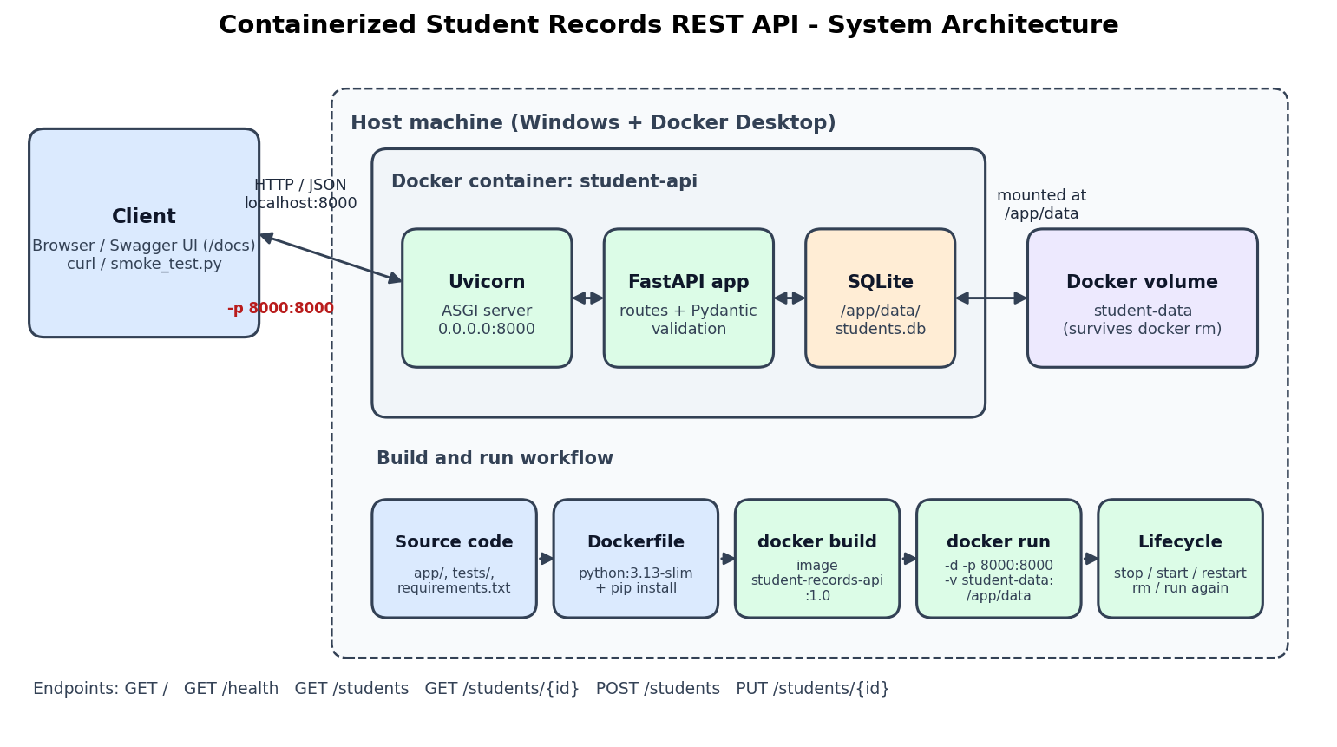
System Architecture
4

Slide 5
API Endpoints
Method | Endpoint | Purpose | Status codes
GET | / | Welcome message and list of endpoints | 200
GET | /health | Health check (also used by Docker HEALTHCHECK) | 200
GET | /students | View all students | 200
GET | /students/{student_id} | View one student by ID | 200 / 404
POST | /students | Add a new student | 201 / 409 / 422
PUT | /students/{student_id} | Update an existing student | 200 / 404 / 409 / 422
Fields: id, name, roll_no (unique), department, email
Errors: 404 missing student • 422 invalid input • 409 duplicate roll number
5

Slide 6
Docker Configuration
FROM python:3.13-slim
ENV PYTHONDONTWRITEBYTECODE=1 \
PYTHONUNBUFFERED=1 \
DB_PATH=/app/data/students.db
WORKDIR /app
COPY requirements.txt .
RUN pip install --no-cache-dir -r requirements.txt
COPY app/ ./app/
COPY tests/ ./tests/
COPY pytest.ini .
RUN mkdir -p /app/data
VOLUME ["/app/data"]
EXPOSE 8000
HEALTHCHECK --interval=30s --timeout=5s --start-period=10s --retries=3 \
CMD python -c "import urllib.request; urllib.request.urlopen('http://localhost:8000/health')" || exit 1
CMD ["uvicorn", "app.main:app", "--host", "0.0.0.0", "--port", "8000"]
Build and run
docker build -t student-records-api:1.0 .
docker run -d --name student-api
-p 8000:8000
-v student-data:/app/data
student-records-api:1.0
• -p 8000:8000 host port → container port
• -v volume keeps students.db outside the container
• --host 0.0.0.0 reachable from outside
• HEALTHCHECK shows (healthy) in docker ps
6

Slide 7
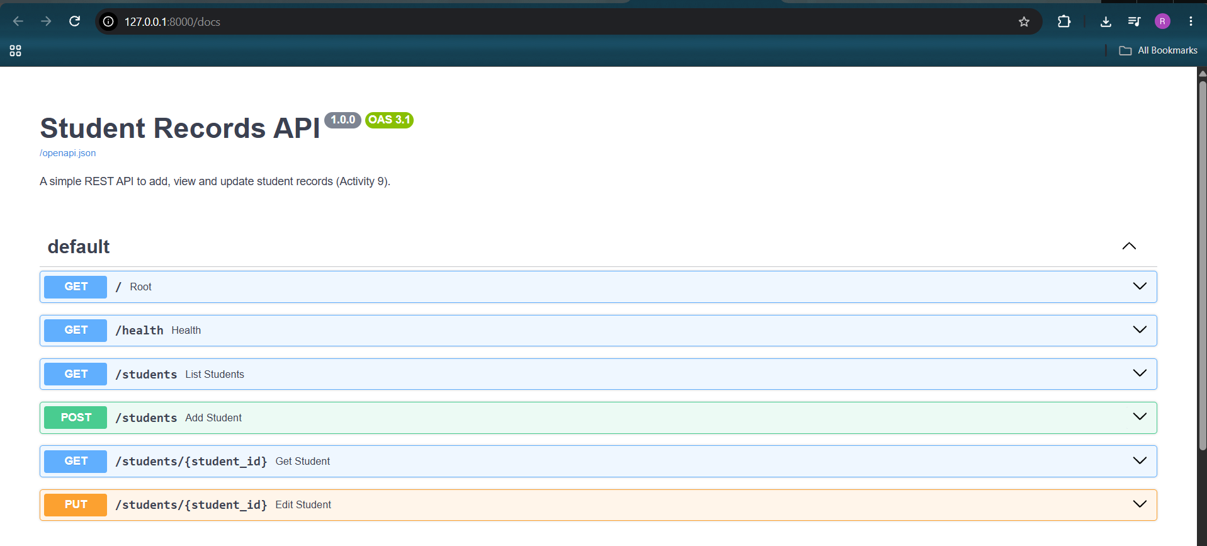
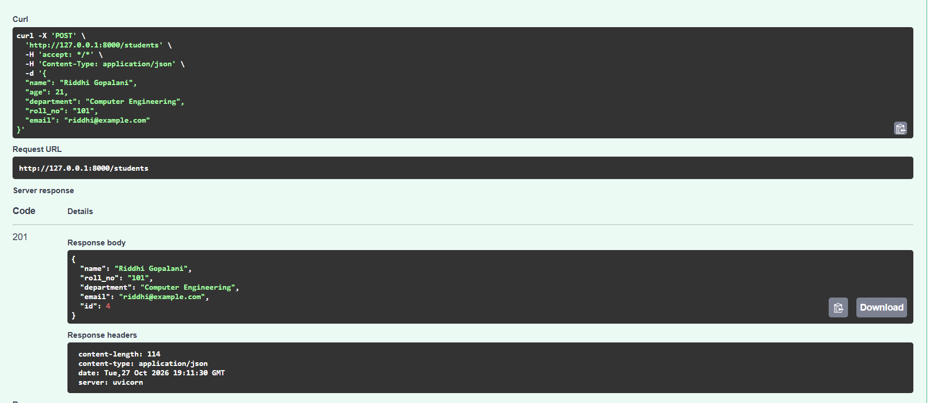
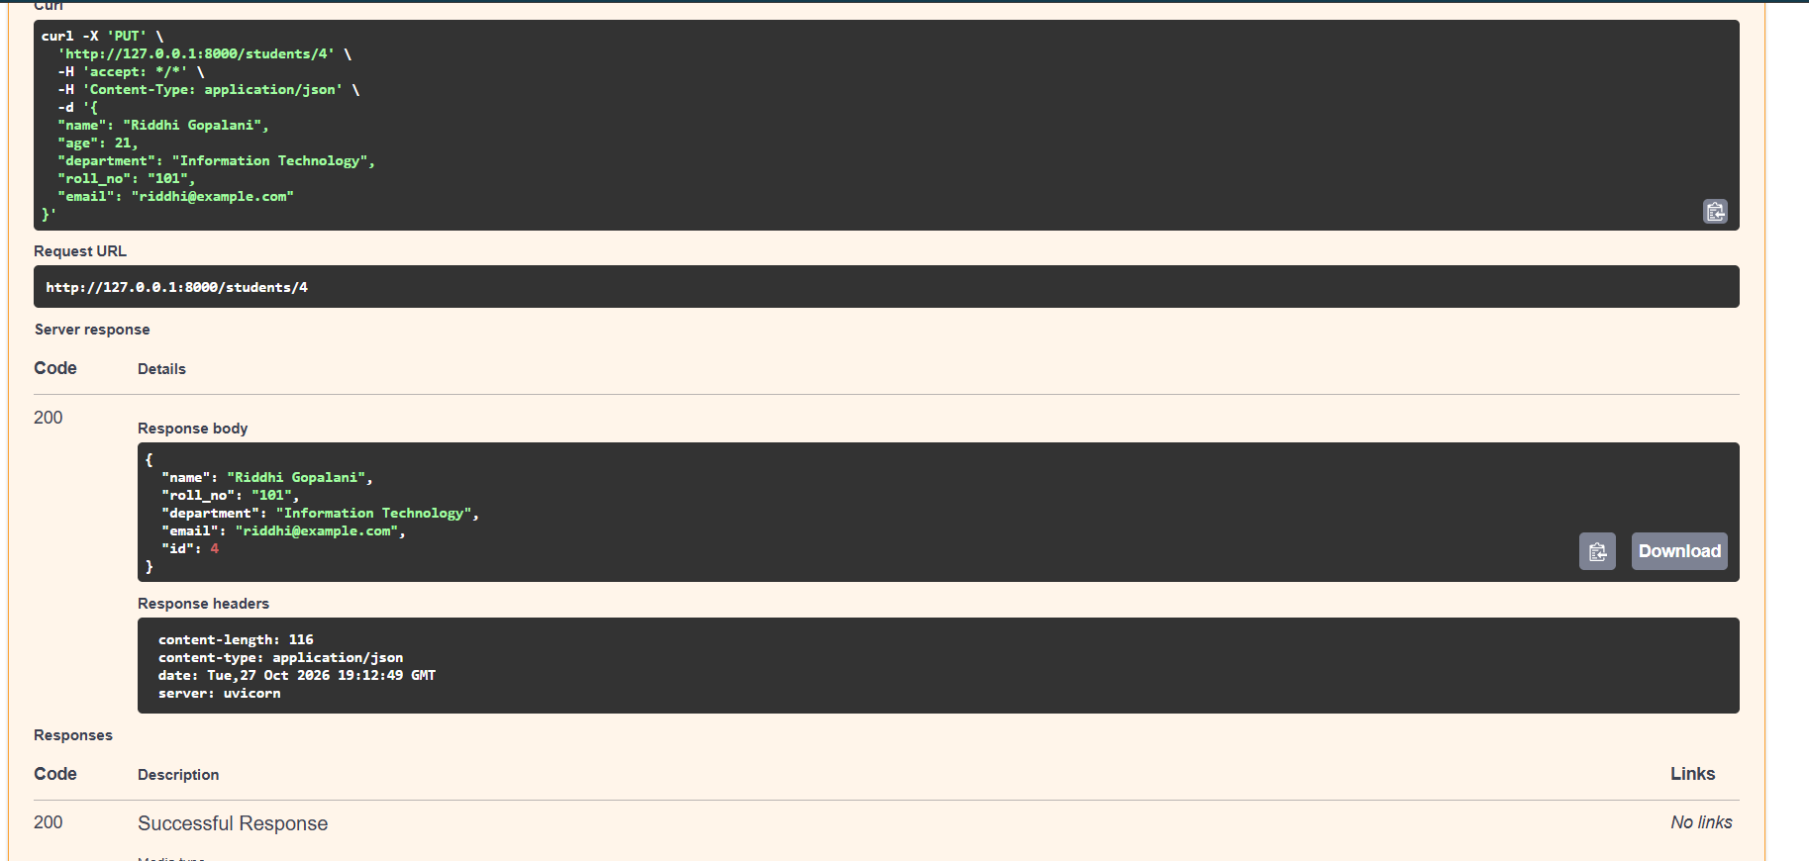
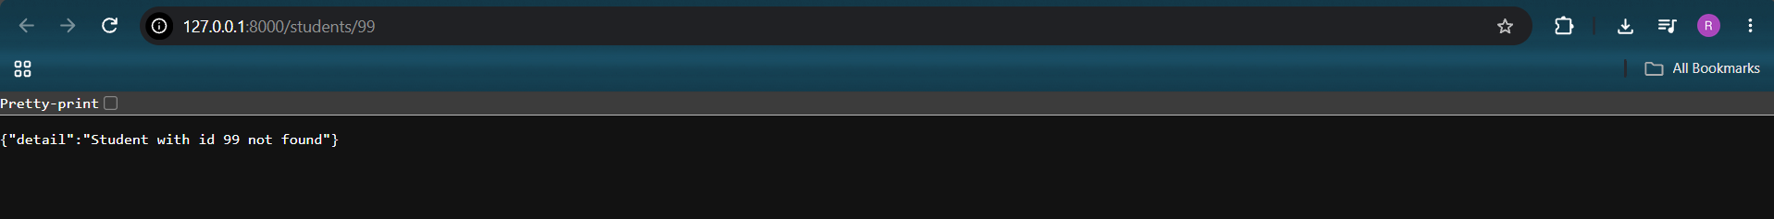
API Demo - Swagger UI
Swagger docs at /docs
POST /students → 201 Created
GET /students/99 → 404 Not Found
PUT /students/4 → 200 OK
7

Slide 8
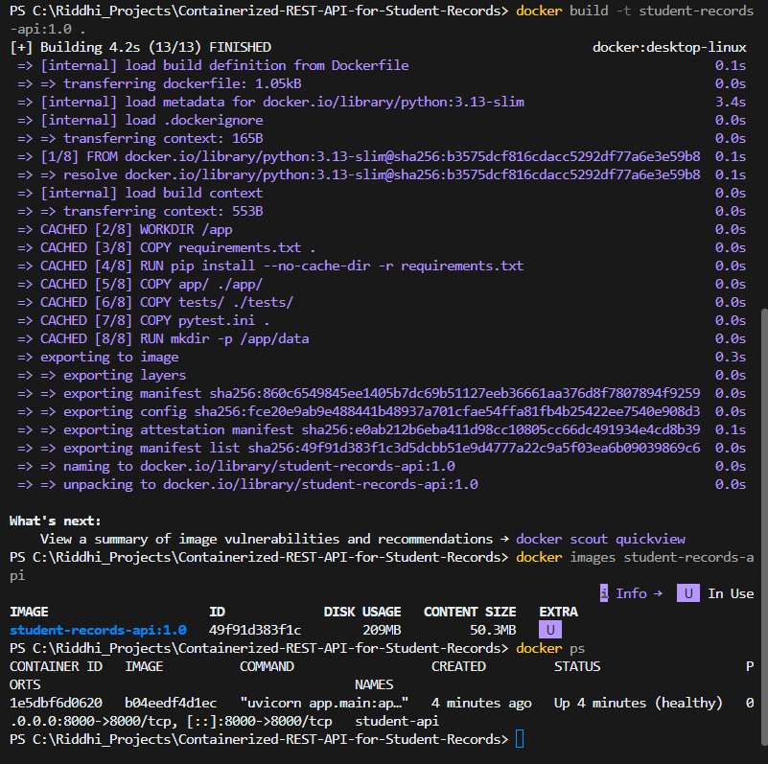
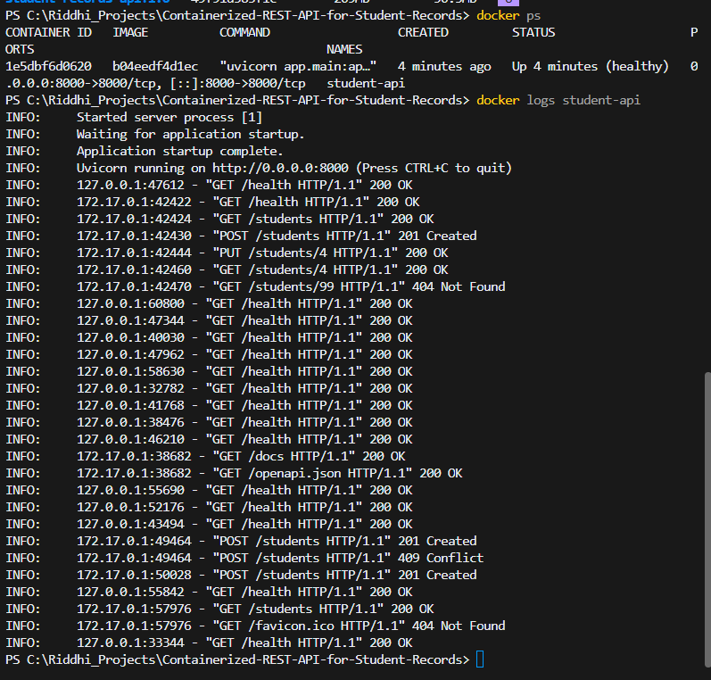
Docker Image and Running Container
docker build, docker images, docker ps
docker logs student-api
8

Slide 9
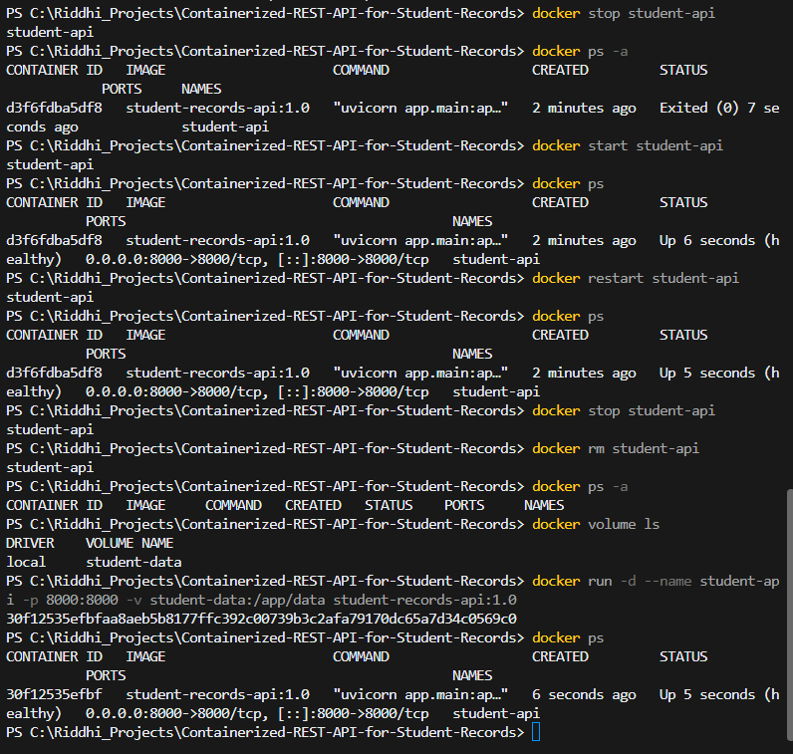
Container Lifecycle & Data Persistence
• docker stop → status Exited (0)
• docker start → Up (healthy)
• docker restart → Up 5 seconds
• docker rm → container gone, volume student-data still listed
• docker run → new container ID 30f12535efbf
• All student records still available after recreation
9

Slide 10
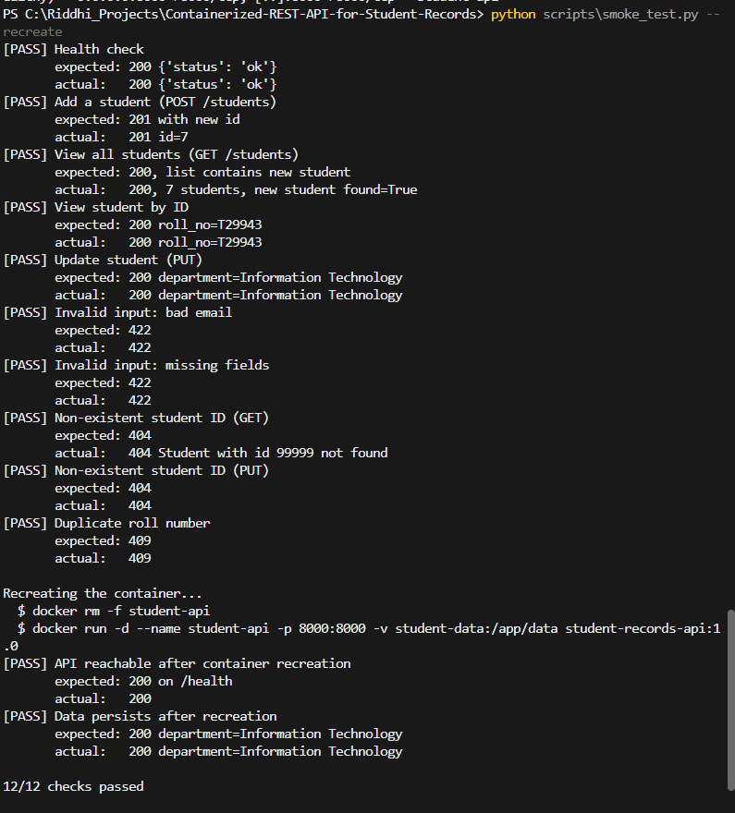
Testing Results
Test | Result | Status
Add / view all / view by ID / update | 201 / 200 | Pass
Invalid input (bad email, missing fields, bad ID) | 422 | Pass
Student ID does not exist (GET, PUT) | 404 | Pass
Duplicate roll number | 409 | Pass
API after docker rm + run | 200 | Pass
Data persists after recreation | Same record | Pass
Pytest - host and container | 11 passed | Pass
10

Slide 11
Troubleshooting
Problem | Solution
Docker engine not running | Started Docker Desktop and waited until the engine was running.
Wrong fields in the POST request | Sent all required fields (name, roll_no, department, email). The request then returned 201 Created. Extra fields like age are simply ignored.
Slow first image build | requirements.txt is copied and installed before the app code, so Docker caches that layer. Later builds took about 4 seconds (Fig. 10 shows the CACHED steps).
Git Bash changes container paths | Ran the command in PowerShell instead, or used MSYS_NO_PATHCONV=1 in Git Bash.
PowerShell removes nested quotes | Avoided nested quotes in PowerShell and used Git Bash or a script file for such commands.
Port 8000 already in use (precaution) | Stopped the local server with Ctrl+C before starting the container.
11

Slide 12
Individual Contributions
Member | Roll No. | Work done
Riddhi Gopalani | 34124 | GitHub setup, FastAPI endpoints, SQLite database, validation, volume persistence, demo and commits
Om Mahajan | 34140 | Dockerfile, .dockerignore, port mapping, image build, lifecycle demonstration
Sudhan Dabhade | 34118 | Pytest test cases, smoke test script, test execution and troubleshooting notes
Pratik Kalburgi | 34130 | Project report, presentation, architecture diagram and README
12

Slide 13
Conclusion
• Built a working REST API for student records with FastAPI and SQLite
• Packaged it as a Docker image - no Python setup needed on the host
• Container can be stopped, started, removed and recreated with simple commands
• Docker volume keeps the data safe across container recreation
• All 15 test cases passed
https://github.com/RiddhiGopalani/Containerized-REST-API-for-Student-Records
13

