Slide 1
Mimic Human Level Understanding of Image
by
ANIKET SINGH (519) | RHITAZA JANA (554) | RIDDHICK DALAL (504)
Under the guidance of
Dr. Sonali Sen
(Assoc. Professor, Postgraduate & Research Department of Computer Science)
Department of Computer Science,
St. Xavier’s College, Kolkata

Slide 2
Introduction
This project’s goal is to enable computers to mimic human-level image understanding by generating concise and meaningful image descriptions.
This model’s aims generates concise image descriptions, by capturing semantic meaning, object relationships, using GCN and MultiHead Self Attentions and Multi head Cross Attention.
The project has broad applications in content recommendation, autonomous driving, healthcare, and accessibility such as a transformative tool for visually impaired individuals, providing detailed environmental descriptions and enhancing safety.

Slide 3
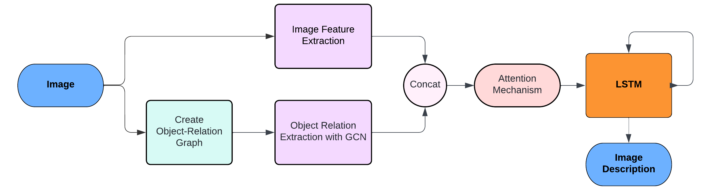
Sequence to Sequence Image Descriptions Architecture Model
Image Encoding
Text Decoding

Slide 4
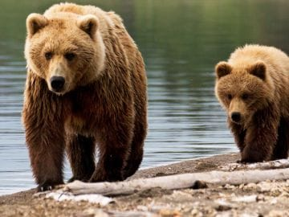
Object Relationship Graph GCN
We Construct a graph to define the relation between different objects in same image, where:
Each node is representing an Object.
Assign each object features to each node, representing characteristics of the corresponding object.
Define edges between objects that has overlapping bounding box over a threshold
The edge of the graph represents the relative relationship between objects.
Bear
Bear Cub
Land
Water Body
log
GCN
GCN
Relation Analysis using GCN

Slide 5
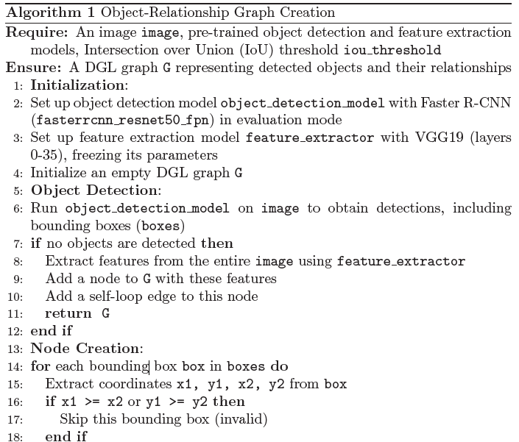
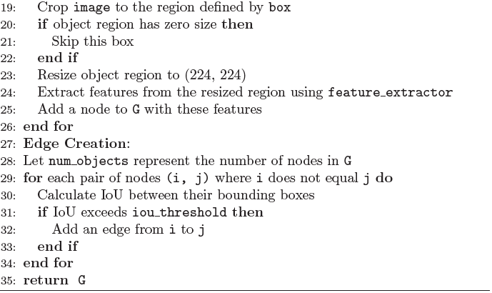
Image Object Detection and Feature Extraction to create the Image Graph

Slide 6
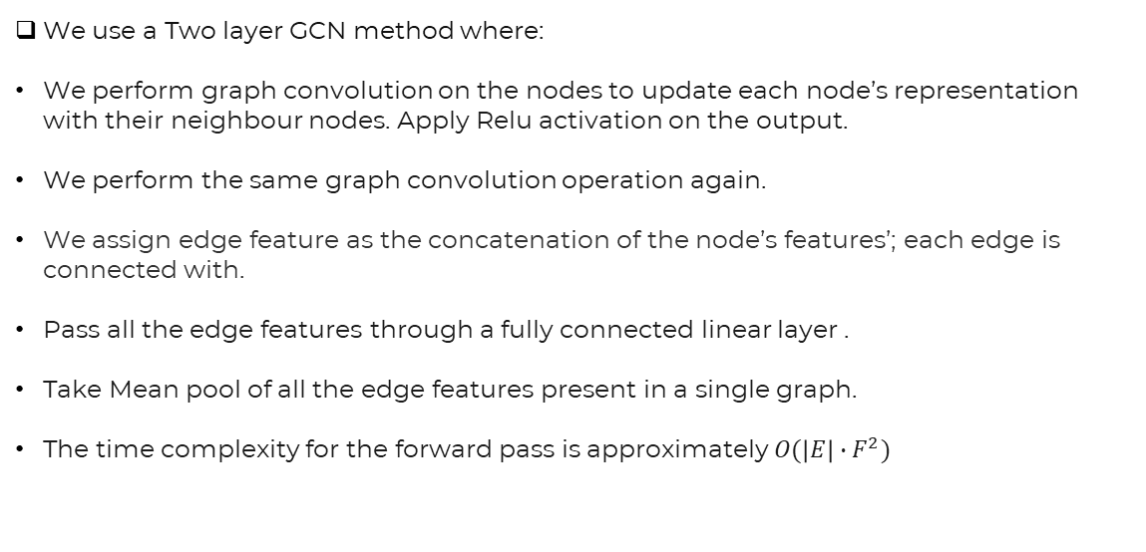
Object relation Feature Extraction With GCN
We use a Two layer GCN method where:
We perform graph convolution on the nodes to update each node’s representation with their neighbour nodes. Apply Relu activation on the output.
We perform the same graph convolution operation again.
We assign edge feature as the concatenation of the node’s features’; each edge is connected with.
Pass all the edge features through a fully connected linear layer .
Take Mean pool of all the edge features present in a single graph.
The time complexity for the forward pass is approximately $O(\left|E\right|∙F^{2})$

Slide 7
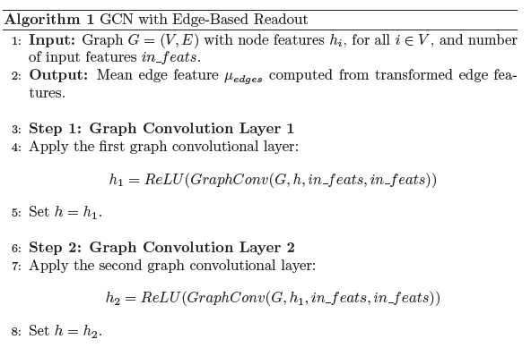
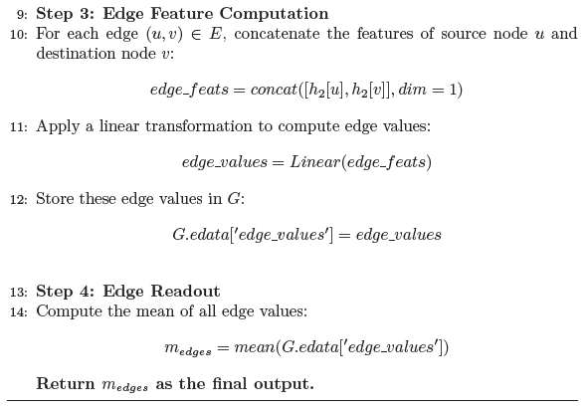
Object relation Feature Extraction With GCN (Cont.)

Slide 8
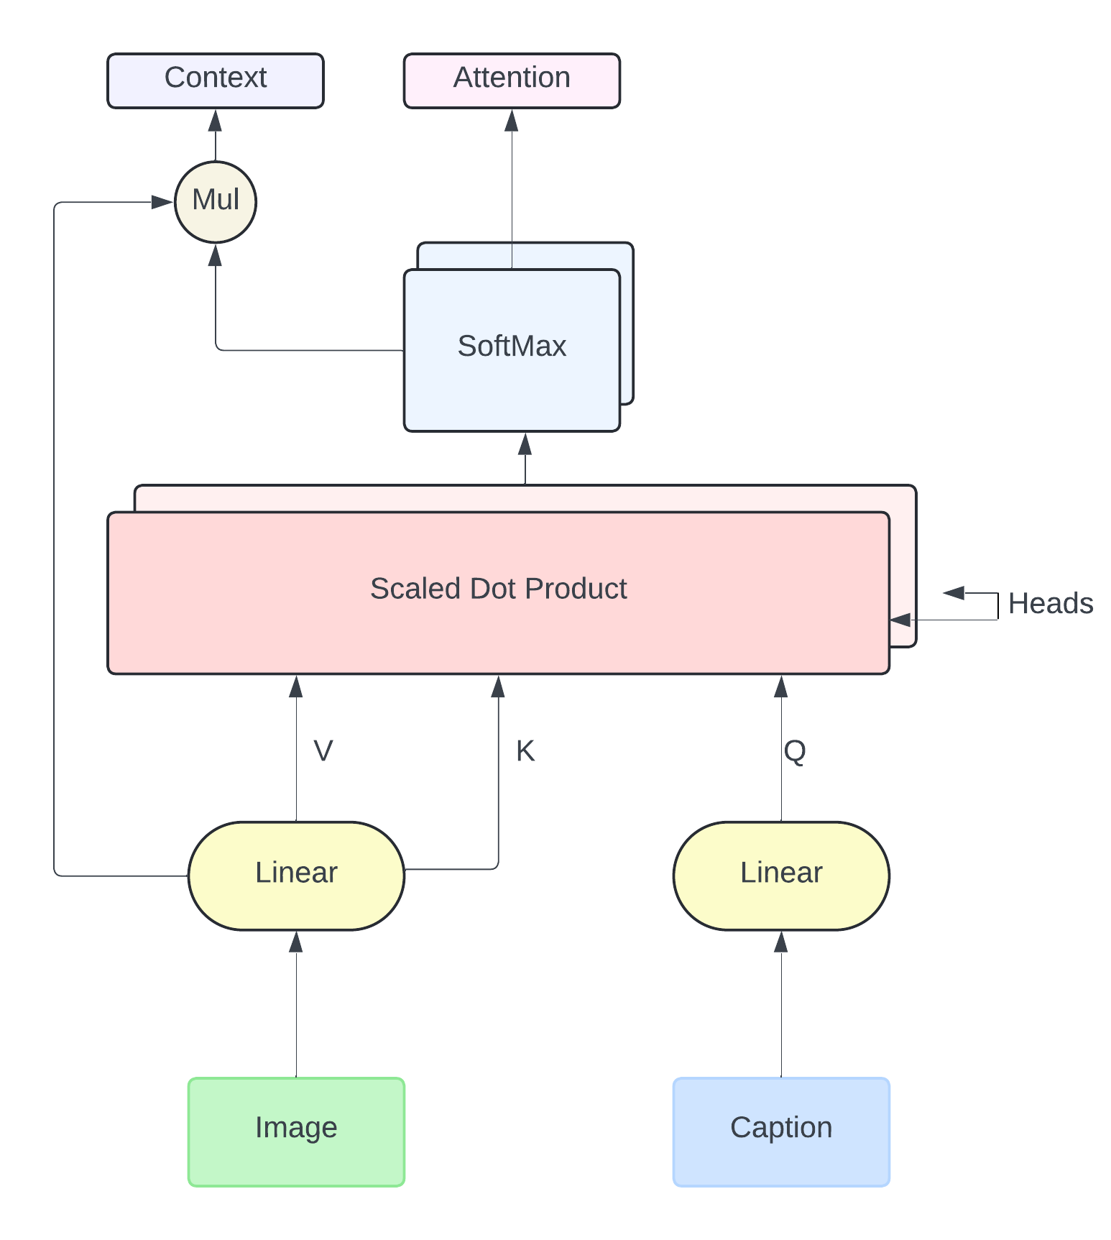
Attention Based Decoder
We use a Dual Attention methods Inspired from the use of attention in transformer Models
We propose use of Multi Head Self Attention and Multi Head Cross Attention.
Using Self Attention, we try to understand the context of the caption texts.
We use Cross Attention to get the context of the image [Key(K)] with respect to the Caption [Query (Q)].
We use 2 heads where each head operates independently
Output of LSTM goes to a fully connected layer with SoftMax activation Function.
Multi Head Cross Attention

Slide 9
Attention Based Decoder (cont.)
We advocate for the use of multiple heads because:
By having multiple heads, each head can focus on different aspects or regions of the image.
By splitting the attention process into multiple independent heads, the model can discover a broader set of relationships and interactions within the data, leading to improved generalization and performance.
This is useful in this scenarios where you would want to capture different semantic or contextual meanings from the same image.
After obtaining the context from both attention mechanisms we pass the data through a LSTM.
The LSTM learns the mapping of image and text context input, to predict the correct next word.

Slide 10
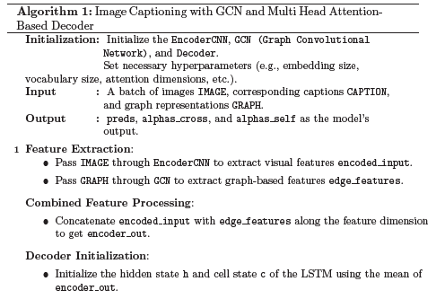
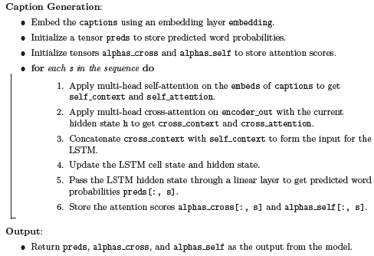
Complete Caption Generation Algorithm

Slide 11
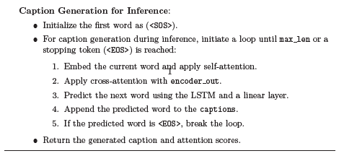
Caption Generation
To generate caption, we send the image along with its Object Relation Graph through the model.
We create a caption list and add the start token.
We pass the image and the caption embedding through the attention layers and the LSTM layer.
We take the word with highest prediction.
Continue this until max length of sentence or end token is reached.
Algorithm for caption generation

Slide 12
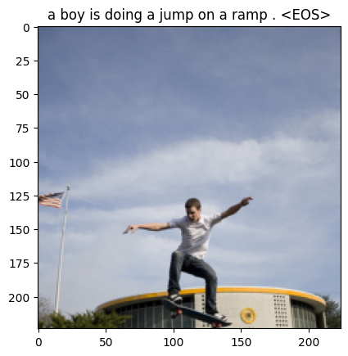
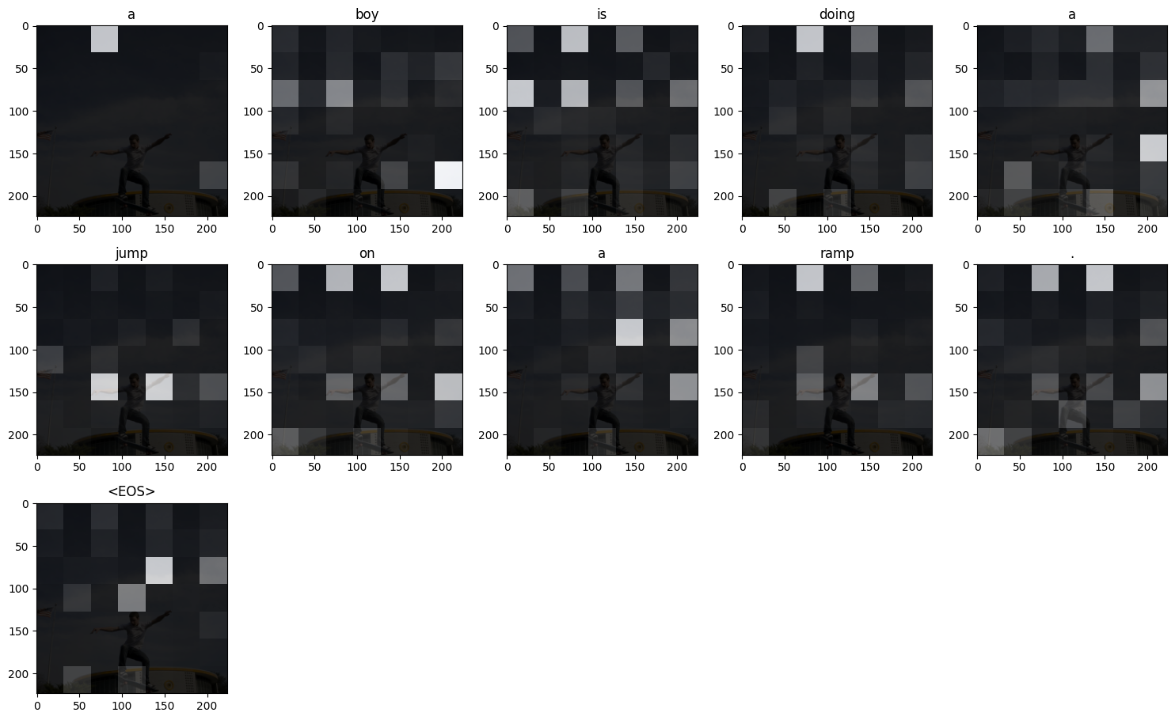
Results
Image Description
Visualization of Attention
Output 1

Slide 13
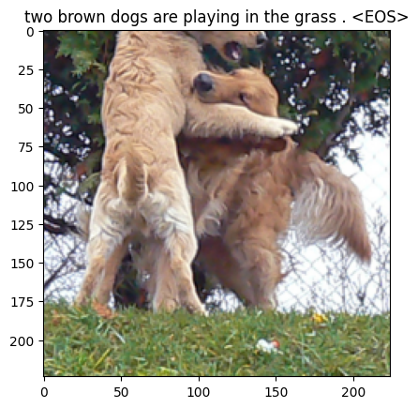
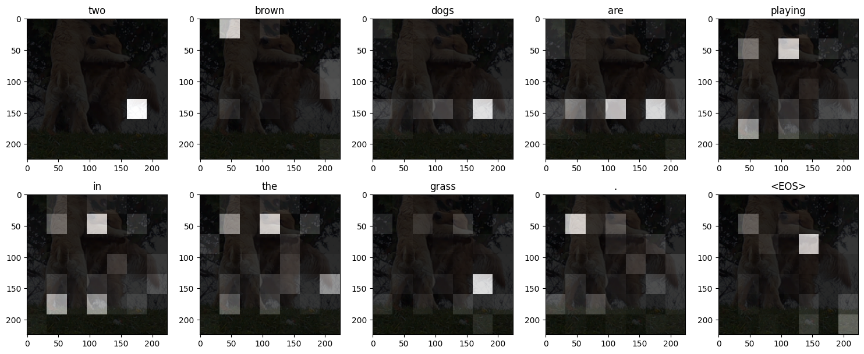
Results(Cont.)
Image Description
Output 2
Visualization of Attention

Slide 14
Limitations
Not Able to Recognize Colour and other image attributes.
Due use a dataset of only 8000 images still not able to correctly recognize Different human postures and genders.
Prediction is Limited to the Vocabulary used to train the model.
As we used pretrained object detector only able to detect 90 classes of objects.
May not detect object relations in the image, if their bounding box is not overlapping.
Due Implementation of Attention mechanism, the model losses any positional information from the data used to train it.
Prediction is volatile.

Slide 15
Future Scope
Train with larger datasets like MSCOCO of flicker30k for better prediction on unknown images.
Use of larger vocabulary to cover the unknow words.
For better results, a custom description data should be used, which will describe the images in more detail.
Custom-train the Faster R-CNN to identify more objects in the image.
Better Feature detection to keep the image attributes.
Pre Train a Scene Graph Generation Network using <subject, predicate, object> tuples dataset.

Slide 16
Conclusion
our project has demonstrated the utility and effectiveness of GCN combined with attention mechanisms to generate descriptions for images.
We have leveraged the relationships of different objects in image, where the GCN has enabled us to capture complex contextual dependencies .
The Multi Head Attention mechanisms has allowed our model to capture more patterns and contexts.

Slide 17
References
Sasibhooshan, R., Kumaraswamy, S. &amp; Sasidharan, S. Image caption generation using Visual Attention Prediction and Contextual Spatial Relation Extraction. J Big Data 10, 18 (2023). https://doi.org/10.1186/s40537-023-00693-9
L. Li, S. Tang, Y. Zhang, L. Deng, and Q. Tian,; GLA: Global–Local Attention for Image Description; in IEEE Transactions on Multimedia, vol. 20, no. 3, pp. 726-737, March 2018, doi: 10.1109/TMM.2017.2751140.
Jiang, W., Ma, L., Jiang, YG., Liu, W., Zhang, T. (2018). Recurrent Fusion Network for Image Captioning. In: Ferrari, V., Hebert, M., Sminchisescu, C., Weiss, Y. (eds) Computer Vision – ECCV 2018. ECCV 2018. Lecture Notes in Computer Science(), vol 11206. Springer, Cham. https://doi.org/10.1007/978-3-030-01216-8_31
Yao, Ting, et al; Exploring visual relationship for image captioning Proceedings of the European Conference on Computer Vision (ECCV). 2018.
Fu, Kun, et al.; Aligning where to see and what to tell: Image captioning with region-based attention and scene-specific contexts; IEEE Transactions on Pattern Analysis and Machine Intelligence 39.12 (2016): 2321-2334.
L. Huo, L. Bai and S. -M. Zhou; Automatically Generating Natural Language Descriptions of Images by a Deep Hierarchical Framework; in IEEE Transactions on Cybernetics, vol. 52, no. 8, pp. 7441-7452, Aug. 2022, doi: 10.1109/TCYB.2020.3041595.
Xia, X., Wang, L., Ding, K., Xiang, S., & Pan, C., 2019, Dense semantic embedding network for image captioning, http://www.elsevier.com/locate/patcog
Krause, J., Johnson, J., Krishna, R., & Fei-Fei, L. A Hierarchical Approach for Generating Descriptive Image Paragraphs. At the Conference on Computer Vision and Pattern Recognition(CVPR), 2017
Al-Malla, M. A., Jafar, A., & Ghneim, N. Image captioning model using attention and object features to mimic human image understanding, Journal of Big Data (2022) https://doi.org/10.1186/s40537-022-00571-w
J. Johnson, A. Karpathy, and L. Fei-Fei. DenseCap: Fully Convolutional Localization Networks for Dense Captioning. In CVPR, 2016.
Vaswani, A., Shazeer, N., Parmar, N., Uszkoreit, J., Jones, L., Gomez, A.N., Kaiser, Ł. and Polosukhin, I., 2017. Attention is all you need. Advances in neural information processing systems, 30.

Slide 18
Thank You

