Slide 1
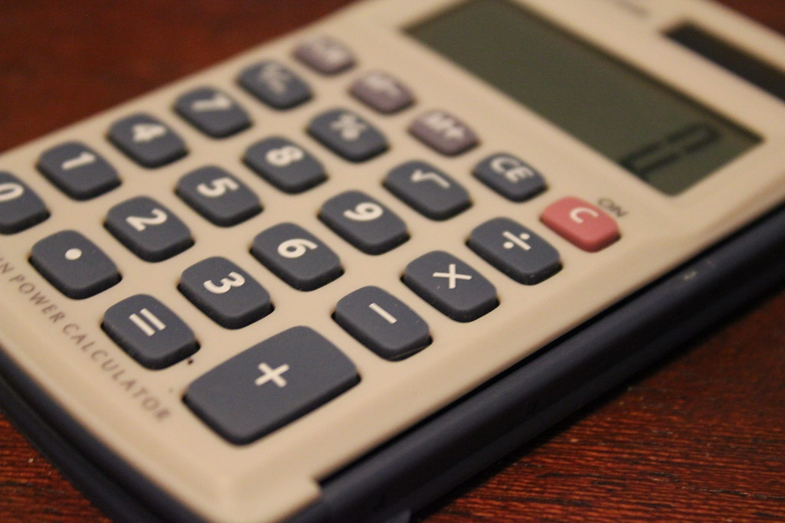
Python-based calculator
NEXTHIKES IT Solutions
A Tkinter-based calculator is a simple Python GUI application for performing basic arithmetic operations. It features a user-friendly interface with buttons for numbers and operators, an entry display, and event handling for calculations.

Slide 2

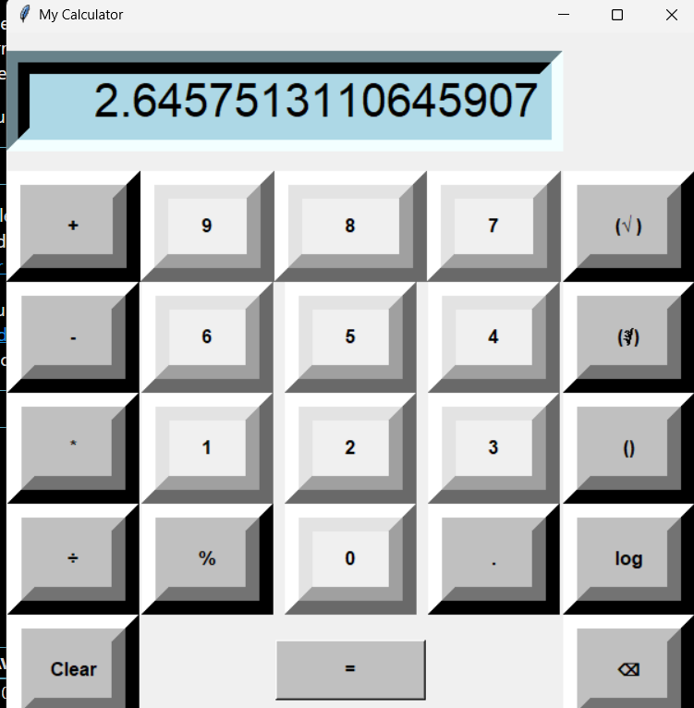
Additional Functionalities
Enhanced Calculator Features:
Logarithm (log): Calculates the logarithm of a number to a specified base.
Small Brackets (): Allows prioritization of operations for accurate calculations.
Percentage (%): Computes percentages for quick financial and mathematical evaluations.
Square Root (√): Finds the square root of a given number.
Cube Root (∛): Computes the cube root of a number for advanced calculations.

Slide 3
Main Strengths of the Calculator Application
User-Friendly Interface
Efficient Functionality
Designed using Tkinter, the interface is intuitive with buttons for digits and operations, making it easy to use for all users.
Performs accurate arithmetic operations (addition, subtraction, multiplication, division) instantly, ensuring smooth calculations
Error Handling & Validation
Customization & Extendability
Includes built-in error handling (e.g., division by zero) to prevent crashes and show meaningful error messages to the user.
Easily customizable to add more features like scientific functions, with a flexible structure that supports future improvements

Slide 4

Challenges Faced in the Project
Designing the GUI Layout
Handling User Input
Error Handling for Edge Case
Challenge: Arranging buttons and labels in a way that was both user-friendly and visually appealing, while ensuring the layout was responsive.
Solution: Leveraged Tkinter’s grid and pack geometry managers for a well-organized and intuitive layout.
Challenge: Managing diverse user inputs (e.g., numbers, operators) without errors, especially preventing invalid characters or multiple operators.
Solution: Implemented input validation and error handling to ensure smooth input processing.
Challenge: Preventing crashes when users performed actions like division by zero or inputting large values.
Solution: Used try-except blocks to manage errors and displayed helpful messages to users without crashing the app.

Slide 5
Research & Learnings from the Project
Tkinter Documentation
Explored Tkinter’s official docs to understand GUI components and layout management.
Python Error Handling
Researched error handling techniques (e.g., try-except) to manage runtime errors.
UI Design Principles
Reviewed UI design resources to ensure a clean, user-friendly interface for the calculator.
01
02
03
04
05
Mathematical Algorithms
Studied basic arithmetic operations and efficient implementation in Python for accurate calculations.
Optimizing Code for Performance Researched ways to make Python code run faster and
more efficiently.

Slide 6



References and Inspirations
Tkinter Documentation-https://docs.python.org/3/library/tkinter.
Tkinter Calculator Tutorial : GeeksforGeeks-https://www.geeksforgeeks.org/python-simple-gui-calculator-using-tkinter/

Slide 7

THANKS!

