Slide 1
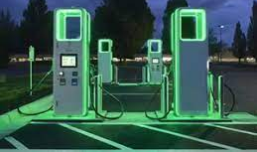
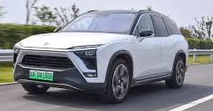

Electrifying Transportation
~ Riddhiman Moulick
(ET-210882)

Slide 2

Electric Vehicle Consumer Demands
Vehicle Price
Drive Range
Charging Cost
Charging Time

Slide 3
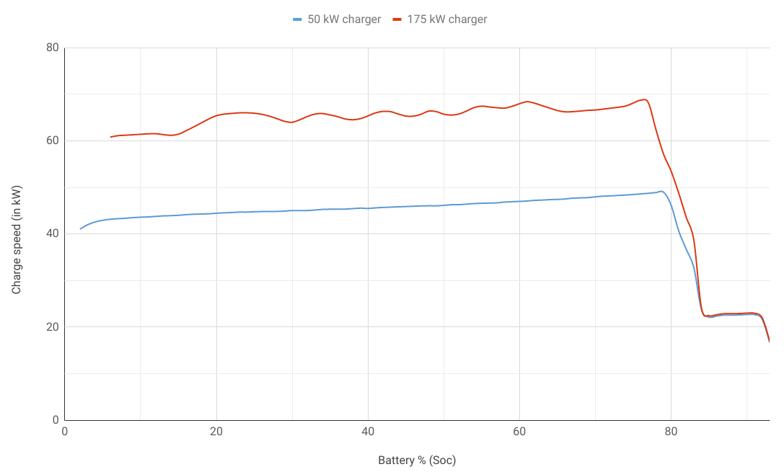
The Charging Phenomenon
Notes:
Li-ion batteries are considered fit for EVs due to their high power-to-weight ratio, high energy efficiency, good high-temperature performance, and low self-discharge

Slide 4





The Charging Phenomenon

Slide 5


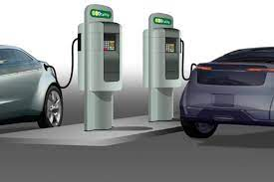
Devised Solution
Efficient Charging Infrastructure Distribution
Max Utilization of Charging Capacity
Charging Time and Drive Range related problems solved
Notes:
Proposed Solution: Charging Infrastructure Distribution
The charging related concerns of consumers can be solved by: Strategic/ Efficient Distribution of Charging Stations

Slide 6
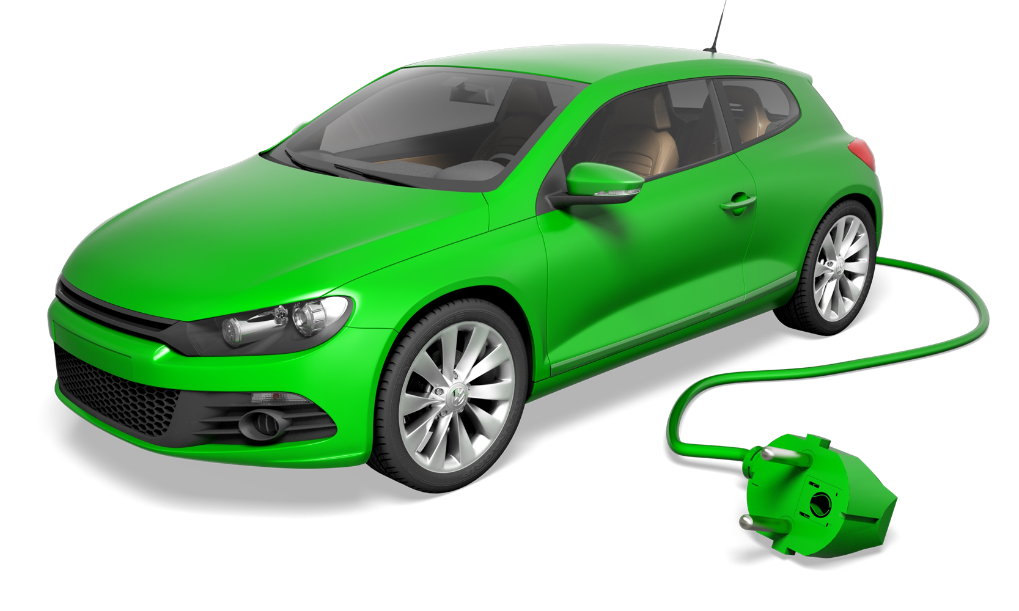
Smart E-Planner
Ascertains the ideal locations for setting up
Charging Stations
Notes:
Here’s My Product!

Slide 7
Plan to Charge!
INPUT (Computer Vision)
PROCESSING (K-Means Clustering)
OUTPUT (Optimum Locations of Charging Stations!)

Slide 8
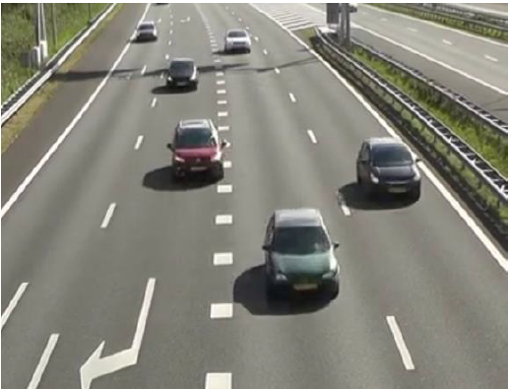
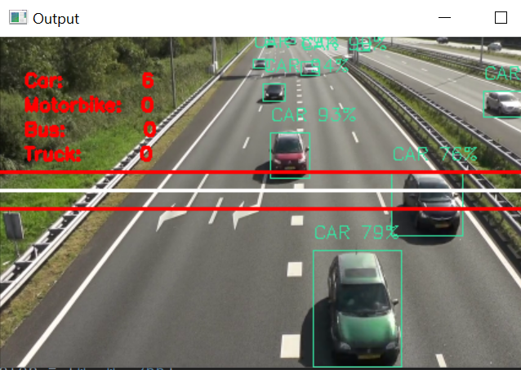
Input
Processed output frame (with vehicle counter)
Raw frame from input video feed

Slide 9
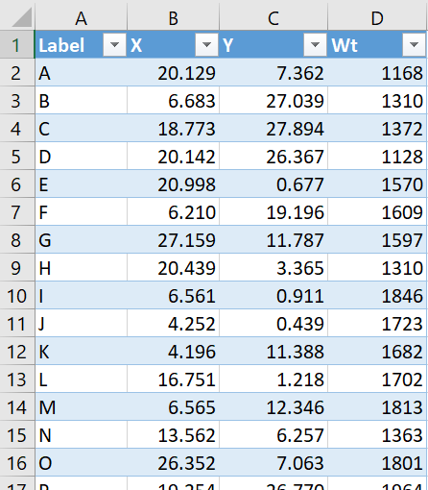
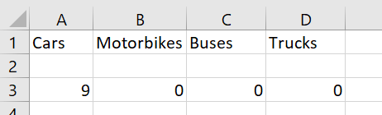
Input Storage
.csv file
Compiled data from different locations
Notes:
Input retrieved from video processing

Slide 10
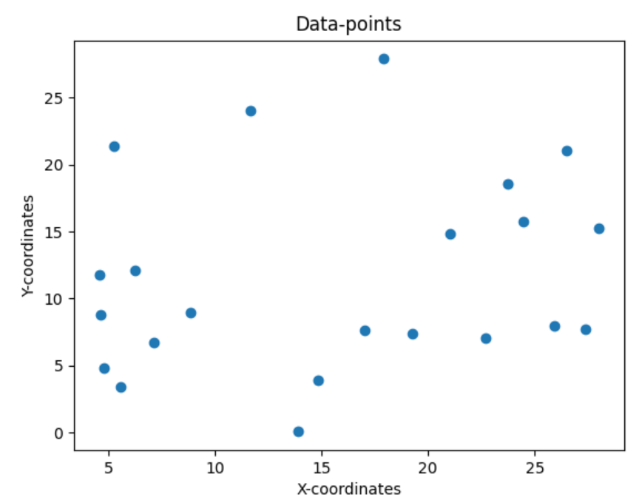
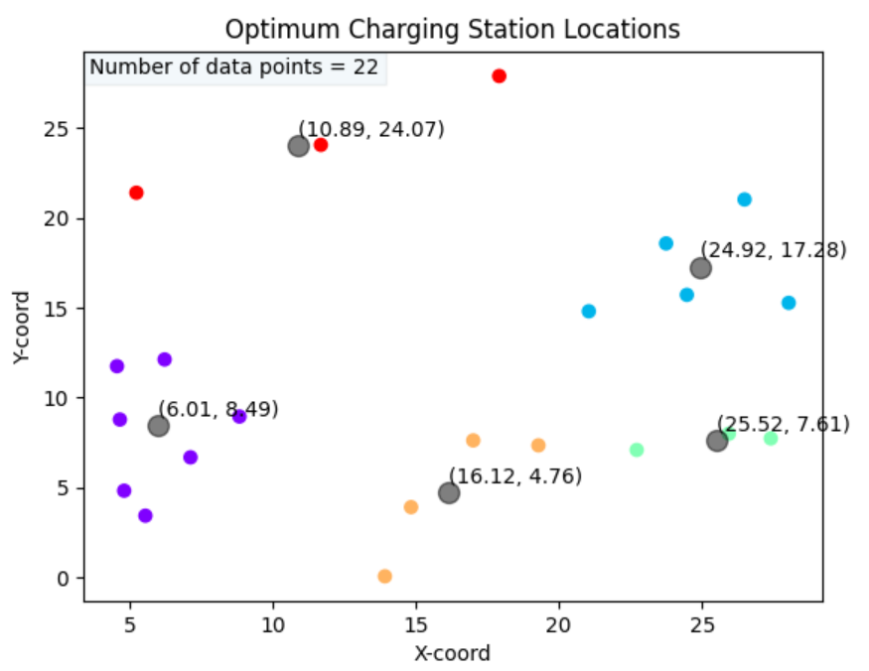
Processing
Grouping co-ordinates using K-Means Clustering

Slide 11
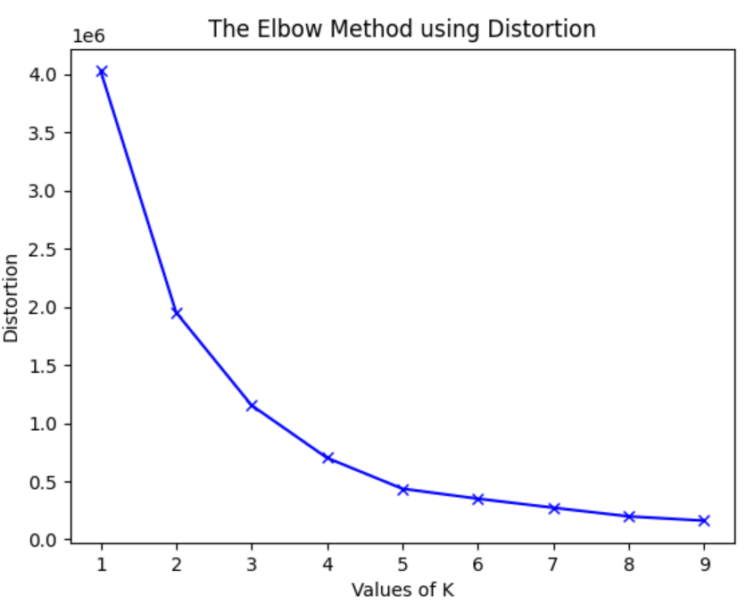
Processing
To facilitate ease of use, we generate this plot :
By observing the maximum slope change in the graph we can choose the optimum number of clusters to be formed

Slide 12

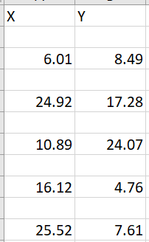
Storing the Output
Co-ordinates of cluster centers stored in a .csv file
Co-ordinates of cluster centers stored in a .csv file
Final Retrieved Data!

Slide 13

Future Enhancement Prospects
Creating a user friendly GUI for the software
Taking into account, already existing Charging Stations
Implementing ‘Subscription Models’ and ‘Easy Re-Charge Schemes’ (by vehicle identification)
Notes:
1. Our target customers for this product are the EV Charging Station Companies like .
Customers can purchase a weekly/ monthly/ quarterly/ yearly – ‘Easy Recharge Scheme’. Just like we have monthly subscription schemes etc. Identifying vehicles by their number plates

Slide 14



